Slide 1
COSC160: Data Structures
Hashing Structures
Jeremy Bolton, PhD
Assistant Teaching Professor

Slide 2
Outline
Hashing Structures
  Motivation and Review
Hash Functions
HashTables
  Implementations
  Time Complexity
Collisions
  Resolution Schemes

Slide 3
Retrieval Time Review
Unordered Lists
Trees or ordered lists
Can we improve?

Slide 4
Motivation: Simple Example
Suppose we wanted to store a set of unique numbers within the range 1 – 1,000
Is there a structure and storage scheme that would permit searching, inserting and removing in O(1) time?
  Hint: the answer is yes! Motivation: Constant Time Example

Slide 5
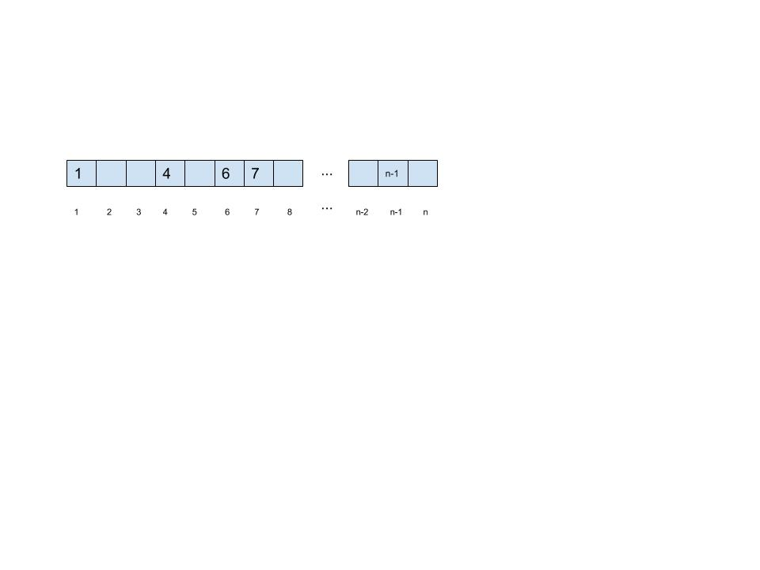
Motivation: Simple Example
Simply use an array with indices 1 – 1000.

Slide 6
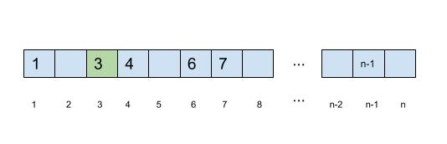
Motivation: Simple Example
Insertion
Example: insert 3
Time Complexity
  Direct indexing
  O(1)

Slide 7
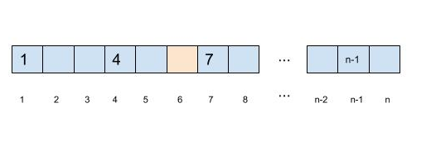
Motivation: Simple Example
Removal
Remove 6
Time Complexity
  Direct Indexing
  O(1)

Slide 8
Motivation: Simple Example Analysis
How are we able to attain such a time complexity?
  It is known, apriori, where each item is (to be) stored
  Direct indexing: indexing is accomplished in constant time
We know where to go, and we can get there fast!

Slide 9
Simple Example: How?
Direct indexing is no mystery. But how did we know, apriori, where each item is (to be) stored
  The value stored was simply the index!
This works well if we are storing integers, but what about non-integer data types or values that are not within a good indexing range…?

Slide 10
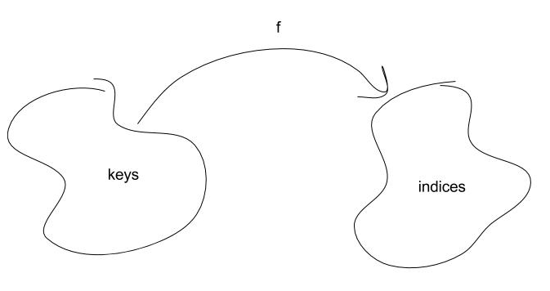
Direct Indexing with non-integer types
In our simple example, the key (which is the data itself) is also the index.
  That is, each data value, directly maps to an appropriate index.
Solution general case: find a function f that maps from the set of keys to a set of indices.

Slide 11
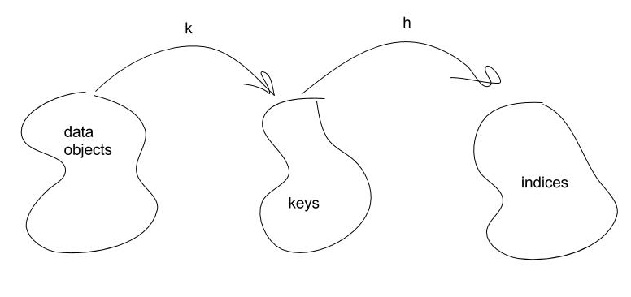
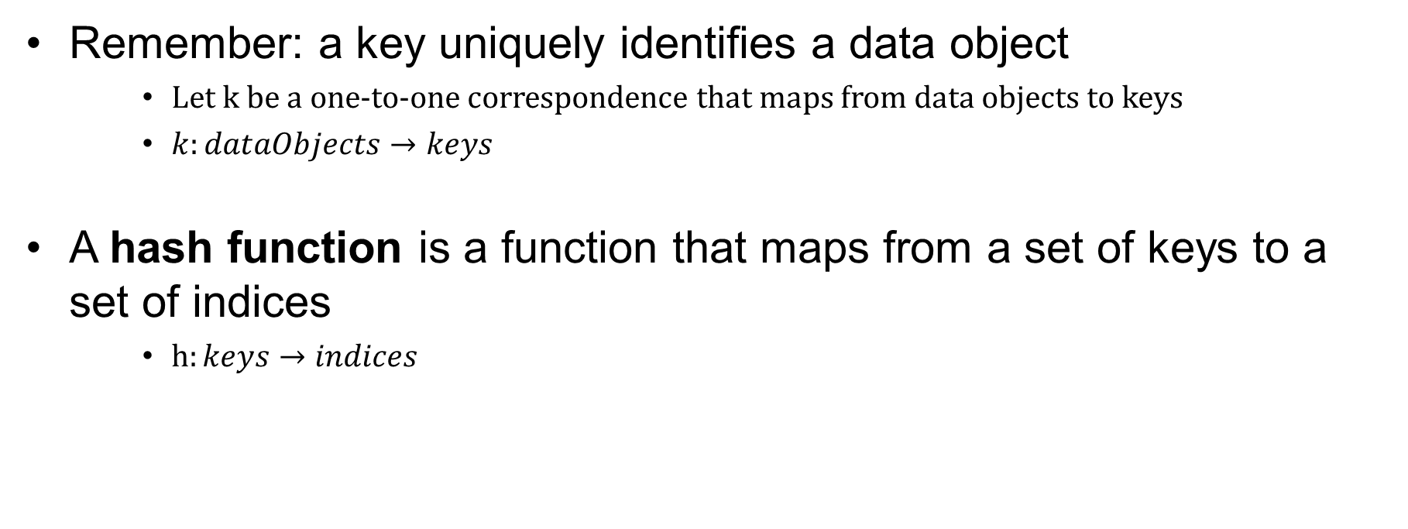
The hash function
Remember: a key uniquely identifies a data object
    Let k be a one-to-one correspondence that maps from data objects to keys
    $k:dataObjects→keys$
A hash function is a function that maps from a set of keys to a set of indices
    $h:keys→indices$

Slide 12
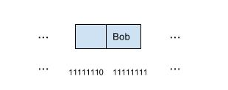
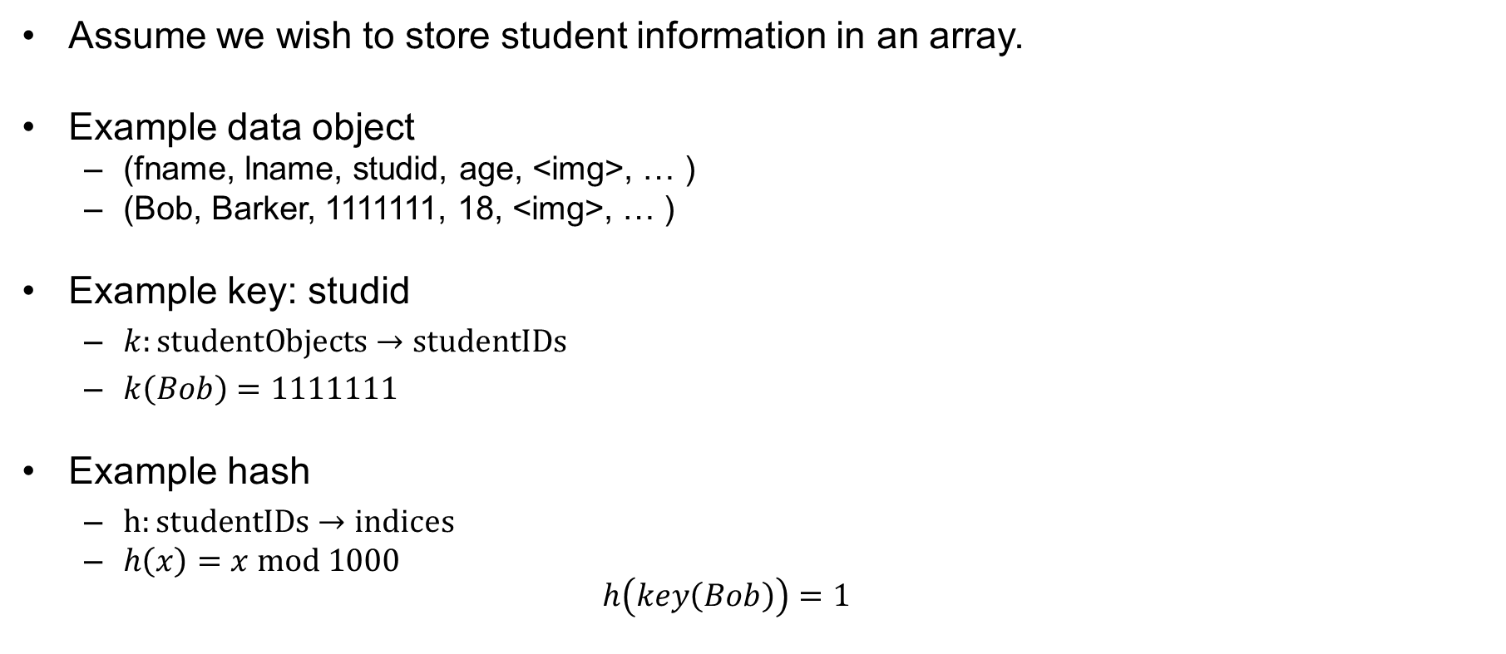
Hash Example
Assume we wish to store student information in an array.
Example data object
  (fname, lname, studid, age, <img>, … )
  (Bob, Barker, 1111111, 18, <img>, … )
Example key: studid
  $k:studentObjects→studentIDs$
  $k\left(Bob\right)=1111111$
Example hash
  $h:studentIDs→indices$
  $h\left(x\right)=x mod 1000$
  $h\left(key\left(Bob\right)\right)=1$
0
1

Slide 13
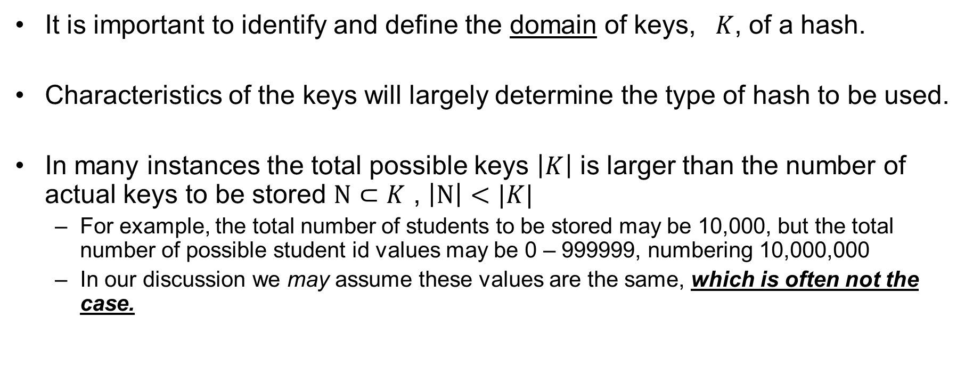
Domain of Keys
It is important to identify and define the domain of keys, $K$, of a hash.
Characteristics of the keys will largely determine the type of hash to be used.
In many instances the total possible keys $\left|K\right|$ is larger than the number of actual keys to be stored $N⊂K$ , $\left|N\right|<|K|$
  For example, the total number of students to be stored may be 10,000, but the total number of possible student id values may be 0 – 999999, numbering 10,000,000
  In our discussion we may assume these values are the same, which is often not the case.

Slide 14
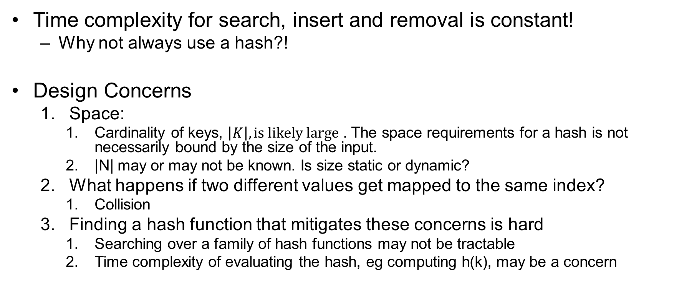
Hashing: Design Concerns
Time complexity for search, insert and removal is constant!
  Why not always use a hash?!
Design Concerns
  Space:
    Cardinality of keys, $\left|K\right|, is likely large$ . The space requirements for a hash is not necessarily bound by the size of the input.
    |N| may or may not be known. Is size static or dynamic?
  What happens if two different values get mapped to the same index?
    Collision
  Finding a hash function that mitigates these concerns is hard
    Searching over a family of hash functions may not be tractable
    Time complexity of evaluating the hash, eg computing h(k), may be a concern

Slide 15
Hashing: Space concerns
Example 1. Reasonable Index Range.
  Store up to 1000 values within range 1 – 1000.
  More generally: store up to n values within range 1 – n.
    Note here the size of the input may be up to n numbers, thus we can bound the memory constraints in terms of n, the size of the input.
  Use simple hash: h(i) = i
    Size of input (potentially n) , size of space requirements O(n)

Slide 16
Hashing: Space concerns
Example 2. Unreasonable Index Range.
  Store up to n values within unknown range, eg, |K| is large.
    Size of input is n, how big of an array is needed
  Using simple hash from Ex. 1, is not efficient
    Use simple hash: h(i) = i
      Size of input (potentially n) , size of space requirements …?
    In this simple case, space requirements depend on the value of the input, and not the size of the input.

Slide 17
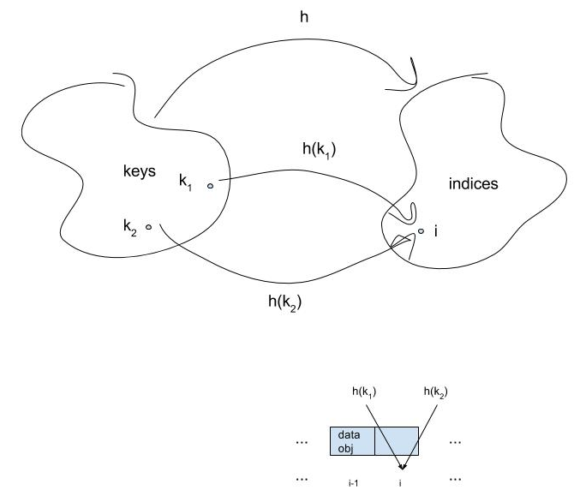
Hash: Collision Concerns
If a hash function is not a one-to-one correspondence, then a collision is possible
A collision occurs when a hash function maps two different key values to the same index.

Slide 18
Finding a Desirable Hash Functions
Desirable characteristics of a hash function
  Space efficient. If n items to store, O(n) space.
  Minimize collisions
  Hash computation is fast
A hash table of size m is an array of size m that uses a hash function for indexing (for searches, inserts and removals)

Slide 19
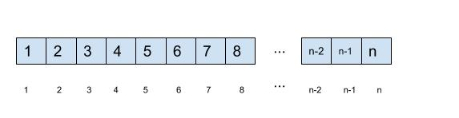
Addressing space efficiency
Our simple hash example is a poor choice
  h(i) = i
  This depends on the value of keys and not the number of keys.
Optimally. If there are n items to store, use an array of size m=n.
  Finding a hash function that maps each item perfectly (without collision) and has no wasted space is very difficult in the general case.

Slide 20
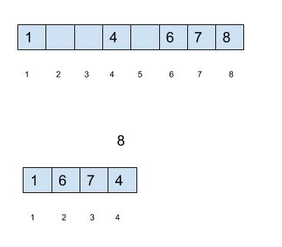
Addressing space efficiency
Intuitively, there is a tradeoff between the size of the hash table and frequency of collisions.
Intuitively, assume indices were randomly assigned to n different keys, the probability of collision would increase if the range of indices was reduced (if the array was smaller)

Slide 21
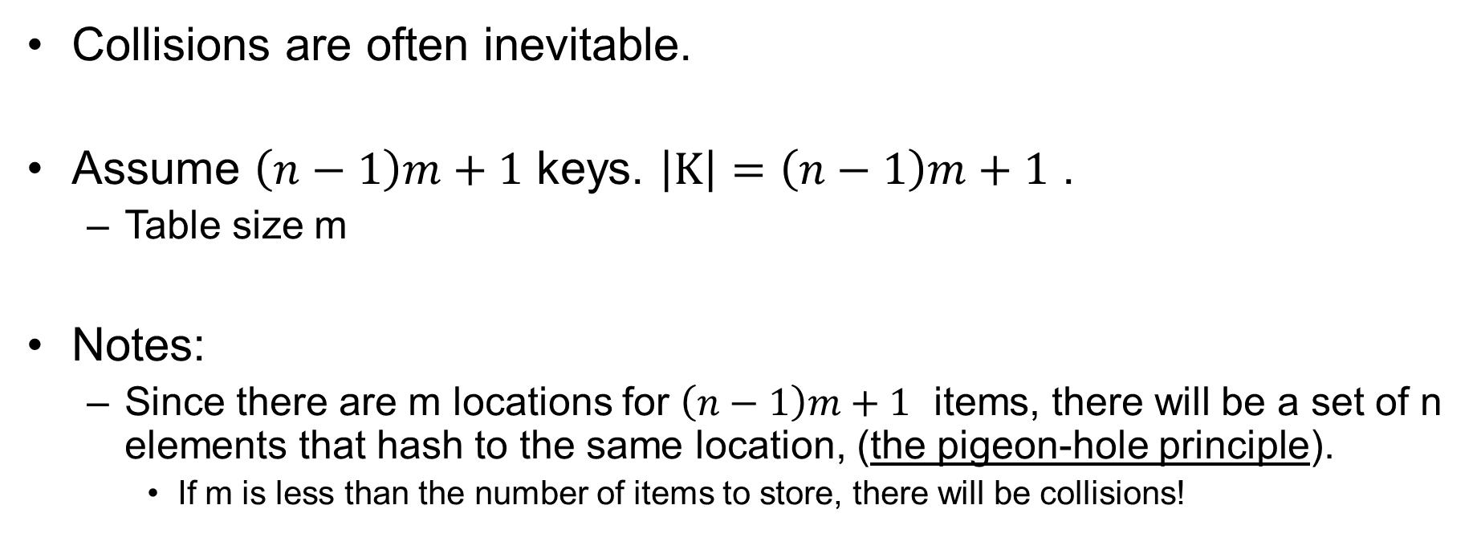
Addressing Collisions
Collisions are often inevitable.
Assume $\left(n−1\right)m+1$ keys. $\left|K\right|=\left(n−1\right)m+1$ .
  Table size m
Notes:
  Since there are m locations for $\left(n−1\right)m+1$ items, there will be a set of n elements that hash to the same location, (the pigeon-hole principle).
    If m is less than the number of items to store, there will be collisions!

Slide 22
Some Hashing Schemes
Division Method
Folding Method
Mid-Square Method
Radix Method
Universal Hashing
Perfect Hashing
Double Hashing

Slide 23
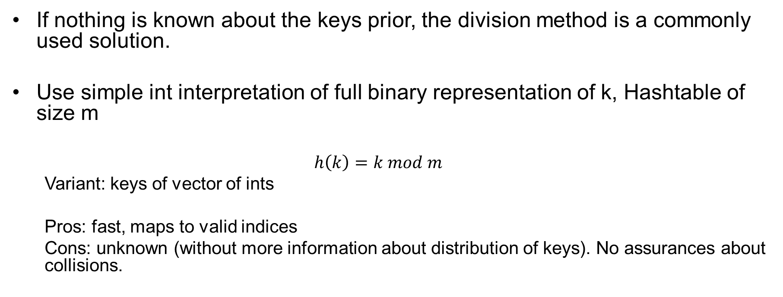
Hash: Division Method
If nothing is known about the keys prior, the division method is a commonly used solution.
Use simple int interpretation of full binary representation of k, Hashtable of size m
  $$h\left(k\right)=k mod m$$
  Variant: keys of vector of ints
  Pros: fast, maps to valid indices
  Cons: unknown (without more information about distribution of keys). No assurances about collisions.

Slide 24
Folding Method
Method.
  key is partitioned,
  each partition is manipulated,
  then the results are aggregated together (folded together) to produce a final index
Example.
  SSN key.
  Partition into 3 sections.
  Add three parts
  Perform division on resulting scheme (table size m = 1000)
Pros.
  Provides means to incorporate more digits into index computation.
Key k: 123- 45-6789
Partition and Add: 123 + 45 + 6789
Sum: 6,957
index =
6,957 mod 1000 =
957

Slide 25
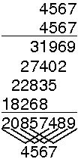
Hash: Mid square approach
Mid square approach
  Interpret binary sequence of key as an int
  Hash function
    Square the key value
    Use the r-inner bits as the index
  Intuition
    Pro: All digits will affect the innermost bits of the squared value.
    Generally good uniform distribution
    Con: must compute square
Example:
  Key 4567
  R= 2
  Use 2-inner bits of square. 57 is index

Slide 26
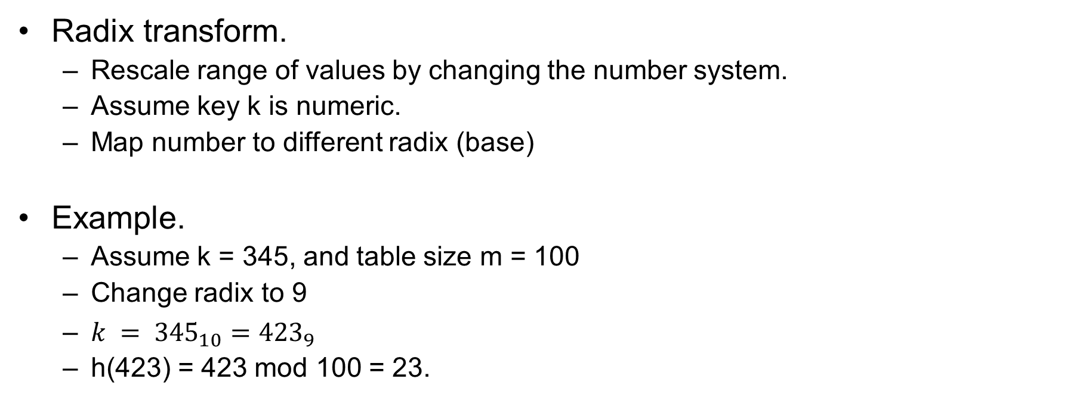
Radix Method
Radix transform.
  Rescale range of values by changing the number system.
  Assume key k is numeric.
  Map number to different radix (base)
Example.
  Assume k = 345, and table size m = 100
  Change radix to 9
  $k = {345}_{10}={423}_{9}$
  h(423) = 423 mod 100 = 23.

Slide 27
Simple Hashing Schemes
Simple Schemes.
  Division Method
  Folding Method
  Mid-Square Method
  Radix Method
Observations.
  Provide an means to mathematically map keys to index range.
  These mapping schemes are
    Easy to implement
    Hash is fast to compute
    But make no assurances about collisions (unless keys are known apriori)

Slide 28
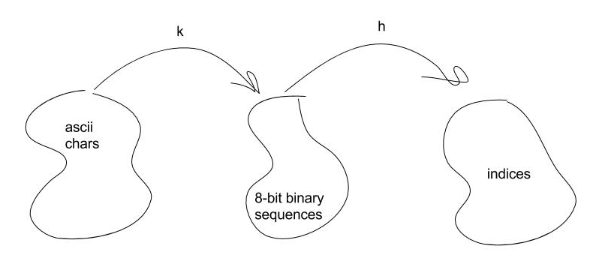
Designing a Hash. Case Study Chars
Storing ASCII characters
  chars are stored in 8 bits, thus there are 256 unique chars to store
  256 unique data objects
    Not many, lets simply create a hash table of size 256
  What is a good key?
    Trivial key mapping. Each char has a unique binary encoding … which easily can be interpreted as a non-negative integer using polynomial expansion … lets use that!
  Hash is simply the int interpretation of the keys binary value
    Trivial Hash. one-to-one correspondence and space efficient!

Slide 29
Designing a Hash. Case Study Strings
Store a set of n strings
  String: Simply a sequence of chars
  Key ideas
    Strings are unique based on uniqueness of each char at each location
    Simple concatenation of binary sequence of chars
  Hash ideas
    (Bad) Idea 1: Using int interpretation of FULL binary sequence
      Would provide for no collisions, but at what cost!
        Assume: Each char may use up to 8-bits. Longest string will be 25 chars long
        Possible indices needed (for no collisions): 2²⁰⁰

Slide 30
Designing a Hash: Case Study String (cont)
Idea 2: Simple design scheme.
  Fix the table size to something reasonable, m = 1000.
  Use Folding Scheme. Sum numeric interpretation of each characters
    hash function: h(string) = sum mod 1000
  Alleviates space concerns, but may result in collisions.
  Note here N < |K| is likely and so allocating |K| spaces may be unnecessary and impractical
  Observation: may not map to range 0 – 999 very uniformly. May result in more collisions that desired.
      EG: all of the following strings would map to the same key
        az, za, by, yb, cx, xc, …

Slide 31
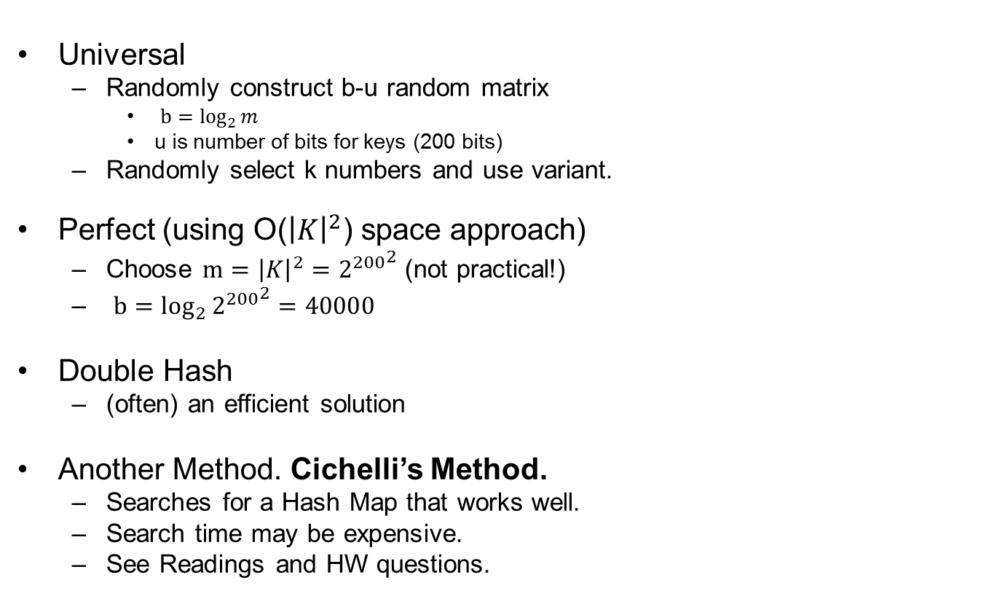
Designing a Hash: Case Study Strings
Universal
  Randomly construct b-u random matrix
    $b=\log_{2}{m}$
    u is number of bits for keys (200 bits)
  Randomly select k numbers and use variant.
Perfect (using O(${\left|K\right|}^{2}$) space approach)
  Choose $m={\left|K\right|}^{2}={2^{200}}^{2}$ (not practical!)
  $b=\log_{2}{{2^{200}}^{2}}=40000$
Double Hash
  (often) an efficient solution
Another Method. Cichelli’s Method.
  Searches for a Hash Map that works well.
  Search time may be expensive.
  See Readings and HW questions.

Slide 32
Collision Resolution
In some instances collisions may be hard to avoid.
Having an efficient resolution scheme is important.
  Annex / Cellars
  Probing
  Chaining

Slide 33
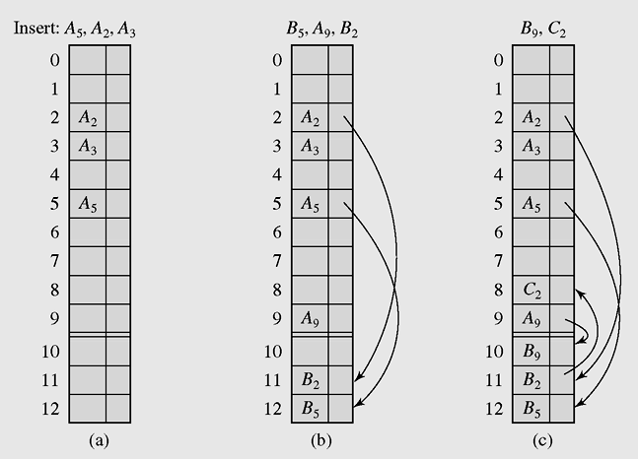
Collision Resolution: Annex or Cellar
Example table of size 10
Scheme: reserve c spots to end of array; designate as cellar. Store collisions there sequentially.
Worst Case Complexity: O(c)
Cons:
  Cellar size = c is fixed
    may fill up
    Is unordered and generally large

Slide 34
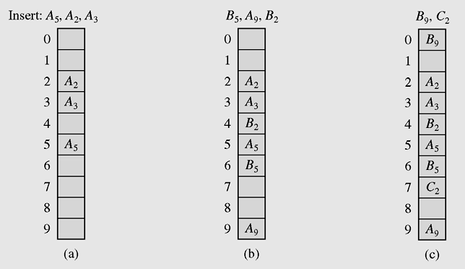
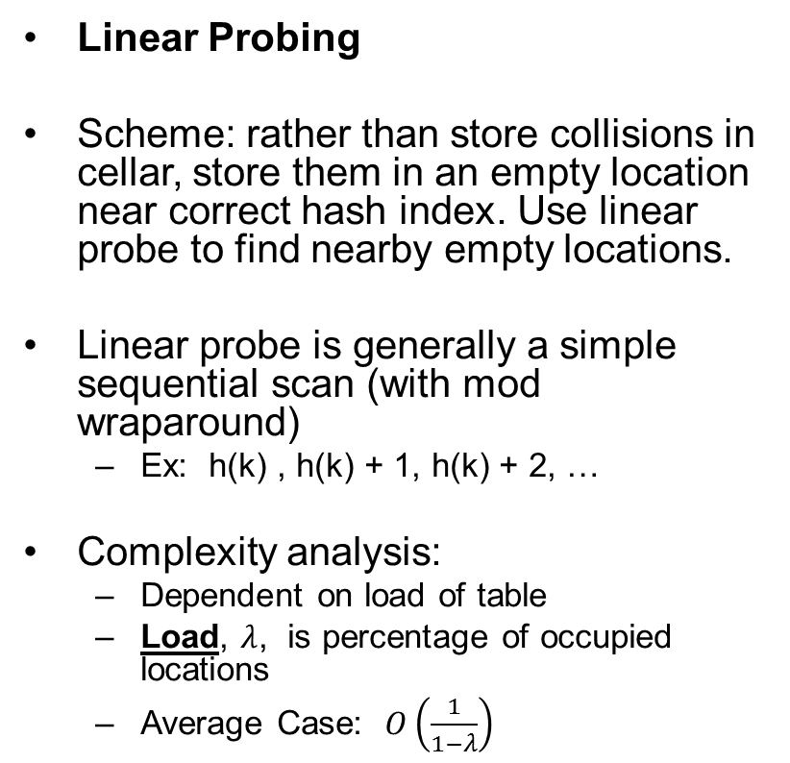
Collision Resolution Scheme: Probing
Linear Probing
Scheme: rather than store collisions in cellar, store them in an empty location near correct hash index. Use linear probe to find nearby empty locations.
Linear probe is generally a simple sequential scan (with mod wraparound)
  Ex: h(k) , h(k) + 1, h(k) + 2, …
Complexity analysis:
  Dependent on load of table
  Load, $λ$, is percentage of occupied locations
  Average Case: $O\left(\frac{1}{1−λ}\right)$

Slide 35
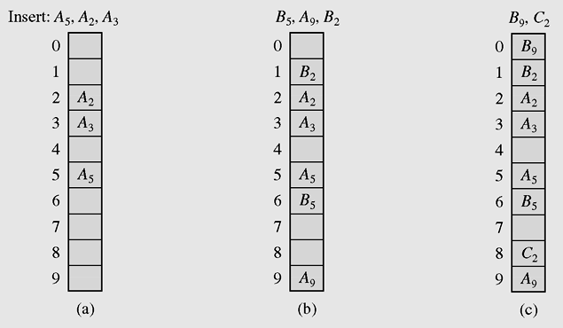
Collision Resolution Scheme: Probing
Quadratic Probing
Linear probing may suffer if keys are not uniformly distributed. “Clustering” in some regions of the table will occur which will increase the number of overall collisions.
Scheme: Search for empty spaces, further away.
  h(k), h(k)+1, h(k)+4, h(k) + 9, …
Complexity:
  Must be sure to traverse indices without repetition.
  This is assured if m is prime.

Slide 36
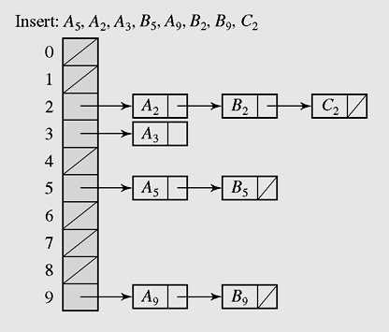
Collision Resolution: Chaining
Each Array entry is a linked list
Collision is implicitly handled by adding to top of list.
Pros:
  Dynamic size,
  Static size issues resolved: cellar overflow, or table overflow (probing)
Complexity:
  Conceptually better than cellar as the collision space is organized by original hash entry
  Assume c is number of total collided items over m buckets. Average case: O(c/m)
  Practical Concerns: memory not contiguous, may have disk access delays
Alternative (to linked list) approaches
  Implement Hash table, where each bucket is a B-Tree
  Implement Hash table, where each bucket is a hash table

Slide 37
Collision Resolution Schemes
Cellar
  Static Size
  Sequential search in cellar if collision
Probing
  Static size
  Searching is done locally if collision
  Efficiency highly dependent on average load of table
Chaining
  Dynamic size
  Possible delays related to non-contiguous allocation
  Organized search if collision

Slide 38
Avoiding Collisions: Statistical Perspective
If all the keys are known apriori, then we can construct a simple hash that avoids all collisions. However, this is not often the case.
Some CS problems are hard (eg collision-free hashing when little is known about the keys apriori), and finding an optimal solution is impractical.
  Sometimes its more appropriate to find a good solution (with high probability) fast.
  Statistical approaches: Quantify probability of poor result.
  Rather than trying to avoid all collisions, quantify (minimize) how often they might occur.
Universal Hash Idea. (Monte Carlo Scheme)
  Assume n items are assigned indices randomly by h.
  We can statistically bound the number of collisions, if we construct the hash in a “random” sense.
    We can choose the size of m to bound the number of expected collisions.

Slide 39
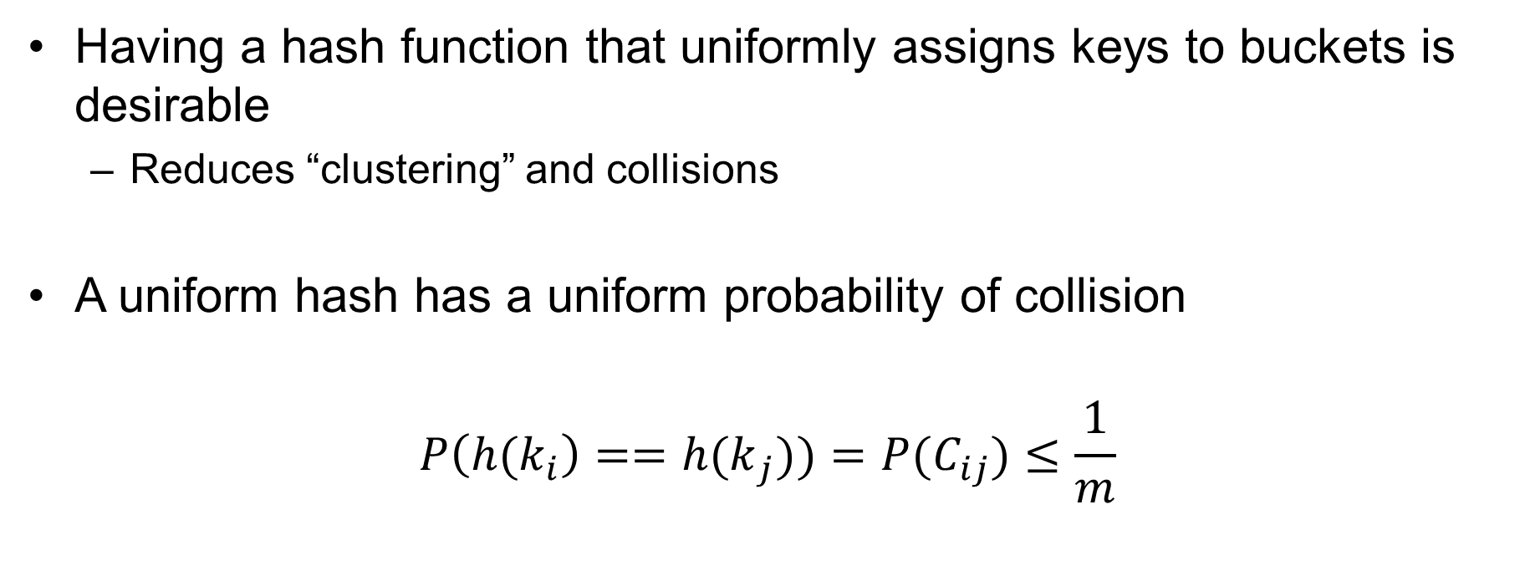
Uniform Hash
Having a hash function that uniformly assigns keys to buckets is desirable
  Reduces “clustering” and collisions
A uniform hash has a uniform probability of collision
$$P\left({h(k}_{i}\right)=={h(k}_{j}))={P(C}_{ij})≤\frac{1}{m}$$

Slide 40
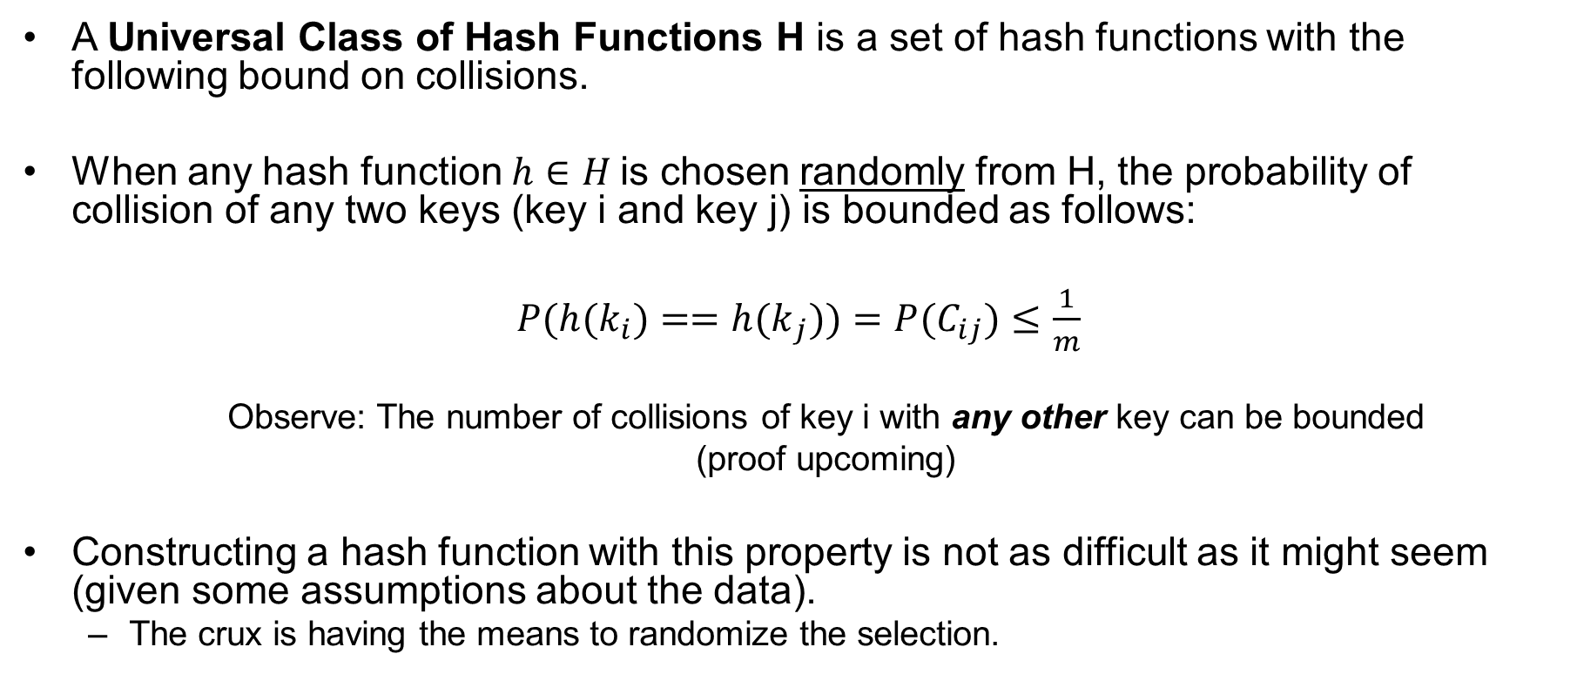
Universal Hashing
A Universal Class of Hash Functions H is a set of hash functions with the following bound on collisions.
When any hash function $h∈H$is chosen randomly from H, the probability of collision of any two keys (key i and key j) is bounded as follows:
$P({h(k}_{i})=={h(k}_{j}))={P(C}_{ij})≤\frac{1}{m}$
  Observe: The number of collisions of key i with any other key can be bounded
  (proof upcoming)
Constructing a hash function with this property is not as difficult as it might seem (given some assumptions about the data).
  The crux is having the means to randomize the selection.

Slide 41
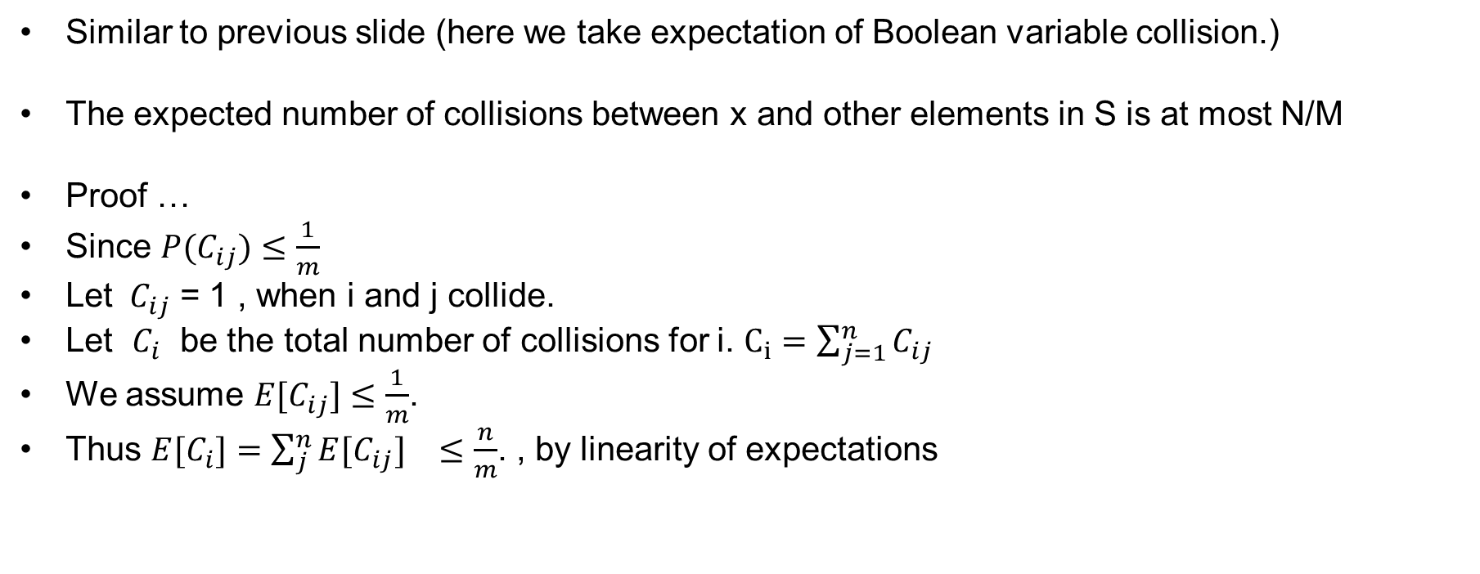
Universal Hashing: Expected Number of Collisions
Similar to previous slide (here we take expectation of Boolean variable collision.)
The expected number of collisions between x and other elements in S is at most N/M
Proof …
Since ${P(C}_{ij})≤\frac{1}{m}$
Let $C_{ij}$ = 1 , when i and j collide.
Let $C_{i}$ be the total number of collisions for i. $C_{i}=\sum_{j=1}^{n}{C_{ij}}$
We assume ${E[C}_{ij}]≤\frac{1}{m}$.
Thus ${E[C}_{i}]={\sum_{j}^{n}{E[C_{ij}]}}_{}≤\frac{n}{m}$. , by linearity of expectations

Slide 42
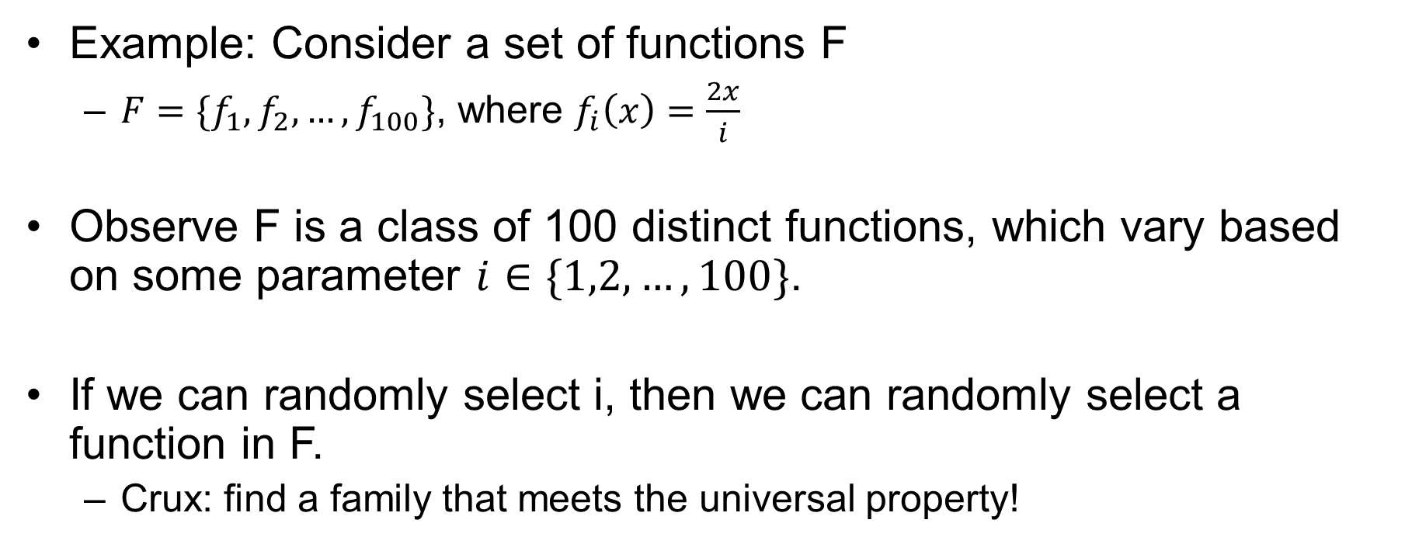
What is a class or family of functions?
Example: Consider a set of functions F
  $F=\{f_{1},f_{2}, …, f_{100}\}$, where $f_{i}\left(x\right)=\frac{2x}{i}$
Observe F is a class of 100 distinct functions, which vary based on some parameter $i∈\{1,2,…,100\}$.
If we can randomly select i, then we can randomly select a function in F.
  Crux: find a family that meets the universal property!

Slide 43

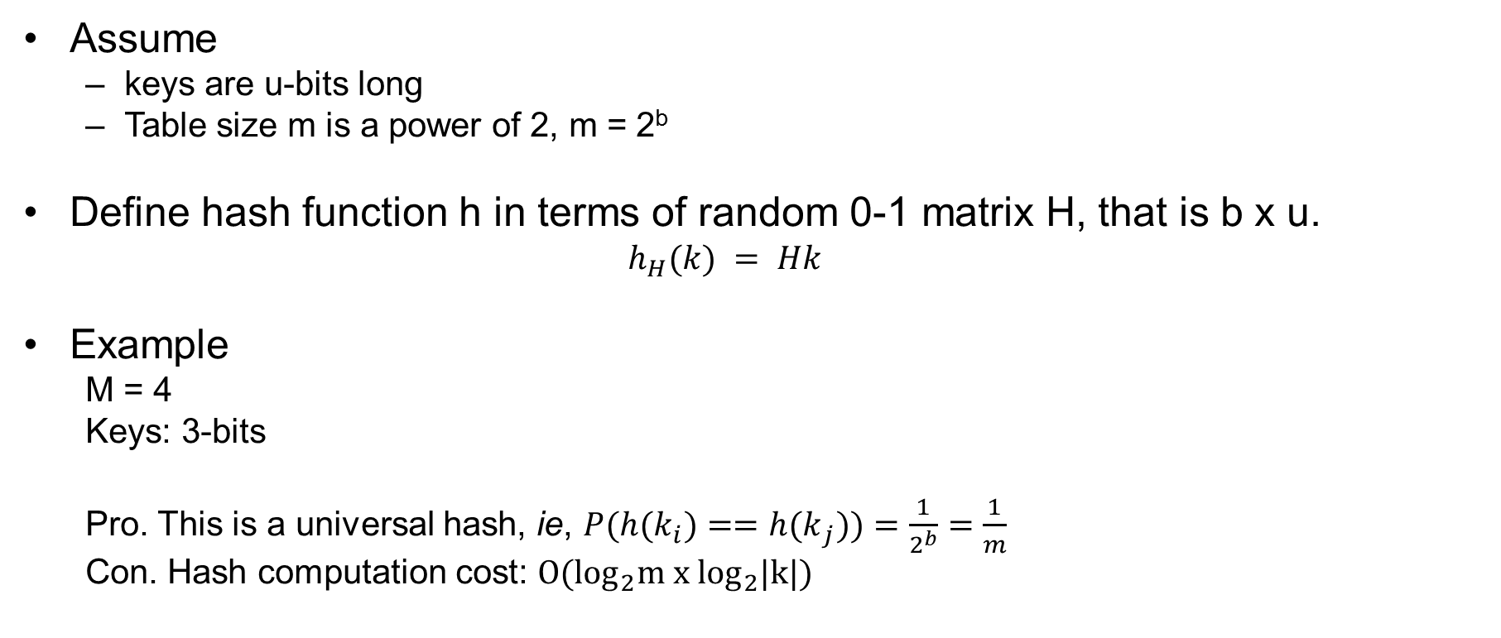
Designing a Universal Hash Family (Matrix Method)
Assume
  keys are u-bits long
  Table size m is a power of 2, m = 2^{b}
Define hash function h in terms of random 0-1 matrix H, that is b x u.
  $$h_{H}(k) = Hk$$
Example
  M = 4
  Keys: 3-bits
  Pro. This is a universal hash, ie, $P({h(k}_{i})=={h(k}_{j}))=\frac{1}{2^{b}}=\frac{1}{m}$
  Con. Hash computation cost: ${O(log}_{2}m x \log_{2}|k|)$
H
k
Hk
$$\left[\begin{matrix}1 & 0 & 1 \\ 0 & 0 & 1\end{matrix} \right]\left[\begin{matrix}1 \\ 1 \\ 0\end{matrix}\right]=\left[\begin{matrix}1 \\ 0\end{matrix}\right]$$

Slide 44
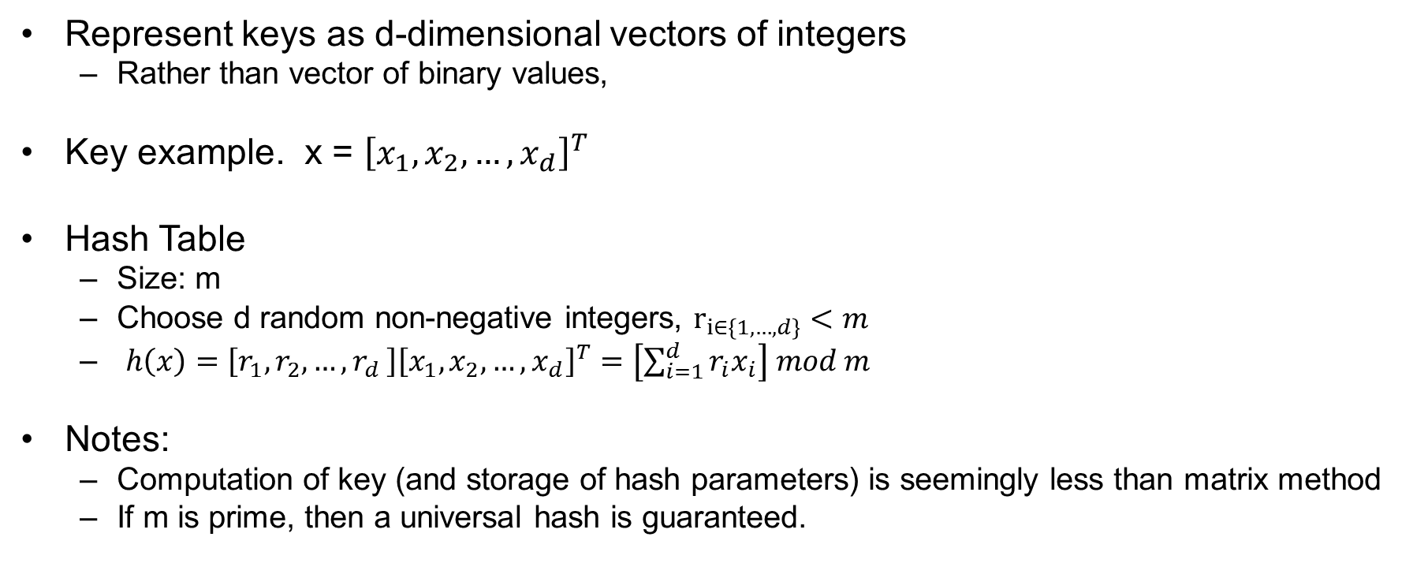
Universal Hash Familty: Division Method
Represent keys as d-dimensional vectors of integers
  Rather than vector of binary values,
Key example. x = ${\left[x_{1},x_{2},…,x_{d}\right]}^{T}$
Hash Table
  Size: m
  Choose d random non-negative integers, $r_{i∈\left\{1,…,d\right\}}<m$
  ${h\left(x\right)=\left[r_{1},r_{2},…{,r}_{d}\right]\left[x_{1},x_{2},…,x_{d}\right]}^{T}=\left[\sum_{i=1}^{d}{r_{i}x_{i}}\right] mod m$
Notes:
  Computation of key (and storage of hash parameters) is seemingly less than matrix method
  If m is prime, then a universal hash is guaranteed.

Slide 45
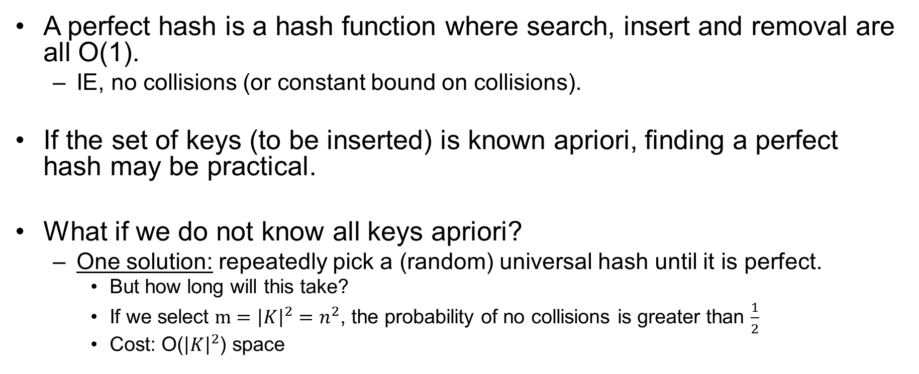
Perfect Hashing
A perfect hash is a hash function where search, insert and removal are all O(1).
  IE, no collisions (or constant bound on collisions).
If the set of keys (to be inserted) is known apriori, finding a perfect hash may be practical.
What if we do not know all keys apriori?
  One solution: repeatedly pick a (random) universal hash until it is perfect.
    But how long will this take?
    If we select $m={\left|K\right|}^{2}=n^{2}$, the probability of no collisions is greater than $\frac{1}{2}$
    Cost: O(${\left|K\right|}^{2}$) space

Slide 46
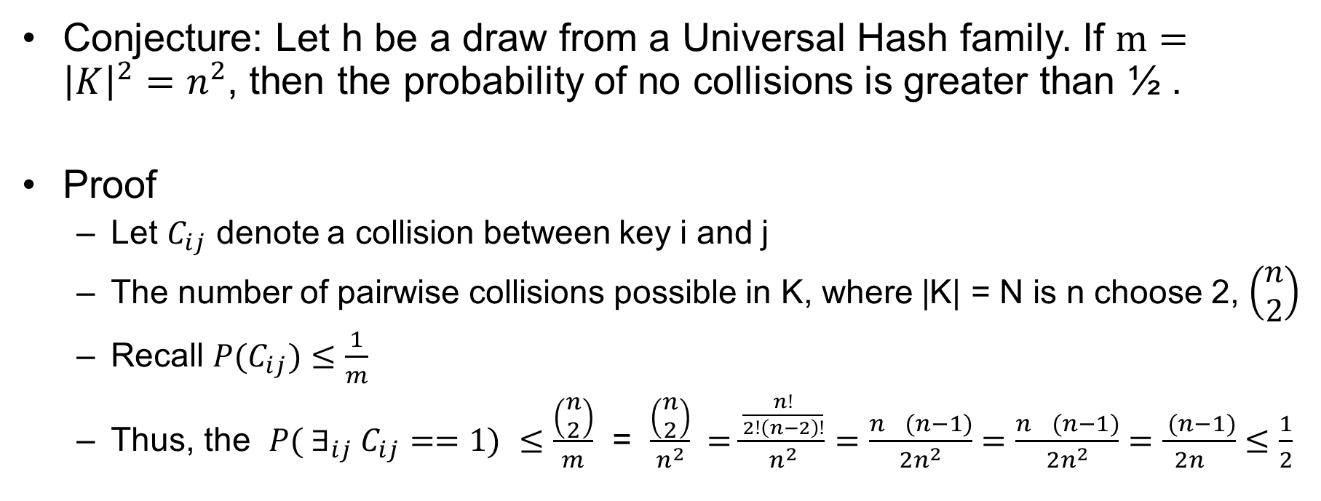
Perfect Universal Hash: Quadratic Space Method
Conjecture: Let h be a draw from a Universal Hash family. If $m={\left|K\right|}^{2}=n^{2}$, then the probability of no collisions is greater than ½ .
Proof
  Let $C_{ij}$ denote a collision between key i and j
  The number of pairwise collisions possible in K, where |K| = N is n choose 2, $\left(\begin{matrix}n \\ 2\end{matrix}\right)$
  Recall ${P(C}_{ij})≤\frac{1}{m}$
  Thus, the ${P( ∃}_{ij} C_{ij}==1)$ $≤\frac{\left(\begin{matrix}n \\ 2\end{matrix}\right)}{m}$ = $\frac{\left(\begin{matrix}n \\ 2\end{matrix}\right)}{n^{2}} =\frac{\frac{n!}{2!\left(n−2\right)!}}{n^{2}}=\frac{n^{}(n−1)}{{2n}^{2}}=\frac{n^{}(n−1)}{{2n}^{2}}=\frac{ (n−1)}{{2n}^{}}≤\frac{1}{2}$

Slide 47
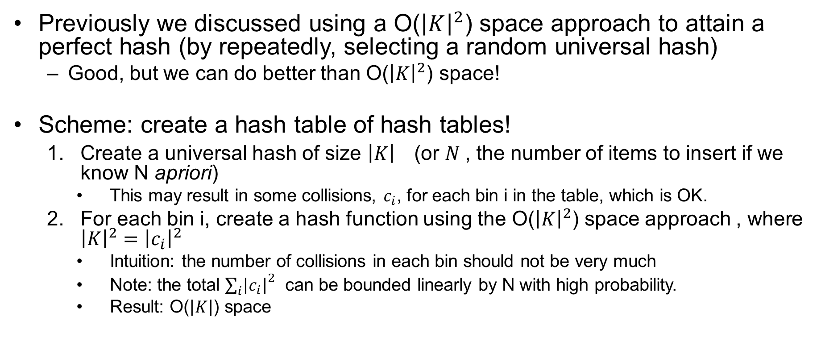
Hash of Hashes Scheme: Universal and Perfect!
Previously we discussed using a O(${\left|K\right|}^{2}$) space approach to attain a perfect hash (by repeatedly, selecting a random universal hash)
  Good, but we can do better than O(${\left|K\right|}^{2}$) space!
Scheme: create a hash table of hash tables!
  Create a universal hash of size ${\left|K\right|}^{}$(or $N$, the number of items to insert if we know N apriori)
    This may result in some collisions, $c_{i}$, for each bin i in the table, which is OK.
  For each bin i, create a hash function using the O(${\left|K\right|}^{2}$) space approach , where ${\left|K\right|}^{2}={\left|c_{i}\right|}^{2}$
    Intuition: the number of collisions in each bin should not be very much
    Note: the total ${\sum_{i}{\left|c_{i}\right|}}^{2}$ can be bounded linearly by N with high probability.
    Result: O($\left|K\right|$) space

Slide 48
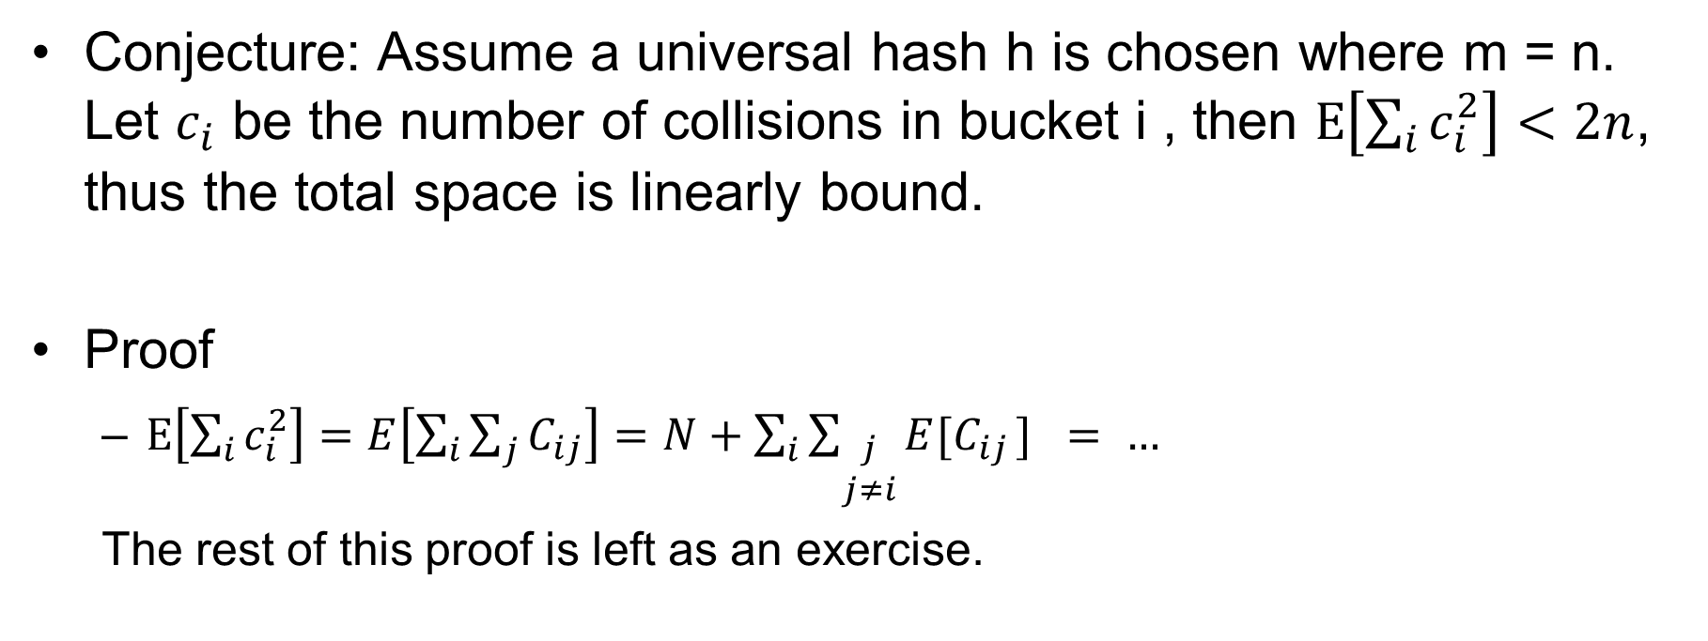
Perfect Universal Hash: Linear Space
Conjecture: Assume a universal hash h is chosen where m = n. Let $c_{i}$ be the number of collisions in bucket i , then $E\left[\sum_{i}{c_{i}^{2}}\right]<2n$, thus the total space is linearly bound.
Proof
  $E\left[\sum_{i}{c_{i}^{2}}\right]=E\left[\sum_{i}{\sum_{j}{C_{ij}}}\right]=N+\sum_{i}{\sum_{\begin{aligned}j \\ j≠i\end{aligned}}{E[C_{ij }] }}= …$
  The rest of this proof is left as an exercise.

Slide 49

RE-Hashing
Sometimes the choice of hash or size of hashtable is poor, and should be changed.
  In general this results in a complete reconstruction of the hash table, which is slow: O($\left|K\right|$)

Slide 50
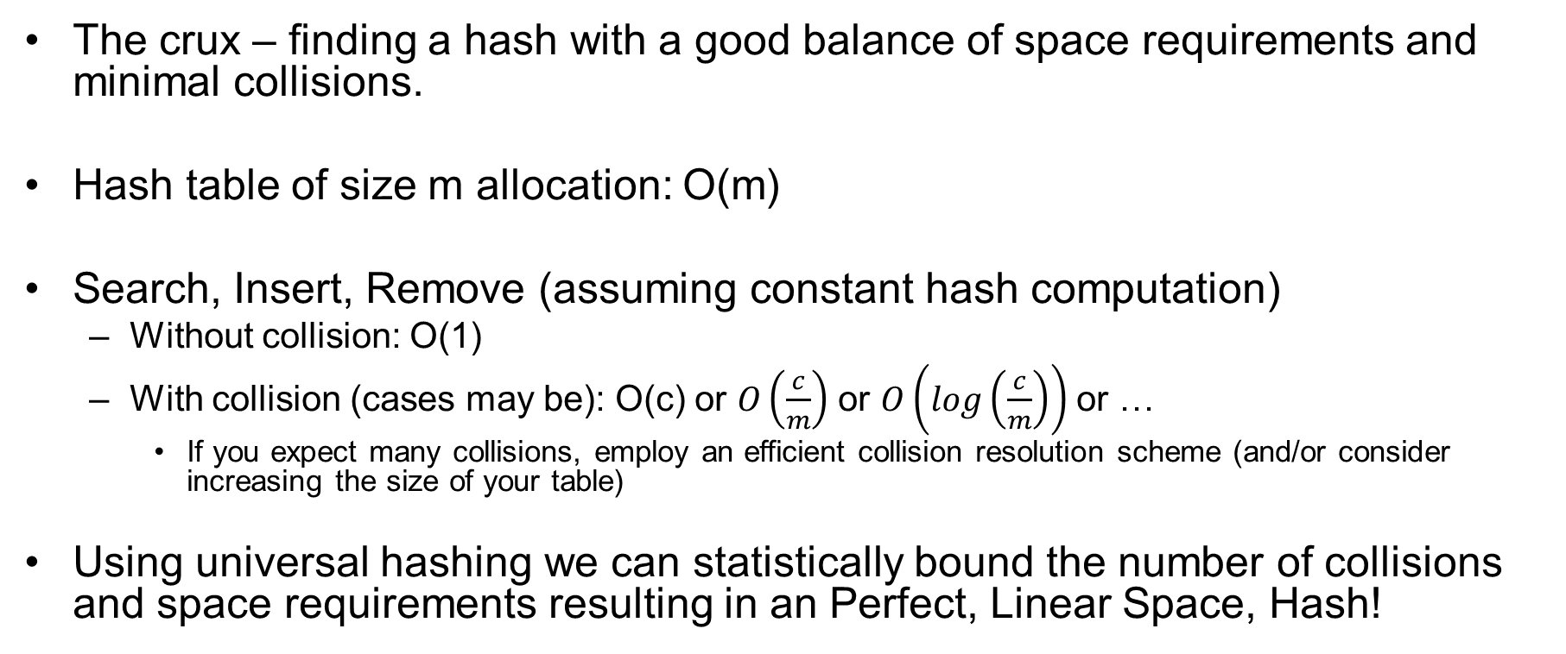
Hash Summary and Time Complexity
The crux – finding a hash with a good balance of space requirements and minimal collisions.
Hash table of size m allocation: O(m)
Search, Insert, Remove (assuming constant hash computation)
  Without collision: O(1)
  With collision (cases may be): O(c) or $O\left(\frac{c}{m}\right)$ or $O\left(log\left(\frac{c}{m}\right)\right)$ or …
    If you expect many collisions, employ an efficient collision resolution scheme (and/or consider increasing the size of your table)
Using universal hashing we can statistically bound the number of collisions and space requirements resulting in an Perfect, Linear Space, Hash!

Slide 51
Bonus: Radix Sort
Sort items in list, one digit at a time using a (simple) hash with chaining
See supplemental PPT for animated example.

