Slide 1
COSC160: Data Structures B-Trees
Jeremy Bolton, PhD
Assistant Teaching Professor

Slide 2
Outline
B-Trees
Motivation
Memory hierarchy
m-way trees
B-Trees
Insert / Split
Remove / Merge
Family of B-Trees

Slide 3
Depth, Time Complexity, and Disk Access
Logarithmic time complexity is quite efficient.
Can we improve efficiency further?
How?
Motivation
Practical Improvements: Disk, Memory and Cache delays
Useful for databases.
Linear search (with no memory delays) may be better than a logarithmic search with delays
Von Neuman Bottleneck: accessing low levels of memory hierarchy is slow
How can we reduce the computational steps associated with a search tree?
Reduce its height?

Slide 4
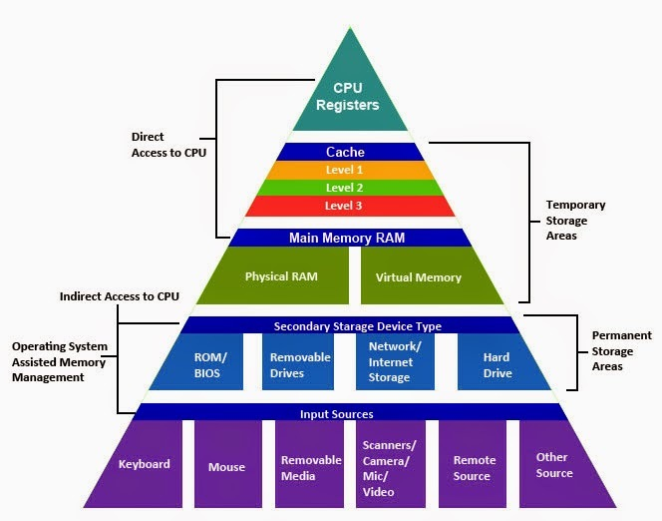
Memory Penalties
Memory is hierarchical to mitigate the effects of the Von Neumann bottleneck
However: Accessing secondary memory still incurs a significant penalty (delay!)
This penalty is high enough to offset many orders of magnitude of theoretical time complexity reduction

Slide 5
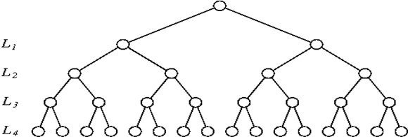
m-way Search Tree
Observations of multiple branches
Height
Height of balanced binary (2-way) tree is $O(\log_{2}⁡(n))$
Height of balanced m-way tree is $O(\log_{m}{⁡(n)})$
As m increases the height of tree decreases. “Less” node traversals.
However this design allows (and may require) multiple keys (m-1) stored at each node. The search time at each node increases

Slide 6
m-way Search Tree
Contiguous vs Non-Contiguous storage:
Each time a nodes keys are accessed, they are loaded from memory
THUS Reduce the height of the tree, reduce memory accesses
Notes:
But multiple keys in each node will increase searching time over keys in each node
If keys in each node are stored contiguously, this is likely done with only 1 access to memory chuck.
Crux: May not reduce step count but may reduce the total number of disk access (where disk access might have a memory delay).

Slide 7
Using keys to represent large data file
A Key should uniquely identify a data entry
Example database entries
Data entry may be a tuple ( ssn, first name, last name, image, … )
Key should uniquely identify each data entry, e.g. ssn
Keys should be “light weight” and stored contiguously in node structure.
Bulky data can then be accessed by pointers associated with each key
We neglect these pointers in our conceptual introduction here, but they will be necessary for a real-world implementation.

Slide 8
Operations on m-way Search Tree
Similar to BST, but may have m children at most.
m-way or m-ary tree
each node has up to m children and m-1 keys
keys are in some order
All keys within first i children are less than the i^{th} key
All keys within last m-i children are greater than the i^{th} key
Operations:
Search
Insert
Remove
Example: 5-way tree

Slide 9
B-Trees
Definition:
A b-tree of order m is a m-ary (m $≥4$ ) search tree, with the following properties.
The root has between 2 and m children (unless it is a leaf)
All non-leaf nodes (except the root) have between $\left\lceil \text{m}\text{/2}\right\rceil$and m children
All non-root nodes contain k-1 keys and k pointers to children where $\left\lceil \text{m}\text{/2}\right\rceil ≤k≤m$
All leaf nodes are the same depth
Strict balance constraint.
Note: The depth of all leaf nodes are the same
How is this maintained? Height only changes by adding or removing root.
Rotations (reorganization) “similar” to AVL but a bit more complex

Slide 10
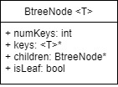
B-Tree Nodes
Each node in a B-Tree of order m has the following information.
Up to m-1 keys
The number of current keys stored
m pointers to children
isLeaf: is the node a leaf node
Even given these standard constraints, there are some variations and design decisions to make. We will discuss some later.
Family of B-Trees

Slide 11
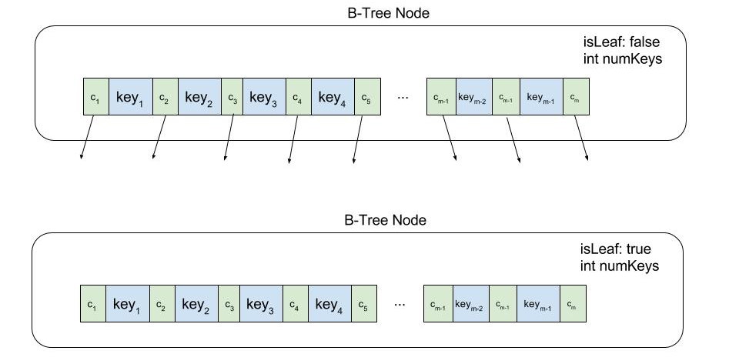
B-Tree Node Illustration
Each node contains children array and key array
Intuitively these two arrays are often illustrated in an interleaved fashion. Keep in mind these are two distinct arrays in implementation!!
Leaf Nodes: the children array can be absent or all values are set to NULL

Slide 12
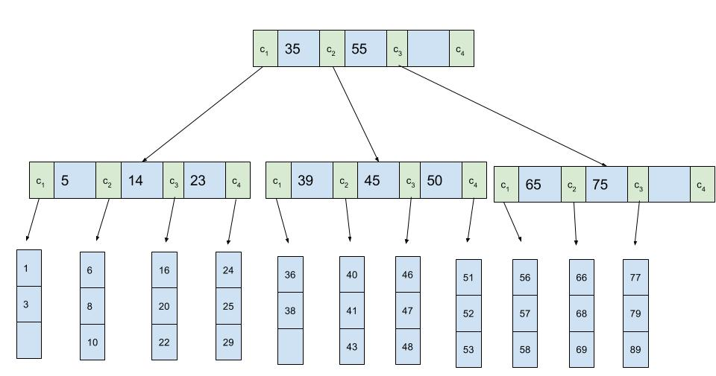
Example: 4-way B-Tree
Leaf Nodes: the children arrays are absent in this example

Slide 13
Searching in a B-Tree
// assumes subtrtree rooted at root, searching for key value k.
// returns pointer to “data object” specified by key k
// assumes design 2
$$function searchBtree\left(root, k\right) \\ i ≔1 \\ while i≤root.numChildren AND k>root.keys\left[i\right]$$ $i ≔i+1$
$$if i≤root.numChildren AND k==root.keys\left[i\right]$$
$return root.data[i]$ // base case: found it
$$if root is a leaf$$ $return NULL$ // base case: did not find it!
$else$ // recursive case: keep traversing down
$return searchBtree(root.child\left[i\right],k)$
Complexity Analysis (worst case)
Traversing down the tree $Θ(h)$ = $Θ(\log_{m}{n})$
At each node in the tree, sequentially search keys:$Θ(m)$
Total computational steps: ${Θ(m log}_{m}{n})$

Slide 14
Searching B-Tree Complexity
Practical Notes:
Not a theoretical improvement ${{O(m log}_{m}{n}) }_{}{}$
Pro: number of disk accesses is reduced!
$Θ(\log_{m}{n})$
Can we improve upon this?
Try binary search on m-1 keys at each node
Given the overhead, we may not gain much here
Complexity Analysis (assume m = L)
Traversing down the tree $Θ(h)$ = $Θ(\log_{m}{n})$
At each node in the tree, sequentially search keys: $O(m)$
Total computational steps: ${O(m log}_{m}{n})$

Slide 15
Inserting a key into a B-Tree
Insertion is always done at a leaf node
Insertion is done in a single pass down the tree
Uses splitChildBtree function
This function assures b-tree constraints are not violated.
During traversal to leaf node for insertion, all nodes encountered that have a maximum number of keys are split (otherwise a violation may occur).

Slide 16
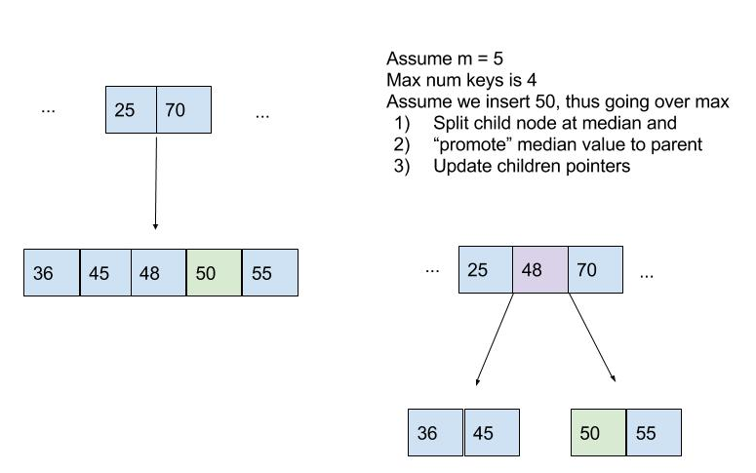
Inserting into a B-Tree
Inserting into a B-Tree is not simple
If a node’s keys are full, then the node is split into two nodes
Splitting around the median key value is intuitive
Median value is moved to parents key list
Must maintain a valid B-Tree after the split
NOTE: promotion of child median value to parent may cause parent to have too many keys!

Slide 17
Splitting a node
// parent is a “non-full” internal node
// child is a “full” child of root
// i is index into key
$$function splitChildBtree\left(parent, child, i\right) \\ newNode ≔create new Node \\ newNode.isLeaf ≔child.isLeaf;$$
newNode.numChildren := $\frac{m−1}{2}$
// copy right half of keys to new node $for j from 1 to\frac{m−1}{2}$ $newNode.keys\left[j\right]≔child.keys[j+\frac{m−1}{2}]$
// copy right half of children to new node
$$if not child.isLeaf$$ $for j from 1 to\frac{m}{2}$
$newNode.children\left[j\right]≔child.children[j+\frac{m}{2}]$
child.numChildren := $\frac{m−1}{2}$
// more details required e.g. values copied to
// newNode should be “removed” from child (sometime before end of method)
// parent is a “non-full” internal node
// child is a “full” child of root
// i is index into key
$$function splitChildBtree\left(parent, child, i\right) \\ newNode ≔create new Node \\ newNode.isLeaf ≔child.isLeaf;$$
newNode.numChildren := $\frac{m−1}{2}$
// copy right half of keys to new node $for j from 1 to\frac{m−1}{2}$ $newNode.keys\left[j\right]≔child.keys[j+\frac{m−1}{2}]$
// copy right half of children to new node
$$if not child.isLeaf$$ $for j from 1 to\frac{m}{2}$
$newNode.children\left[j\right]≔child.children[j+\frac{m}{2}]$
child.numChildren := $\frac{m−1}{2}$
// more details required e.g. values copied to
// newNode should be “removed” from child (sometime before end of method)
// make room for new child in parent
$$for j from parent.numChildren+1 downto i+1$$
$parent.children\left[j+1\right]≔parent.children\left[j\right]$
// insert new child in parent
$$parent.children\left[i+1\right]≔newNode$$
// make room for new key in parent
$$for j from parent.numChildren downto i$$
$parent.key\left[j+1\right]≔parent.key\left[j\right]$
// insert new key in parent
$$parent.keys\left[i\right]≔child.keys\left[\frac{m}{2}\right]$$
$$parent.numChildren≔parent.numChildren+1$$

Slide 18
Splitting a node (High-Level)
// parent is a “non-full” internal node
// child is a “full” child of root
// i is index into key
$$function splitChildBtree\left(parent, child, i\right)$$
Create new node
Identify median entry in child.keys
Copy right half (right of median) of key values into new node
Copy right half of children pointers to new node
Update child.numKeys and newNode.numKeys
account for median removal
Promote Median to Parent
Make room for and insert median value into parent.key
Make room for and insert pointer for newNode in parent.child
Update parent.numKey

Slide 19
Inserting: Inserting into a non-full node
// assumes is leaf
$$function insertNonFullBtree\left(node, k\right) \\ i ≔node.numChildren$$
// always insert at leaf $if node.isLeaf$
// find correct index for insertion
$while i≥1 and k<node.keys\left[i\right]$
$node.keys\left[i+1\right]≔node.keys\left[i\right]$
$i≔i−1$
// insert
$node.keys\left[i+1\right]≔k$
$node.numChildren ≔node.numChildren+1$
$else$ // continue down to leaf and confirm internal nodes are not full!
$while i≥1 and k<node.keys\left[i\right]$
$i≔i−1$
$i≔i+1$
$if node.children\left[i\right].numChildren==m$ // child is full on path to leaf
// split node in the case we need to split a descendent $splitChildBtree(node, node.children\left[i\right], i)$
$if k>node.keys[i]$
$i≔i+1$
// recursion: continue down to leaf for insertion
$insertNonFullBtree\left(node.children[i], k\right)$

Slide 20
Inserting: Inserting into a non-full node High-Level
// assumes is leaf
$$function insertNonFullBtree\left(node, k\right)$$
If node is leaf // perform insert
Find correct index i for insertion of k into node.key[i]
Insert k into node.key[i]
Update node.numKeys
$else$ // continue down to leaf and confirm internal nodes are not full!
Find correct index i for traversal node.children[i]
if node.child[i] is full
$splitChildBtree(node, node.children\left[i\right], i)$
update i as needed, if split$occurred$
3. $insertNonFullBtree\left(node.children[i], k\right)$

Slide 21
Inserting into a B-Tree
// The only reason we need this wrapper function is to account for the
// case where the root is full! The main work is being done by the helper
// methods previously defined
$$function insertBtree\left(T, k\right)$$
$$root≔Tree.root$$
// if root is full, we must create a new root and increase tree depth by 1 $$if root.numChildren==m$$
$newRoot ≔create new node$
$Tree.root≔newRoot$
$newRoot.isLeaf ≔false$
$newRoot.numChildren≔1$
// make old root, the newRoots child
$newRoot.children\left[1\right]≔root$
// the old root is full, need to split it before we can insert
$splitChildBtree(newRoot,root,1)$
// now continue with insert
$insertNonFullBtree\left(newRoot, k\right)$
$else$ // if root is not full, we can use standard insert
$insertNonFullBtree\left(root, k\right)$

Slide 22
Inserting into a B-Tree High-Level
// The only reason we need this “wrapper” function is to account for the
// case where the root is full! The main work is being done by the helper
// methods previously defined
$$function insertBtree\left(T, k\right)$$
$$oldRoot≔Tree.root$$
// if root is full, we must create a new root and increase tree depth by 1 $$if root is full$$
Create newRoot
Make oldRoot the first child of newRoot
$splitChildBtree(newRoot,root,1)$
// the old root is full, need to split it before we can insert
$insertNonFullBtree\left(newRoot, k\right)$
$else$ // if root is not full, we can use standard insert
$insertNonFullBtree\left(root, k\right)$

Slide 23
Insert Examples
B-tree, m = 6
max keys is 5
Example Insert 7

Slide 24
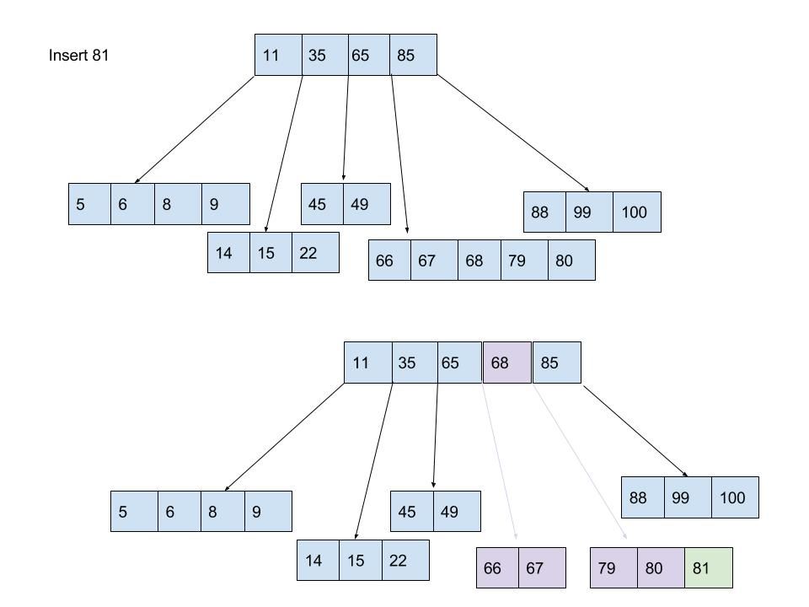
Insert Example
B-tree, m = 6
max keys is 5
Insert into full node.
Run split node procedure

Slide 25
Deleting a Key from a B-tree
Similar to insertion, but a few more cases to consider
Single pass down the tree, key to be deleted is “moved” to the leaf and deletion occurs at the leaf
If key is deleted from internal node, then there are a few cases of concern.
Is resulting b-tree valid
Constraint: All non-leaf nodes (except the root) have between m/2 and m children

Slide 26
Deleting a Key from a B-tree
During traversal for deletion there are 3 Cases
General idea:
Traverse down the tree in search of key k, at each node identify the case and proceed appropriately
If a node with a min number of keys is encountered, we will “adjust” keys so that the number is not min. (case 3)
(Why? Removal in the subtree may decrease the number of keys in a parent potentially causing a violation. )
Key to remove is found in internal node, recursively demote the key down to a leaf node for deletion. (case 2)
Key is found in leaf node. Delete key (case 1)

Slide 27
Deleting a Key from a B-tree
Cases 1 + 2
Key k is deleted from node thisNode
thisNode is a leaf node. Simple – just delete k. base case.
thisNode is an internal node
Assume k is the i^{th} key in thisNode. thisNode.child_{i} has more than the minimum number of keys, find predecessor key k’ in subtree rooted by thisNode.child_{i} . Delete k’ and replace k with k’ in thisNode. (Goal: repeatedly demote k down to a leaf node with a series of “swaps”). Continue traversal down tree (to continue demotion).
ELSE if thisNode.child_{i} does not have more than minimum number of keys: perform the step above with the thisNode.child_{i+1.} Continue traversal down tree (to continue demotion).
ELSE if both thisNode.child_{i} and thisNode.child_{i+1} do not have the minimum number of keys, demote k and merge k and the contents of thisNode.child_{i+1} into thisNode.child_{i.} Adjust thisNodes keys appropriately. Continue traversal down tree (to continue demotion).

Slide 28
Deleting a Key from a B-tree
Final Case: traversing down tree, searching for key k. Ensure appropriate number of keys on the way down
k is not contained in internal node iNode. Determine which child iNode.child_{i} roots the subtree that contains k
If iNode.child_{i} has the minimum number of keys, but has a sibling with more than the minimum number of keys. Transfer an extra key into iNode.child_{i} from iNode: move a key from sibling iNode.child_{i+1} or iNode.child_{i-1} to iNode , and “promote” the appropriate child from sibling to iNode. Continue traversal down tree (in search of k).
If all children of iNode have the minimum number of keys, merge two of the sibling into one. Move a key down from iNode to the new merged node to become the median key for the new node. Adjust iNodes appropriately. Continue traversal down tree (in search of k).
iNode.child_{i} has the MORE THAN minimum number of keys, Continue traversal down tree (in search of k).

Slide 29
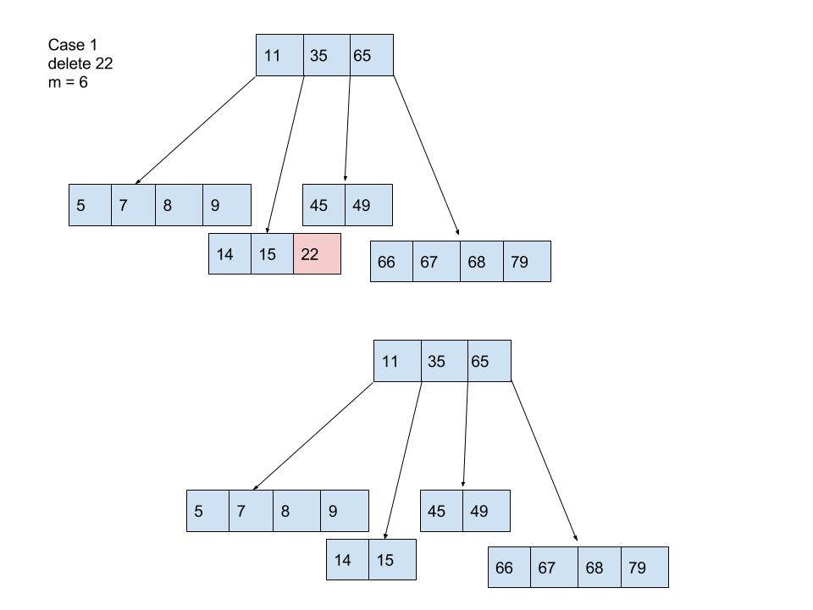
Example: Deleting from a B-Tree
Case 1:
Remove 22

Slide 30
Example: Deleting from a B-Tree

Slide 31
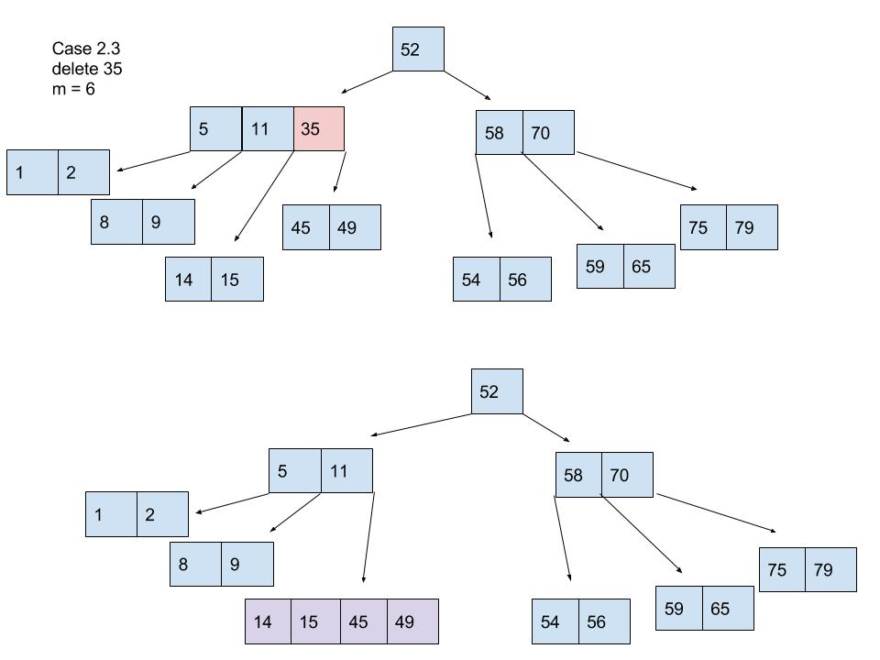
Example: Deleting from a B-Tree
Case 2.3
Note that thisNode’s children do not have more than the minimum number of keys
Therefore merge two children into a new node

Slide 32
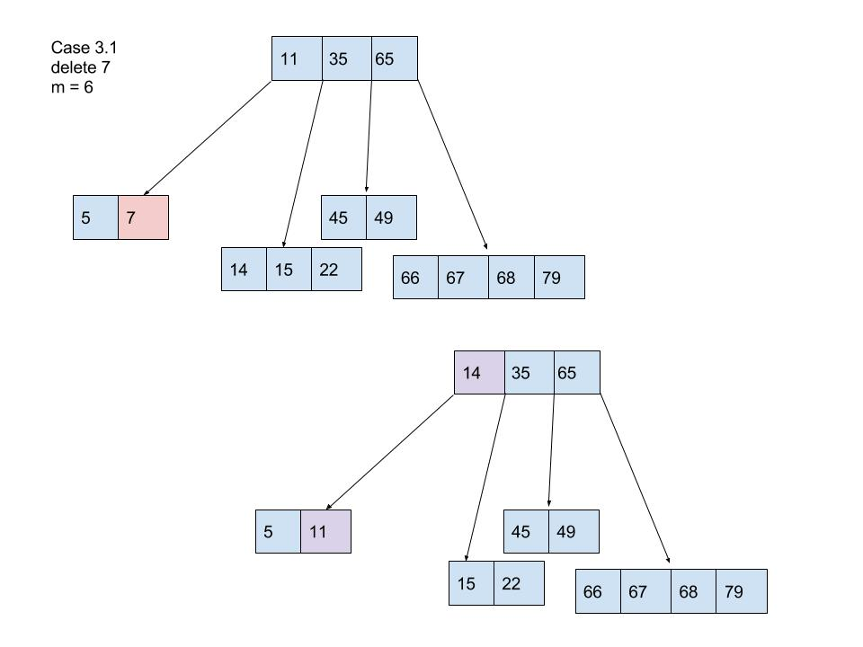
Example: Deleting from a B-Tree
Case 3.1
Remove 7
The resulting node, thisNode, will not have a sufficient number of keys.
Therefore “demote” key from iNode and “promote” key from sibling

Slide 33
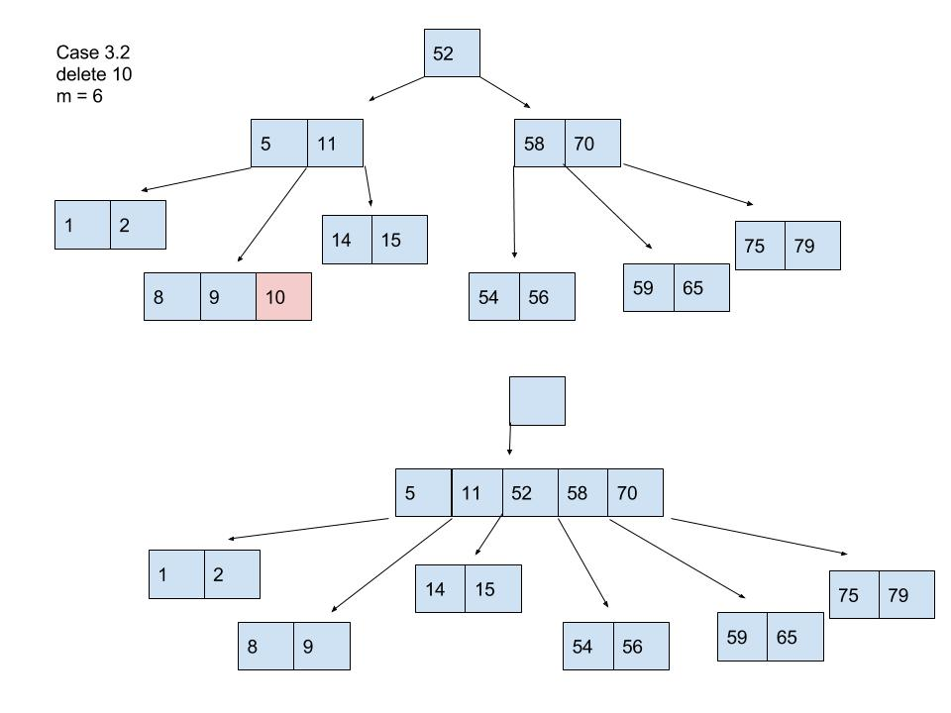
Example: Deleting from a B-Tree
Case 3.2
Since both siblings (5,11) and (58,70) do not have more than the min number of keys we cannot simply perform a demotion-promotion swap (case 3.1)
Therefore we must merge node (5,11) with one of its siblings and use iNodes key as the new median
Special case: demoting the root. Since the only key in iNode has been demoted. All other keys at iNode must be adjusted (but there are no others!)
Delete oldRoot
Observe the height of the tree changes only in this case – with the deletion of the oldRoot.
Once this merge occurs, the recursive search for the key 10 can proceed. 10 is finally removed (case 1)

Slide 34
Readings
Family of B-Trees
B* Trees
If node is full, only split if sibling is also full; otherwise swap values with parent and sibling to avoid split.
Idea: reduces the frequency of splitting which can be time consuming.
Variation of “fullness” constraint for splitting nodes.
Result minimum fullness is $\frac{2}{3}$ instead of $\frac{1}{2}$ .
B^{n} Trees (generalization): a node is full at ratio (n+1)/(n+2)
B+ Trees
Observe: B-tree still have a very inefficient in-order traversal.
Internal nodes contain keys (only)
Leaf nodes contain keys and pointers associated with corresponding data
Leaves also generally contain pointer to the next leaf node (in order)
Result
Leaves contain all keys and all data references
Internal nodes are only used as indices to search for data.
Thus a key found in an internal node is also found in a leaf node!

Slide 35
Summary of B-Trees
Practical benefits to be gained when storing large structures in memory
Accessing memory off chip is slow! B-trees reduce the number of memory accesses in the worst case as compared to BSTs
${O(m log}_{m}{n})$ vs ${O( log}_{2}{n})$
Number of disk accesses is reduced for large m.
$Θ(\log_{m}{n})$
Investigation: How does the choice of m affect the overall complexity?
Theoretically?
In practice?

Slide 36
Appendix
Jeremy Bolton, PhD
Assistant Teaching Professor

Slide 37
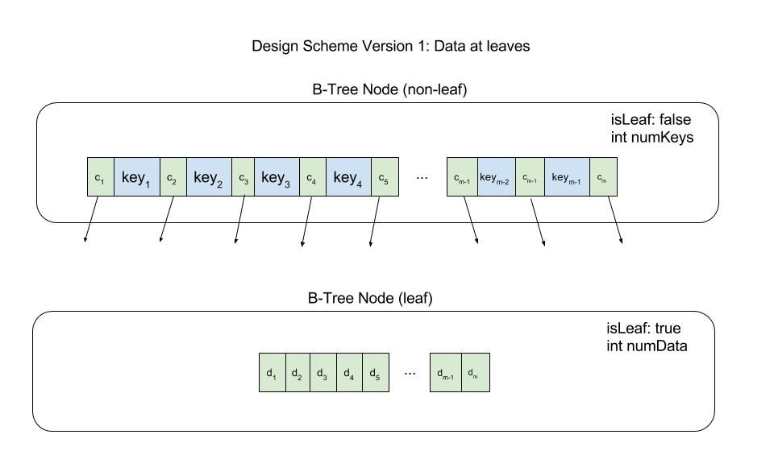
Design Scheme: B+ trees
Data only at the leaves
Keys are only used to guide a search to data
Key values are by standard the smallest value in the right subtree

Slide 38
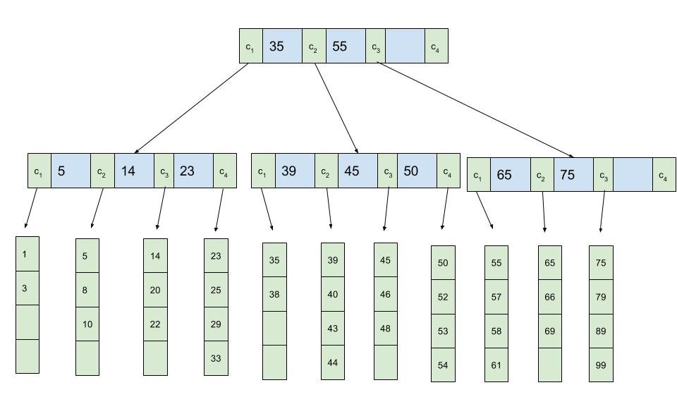
Design Scheme: B+ trees
Data only at the leaves
Keys are only used to guide a search to data
Key values are by standard the smallest value in the right subtree
Here m = 4

