Slide 1
COSC160: Data Structures Balanced Trees
Jeremy Bolton, PhD
Assistant Teaching Professor

Slide 2
Outline
Balanced Trees
AVL Trees
Balance Constraint
Examples
Searching
Insertions
Removals

Slide 3
Balancing a Tree
Binary trees lack a depth constraint. As a result the worst case insertion, removal and retrieval times are O(n).

Slide 4
Balanced Trees: Time Complexity Implications
If a tree is “balanced” in some sense. The time complexity of insertions, removals and retrievals will have a logarithmic bound.

Slide 5
AVL Trees
AVL trees
Binary Search Tree with added balance constraint
Adelson, Veliskii and Landis
Definition: AVL constraint
For any node in the tree, the height of the left and subtrees can differ in height only by one.
Uses weak notion of “balance”
Sufficient to ensure logarithmic depth in worst case!

Slide 6
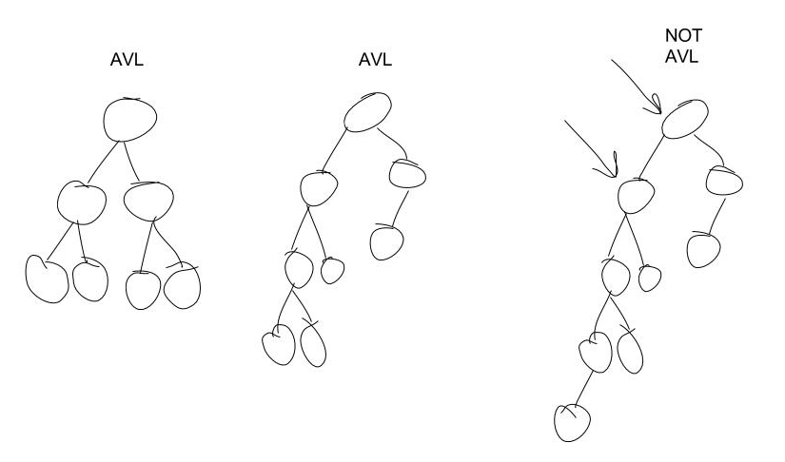
Example AVL trees

Slide 7
Logarithmic Depth
AVL trees are guaranteed to have logarithmic depth.
As a result, the worst case time complexities for insert, removal and retrieve is O(log₂n).
Proof idea: Prove the height can be represented as a logarithmic function of n the number of nodes.
By definition, the minimum number of nodes is in AVL tree of height h is defined by recurrence ${AVL}_{h}$:
$${AVL}_{h}=AVL_{h−1}+AVL_{h−2}+1 \\ AVL_{0}=0 \\ AVL_{1}=1$$
Solving and bounding this recurrence we get : ${h<1.4\log_{2}\left({AVL}_{h}+2\right)}_{}$
See Appendix A.5
Thus worst case operations based on traversing the height h of the tree are O(log₂${AVL}_{h}$)

Slide 8
The Valid State of A Balanced Tree
Operations on an AVL tree may result in an “invalid” state.
Insert
Nodes along the path from the inserted node to the root might violate the balance condition.
Remove
Nodes along the path from the replacement node to the root might violate the balance condition.
Re-balancing must be incorporated into these operations.

Slide 9
Insert into AVL Tree
Assume node thisNode is the deepest node that violates the balance constraint and must be rebalanced.
The violation may occur as a result of 1 of 4 Cases:
Case 1: Insertion into left subtree of the leftChild of thisNode
Case 2: Insertion into the right subtree of the leftChild of thisNode
Case 3: Insertion into the left subtree of the rightChild of thisNode
Case 4: Insertion into right subtree of the rightChild of thisNode

Slide 10
Balancing by Single Rotation Case 1
// rotate AVL tree single rotation
// solution for Case 1: Insertion into left subtree of the leftChild of thisNode
// performs rotation and returns new root of subtree, oldLeftChild
$$function rotateWithLeftChild\left(thisNode\right)$$
$oldLeftChild≔thisNode.leftChild$ $thisNode.leftChild≔oldLeftChild.rightChild$ $oldLeftChild.rightChild≔thisNode$
return oldLeftChild

Slide 11
Balancing by Single Rotation Case 4
// rotate AVL tree single rotation
// solution for Case 4: Insertion into right subtree of the rightChild of thisNode
// performs rotation and returns new root of subtree, oldRightChild
$$function rotateWithRightChild\left(thisNode\right)$$
$oldRightChild≔thisNode.rightChild$ $thisNode.rightChild≔oldRightChild.leftChild$ $oldRightChild.leftChild≔thisNode$
return oldRightChild

Slide 12
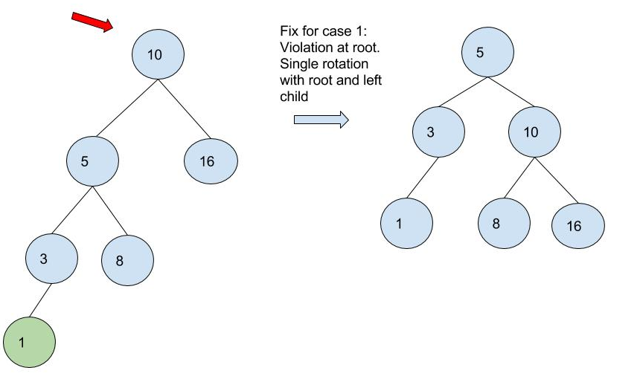
Balancing by Single Rotation

Slide 13
Single Rotation fails when “inner” subtree is largest

Slide 14
Double Rotations.
Example: Double rotation balances case 2 (and 3)
Rotate between thisNode’s child and grandchild
Rotate between thisNode and its new child

Slide 15
Double rotate with left child: Case 2
// rotate AVL tree single rotation
// solution for Case 2:
// performs double rotation and returns new root of subtree
$$function doubleRotateWithLeftChild\left(thisNode\right)$$
$thisNode.leftChild≔rotateWithRightChild\left(thisNode.leftChild\right)$ $return rotateWithLeftChild\left(thisNode\right)$

Slide 16
Example: Balancing by Double Rotation

Slide 17
Double rotate with right child: Case 3
3
// rotate AVL tree single rotation
// solution for Case 3
// performs double rotation and returns new root of subtree
$$function doubleRotateWithRightChild\left(thisNode\right)$$
$thisNode.rightChild≔rotateWithLeftChild\left(thisNode.rightChild\right)$ $return rotateWithRightChild\left(thisNode\right)$

Slide 18
Insert into AVL Tree
Note: root must be passed by reference in this implementation! This allows for appropriate linking to parents for base case and rotations
// insert key in AVL tree rooted at root
$$function insertAVL(\&root, key)$$
$if root is NULL$ // base case: insert node here!
$root ≔new node$
$root.key≔key$
$if root.key==key, then return$ // assume no duplicates
$if root.key>key$ // continue down left subtree
$insertAVL(root.leftChild,key)$
$if |height\left(root.leftChild\right)−height\left(root.rightChild\right)|==2$
$if root.leftChild.key>key$ // case 1
$root≔rotateWithLeftChild(root)$
$else$ // case 2
$root ≔doubleRotateWithLeftChild(root)$
$if root.key<key$ // continue down right subtree
$insertAVL(root.rightChild,key)$
$if |height\left(root.leftChild\right)−height\left(root.rightChild\right)|==2$
$if root.leftChild.key<key$ // case 4
$root≔rotateWithRightChild(root)$
$else$// case 3
$root ≔doubleRotateWithRightChild(root)$
Code facilitating insertion shown in blue
Code enforcing balance shown in orange

Slide 19
Try this at home
Note: we must check the height of each subtree to check for balance. Change the insert pseudocode so we do not need to recompute the height during each step of traversal for an insert!
In the pseudocode provided, this was done by calling a height function
This is slow! How slow?
Instead a height attribute -- AKA balance factor -- should be maintained at each node and updated during any insertion or removal.

Slide 20
Balance Factor
Balance Factor.
Stored at each node in AVL tree
balanceFactor = height of right subtree less height of left subtree
Valid values are -1, 0, and +1.
During insertion and removal, all affected balance factors must be updated
Balance factors are then checked to determine if rotation is necessary

Slide 21
AVL Tree: Remove
Removal is similar to insertion: perform alteration, then rebalance
Rebalance using single and double rotations
Difference: imbalance may propagate upwards, rotations at multiple nodes along the path to the root may be necessary

Slide 22
Cases for Removal from AVL tree
Similar to cases for standard BST
Delete node from AVL tree
Case 0: 0 children. delete node.
Case 1: 1 child. Connect child to parent.
Case 2: 2 children. Choose replacement node (e.g. min val in right subtree) and make the appropriate substitution.
re-balance as needed
Case 0: all nodes from removed node to root must be checked
Case 1: all nodes from removed node to root must be checked
Case 2: all nodes from deleted replacement node to root must be checked
Can rebalance while returning along the path.

Slide 23
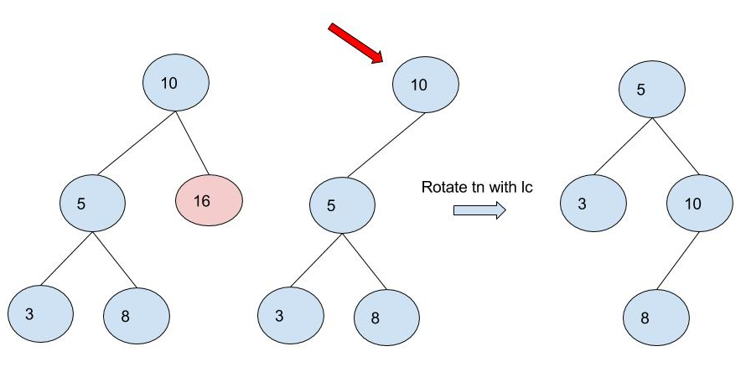
Remove Example

Slide 24
Try at home
Create pseudocode for AVL node removal
Cases and reconnection of separated tree similar to BST node removal
Height condition checks and rotations similar to AVL insert

Slide 25
Time Complexity including Balance
Search: $Θ(\log_{2}{n})$
Note: Height Balancing only adds constant factor to complexity since
Balancing is performed while simultaneously traversing the tree for insert or remove
ie the traversal is “free”, and each balance case in done in a constant number of operations.
Should keep height attribute at each node; otherwise complexity may increase
Insertion: $Θ(\log_{2}{n})$
Removal$: Θ(\log_{2}{n})$

Slide 26
Summary: AVL Trees
Efficient
Constraint ensures logarithmic depth
Theoretically fast, but rebalancing will decrease execution by a constant factor.
Other Notes:
For large trees, the log time will be a huge savings
But there are practical issues related to cache, memory, and other delays to consider
For example linear search time (without any memory delays) may be better than log search time (with memory delays).
B-Trees …

