Slide 1
COSC160: Data Structures Heaps
Jeremy Bolton, PhD
Assistant Teaching Professor

Slide 2
Outline
Priority Queue
Heaps
Binary Heaps
Skew Heaps

Slide 3
Balancing a Tree
Binary trees lack a depth constraint. As a result the worst case insertion, removal and retrieval times are O(n).

Slide 4
Balanced Trees: Time Complexity Implications
If a tree is “balanced” in some sense. The time complexity of insertions, removals and retrievals may have a logarithmic bound.

Slide 5
Heaps
Another tree structure well suited for a priority queue is a Heap.
Similar to other BSTs, BUT key order is determined by parent-child relationship alone, not necessarily which child (left and right child have no order constraint).
A binary heap of size n, is a complete, binary tree where key order is determined by the heap-order property.
A complete binary tree of size n has a height of $\left\lfloor \log{n}\right\rfloor$ and the tree is completely filled up to depth $\left\lfloor \log{n}\right\rfloor −1 .$
A complete tree, has all nodes at the maximum depth in leftmost position.
If the tree was implemented as an array and ordered by a BFS, all nodes would be contiguous (no vacant spaces until BFS is complete).
(min) Heap-order: a parents key is less than its children’s key
min-heap or max-heap

Slide 6
Heap Example: Heap Order
(min) Heap-order: a parents key is less than its children’s key
Structural constraints
A complete binary tree of size n has a height of $\left\lfloor \log{n}\right\rfloor$ and the tree is completely filled up to depth $\left\lfloor \log{n}\right\rfloor −1 .$
A complete tree, has all nodes at the maximum depth in leftmost position.
If the tree was implemented as an array and ordered by a BFS, all nodes would be contiguous (no vacant spaces until BFS is complete).
$$h= \left\lfloor \log{15}\right\rfloor =3$$
minDepth $= \left\lfloor \log{11}\right\rfloor −1=2$
has all nodes at the maximum depth in leftmost position.
$$h= \left\lfloor \log{11}\right\rfloor =3$$

Slide 7
Not Binary Heaps
Violations of
Min filled depth
Heap order
Leftmost position

Slide 8
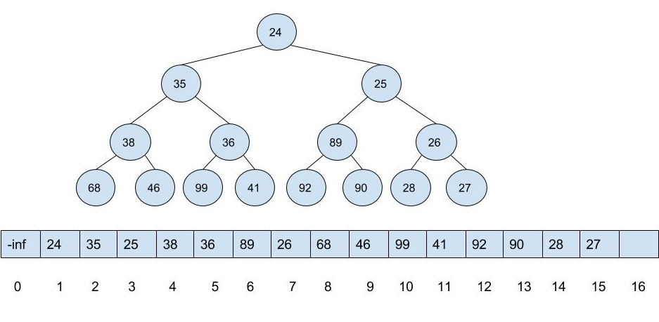
Implementation
Given that the heap is complete in leftmost position, it is reasonable to implement as an array.
In the simple case, no need for left and right child pointers
Con: static maximum size (use dynamic array)
Attributes:
Array (for keys / priorities)
Some use sentinel at 0th position
currentSize
maxSize
inOrder
Chaining implementation
Binary Tree Node

Slide 9
Traversing an array implementation of a tree
Assume a (BF) level-ordering of keys in the array.
Review and Examples of array implementation of trees:
Implement a method to traverse and print keys in BF order
Implement a method to traverse and print keys in a DF order
Observations
Doubling parentIndex: leftChild index
Double parentIndex + 1: rightChild index
childIndex/2 : parentIndex
Assume floor when odd
Try this at home!

Slide 10
Insertion
Conceptually
Insert the key k in the leftmost available position at height $\left\lfloor \log{n}\right\rfloor$.
If heap order is not violated by k, then done.
Else, swap k with parent key
Repeat at step 2.
Implementation
Inserting and swapping occurs in array.
Must be able to determine parents index.

Slide 11
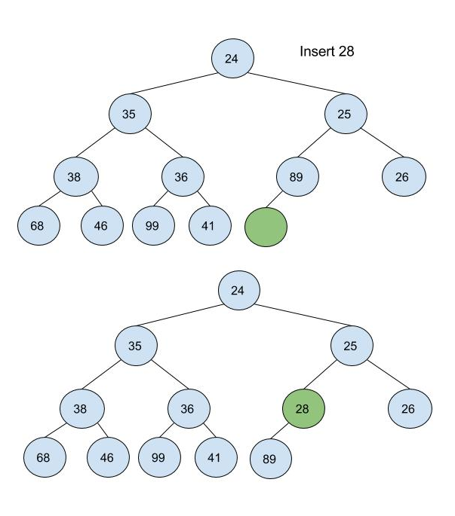
Heap Insertion
// Assumes array size sufficient
// insert hole into next leftmost location
// swaps hole up to maintain heap order
// inserts val in hole
$$function insertHeap\left(heap, val\right)$$
hole := heap.currentSize := heap.currentSize + 1
while val < heap.array[hole/2] // swap keys/priorities down
heap.array[hole] := heap.array[hole/2]
hole := hole/2
$heap.array$[hole] := val // inserts val at stopped hole location

Slide 12
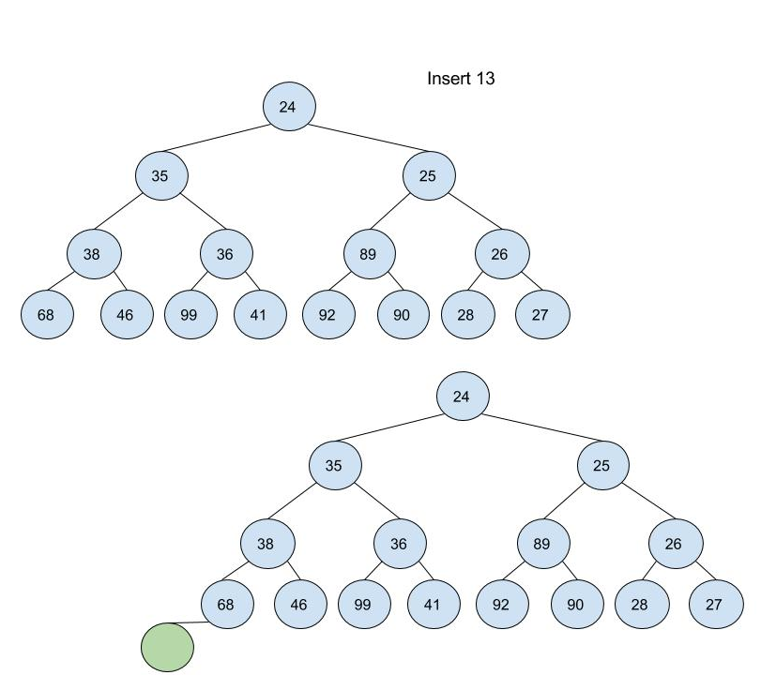
Insertion Example
Insert hole in leftmost position
Repeatedly swap up until insertion does not violate heap order
Then insert

Slide 13
Removal
Find min
The min value (in a minHeap) is simply the root of the tree (if heap is inOrder)
Remove Min
The item to remove from the priority queue is the item with “highest” priority (always the root in a heap!)
The “last” item is detached (for future insertion at hole) since the number of elements is decremented
Result will be a tree with a hole for a root
Fix: propagate hole down and insert the “last” item into the hole when possible
“last” refers to order in a BF scan.

Slide 14
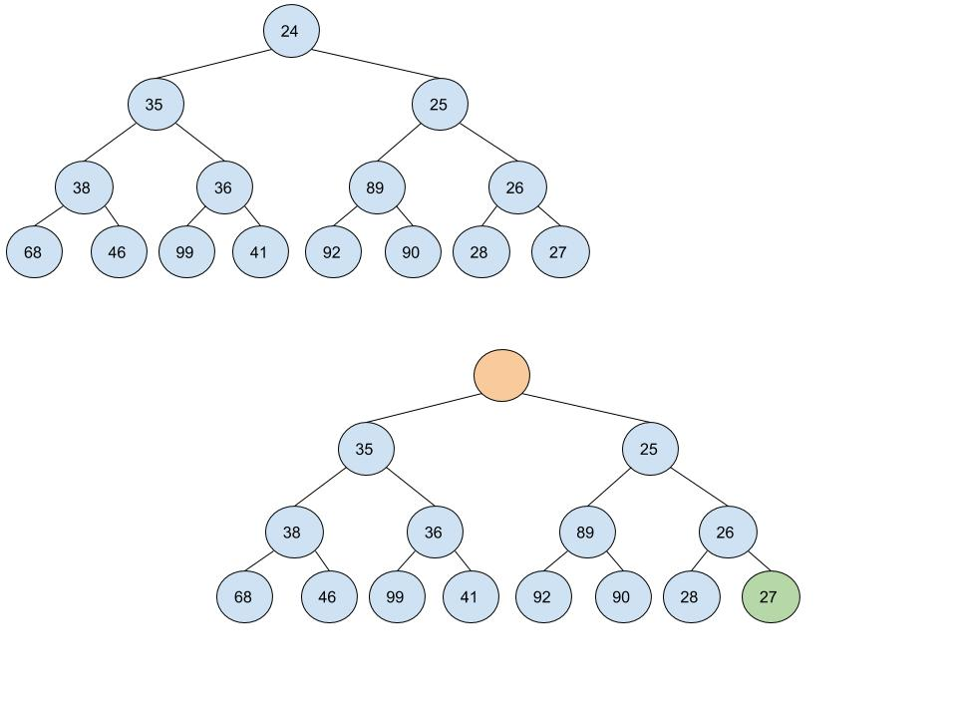
Heap Removal Example
Remove root (always root if heap is inOrder)
Detach “last” item from tree to insert into new location
Last in BF scan
Right most item at max depth
Swap hole down until we can insert the “last” item

Slide 15
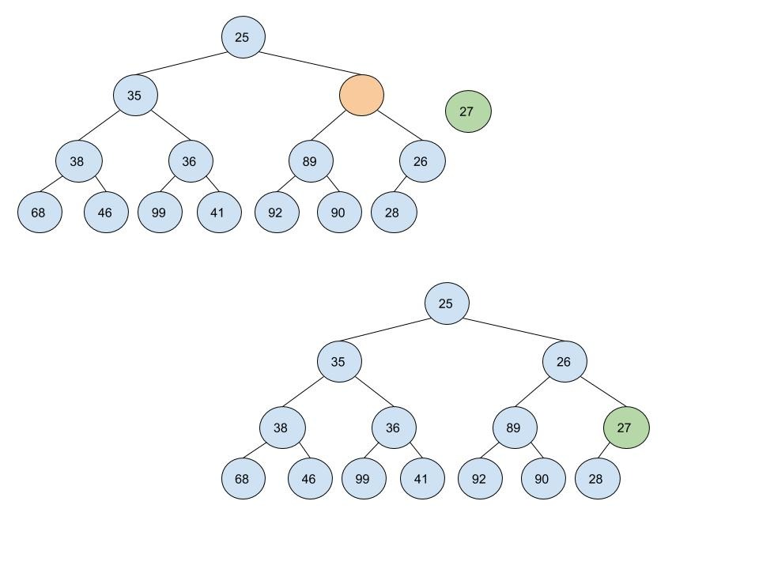
Heap Removal Example (cont)
Remove root (always root if heap is inOrder)
Detach “last” item from tree to insert into new location
Last in BF scan
Right most item at max depth
Swap hole down until we can insert the “last” item

Slide 16
Heap Removal
// Removes item with highest priority
// detaches lastItem
// Swaps hole down and reinserts lastItem so heap is inOrder
$$function Remove\left(heap\right)$$
returnVal := heap.array[1]
temp := heap.array[heap.currentSize]
heap.currentSize := heap.currentSize – 1
hole := 1
while hole <= heap.currentSize // while there exists a child , traverse down
child := hole * 2 // check left child
if child != heap.currentSize AND heap.array[child+1] < heap.array[child] // swap down to lesser of two children
child := child + 1
if heap.array[child] < temp // not ready to insert … continue swapping down
heap.array[hole] := heap.array[child]
else
break // ready to insert
heap.array[hole] := toInsert
return returnVal

Slide 17
RE-write removal using helper function
$$function swapDown\left(heap, hole\right)$$
temp := heap.array[hole] // assumes last item was copied to hole location
while hole <= heap.currentSize // while there exists a child , traverse down
child := hole * 2 // check left child
if child != heap.currentSize AND heap.array[child+1] < heap.array[child] // swap down to lesser of two children
child := child + 1
if heap.array[child] < temp // not ready to insert … continue swapping down
heap.array[hole] := heap.array[child]
hole := child
else
break // ready to insert
hole := child // update and continue traversal
heap.array[hole] := temp
// Removes item with highest priority
// detaches lastItem
// Swaps hole down and reinserts lastItem so heap is inOrder
$$function Remove\left(heap\right)$$
returnVal := heap.array[1]
heap.array[1] := heap.array[heap.currentSize] // copy last item to hold location
heap.currentSize := heap.currentSize – 1
swapDown(heap , 1)
return returnVal

Slide 18
Analysis of Insert and Remove
Insert
Add hole to next leftmost position
Swap up hole until insertion does not violate heap order
Worst case: O(log n)
Remove
Replace root with hole
Detach rightmost item at max depth
Swap hole down until insertion of detached item does not violate heap order
Worst case: O(log n)

Slide 19
Heap uses
Observe we have sacrificed “order” for “balance”
When can we make use of a heap?
Only partial order matters
Min or max

Slide 20
Queue
FIFO and LIFO
Removal from queue is based on order of entry
As a result, access can be restricted to head or tail (base or top) only
Priority Queue
Removal is based on priority ranking
Tracking priority rankings is necessary to determine removal order

Slide 21
Priority Queue
Using a list implementation
Array or linked list
Option 1 unordered:
Insert: O(1)
Remove: O(n)
Option 2 ordered:
Insert: O(n)
Remove: O(1)
Using a BST
Insert, remove, search: Average case, O(log n)
AVL: worst case O(log n) ** (later!)

Slide 22
“Lazy” Insertion: Heap
O(log n) insertion time is not bad.
Can we do better … ? Sometimes.
Lazy insertion.
Simply place the item in the heap, without consideration for heap order.
Time: O(1)
Why? … If we plan to perform many insertions, before attempting any removals, then why waste time maintaining hash order. Instead delay ordering until the next removal.
Before a removal must “fixHeap” aka “heapify” – update heap such that heap order is maintained.

Slide 23
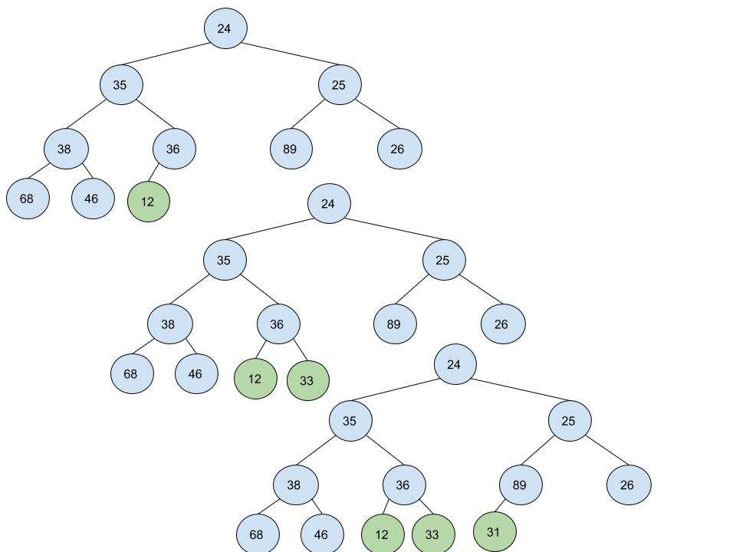
Lazy insert or “tossIn”
Lazy Insert: 12, 33, 31
// insert vals into next leftmost location, no check for heap order
$$function tossIn\left(heap, val\right)$$
heap.currentSize := heap.currentSize + 1
$heap.array$[currentSize] := val
if(val < heap.array[currentSize/2])
heap.inOrder := false // set flag

Slide 24
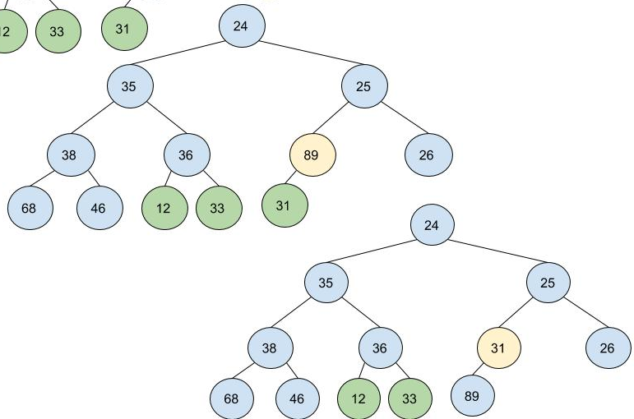
Binary Heap Example: fixHeap aka heapify
// for use with lazy insert
// repeatedly check with swap down
$$function fixHeap\left(heap\right)$$
i := heap.currentSize / 2
while i > 0
swapDown(heap , i)
i := i - 1
heap.inOrder = true

Slide 25
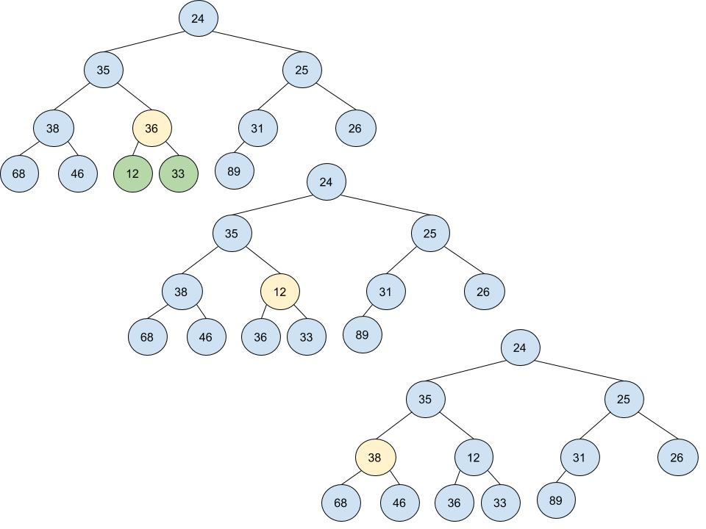
Binary Heap Example: fixHeap aka heapify
// for use with lazy insert
// repeatedly check with swap down
$$function fixHeap\left(heap\right)$$
i := heap.currentSize / 2
while i > 0
swapDown(heap , i)
i := i - 1
heap.inOrder = true
Try at home: create a worst case unordered heap. How many swaps are needed?

Slide 26
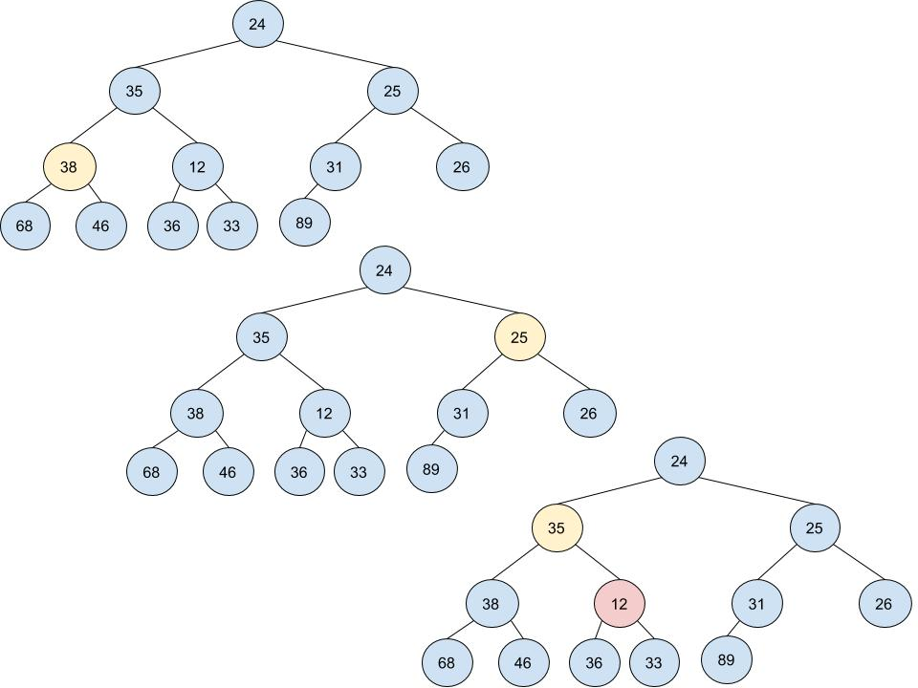
Binary Heap Example: fixHeap aka heapify
Another heap order violation. Swap down is applied.

Slide 27
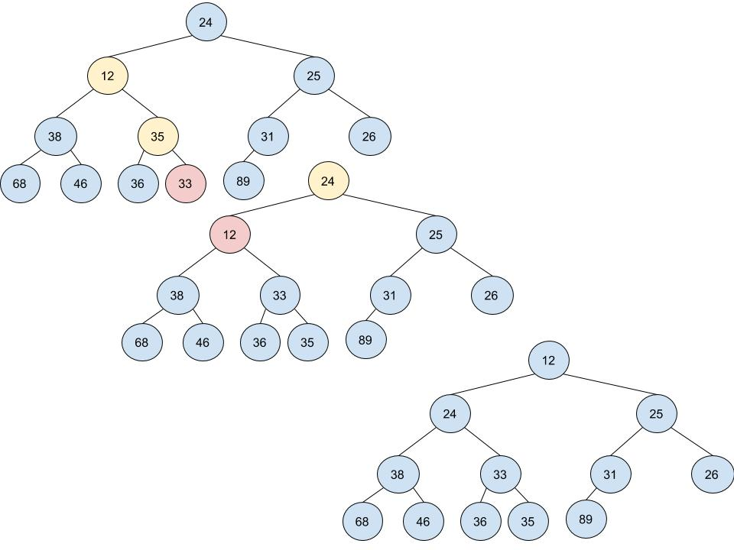
Binary Heap Example: fixHeap aka heapify
Swap Down may need to perform repeated swaps to ensure heap order is preserved
Observations: The initial swap of 12 and 35 is progress, however, there is a violation still with 35 and 33. The swap down method will repeatedly swap down, thus assuring heap property order.
Result: Swap down in the worst case will result in O(log n); swapping down the height of the tree.

Slide 28
Analysis of tossIn and fixHeap (heapify)
tossIn
all cases time (assuming size is sufficient): O(1)
fixHeap
Fix heap performs a reverse BFS O(n) and potentially swaps down at each step of the traversal O(log n), for a total upperbound of O(n log n)
Swap down has a worst case of O(log n), BUT is this worst case possible in every iteration of our reverse BFS in fixHeap – NO.
In fact we can limit the total number of swaps performed by swap down when used in conjunction with this reverse BFS.
The Result: O(n)

Slide 29
Bounding fixHeap
How can we more tightly bound fixHeap by O(n) ?
Proof idea:
Observe: Each node can be swapped down, at maximum the distance to its furthest leaf node (the height of that specific node)
Thus we need only compute the sum of the heights of all nodes to compute an upper bound (teaser alert! Its O(n)).
The maximum number of swaps 25 could potentially have is 2 (the distance to 89), this is its height

Slide 30
Proof idea: fixHeap is O(n)
Show the sum of the heights of all nodes in a BST is linear.
1 node (the root node), will have the maximum height $\left\lfloor \log_{2}{n}\right\rfloor$, its children (2 nodes) will have heights $\left\lfloor \log_{2}{n}\right\rfloor$ - 1, continuing on in this fashion we have the following sum of heights:
Sum of heights =
$\sum_{i=0}^{\left\lfloor \log_{2}{n}\right\rfloor }{2^{i}∗\left(\left\lfloor \log_{2}{n}\right\rfloor −i\right) } = \sum_{i=0}^{h}{2^{i}\left(h−i\right)}=2^{h}\left(0\right)+2^{h−1}\left(1\right)+$…+$2^{0}\left(h\right)$=
$2^{h}[\left(0\right)+2^{−1}\left(1\right)+$…+$2^{−h}\left(h\right)]=$
=$n\sum_{i=0}^{h}{\frac{i}{2^{i}}}≤2n$
Side note: this proof shows that we can upper bound the number of total swaps linearly! In fact we can more strictly bound this expression:
Sum of heights = n – h.
Try a proof by induction.
See our example on previous slide:
Sum of heights = 9
n – h = 12 - 3
Note that when h approaches inf, this sum converges to 2, thus we can upperbound it.

Slide 31
Repeated inserts vs. toss and heapify
Which is more efficient?
Assume we start with an empty heap and perform n inserts.
tossIn and fixHeap
O(n) + O(n) = O(n)
Repeated Inserts
O(n log n)

Slide 32
Priority Queues (with changing priorities)
Array implementation permits efficient implementation
Previous implementation priorities were fixed
Permitting priority updates
Concerns
Identifying item to be updated
Updating item and updating heap order

Slide 33
updatePriority
Updating a nodes priority
Assume location of priority to be updated is known.
**If location is not assumed, must search heap before update
// updates priority value at node index with newVal
$$function updateP\left(heap, index, newVal\right)$$
if heap.array[index] < newVal // lowering priority
heap.array[index] := newVal
swapDown(heap, index)
else // increasing priority
heap.array[index] := newVal
swapUp(heap, index)

Slide 34
Side Note: Applications
Priority Queues
Sorting
Data structures are used to store data
Data structures are also used to help facilitate computational tasks efficiently
Heaps are useful for sorting
Takes advantage of efficiency of fixHeap (aka heapify)
First weakly orders elements, then removes min

Slide 35
Heap Sort
Input: n orderable items
Heap sort algorithm
Build heap
tossIn all n items , O(n)
fixHeap , O(n)
Iteratively disassemble heap and build ordered list
Repeatedly Remove O(n log n)
remove root (min thus far) and add to tail of growing list
swapDown(heap,1)

Slide 36
Analysis of some sorting algorithms
Insertion Sort
Time
Worst Case: O(n²)
Best Case: O(n)
Space:
In-place: YES
Heap Sort
Time
Worst Case: ?
Best Case: ?
Space:
In-place: YES
Bubble Sort
Time
Worst Case: O(n²)
Best Case: O(n)
Space:
In-place: YES
Selection
Time
Worst Case: O(n²)
Best Case: O(n)
Space:
In-place: YES

Slide 37
Merging Heaps
In some applications, merging or combining priority queues is fundamental
Eg a set of queues is formed for set of resources and a resource is eliminated.
Implementation Implications
Array
Idea: copy items from array into appropriate locations into other array (likely with some extra rearrangements)
At best, linear time given contiguous allocation (must at least copy over one of the hashes)
One simple scheme
newHeap := concatenate(heap1 ,heap2) // repeated lazy insertions
fixHeap(newHeap)

Slide 38
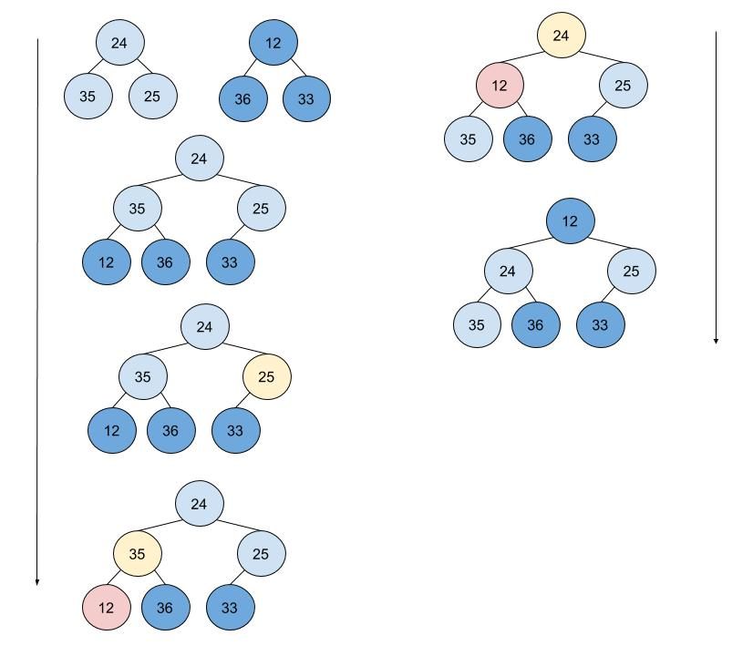
Merging Examples
One simple scheme (assuming array implementation)
newHeap := concatenate(heap1 ,heap2)
// repeated lazy insertions
fixHeap(newHeap)

Slide 39
Merging Heaps
Array vs. Chaining
Simple merging for array implementation required O(sizeHeap1 + sizeHeap2)
Chaining
If the priority queue requires a merging operation, then a chaining implementation may be more efficient.
Merging can be done with O(log n) with the following design changes
Chaining with nodes (not array)
Relax height constraint (really ?!?)
The skew heap!

Slide 40
Skew heaps
A skew heap is a binary tree with heap order (and no balance constraint) and a skew merging scheme
Result: may have linear depth in worst case (though as we have shown, with BST, the average depth is logarithmic)
All operations will have logarithmic time for the average case.
Implementation (structurally)
Chaining with pointers: leftChild and rightChild
Node similar to node used in BST

Slide 41
Merging Skew Heaps
Scheme to merge heap₁ and heap₂, with root nodes r₁ and r₂
Repeatedly merge
Base Case: if one tree is empty, return the other
Recursive Case:
temp := r₁.rightChild
r₁.rightChild := r₁.leftChild
r₁.leftChild := merge(temp, r₂)
return r₁
- Remove right child of left tree
- Make left child of left tree, the right child
- Make new left child of left tree, the result of merging the right tree with the old right child.

Slide 42
Merge Skew Heap
// assume $r_{1}$ and $r_{2}$ are the roots of heap₁ and heap₂ initially
// recursively merges the heaps using skew scheme
$$function mergeSkewHeap\left(r_{1}, r_{2}\right)$$
if $r_{1} is NULL , return r_{2}$
if $r_{2} is NULL , return r_{1}$ $if r_{1}.priority<r_{2}.priority$
temp := $r_{1}$.rChild
$r_{1}$.rChild := $r_{1}$.lChild
$r_{1}$.lChild := mergeSkewHeap($r_{2}, temp$)
$return r_{1}$ $else$
$return {merge(r_{2},r_{1})}_{}$

Slide 43
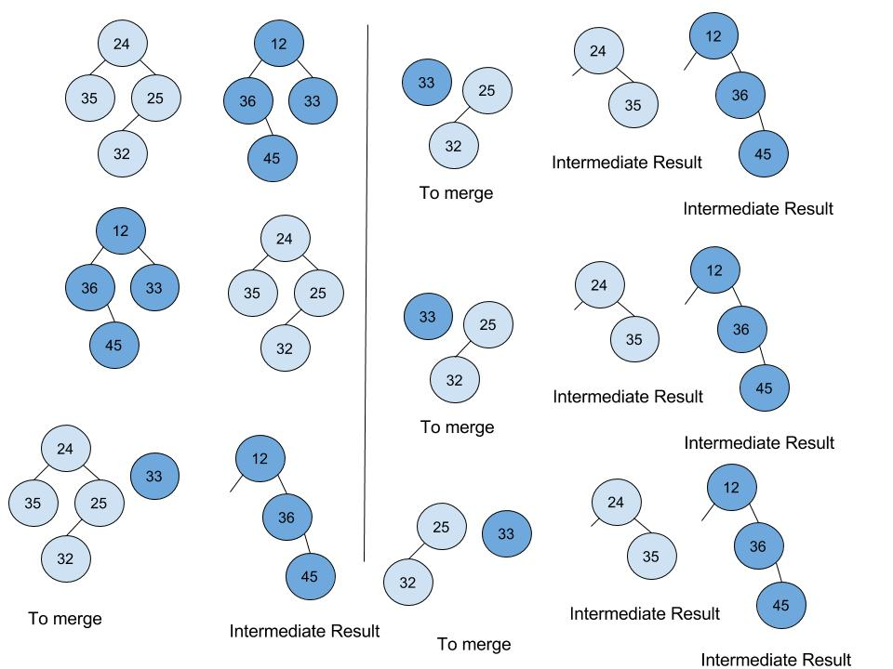
Merge Skew Heaps Example
1
4
2
// assume $r_{1}$ and $r_{2}$ are the roots of heap₁ and heap₂ initially
// recursively merges the heaps using skew scheme
$$function mergeSkewHeap\left(r_{1}, r_{2}\right)$$
if $r_{1} is NULL , return r_{2}$
if $r_{2} is NULL , return r_{1}$ $if r_{1}.priority<r_{2}.priority$
temp := $r_{1}$.rChild
$r_{1}$.rChild := $r_{1}$.lChild
$r_{1}$.lChild := mergeSkewHeap($r_{2}, temp$)
$return r_{1}$ $else$
$return {mergeSkewHeap(r_{2},r_{1})}_{}$
5
3
6

Slide 44
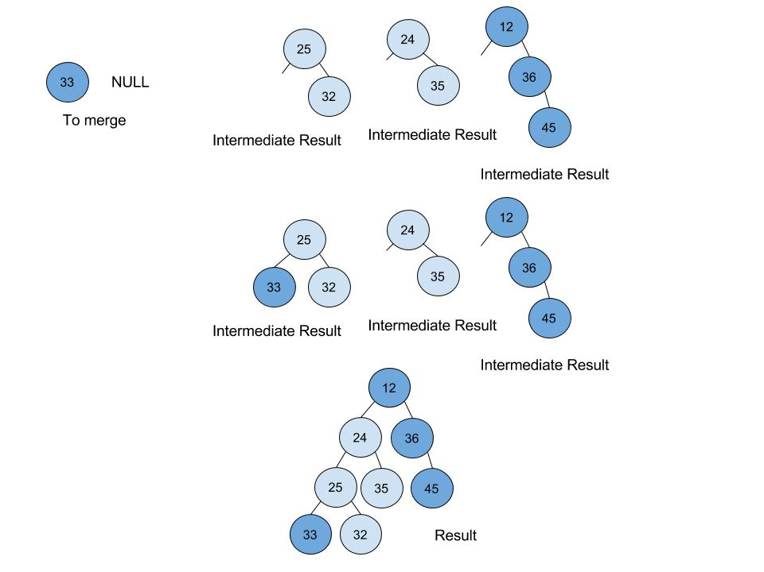
Merge Skew Heaps Example
7
// assume $r_{1}$ and $r_{2}$ are the roots of heap₁ and heap₂ initially
// recursively merges the heaps using skew scheme
$$function mergeSkewHeap\left(r_{1}, r_{2}\right)$$
if $r_{1} is NULL , return r_{2}$
if $r_{2} is NULL , return r_{1}$ $if r_{1}.priority<r_{2}.priority$
temp := $r_{1}$.rChild
$r_{1}$.rChild := $r_{1}$.lChild
$r_{1}$.lChild := mergeSkewHeap($r_{2}, temp$)
$return r_{1}$ $else$
$return {mergeSkewHeap(r_{2},r_{1})}_{}$
8
9

Slide 45
Notes
Other operations on skew heaps
Since Skew Heaps are not array implementations, nor are they balanced, the insertion operation and update priority operations are somewhat different as compared to the Binary Heap
Interestingly, these operations can be managed with using merges
Insert(val): merge(heapRoot, newNode(val))
Remove:
newRoot : =merge(root.lChild, root.rChild)
return oldRoot
updatePriority(node, newVal):
node.priority := newVal
detach node from parent // this requires pointer to parent
newRoot := merge(root, node)

Slide 46
Summary
Binary Heaps
Relaxed order compared to BSTs
Strict balance and leftmost structure
Provides for log time worst case for all operations except merge
Array implementation provides for efficient space and time
Not bad for sorting
Skew Heaps
Chaining implementation
Binary Tree with Heap order (but no balance constraint)
Provides for average logarithmic time for all operations, including merge

