Slide 1
COSC160: Data Structures Binary Trees
Jeremy Bolton, PhD
Assistant Teaching Professor

Slide 2
Outline
Binary Trees
Implementations
Memory Management
Binary Search Tree
Operations

Slide 3
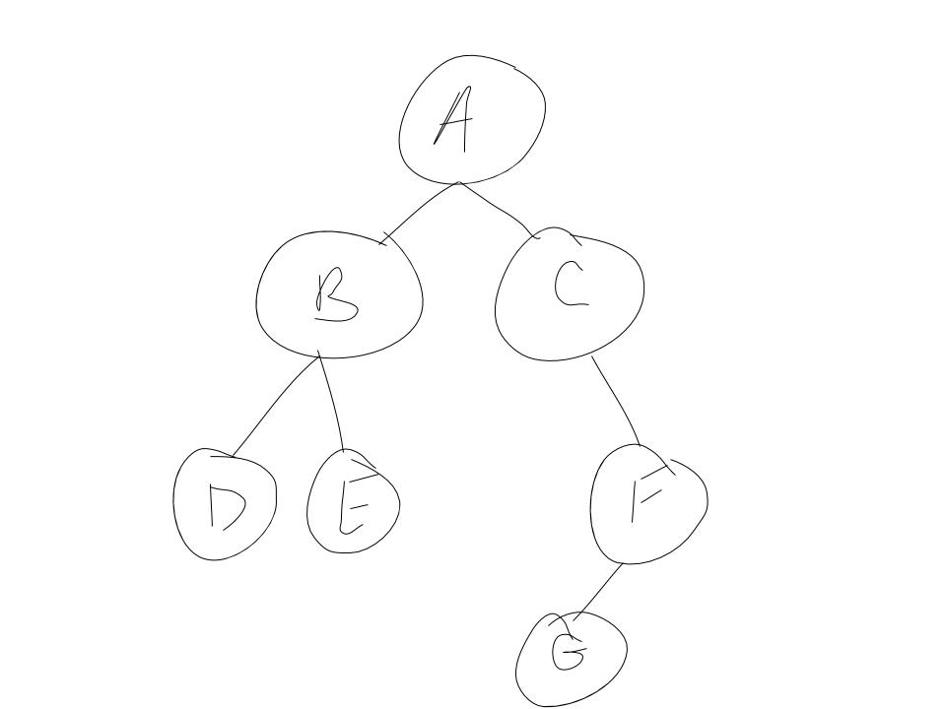
Binary Trees
A binary tree is a tree where every node has at most 2 children.
By standard: leftChild and rightChild

Slide 4
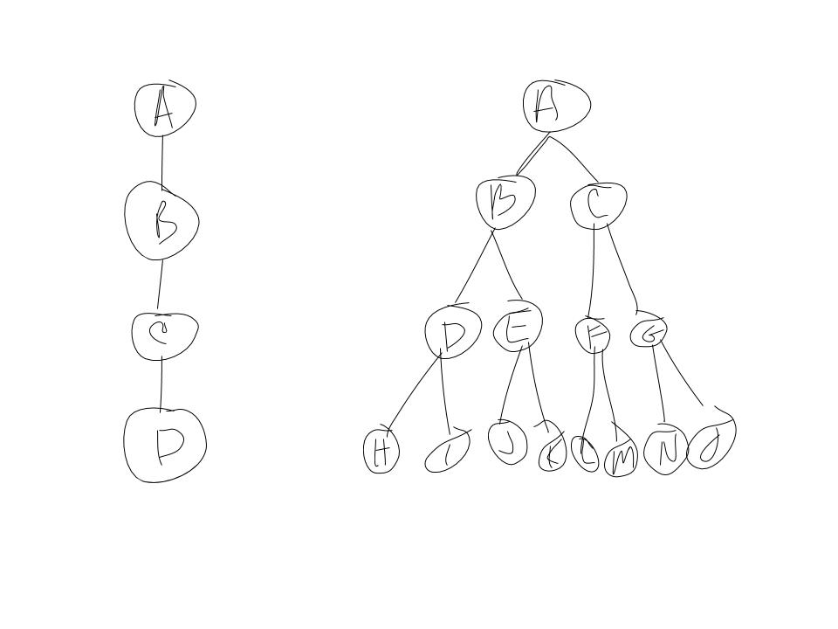
Binary Trees
Observations: number of children constrained
Mitigates allocation issues related to unconstrained numbers of children
Permits “simple” implementations
The maximum number of nodes is of a binary tree with height h is constrained: $maxNumNodes=\sum_{\left\{depth=0\right\}}^{h}{2^{depth}}=2^{h+1}−1$
This constraint is not as helpful as one might think; if fact, it would be much more relevant if we could constrain the height of a tree in terms of the height of its subtrees. More on this later!
Further note: given tree height h. the maximum number of nodes is $2^{h+1}−1$ the minimum number of nodes is h+1.

Slide 5
DF Traversal of Binary Tree
$$function DFS_preorder\left(root\right)$$ //$Process root here$ (preorder)
$if\left(root is Null\right), return$
$DFS(leftChild)$ $DFS(rightChild)$
Traversals are similar to unconstrained trees, but only children.
$$function DFS_inorder\left(root\right)$$ $if\left(root is Null\right), return$
$DFS(leftChild)$ //$Process root here$ (inorder) $DFS(rightChild)$
// iterative
$$function DFS\left(root\right)$$ $stack.push(root)$ $while\left( stack is not empty \right)$ $thisNode ≔stack.pop\left(\right)$ //$Process thisNode here$ (preorder)
$stack.push(rightChild)$
$stack.push(leftChild)$
$$function DFS_postorder\left(root\right)$$ $if\left(root is Null\right), return$
$DFS(leftChild)$ $DFS\left(rightChild\right)$
//$Process root here$ (post order)

Slide 6
BF (level-order) Traversal of Binary Tree
Traversals are similar to unconstrained trees, but only children.
//$recursive$(not practical)
$$function BFS\left(root \right)$$
queue := new queue
$queue.add(root)$
$BFS_helper\left(queue\right)$
$$function BFS_helper\left(queue\right)$$ $thisNode :=queue.dequeue\left(\right)$ //$Process thisNode here$
$if c is not null, then queue.add\left(leftChild\right)$
$if c is not null, then queue.add\left(rightChild\right)$ $BFS(queue)$
$$function BFS\left(root\right)$$ $queue.add(root)$ $while\left( queue is not empty \right)$ $thisNode :=queue.dequeue\left(\right)$ //$Process thisNode here$
if leftChild is not null, $queue.add\left(leftChild\right)$
if rightChild is not null, $queue.add\left(rightChild\right)$

Slide 7
Implementation of Binary Tree
Chaining:
It is intuitive to implement a binary tree using a node entity that has attributes: data, leftChild, rightChild.
Array implementation
If the height of the tree is known, the maximum number of nodes is known and thus we can allocate contiguous space in memory (an array). We can index each node in the binary given a breadth first scan of the tree, and use this index to store each node into an array.
Not efficient if the number of nodes is not near maximum
If the height of the tree can change dynamically, a dynamic array implementation would be necessary (and possibly inefficient).
Exercise:
Implement Breadth First Traversal
Implement Depth First Traversal
A
B
C
D
E
F
G

Slide 8
Operations on a Binary Tree
Common Operations – will depend on application
Make copy or delete (discussed during generic trees)
Determine height
Count number of elements
Insert item
Search for item (traversals)
Important: for all data structures, it is important to identify the “valid” state of the structure and maintain that state through each operation.
Application example:
Binary search tree

Slide 9
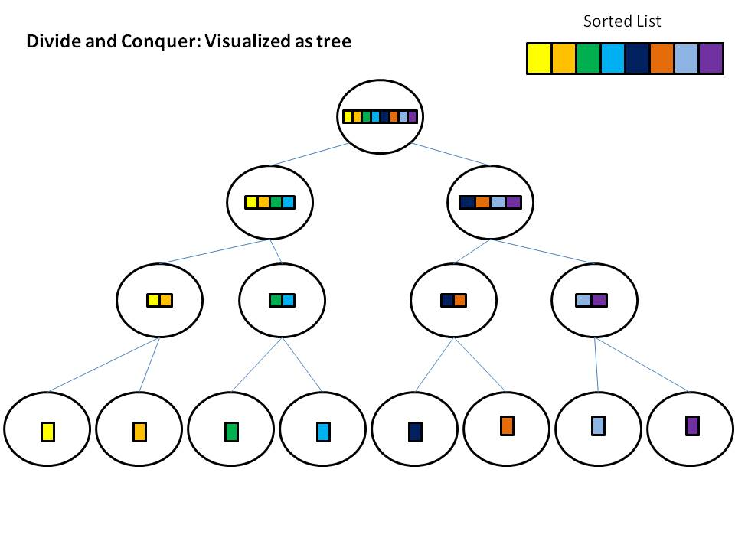
Example: Binary Search Tree
When searching for data in a list
Performing a sequential search yielded a worst case complexity of O(n)
Note: when employing binary search we were able to achieve a significant reduction O(log n)
REMEMBER: This was achieved by employing a divide and conquer scheme – this process can be visualized as a decision tree
We can achieve a similar result when explicitly using a tree structure as well! (in some cases)

Slide 10
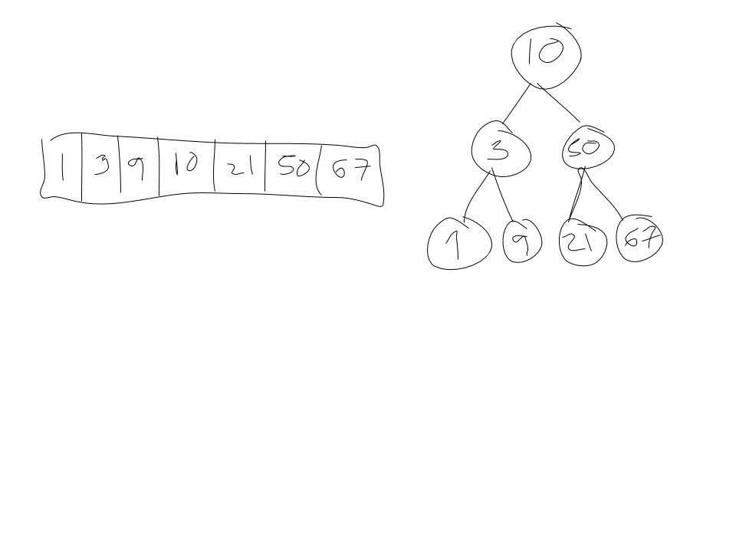
Binary Search Tree: Binary Search using a Tree
The data stored in each node is referred to as the key.
Binary Search Tree is a binary tree where, for each node n all the keys in the left subtree are less than the key of n, and all keys in the right subtree are greater than the key at n.
Note that we get a similar traversal by using an explicit BST or a sorted array using binary search

Slide 11
Binary Search Tree
Search Binary Search Tree for key i.
How should we traverse the tree: DF-like or BF-like?
Note, there is no need to “backtrack” so we do not need a stack
$$function search\left(root, i\right)$$
$thisNode ≔root$ $while\left( thisNode !=NULL\right)$ $if\left(i> thisNode.key\right)$ // go to right subtree
$thisNode ≔thisNode.rightChild$ $elseif\left(i< thisNode.key\right)$ // go to left subtree
$thisNode ≔thisNode.leftChild$ else // $i== thisNode.key$
return thisNode
return NULL; // not found

Slide 12
BST: Insert
$$function insert\left(root, i\right)$$
$thisNode ≔root$ $while\left( thisNode !=NULL\right)$ $if\left(i> thisNode.key\right)$ // go to right subtree
$if rightChild not null, thisNode ≔thisNode.rightChild$
$else, thisNode.rightChild:=new Node(i)$ $elseif\left(i< thisNode.key\right)$ // go to left subtree
$if leftChild not null, thisNode ≔thisNode.leftChild$
$else, thisNode.leftChild:=new Node(i)$ else // $assume unique items$: do not add
Worse Case Time Complexity: O(h), where h is the height of the tree.
… but what is this in terms of the number of nodes n?
This depends on the structure of the tree. (More discussion later.)

Slide 13
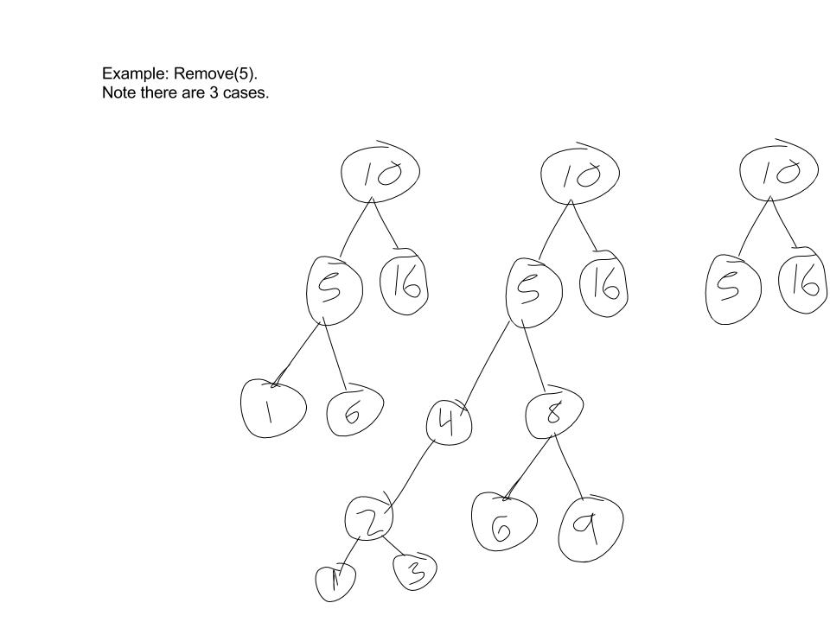
BST: Remove
Removing Nodes from a BST is a bit more difficult. We must assure the resulting structure a valid BST.
Removing a node may create a “disconnected” tree – not valid!
The node we remove may have 0,1 or 2 children.
Cases 0 and 1 are fairly simple.
Case 0: deletion requires no further action
Case 1: connect child to deleted nodes parent
Case 2: ?
Time Complexity: O(h), where h is the height of the tree. In terms of the size of the tree (the number of nodes in the tree), what is the worst case complexity? What is the best case complexity?

Slide 14
BST: Remove
Example Remove 5.
Note this is case 2. Removed node has two children
Which node should replace 5?
Max value is left subtree or min value in right subtree.
Note we cannot simply remove the min value from the right subtree as this may also create a disconnect. How can we create a general solution.
Observe: if node m is the min value in the right subtree, it will not have a left child (removal of this item is simple: case 1)
First, we define a method to remove the min value from a tree (below), then we can define a method to remove any node from a tree
$$function removeMin\left(parent,node\right)$$
// removes node, but does not delete, returns ptr instead;
$if\left( node!=NULL\right)$ $if\left(node.leftChild !=NULL\right)$ // go to leftmost child in right subtree
$return removeMin(node, node.leftChild)$ else // min val
$parent.leftChild=node.rightChild$ // removes root from tree (case 1)
return node
else // subtree is empty: incorrect use of function
return NULL

Slide 15
BST: Remove
$$function remove\left( \&root,item\right)$$
$if\left( root!=NULL\right)$ $if\left(root.key<item \right)$ // go to right subtree
$remove(root.rightChild, item)$ $else if\left(root.key>item \right)$ // go to left subtree
$remove(root.left, item)$ $else if \left(root.leftChild !=NULL \&\&root.rightChild !=NULL\right)$
// node found – two children (case 2)
// remove min of right subtree and copy its value into root
$Node minRightSubtree :=removeMin\left(root,root.rightChild\right)$
$root.key :=minRightSubtree.key$ // copy other data as needed
$delete minRightSubtree$
else // node to remove only has 0 or 1 child
$trash≔root$
$if\left(root.leftChild !=NULL\right)$
$root≔root.leftChild$ // copy other data as needed
$else$
$root≔root.rightChild$ // copy other data as needed
$delete trash$
else // subtree is empty: item not found?
Note:
Must account for all cases. Uses helper function removeMin to find min value in right subtree.
Time Complexity?
How many recursive function calls (iterations) will occur in the
Best case?
Worst case?
Note
Root is passed in by reference

Slide 16
BST: Complexity Analysis
For insert and remove, where n = number of nodes:
Best case: O(1)
Item searched for is at root
Worst case: O(n)
Worst Case: Item is at leaf node.
Different worst cases for different tree structures
If n = h. Worst case O(n)
If n = log(h). Worst case is O(log n)
Observe the worst case is still O(n) which is not necessarily an improvement over using a standard list. In fact, the worst case binary tree is a list.
Is complexity reduced on average when using a tree? What is the average case complexity?
For a tree with n nodes, there are many different cases that will affect search complexity. These different cases correspond to the different possible tree structures given n nodes. We can attempt to compute the approx. computation steps for all cases and take the average … but how?

Slide 17
BST search: Average Case with proof
Given a tree structure, How do we compute the average search time?
Two major factors that result in different step counts:
Structure of tree
Depth of searched item in tree
Assume T_{n} is the set of all possible tree structures with n nodes and $t∈T_{n}$ is one such structure.
Assume N is the set of all nodes in the tree.
Average step count for tree structure t with n nodes
$averageStepCount_{t}= \frac{\sum_{n_{i}∈N }{stepCount_{t}(n_{i})}}{n}$

Slide 18
Using IPL to Compute Average Case
Average step count (assuming each tree structure is equally likely) is
$averageStepCount=\frac{\sum_{t∈T_{n}}{averageStepCount_{t}}}{|T_{n}|}$
However computing this value for all possible tree structures iteratively, may be tedious. If we can define this in terms of a recurrence for any tree structure, we can simplify the computation.
To simplify the computation, we define the Internal Path Length (IPL) of a binary tree t with n nodes:
Conceptually this is simply the sum of the depths of all of its nodes, which is proportional to step count for a search operation.
Observe, the IPL can be computed given a tree structure t
$$averageIPL=\frac{\sum_{t∈T_{n}}{{IPL}_{t}}}{|T_{n}|}$$

Slide 19
Define recurrence to compute averageIPL
Determine a recurrence
Define function D(n) to be the averageIPL for a tree of n nodes.
An n-node tree has a root and two subtrees: one with i nodes (left) and one (right) with n - i -1 nodes.
Here we use i to constrain the tree structure at each stage of the recurrence. And we assume each tree structure is equally likely, and thus each i chosen is equally likely
For a given i, D(i) is the average internal path length for the left subtree (for a tree of i nodes).
Big Picture: If we average over i, we effectively average over tree configurations
$D\left(n\right)=n−1+D\left(i\right)+D(n−i−1)$
The root contributes 1 to the path length of each of the remaining n-1 nodes (for a total of n-1).
Average over all possible i, $0≤i≤n−1$ (over subtree configurations)
$D\left(n\right)=n−1+2∗\frac{D\left(0\right)+D\left(1\right)+D\left(2\right)+…+D\left(n−1\right)}{n}=n−1+\frac{2}{n}\sum_{i=1}^{n−1}{D(i)}$
Note: This recurrence is difficult to evaluate since D(n) is in terms of all of ALL of its predecessors in the recurrence.

Slide 20
Solving averageIPL recurrence
Recurrence is difficult to compute since the n^{th} term contains ALL previous terms
n$D\left(n\right)=n(n−1)+2∗\frac{D\left(0\right)+D\left(1\right)+D\left(2\right)+…+D\left(n−1\right)}{1}$
$$(n−1)D\left(n−1\right)=(n−1)(n−2)+2∗\frac{D\left(0\right)+D\left(1\right)+D\left(2\right)+…+D\left(n−2\right)}{1}$$
Subtracting equations we arrive at the following equation:
$$nD\left(n\right)−(n−1)D\left(n−1\right)=2n+2+2∗D(n−1)$$
$nD\left(n\right)=2n+(n+1)D(n−1)$ , rearranging terms, and ignoring constants
$$\frac{D\left(n\right)}{n+1}=\frac{D\left(n−1\right)}{n}+\frac{2}{n+1}$$
Telescoping these terms we have
$$\frac{D\left(n\right)}{n+1}=\frac{D\left(n−1\right)}{n}+\frac{2}{n+1}$$
$$\frac{D\left(n−1\right)}{n}=\frac{D\left(n−2\right)}{n−1}+\frac{2}{n}$$
$$\frac{D\left(n−2\right)}{n−1}=\frac{D\left(n−3\right)}{n−2}+\frac{2}{n−1}$$
…
$$\frac{D\left(2\right)}{3}=\frac{D\left(1\right)}{2}+\frac{2}{3}$$
$$\frac{D\left(1\right)}{2}=\frac{D\left(0\right)}{1}+\frac{2}{2}$$
D(0) = 0
Try to manipulate equation to solve for 1st order recurrence (only 1 previous term).
Start by multiplying both sides by n.
Next, derive equation for (n-1)^{st} term and subtract. (common “trick”)
Dividing both side by n(n+1) , by experience, we know this will simplify the next step by clearly flushing out a harmonic series
Next, Solve recurrence by summing telescoping terms. Observe there are many cancellations and we get a closed form for D(n).

Slide 21
BST search: Average case using averageIPL recurrence
We can now compute the value of each term in the recurrence, via sequential substitution. The result is a sum including previous terms.
$\frac{D\left(n\right)}{n+1}=\frac{D\left(1\right)}{2}+2∗(\frac{1}{2}+\frac{1}{3}+…+\frac{1}{n+1})$ , we add and subtract (2) to the RHS to rearrange the terms in the sum to match a harmonic series
$\frac{D\left(n\right)}{n+1}=1 +2∗\left(1+\frac{1}{2}+ \frac{1}{3}+\frac{1}{4}+…+\frac{1}{n+1}\right) −2$
$\frac{D\left(n\right)}{n+1}=2∗\left(1+\frac{1}{2}+ \frac{1}{3}+\frac{1}{4}+…+\frac{1}{n+1}\right) −1$ , using harmonic series inequality we have
$\frac{D\left(n\right)}{n+1}=2∗\left(1+\frac{1}{2}+ \frac{1}{3}+\frac{1}{4}+…+\frac{1}{n+1}\right) −1≤2∗log⁡(n)$ +1
$D\left(n\right)≤\left(n+1\right)(2\log\left(n\right)+1)$
Thus D(n) is $O(n log(n))$
Use Fact: Harmonic Series
$$\sum_{i=1}^{n}{\frac{1}{i}≤log⁡(n)+1}$$

Slide 22
BST search: Average Case
Final Step:
Thus D(n) is $O(n log⁡(n))$
D(n) is the sum of the depths for all nodes. Thus the average depth (proportional to the average search/traversal time) for a tree with n nodes is $O\left(n log⁡(n)\right)/$n which is $O\left(log⁡(n)\right)$

Slide 23
Why Use Binary Trees?
What is gained with the use of a tree?
The average case for standard operations is O(log n)
BUT the worst case is still O(n)
Can we do better?
Yes! The worst case and others like it are O(n). Why? Because the height of the tree is approximately equal to n, the number of nodes (the tree is list-like).
If we add constraints that limit the depth of the tree we can eliminate these cases.
Balanced Trees …

