Slide 1
COSC160: Data Structures
Matrices
Jeremy Bolton, PhD
Assistant Teaching Professor

Slide 2
Outline
Case Study: Matrices and Sparse Matrices

Slide 3
Case Study: Matrix Structure
Design Matrix Class, to help facilitate basic mathematical matrix operations
  Design Notes:
    Matrix contains real numbers in each entry
    Matrix Addition
    Matrix Transpose
    Matrix Multiplication

Slide 4
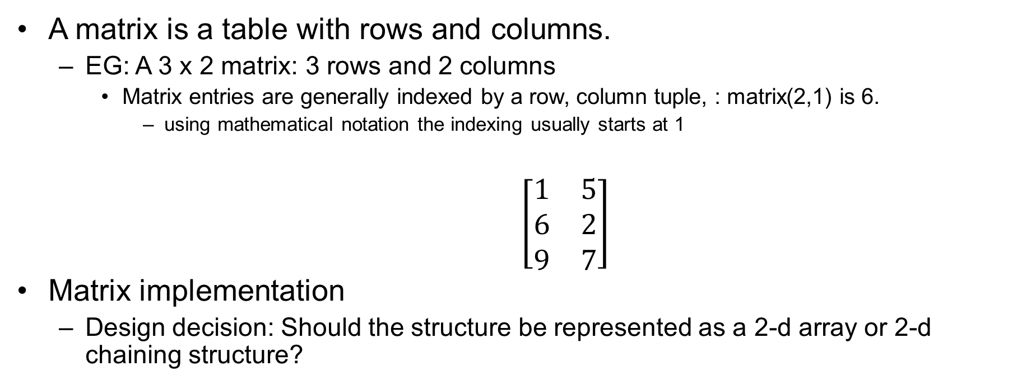
Matrices
A matrix is a table with rows and columns.
  EG: A 3 x 2 matrix: 3 rows and 2 columns
    Matrix entries are generally indexed by a row, column tuple, : matrix(2,1) is 6.
      using mathematical notation the indexing usually starts at 1
$\left[\begin{matrix}1 & 5 \\ 6 & 2 \\ 9 & 7\end{matrix}\right]$
Matrix implementation
  Design decision: Should the structure be represented as a 2-d array or 2-d chaining structure?

Slide 5
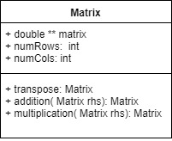
Matrix Implementation (UML)
Intuitively, we can use a 2-d array to implement a matrix.
  Thus we can access ith row and jth col: m[i-1][j-1].
  We can design a Matrix class with
    member variables
      double ** matrix // or use template
      int numRows
      int numCols
    member methods
      Matrix add(Matrix op);
      Matrix transpose();
      Matrix multiply(Matrix op);

Slide 6
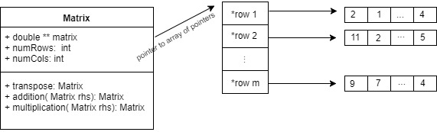
Why is our member a pointer to a pointer?
Matrix member: double ** matrix;
  Size of matrix is variable. Thus our we can implement a matrix as a pointer to an array of pointers.
  Many programming languages also allow you to simply allocate a multi-dimensional array with one instruction: matrix[numRows][numCols]
    Question: Will this matrix need to be allocated on the heap?

Slide 7

Matrix Transpose
Mathematically
  $$∀_{i,j}{ M}_{i,j}^{T}=M_{j,i}^{}$$
Code Snippet
Analysis (also practical)
  Time?
  Space?
    Note: thrashing may be unavoidable
  Comments?
  Can we improve?
    With some pointer arithmetic, we could do an in-place swap as the correct number of locations are indeed allocated … but would we want to manipulate the calling object … ?
Notes:
\documentclass[12pt]{exam}
\usepackage[utf8]{inputenc}
\usepackage[margin=1in]{geometry}
\usepackage{amsmath,amssymb,amsfonts}
\usepackage{multicol}
\usepackage{algorithm}
\usepackage[noend]{algpseudocode}
\makeatletter
\def\BState{\State\hskip-\ALG@thistlm}
\makeatother
\begin{document}
\begin{algorithm}[H]
\caption{
\label{no:label}}
\begin{algorithmic}[hhh!]
\Require{keyword `this' is used to refer to calling Matrix object}
% \State
\Function{transpose}{$this$}
\State $cols \gets this \rightarrow numRows$
\State $rows \gets this \rightarrow numCols$
\State $trans \gets $ initialize new Matrix rows x cols
\For{$i \gets 1 \textrm{ to } rows$}
\For{$j \gets 1 \textrm{ to } cols$}
%\If{$X[j-1] > X[j]$}
\State $trans \rightarrow matrix[i][j] \gets this \rightarrow matrix[j][i]$
%\EndIf
\EndFor
\EndFor
\State \Return{$trans$}
\EndFunction
\end{algorithmic}
\end{algorithm}
\end{document}

Slide 8
Implementation Notes: row major vs. col major
Some matrix operations can be fairly inefficient when the matrices become very large
  Remember:
    Memory / Caching issues can compound this issue (severely!)
    Thrashing
How might we mitigate these issues when implementing an add algorithm?
  Traverse the matrices smartly

Slide 9

Matrix Add
Mathematically
  $${C=A+B ≡ ∀}_{i,j}{ c}_{i,j}^{}=a_{i,j}^{}+b_{i,j}^{}$$
Pseudocode
Analysis
  Space (also practical):
    Pass by reference or pass by copy? Heap or Stack Allocation?
    If allocation on the heap, there must be an infrastructure in place to deallocate this matrix when necessary.
    O(row x col)
  Time:
    O(row x col)
Notes:
\documentclass[12pt]{exam}
\usepackage[utf8]{inputenc}
\usepackage[margin=1in]{geometry}
\usepackage{amsmath,amssymb,amsfonts}
\usepackage{multicol}
\usepackage{algorithm}
\usepackage[noend]{algpseudocode}
\makeatletter
\def\BState{\State\hskip-\ALG@thistlm}
\makeatother
\begin{document}
\begin{algorithm}[H]
\caption{
\label{no:label}}
\begin{algorithmic}[hhh!]
\Require{keyword `this' is used to refer to calling Matrix object}
% \State
\Function{addition}{Matrix this, Matrix rhs}
\State $rows \gets this \rightarrow numRows$
\State $cols \gets this \rightarrow numCols$
\State $result \gets $ initialize new Matrix rows x cols
\For{$i \gets 1 \textrm{ to } rows$}
\For{$j \gets 1 \textrm{ to } cols$}
%\If{$X[j-1] > X[j]$}
\State $result \rightarrow matrix[i][j] \gets (this \rightarrow matrix[i][j]) + (rhs \rightarrow matrix[i][j]) $
%\EndIf
\EndFor
\EndFor
\State \Return{$result$}
\EndFunction
\end{algorithmic}
\end{algorithm}
\end{document}

Slide 10
Matrix Multiply
Try this exercise at home: implement matrix multiply

Slide 11
Summary: Analysis of Matrix Example
Implementation Decisions and Repercussions
  Implemented as 2-d array
    Provides for efficient storage and retrieval (assuming size won’t change)
  ADD Algorithm scans assuming row-major memory storage
    Knowledge of underlying memory details allows for efficient traversal (not improvement in complexity analysis, but improvement in practical application)
    Transpose?
      May require swap of values at different ends of matrix which can cause caching delays.
  If new matrices resulting from operations are allocated on the heap …
    Presents deallocation issues and memory concerns. Probably best to use OOP practices.
    Trade off
      Reliability: keep the object itself “light weight” (use pointers for members as needed), and manage memory deallocation with the implicit call to the destructor (when the objects scope is destroyed)
      Cost: potential unnecessary copy (likely by copy constructor)
Time and Space analyses
  Operations are efficient and on the order of the minimal number of operations necessary to complete the computations

Slide 12
Case Study: Sparse Matrix Structure
Lengthy processing times for large matrices are sometimes unavoidable
  Each operation requires some minimum amount of computation
In some scenarios, a matrix may have a “small” number of non-zero entries.
  Such matrices are called sparse matrices.
    Adding and multiplying with zero is trivial.
  If we can find an efficient representation of a sparse matrix which does not require the traversal of zero-valued entries, we can improve the computational complexity.

Slide 13
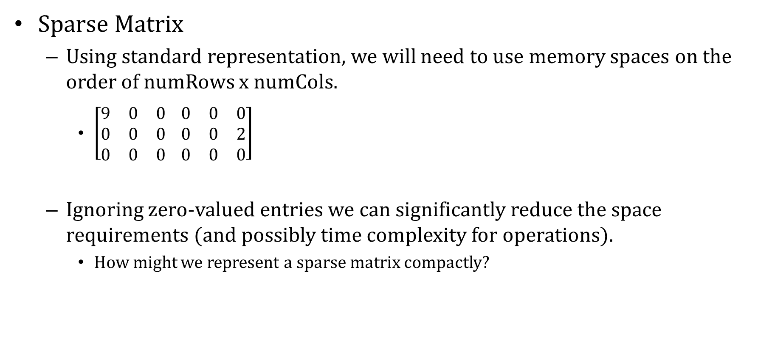
Sparse Matrices
Sparse Matrix
  Using standard representation, we will need to use memory spaces on the order of numRows x numCols.
    $\left[\begin{matrix}9 & 0 & 0 \\ 0 & 0 & 0 \\ 0 & 0 & 0\end{matrix} \begin{matrix}0 & 0 & 0 \\ 0 & 0 & 2 \\ 0 & 0 & 0\end{matrix}\right]$
  Ignoring zero-valued entries we can significantly reduce the space requirements (and possibly time complexity for operations).
    How might we represent a sparse matrix compactly?

Slide 14
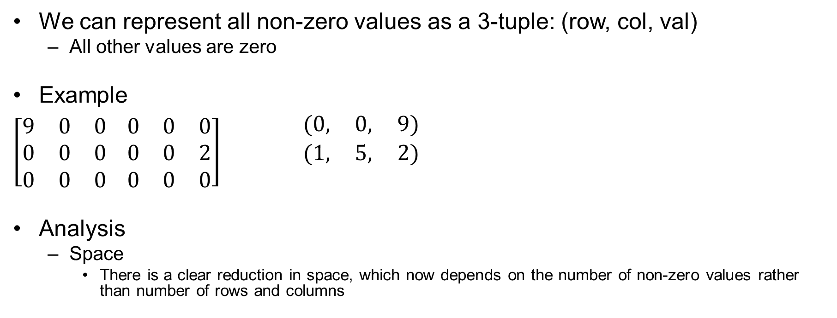
Sparse Matrices
We can represent all non-zero values as a 3-tuple: (row, col, val)
  All other values are zero
Example
$\left[\begin{matrix}9 & 0 & 0 \\ 0 & 0 & 0 \\ 0 & 0 & 0\end{matrix} \begin{matrix}0 & 0 & 0 \\ 0 & 0 & 2 \\ 0 & 0 & 0\end{matrix}\right]$ $\begin{matrix}(0, & 0, & 9) \\ (1, & 5, & 2) \\ & & \end{matrix}$
Analysis
  Space
    There is a clear reduction in space, which now depends on the number of non-zero values rather than number of rows and columns
Row Col Val

Slide 15
Sparse Matrices
Consider, when designing a data structure, Form Follows Function
Investigate the various operations (functions) needed.
Based on your investigation you can identify which design decisions will lead to more efficient implementations
  Contiguous vs non-Contiguous allocation
    May affect space and/or time complexity (of operations)
  Assumptions or requirements concerning the VALID STATE(S) of the data structure
    Imposing certain requirements may improve time and/or space complexity

Slide 16
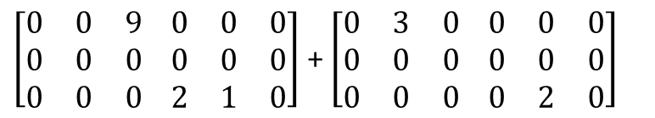
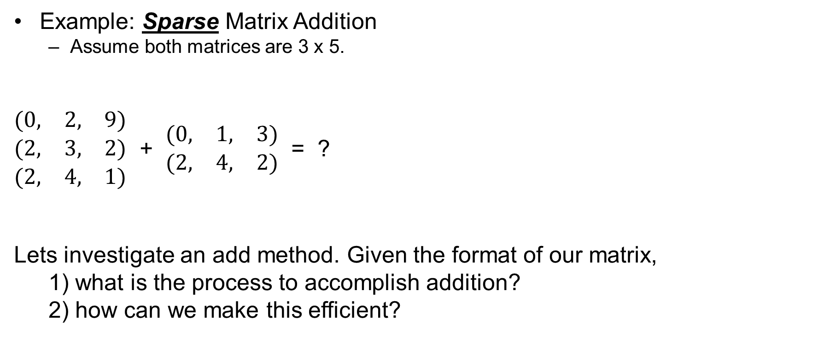
Sparse Matrix: Addition
Example: Sparse Matrix Addition
  Assume both matrices are 3 x 5.
$\begin{matrix}(0, & 2, & 9) \\ (2, & 3, & 2) \\ (2, & 4, & 1)\end{matrix}$ + $\begin{matrix}(0, & 1, & 3) \\ (2, & 4, & 2)\end{matrix}$ = ?
Lets investigate an add method. Given the format of our matrix,
1) what is the process to accomplish addition?
2) how can we make this efficient?
Actual Matrices
$\left[\begin{matrix}0 & 0 & 9 \\ 0 & 0 & 0 \\ 0 & 0 & 0\end{matrix} \begin{matrix}0 & 0 & 0 \\ 0 & 0 & 0 \\ 2 & 1 & 0\end{matrix}\right]$ + $\left[\begin{matrix}0 & 3 & 0 \\ 0 & 0 & 0 \\ 0 & 0 & 0\end{matrix} \begin{matrix}0 & 0 & 0 \\ 0 & 0 & 0 \\ 0 & 2 & 0\end{matrix}\right]$
Sparse Matrix Representations

Slide 17
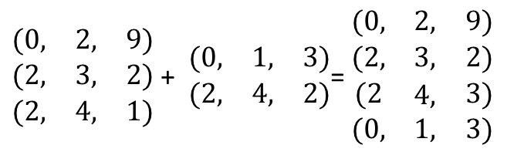
Sparse Matrix Addition (version 1)
Goal: c = a + b
Pseudocode Idea:
  For each row in a, check all rows in b for a match.
    Case 1: if b has a term at same index,
      then create a new term, add a and b val and append to c.
    Case 2: b does not have a matching term
      Append the a-term to c
  For each row in b, check all rows in a for match.
    Case 1: if a has a term at same index,
      Do nothing! Term should already be added.
    Case 2: b does not have a matching term
      Append the b-term to c
Time complexity analysis?
  Embedded looping structure.
  O(numTermsA x numTermsB)
  Can we do better?
$\begin{matrix}(0, & 2, & 9) \\ (2, & 3, & 2) \\ (2, & 4, & 1)\end{matrix}$ + $\begin{matrix}(0, & 1, & 3) \\ (2, & 4, & 2)\end{matrix}$= $\begin{matrix}(0, & 2, & 9) \\ (2, & 3, & 2) \\ \begin{aligned}(2 \\ (0,\end{aligned} & \begin{aligned}4, \\ 1,\end{aligned} & \begin{aligned}3) \\ 3)\end{aligned}\end{matrix}$
  ALSO NOTE: If we choose array implementation, we will need to allocate c before we begin the appending. How can we get this accomplished?

Slide 18
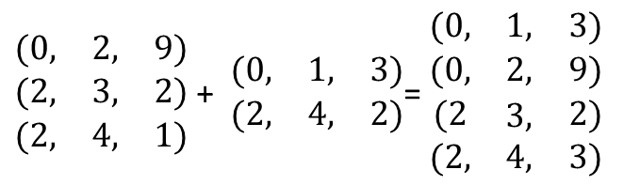
Sparse Matrix Addition (version 2)
Goal: c = a + b
Improvement: If we require the tuples to be ordered, we can simplify the traversal scheme and reduce computation .
Since the matrices are sorted by rows (and then cols), the result is a “row major” order, and thus we can sequentially scan each matrix simultaneously (illustrated with arrows). No embedded iteration! There will be 3 cases per iteration.
  Case 1: The current term in a is earlier in the matrix than the current b term.
    Result: append the a-term to c
  Case 2: The current term in b is earlier in the matrix than the current a term.
    Result: append the b-term to c
  Case 3: The current terms for a and b have the same index.
    Result: Add the values of a and b and append the new term to c
Time Complexity?
  Traverse each structure only once!
  O(numTermsA + numTermsB)
  How does this compare to non-sparse matrix implementation?
  When does it become “useful” to use sparse implementation
  as opposed to standard implementation?
$\begin{matrix}(0, & 2, & 9) \\ (2, & 3, & 2) \\ (2, & 4, & 1)\end{matrix}$ + $\begin{matrix}(0, & 1, & 3) \\ (2, & 4, & 2)\end{matrix}$= $\begin{matrix}(0, & 1, & 3) \\ (0, & 2, & 9) \\ \begin{aligned}(2 \\ (2,\end{aligned} & \begin{aligned}3, \\ 4,\end{aligned} & \begin{aligned}2) \\ 3)\end{aligned}\end{matrix}$
  Again note : If we choose array implementation, we will need to allocate c before we begin the appending. How can we get this accomplished?

Slide 19
Sparse Matrix Data Structure
Investigation of our matrix representation
Maintaining a valid state of a data structure
  Many matrix operations depend on the scanning of rows and columns, maintaining our structure such that it is ordered by row scan (or col) will improve efficiency of operations.
  This State will need to be maintained (and possibly checked) for all operations.
  State of Data Structure (design decision):
    A list of 3-tuples,
    As we have seen, it is beneficial to keep the terms in order (order by row-scan)
    Design decision: array or chain … lets investigate.
      Form Follows Function

Slide 20
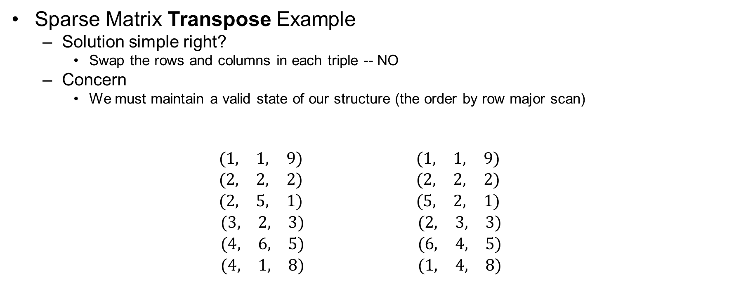
Sparse Matrices
Sparse Matrix Transpose Example
  Solution simple right?
    Swap the rows and columns in each triple -- NO
  Concern
    We must maintain a valid state of our structure (the order by row major scan)
  $$\begin{aligned}\begin{matrix}(1, & 1, & 9) \\ (2, & 2, & 2) \\ (2, & 5, & 1)\end{matrix} \\ \begin{matrix}(3, & 2, & 3) \\ (4, & 6, & 5) \\ (4, & 1, & 8)\end{matrix}\end{aligned} \begin{aligned}\begin{matrix}(1, & 1, & 9) \\ (2, & 2, & 2) \\ (5, & 2, & 1)\end{matrix} \\ \begin{matrix}(2, & 3, & 3) \\ (6, & 4, & 5) \\ (1, & 4, & 8)\end{matrix}\end{aligned}$$
Observe: Requiring order of tuples complicates the transpose operation. If total row scan order is maintained, then transpose can still be performed in linear time, with a minor increase of computational steps to maintain order.
Row Col Val
Row Col Val
transpose

Slide 21


Sparse Matrix Transpose (version 1)
Goal b = a^{T}
Pseudocode idea:
  For each column c in a
    For each term in a
      Identify each term in column c, swap row and col values, and add term to b.
      Note: order should be maintained using standard sequential scan.
Time Complexity
  O(numTerms * numColumns)
  Can we do better?
a
b
$$\begin{aligned}\begin{matrix}(1, & 1, & 9) \\ (2, & 2, & 2) \\ (2, & 5, & 1)\end{matrix} \\ \begin{matrix}(3, & 2, & 3) \\ (4, & 6, & 5) \\ (4, & 1, & 8)\end{matrix}\end{aligned}$$
$$\begin{aligned}\begin{matrix}(1, & 1, & 9) \\ (1, & 4, & 8) \\ (2, & 2, & 2)\end{matrix} \\ \begin{matrix}(2, & 3, & 3) \\ (5, & 2, & 1) \\ (6, & 4, & 5)\end{matrix}\end{aligned}$$

Slide 22


Sparse Matrix Transpose (version 2)
Goal b = a^{T}
Pseudocode idea (build jump table):
  For each term in a
    Count number of terms in each col.
  For each col c in a
    Construct jump table: Determine the start index for each row given count
  For each term in a
    Swap row and col values and add term to be using correct order determined by jump table
Jump Table requires direct access
  Array implementation
Time Complexity
  O(numTerms + numColumns)
  FAST!
a
b
$$\begin{aligned}\begin{matrix}(1, & 1, & 9) \\ (2, & 2, & 2) \\ (2, & 5, & 1)\end{matrix} \\ \begin{matrix}(3, & 2, & 3) \\ (4, & 6, & 5) \\ (4, & 1, & 8)\end{matrix}\end{aligned}$$
$$\begin{aligned}\begin{matrix}(1, & 1, & 9) \\ (1, & 4, & 8) \\ (2, & 2, & 2)\end{matrix} \\ \begin{matrix}(2, & 3, & 3) \\ (5, & 2, & 1) \\ (6, & 4, & 5)\end{matrix}\end{aligned}$$

Slide 23
Observations
Design Observations and Decisions.
  Ordering tuples
    Ordering tuples will reduce addition time complexity from quadratic to linear.
    This is worth the increase in time complexity for the transpose operation.
    Multiply?
    Decision: Yes to order!
  Chaining vs array
    Addition. Size of resulting sparse matrix is unknown until addition is performed. Thus array maybe twice as slow.
    Decision: Yes to chain!
For the sake of example, lets fully investigate chain vs array.

Slide 24
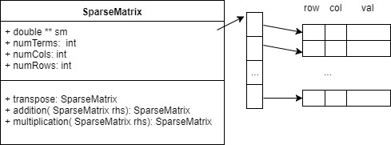
Sparse Matrices: Array Implementation

Slide 25
Array Implementation: Transpose
Sparse Matrix Transpose (version 1)
Notes:
\documentclass[12pt]{exam}
\usepackage[utf8]{inputenc}
\usepackage[margin=1in]{geometry}
\usepackage{amsmath,amssymb,amsfonts}
\usepackage{multicol}
\usepackage{algorithm}
\usepackage[noend]{algpseudocode}
\makeatletter
\def\BState{\State\hskip-\ALG@thistlm}
\makeatother
\begin{document}
\begin{algorithm}[H]
\caption{
\label{no:label}}
\begin{algorithmic}[hhh!]
\Require{keyword `this' is used to refer to calling SparseMatrix object}
% \State
\Function{transpose}{SparseMatrix this}
\State $numTerms \gets this \rightarrow numTerms$
\State $result \gets $ initialize new SparseMatrix numTerms by 3
\State $index \gets 1$
\For{$i \gets 1 \textrm{ to } this \rightarrow numCols$}
\For{$j \gets 1 \textrm{ to } numTerms$}
\If{$(X this \rightarrow sm[j][1]) == i$}
\State $result \rightarrow sm[index][0] \gets this \rightarrow sm[j][1] $
\State $result \rightarrow sm[index][1] \gets this \rightarrow sm[j][0] $
\State $result \rightarrow sm[index++][2] \gets this \rightarrow sm[j][2] $
\EndIf
\EndFor
\EndFor
\State \Return{$result$}
\EndFunction
\end{algorithmic}
\end{algorithm}
\end{document}

Slide 26
Array Implementation: Transpose
Sparse Matrix Transpose (version 2)
Build (initialize) jump table RowStart, based on counts of elements per column.
Use jump table. Determine each entries index into the transposed matrix using jump table
Notes:
\documentclass[12pt]{exam}
\usepackage[utf8]{inputenc}
\usepackage[margin=1in]{geometry}
\usepackage{amsmath,amssymb,amsfonts}
\usepackage{multicol}
\usepackage{algorithm}
\usepackage[noend]{algpseudocode}
\makeatletter
\def\BState{\State\hskip-\ALG@thistlm}
\makeatother
\begin{document}
\begin{algorithm}[H]
\caption{
\label{no:label}}
\begin{algorithmic}[hhh!]
\Require{keyword `this' is used to refer to calling SparseMatrix object}
% \State
\Function{transpose}{SparseMatrix this}
\State $numTerms \gets this \rightarrow numTerms$
\State $result \gets $ initialize new SparseMatrix numTerms
\State $rowSize \gets $ initialize new int array of length this $\rightarrow$ numCols
\State $rowStart \gets $ initialize new int array of length this $\rightarrow$ numCols
\For{$i \gets 0 \textrm{ to } this \rightarrow numTerms-1$}
\State $rowSize[ this \rightarrow sm[i][1] ] ++ $ // count num terms in each col
\EndFor
\For{$i \gets 0 \textrm{ to } this \rightarrow numCols-1$}
\State $rowStart[i] \gets rowStart[i-1] + rowSize[i-1] $ // determine index of rows
\EndFor
\For{$i \gets 0 \textrm{ to } numTerms - 1$}
%\If{$X[j-1] > X[j]$}
\State $j \gets rowStart[this \rightarrow sm[i,1]]$
\State $result \rightarrow sm[j][0] \gets this \rightarrow sm[i][1] $
\State $result \rightarrow sm[j][1] \gets this \rightarrow sm[i][0] $
\State $result \rightarrow sm[j][2] \gets this \rightarrow sm[i][2] $
\State $rowStart[this \rightarrow sm[i,1]] ++$
%\EndIf
\EndFor
\State \Return{$result$}
\EndFunction
\end{algorithmic}
\end{algorithm}
\end{document}

Slide 27
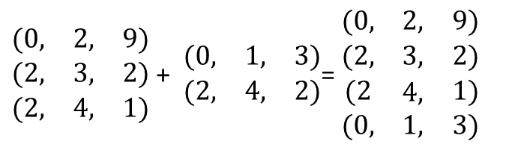
Array Implementation: Addition (version 1)
$\begin{matrix}(0, & 2, & 9) \\ (2, & 3, & 2) \\ (2, & 4, & 1)\end{matrix}$ + $\begin{matrix}(0, & 1, & 3) \\ (2, & 4, & 2)\end{matrix}$= $\begin{matrix}(0, & 2, & 9) \\ (2, & 3, & 2) \\ \begin{aligned}(2 \\ (0,\end{aligned} & \begin{aligned}4, \\ 1,\end{aligned} & \begin{aligned}1) \\ 3)\end{aligned}\end{matrix}$
Notes:
\documentclass[10pt]{exam}
\usepackage[utf8]{inputenc}
\usepackage[margin=1in]{geometry}
\usepackage{amsmath,amssymb,amsfonts}
\usepackage{multicol}
\usepackage{algorithm}
\usepackage[noend]{algpseudocode}
\makeatletter
\def\BState{\State\hskip-\ALG@thistlm}
\makeatother
\begin{document}
\begin{algorithm}[H]
\caption{
\label{no:label}}
\begin{algorithmic}[hhh!]
\Require{keyword `this' is used to refer to calling SparseMatrix object}
% \State
\Function{addition}{SparseMatrix this, Sparse Matrix rhs}
% \State $rows \gets this \rightarrow numRows$
% \State $cols \gets this \rightarrow numCols$
\State $numTerms \gets 0$
\State// Perform addition simply to count the number of resulting terms
\For{$i \gets 0 \textrm{ to } this \rightarrow numTerms-1$}
\For{$j \gets 0 \textrm{ to } rhs \rightarrow numTerms-1$}
\If{$this \rightarrow sm[i][0] == rhs \rightarrow sm[j][0] \hspace{10pt} \&\& \newline \indent \indent\indent this \rightarrow sm[i][1] == rhs \rightarrow sm[j][1] \hspace{10pt}$ }
\If{ $ this \rightarrow sm[i][2] + rhs \rightarrow sm[j][2] == 0 $}
\State Break
\Else
\State $numTerms ++$
\State Break
\EndIf
\EndIf
\If{ $j == rhs \rightarrow numTerms - 1$}
\State $numTerms ++$
\EndIf
\EndFor
\EndFor
\For{$j \gets 0 \textrm{ to } rhs \rightarrow numTerms-1$}
\For{$i \gets 0 \textrm{ to } this \rightarrow numTerms-1$}
\If{$this \rightarrow sm[i][0] == rhs \rightarrow sm[j][0] \hspace{10pt} \&\& \newline \indent \indent\indent this \rightarrow sm[i][1] == rhs \rightarrow sm[j][1] \hspace{10pt}$ }
\State // Do nothing. Term already counted.
\EndIf
\If{ $i == numTerms - 1$}
\State $numTerms ++$
\EndIf
\EndFor
\EndFor
\State $result \gets $ initialize new SparseMatrix numTerms
\State $ind \gets 0$
\State // Perform addition and construct result
\For{$i \gets 0 \textrm{ to } this \rightarrow numTerms-1$}
\For{$j \gets 0 \textrm{ to } rhs \rightarrow numTerms-1$}
\If{$ this \rightarrow sm[i][0] == rhs \rightarrow sm[j][0] \hspace{10pt} \&\& \hspace{10pt} this \rightarrow sm[i][1] == rhs \rightarrow sm[j][1] $}
\If{ $ this \rightarrow sm[i][2] + rhs \rightarrow sm[j][2] != 0 $}
\State $result \rightarrow sm[ind][0] \gets this \rightarrow sm[i][0] $
\State $result \rightarrow sm[ind][1] \gets this \rightarrow sm[i][1]$
\State $result \rightarrow sm[ind++][2] \gets this \rightarrow sm[i][2] + rhs
\rightarrow sm[j][2] $
\Else
\State Break // Do nothing, result of sum is zero
\EndIf
\EndIf
\If{ $j == rhs \rightarrow numTerms-1$} // no matching term in rhs, so add this term
\State $result \rightarrow sm[ind][0] \gets this \rightarrow sm[i][0] $
\State $result \rightarrow sm[ind][1] \gets this \rightarrow sm[i][1]$
\State $result \rightarrow sm[ind++][2] \gets this \rightarrow sm[i][2] $
\EndIf
\EndFor
\EndFor
\For{$j \gets 0 \textrm{ to } rhs \rightarrow numTerms-1$}
\For{$i \gets 0 \textrm{ to } this \rightarrow numTerms-1$}
\If{$this \rightarrow sm[i][0] == rhs \rightarrow sm[j][0] \hspace{10pt} \&\& \hspace{10pt} this \rightarrow sm[i][1] == rhs \rightarrow sm[j][1] $}
\State Break // term already appended
\EndIf
\If{ $i == numTerms - 1$}
\State $result \rightarrow sm[ind][0] \gets rhs \rightarrow sm[j][0] $
\State $result \rightarrow sm[ind][1] \gets rhs \rightarrow sm[j][1]$
\State $result \rightarrow sm[ind++][2] \gets rhs \rightarrow sm[j][2] $
\EndIf
\EndFor
\EndFor
\State \Return{$result$}
\EndFunction
\end{algorithmic}
\end{algorithm}
\end{document}

Slide 28
Array Implementation: Addition (version 2)
Notes:
\documentclass[10pt]{exam}
\usepackage[utf8]{inputenc}
\usepackage[margin=1in]{geometry}
\usepackage{amsmath,amssymb,amsfonts}
\usepackage{multicol}
\usepackage{algorithm}
\usepackage[noend]{algpseudocode}
\makeatletter
\def\BState{\State\hskip-\ALG@thistlm}
\makeatother
\begin{document}
\begin{algorithm}[H]
\caption{
\label{no:label}}
\begin{algorithmic}[hhh!]
\Require{keyword `this' is used to refer to calling SparseMatrix object}
% \State
\Function{addition}{SparseMatrix this, Sparse Matrix rhs}
% \State $rows \gets this \rightarrow numRows$
% \State $cols \gets this \rightarrow numCols$
\State $numTerms \gets 0$
\State// Perform addition simply to count the number of resulting terms
\State $i \gets 0$
\State $j \gets 0$
\While{$i < this \rightarrow numTerms \&\& j < rhs \rightarrow numTerms$}
\State $thisOrder \gets this \rightarrow sm[i][0] * this \rightarrow numCols + this \rightarrow sm[i][1]$
\State $rhsOrder \gets rhs \rightarrow sm[i][0] * rhs \rightarrow numCols + rhs \rightarrow sm[i][1]$
\If{$thisOrder < rhsOrder$} // this term is not in rhs
\State $numTerms ++$
\State $i ++$
\EndIf
\If{$thisOrder > rhsOrder$} // rhs term is not in this
\State $numTerms ++$
\State $j ++$
\EndIf
\If{$thisOrder == rhsOrder$} // matching terms
\If{$this \rightarrow sm[i][2] + rhs \rightarrow sm[i][2] != 0$}
\State $numTerms ++$
\EndIf
\State $i ++$
\State $j ++$
\EndIf
\EndWhile
\While{$i < this \rightarrow numTerms$}
\State $numTerms ++$
\State $i ++$
\EndWhile
\While{$j < rhs \rightarrow numTerms$}
\State $numTerms ++$
\State $j ++$
\EndWhile
\State $result \gets $ initialize new SparseMatrix numTerms
\State $ind \gets 0$
\State // Perform addition and construct result
\While{$i < this \rightarrow numTerms \&\& j < rhs \rightarrow numTerms$}
\State $thisOrder \gets this \rightarrow sm[i][0] * this \rightarrow numCols + this \rightarrow sm[i][1]$
\State $rhsOrder \gets rhs \rightarrow sm[i][0] * rhs \rightarrow numCols + rhs \rightarrow sm[i][1]$
\If{$thisOrder < rhsOrder$} // this term is not in rhs
\State $result \rightarrow sm[ind][0] \gets this \rightarrow sm[i][0] $
\State $result \rightarrow sm[ind][1] \gets this \rightarrow sm[i][1]$
\State $result \rightarrow sm[ind++][2] \gets this \rightarrow sm[i++][2] $
\EndIf
\If{$thisOrder > rhsOrder$} // rhs term is not in this
\State $result \rightarrow sm[ind][0] \gets rhs \rightarrow sm[j][0] $
\State $result \rightarrow sm[ind][1] \gets rhs \rightarrow sm[j][1]$
\State $result \rightarrow sm[ind++][2] \gets rhs \rightarrow sm[j++][2] $
\EndIf
\If{$thisOrder == rhsOrder$} // matching terms
\If{$this \rightarrow sm[i][2] + rhs \rightarrow sm[i][2] != 0$}
\State $result \rightarrow sm[ind][0] \gets this \rightarrow sm[i][0] $
\State $result \rightarrow sm[ind][1] \gets this \rightarrow sm[i][1]$
\State $result \rightarrow sm[ind++][2] \gets this \rightarrow sm[i++][2] + rhs \rightarrow sm[j++][2]$
\EndIf
\EndIf
\EndWhile
\While{$i < this \rightarrow numTerms$}
\State $result \rightarrow sm[ind][0] \gets this \rightarrow sm[i][0] $
\State $result \rightarrow sm[ind][1] \gets this \rightarrow sm[i][1]$
\State $result \rightarrow sm[ind++][2] \gets this \rightarrow sm[i++][2] $
\EndWhile
\While{$j < rhs \rightarrow numTerms$}
\State $result \rightarrow sm[ind][0] \gets rhs \rightarrow sm[j][0] $
\State $result \rightarrow sm[ind][1] \gets rhs \rightarrow sm[j][1]$
\State $result \rightarrow sm[ind++][2] \gets rhs \rightarrow sm[j++][2] $
\EndWhile
\State \Return{$result$}
\EndFunction
\end{algorithmic}
\end{algorithm}
\end{document}

Slide 29
Sparse Matrix: Array Implementation
Try Multiplication as an exercise at home
Notes:
  The result of the multiplication of two sparse matrices may not be sparse!
    Observe sparse matrix representations are not necessarily efficient when matrices are not sparse.
    The goal of sparse matrix representation is to improve efficiency. When does the sparse matrix representation lose its benefits?

Slide 30
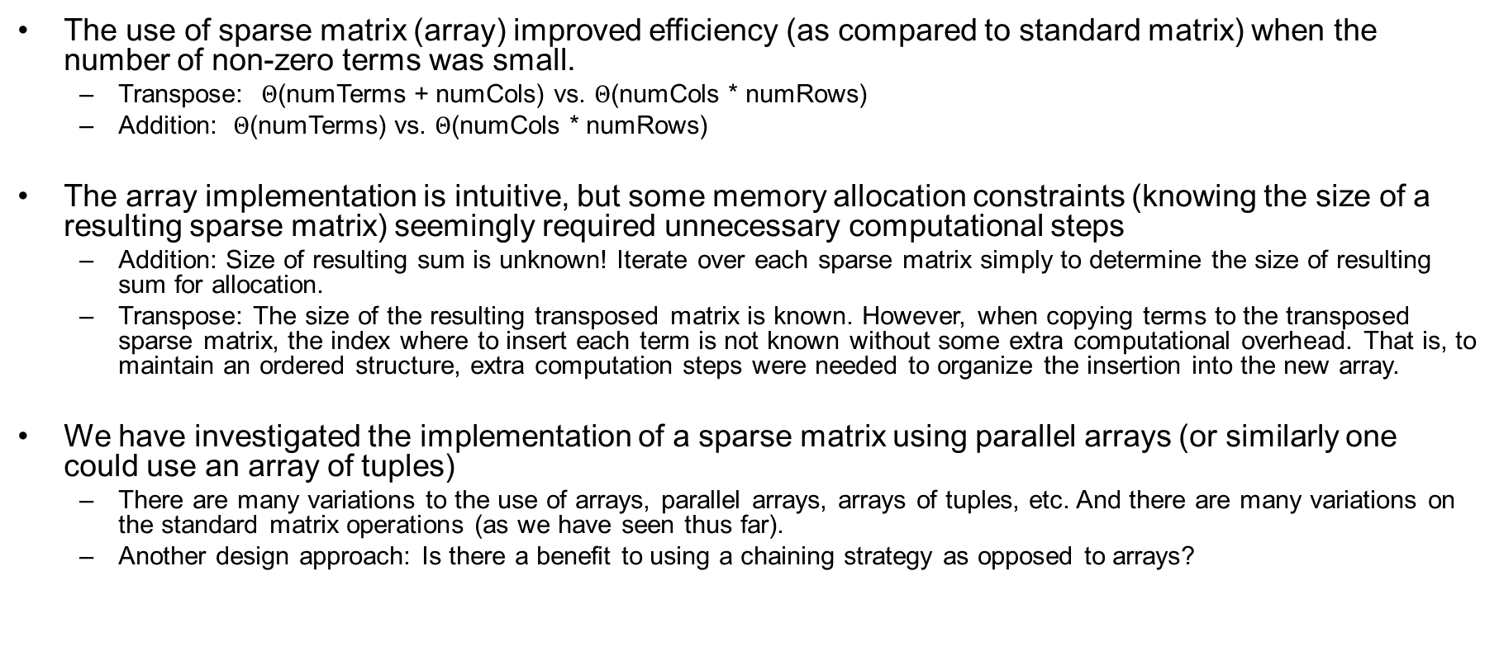
Sparse Matrices: Linked List Implementation
The use of sparse matrix (array) improved efficiency (as compared to standard matrix) when the number of non-zero terms was small.
  Transpose: $Θ$(numTerms + numCols) vs. $Θ$(numCols * numRows)
  Addition: $Θ$(numTerms) vs. $Θ$(numCols * numRows)
The array implementation is intuitive, but some memory allocation constraints (knowing the size of a resulting sparse matrix) seemingly required unnecessary computational steps
  Addition: Size of resulting sum is unknown! Iterate over each sparse matrix simply to determine the size of resulting sum for allocation.
  Transpose: The size of the resulting transposed matrix is known. However, when copying terms to the transposed sparse matrix, the index where to insert each term is not known without some extra computational overhead. That is, to maintain an ordered structure, extra computation steps were needed to organize the insertion into the new array.
We have investigated the implementation of a sparse matrix using parallel arrays (or similarly one could use an array of tuples)
  There are many variations to the use of arrays, parallel arrays, arrays of tuples, etc. And there are many variations on the standard matrix operations (as we have seen thus far).
  Another design approach: Is there a benefit to using a chaining strategy as opposed to arrays?

Slide 31
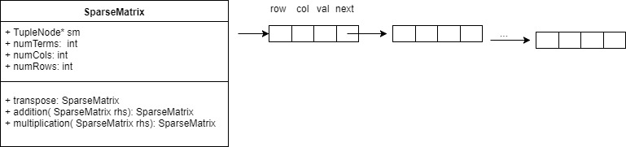
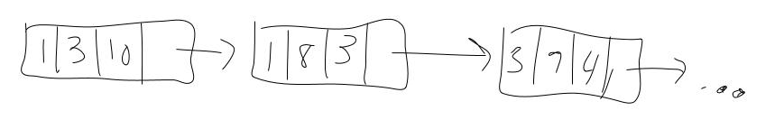
Chaining Design for Sparse Matrix
Option: Design each node to contain 3-tuple and a pointer to the next non-zero term in the matrix (in a row major scan).
  Efficiency note: We will not need to determine the size of the resulting sum before we can start adding terms. (Linked lists can grow dynamically!)

Slide 32
Sparse Matrix: Chaining
Example pseudocode for addition
  Time: Similar to array implementation but with one less pass over each a and b (for allocation size). Thus saving about ½ the computational steps.
  Memory: one extra pointer must be stored per term
Notes:
\documentclass[10pt]{exam}
\usepackage[utf8]{inputenc}
\usepackage[margin=1in]{geometry}
\usepackage{amsmath,amssymb,amsfonts}
\usepackage{multicol}
\usepackage{algorithm}
\usepackage[noend]{algpseudocode}
\makeatletter
\def\BState{\State\hskip-\ALG@thistlm}
\makeatother
\begin{document}
\begin{algorithm}[H]
\caption{
\label{no:label}}
\begin{algorithmic}[hhh!]
\Require{keyword `this' is used to refer to calling SparseMatrix object}
% \State
\Function{addition}{SparseMatrix this, Sparse Matrix rhs}
% \State $rows \gets this \rightarrow numRows$
% \State $cols \gets this \rightarrow numCols$
\State $result \gets $ initialize new SparseMatrix
\State $ thisIter \gets this \rightarrow sm $
\State $ rhsIter \gets rhs \rightarrow sm $
\While{$ thisIter \neq NULL \hspace{10pt} \&\& \hspace{10pt} rhsIter \neq NULL $}
\State $thisOrder \gets thisIter \rightarrow row * thisIter \rightarrow numCols + thisIter \rightarrow col$
\State $rhsOrder \gets rhsIter \rightarrow row * rhsIter \rightarrow numCols + rhsIter \rightarrow col$
\If{$thisOrder < rhsOrder$} // this term is not in rhs
\State $result .addTermToBack( thisIter ) $
\State $thisIter \gets thisIter \rightarrow next$
\EndIf
\If{$thisOrder > rhsOrder$} // rhs term is not in this
\State $result .addTermToBack( rhsIter ) $
\State $rhsIter \gets rhsIter \rightarrow next$
\EndIf
\If{$thisOrder == rhsOrder$} // matching terms
\State $result .addTermToBack( rhsIter ) $
\State $rhsIter \gets rhsIter \rightarrow next$
\State $thisIter \gets thisIter \rightarrow next$
\EndIf
\EndWhile
\While{$ thisIter \neq NULL $}
\State $result .addTermToBack( thisIter ) $
\State $thisIter \gets thisIter \rightarrow next$
\EndWhile
\While{$ rhsIter \neq NULL $}
\State $result .addTermToBack( rhsIter ) $
\State $rhsIter \gets rhsIter \rightarrow next$
\EndWhile
\State \Return{$result$}
\EndFunction
\end{algorithmic}
\end{algorithm}
\end{document}

Slide 33
Sparse Matrix: Chaining
Example pseudocode for a transpose method
  Time and Space analysis?
  Can we do better?
Notes:
\documentclass[10pt]{exam}
\usepackage[utf8]{inputenc}
\usepackage[margin=1in]{geometry}
\usepackage{amsmath,amssymb,amsfonts}
\usepackage{multicol}
\usepackage{algorithm}
\usepackage[noend]{algpseudocode}
\makeatletter
\def\BState{\State\hskip-\ALG@thistlm}
\makeatother
\begin{document}
\begin{algorithm}[H]
\caption{
\label{no:label}}
\begin{algorithmic}[hhh!]
\Require{keyword `this' is used to refer to calling SparseMatrix object}
% \State
\Function{transpose}{SparseMatrix this}
% \State $rows \gets this \rightarrow numRows$
% \State $cols \gets this \rightarrow numCols$
\State $result \gets $ initialize new SparseMatrix
\State $thisIter \gets this \rightarrow sm$
\While{$ thisIter \neq NULL $}
\State $result.insertInOrder( thisIter.swapRowAndCol() )$ // Time Complexity?
\State $thisIter \gets thisIter \rightarrow next$
\EndWhile
\State \Return{$result$}
\EndFunction
\end{algorithmic}
\end{algorithm}
\end{document}

Slide 34
Sparse Matrix: Chain
Transpose (version 2)
  Note:
    We used a jump table to construct a FAST (linear time) transpose for the array implementation
    BUT … Linked Lists (Chains) do not permit random (direct) access.
    One solution for Chain implementation which maintains similar linear time:
      Construct Array Representation of Sparse Matrix // O(numTerms)
      Perform Matrix version of transpose // O(numTerms + numCols)
      Construct Chain Sparse Matrix // O(numTerms)
      TOTAL: O(numTerms + numCols)
      Side Note: Here we solve a new problem by mapping the problem to a different domain for which a solution already exists. As long as the mapping (and inverse) has a time complexity less than the computed solution, this may be a reasonable approach.

Slide 35
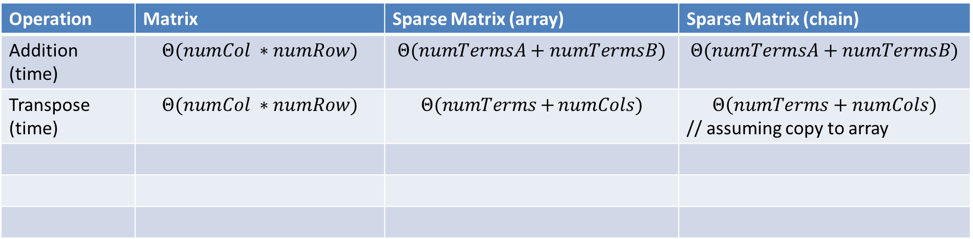
Matrix Representation Comparison
Operation | Matrix | Sparse Matrix (array) | Sparse Matrix (chain)
Addition (time) | $$Θ(numCol ∗numRow)$$ | $$Θ(numTermsA+numTermsB)$$ | $$Θ(numTermsA+numTermsB)$$
Transpose (time) | $$Θ(numCol ∗numRow)$$ | $$Θ(numTerms+{numCols})$$ | $$Θ\left(numTerms+numCols\right)$$ // assuming copy to array
Other:
  Addition: array implementation required twice as many computational steps to allocate memory efficiently
  Transpose: Sparse Matrix may also alleviate some cache delays as compared to Matrix

Slide 36
Project: Polynomials
Reminder: With the sparse matrix structure, we faced many structural design questions and subsequent algorithmic design questions, both of which affected efficiency. You will face similar design questions in your polynomial project.
Design a Representation (Data Structure) for Polynomials
  Goals:
    Polynomial evaluation
    Polynomial arithmetic
Class Project: Design Questions and Goals.
  Linked Chain vs Array Implementation?
  Goal: An efficient Solution (time and space)
    Algorithmic improvements for basic operations
    How can we increase efficiency: reduce computational complexity?
    When you make a design decision, document the reason why and justify in the cover letter.
    Use average and worst cases to make design decisions (not best case)

