Slide 1
COSC160: Data Structures
Linked Lists
Jeremy Bolton, PhD
Assistant Teaching Professor

Slide 2
Outline
Retrieval or Search in List Structures.
Imposing Order
  Order by frequency of access
    Using Expected Values for Average Case Analysis
    Order Heuristic: Move-To-Front
  Order by Value
    Another sorting example

Slide 3
Searching
When searching a list for an item, it may be necessary to traverse the entire list. We will investigate two simple speed-up schemes:
  We can improve search time with improved organization of the data in our structure
    Order based on data value
    Order based on frequency of access
list.search(item)

Slide 4
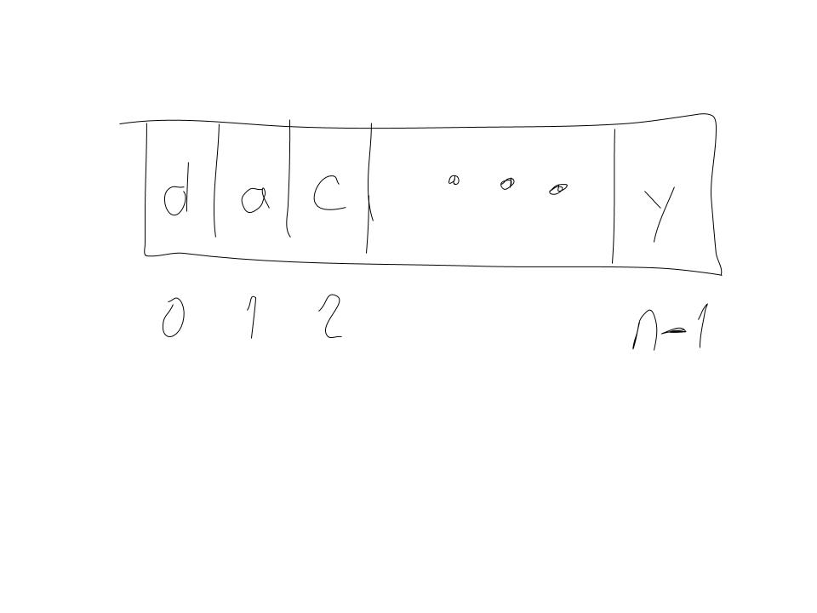
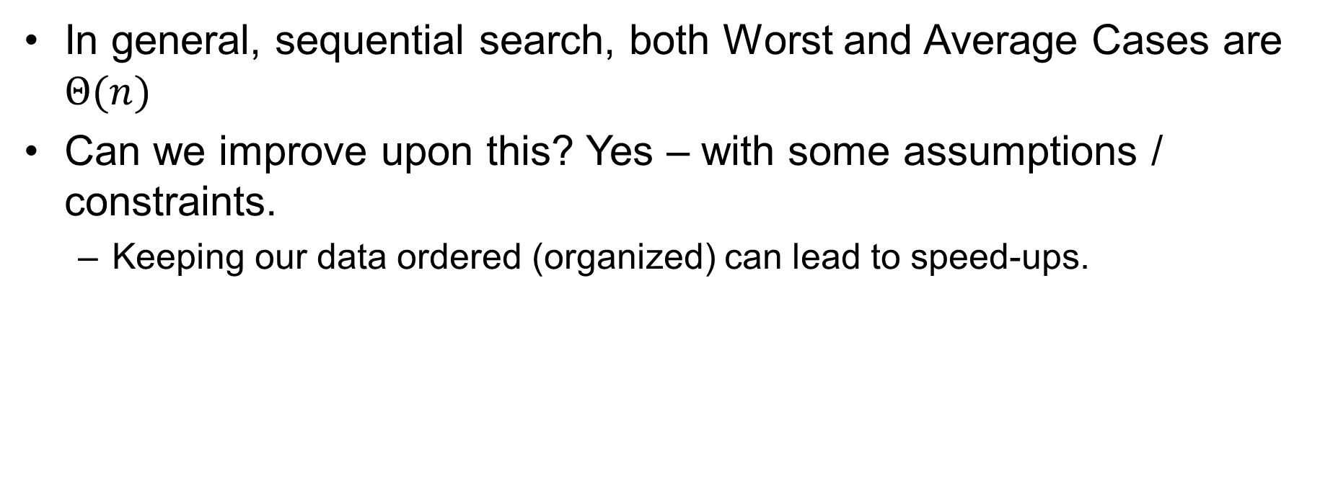
Search List: Worst and Average Case
In general, sequential search, both Worst and Average Cases are $Θ(n)$
Can we improve upon this? Yes – with some assumptions / constraints.
  Keeping our data ordered (organized) can lead to speed-ups.

Slide 5
Frequency Based Analysis
Order based on frequency of access.
Scenario: Assume you are designing a data structure to store records for an institution. Records are retrieved from time to time. Some records may be retrieved more often than others. Some records may be retrieved almost never.
Lets re-inspect the average case…

Slide 6

Average Case as Frequency Based Analysis
Average Case: Add up steps for all cases and divide by number of a cases.
Average number of comparisons $\frac{1+2+3+…+n}{n}$ is $Θ(n)$

Slide 7
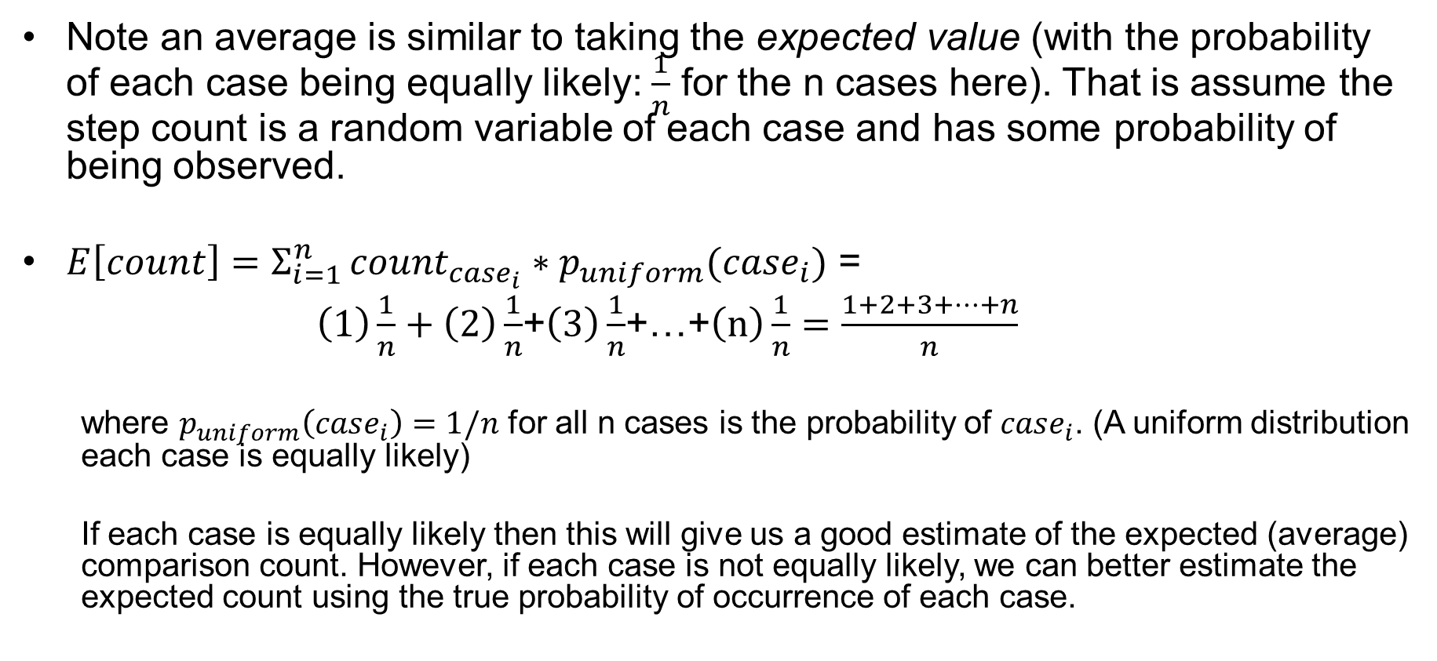
Using Expected Values for Average Case
Note an average is similar to taking the expected value (with the probability of each case being equally likely: $\frac{1}{n}$ for the n cases here). That is assume the step count is a random variable of each case and has some probability of being observed.
$E\left[count\right]=Σ_{i=1 }^{n}count_{case_{i}}∗p_{uniform}(case_{i})$ =
$\left(1\right)\frac{1}{n}+\left(2\right)\frac{1}{n}$+$\left(3\right)\frac{1}{n}$+…+$\left(n\right)\frac{1}{n}=\frac{1+2+3+…+n}{n}$
  where $p_{uniform}\left(case_{i}\right)=1/n$ for all n cases is the probability of $case_{i}$. (A uniform distribution each case is equally likely)
  If each case is equally likely then this will give us a good estimate of the expected (average) comparison count. However, if each case is not equally likely, we can better estimate the expected count using the true probability of occurrence of each case.

Slide 8
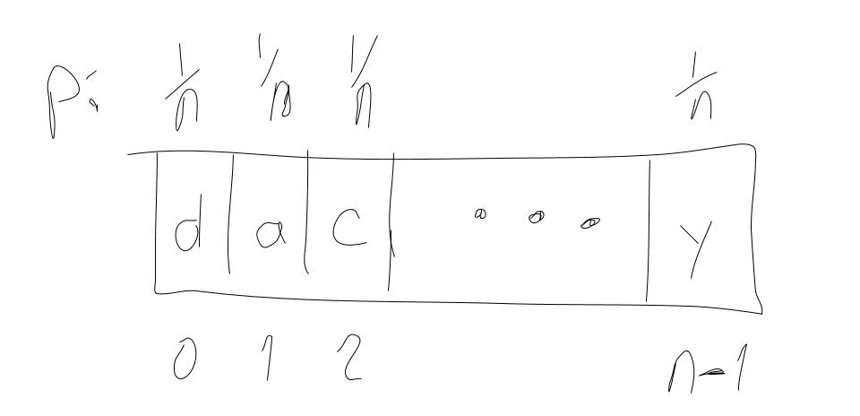

Expected (Average Case) Comparison Count
Standard Average (Uniform) Example:
$$Σ_{i=1 }^{n}count_{case_{i}}∗p\left(case_{i}\right)=Σ_{i=1 }^{n}i∗\frac{1}{n}={\frac{1}{n}Σ}_{i=1 }^{n}i=\frac{n+1}{2}=Θ(n)$$

Slide 9
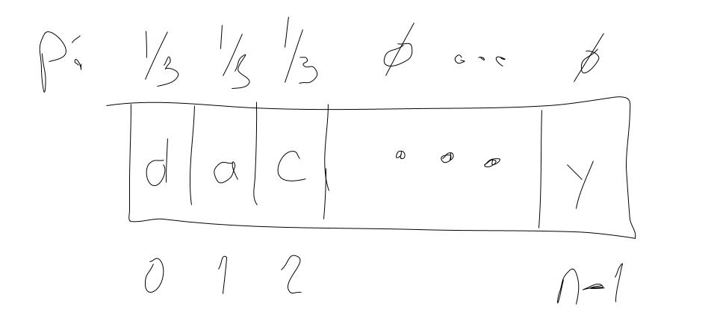
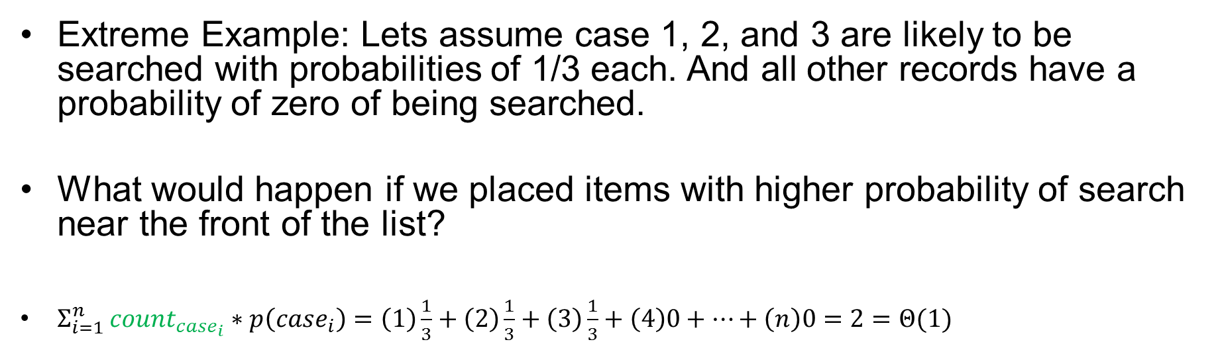
Using Expected Value to Compute Average Case
Extreme Example: Lets assume case 1, 2, and 3 are likely to be searched with probabilities of 1/3 each. And all other records have a probability of zero of being searched.
What would happen if we placed items with higher probability of search near the front of the list?
$Σ_{i=1 }^{n}count_{case_{i}}∗p\left(case_{i}\right)=\left(1\right)\frac{1}{3}+\left(2\right)\frac{1}{3}+\left(3\right)\frac{1}{3}+\left(4\right)0+…+\left(n\right)0=2=Θ(1)$

Slide 10
Ordering a list based on frequency of access
Intuitively, it would then be best to order the items based on their probability of search.
Good in theory! However, one generally does not know this probability distribution for items searched.
If we knew the probability of access of each item, how would we order the items?
  Increasing order of probability

Slide 11
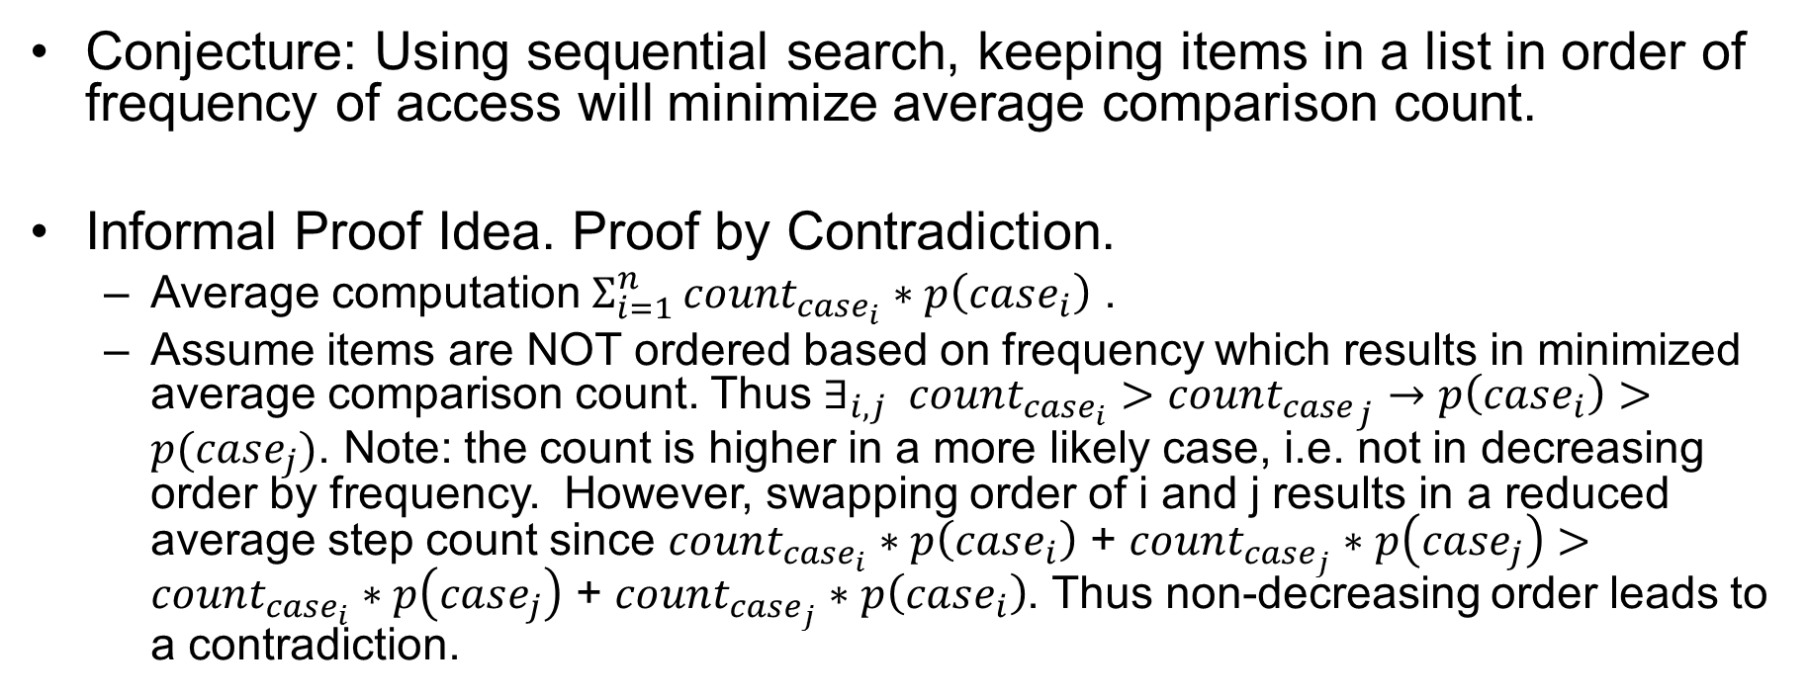
Order based on frequency: proof of efficiency
Conjecture: Using sequential search, keeping items in a list in order of frequency of access will minimize average comparison count.
Informal Proof Idea. Proof by Contradiction.
  Average computation $Σ_{i=1 }^{n}count_{case_{i}}∗p\left(case_{i}\right)$ .
  Assume items are NOT ordered based on frequency which results in minimized average comparison count. Thus $∃_{i,j} count_{case_{i}}>coun{t_{case}}_{j}→p\left(case_{i}\right)>p(case_{j})$. Note: the count is higher in a more likely case, i.e. not in decreasing order by frequency. However, swapping order of i and j results in a reduced average step count since $count_{case_{i}}∗p\left(case_{i}\right)$ + $count_{case_{j}}∗p\left(case_{j}\right)>count_{case_{i}}∗p\left(case_{j}\right)$ + $count_{case_{j}}∗p\left(case_{i}\right)$. Thus non-decreasing order leads to a contradiction.

Slide 12
Order based on frequency of access
Heuristic approach: every time a record is accessed (searched and found), place that item at the beginning of the array. The items that are searched most often, should have a high probability of being near the beginning of this list (thus reducing search time)
  AKA: MOVE TO FRONT
Implementation Details:
  Would you implement this structure as a linked list or an array? Why?

Slide 13
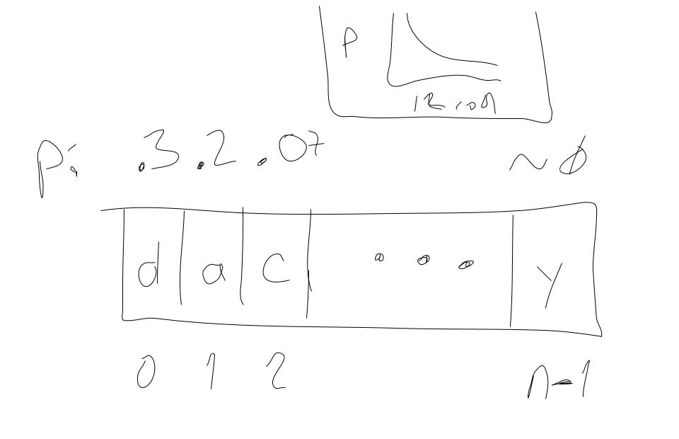
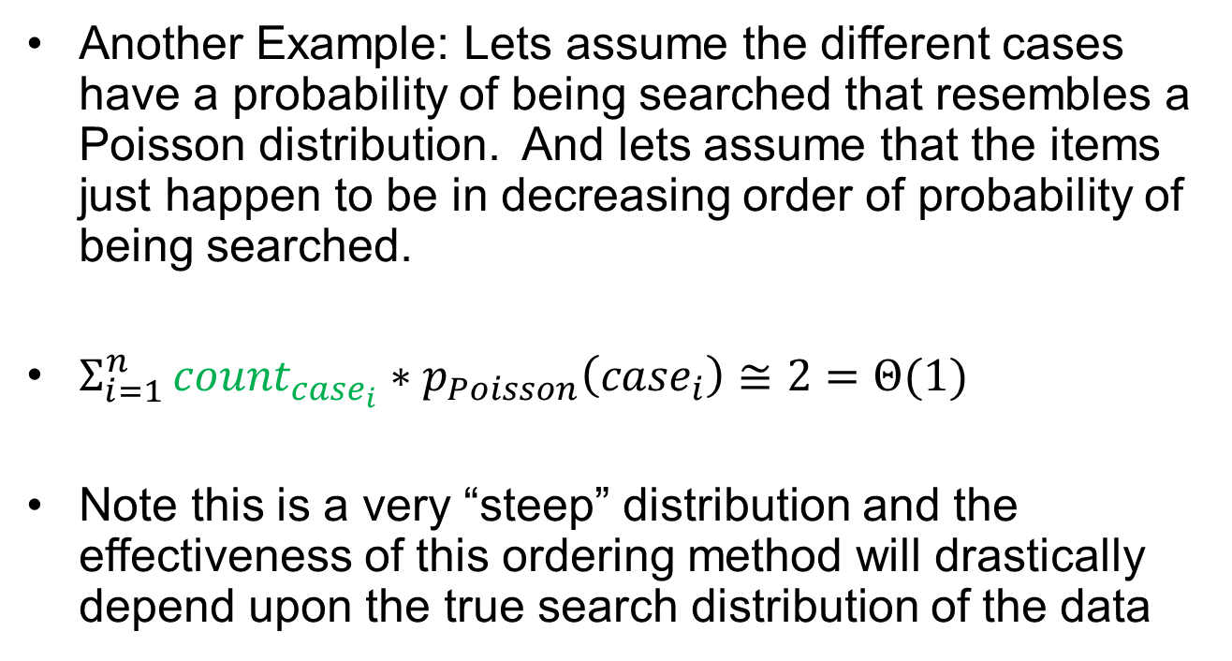
Using Expected Value to Compute Average Case
Another Example: Lets assume the different cases have a probability of being searched that resembles a Poisson distribution. And lets assume that the items just happen to be in decreasing order of probability of being searched.
$Σ_{i=1 }^{n}count_{case_{i}}∗p_{Poisson}\left(case_{i}\right)≅2=Θ(1)$
Note this is a very “steep” distribution and the effectiveness of this ordering method will drastically depend upon the true search distribution of the data

Slide 14
Order based on data value
If the data are ordered, we can reduce search time
  Numeric order, alphabetical order, binary order, …
  E.G. files in a filing cabinet
Binary Search
  Divide and conquer scheme
  Example: Search for 55
1
3
4
7
14
55
57

Slide 15
Pseudocode for Binary Search (iterative)
Worst Case Time Complexity?
// Searches using DaC for x in a where a is sorted. Step Count
// Returns index of x, else -1
Algorithm BinarySearch(a, n,x){
index = -1; 1
searchBegin = 1; 1
searchEnd = n; 1
while searchBegin <= searchEnd do{
searchMid = floor((searchEnd + searchBegin)/2); ?
if x > a[searchMid]{ ?
searchBegin = searchMid+1; ?
} else if x < a[searchMid]{ ?
searchEnd = searchMid-1; ?
} else if x == a[searchMid]{ ?
index = searchMid; ?
} end if
}end while
return index; 1
}end

Slide 16
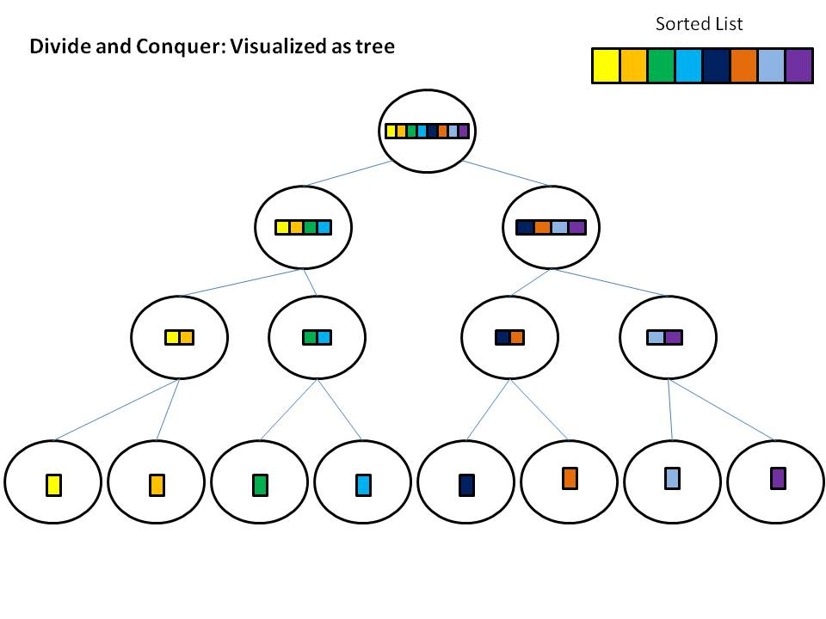
Binary Search: decision tree diagram
The flow of execution is represented as a single path from root to leaf, where each step from parent to child represents 1 iteration in the binary search method.
Thus the number of iterations can be bounded by the height of this tree.
  Note that the number of nodes at each level of our tree doubles at each depth of the tree.
  Nodes at depth d = ?
  How many nodes are at the lowest level of this tree?

Slide 17
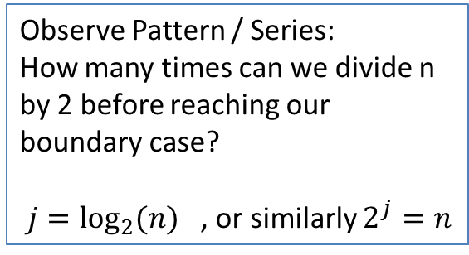
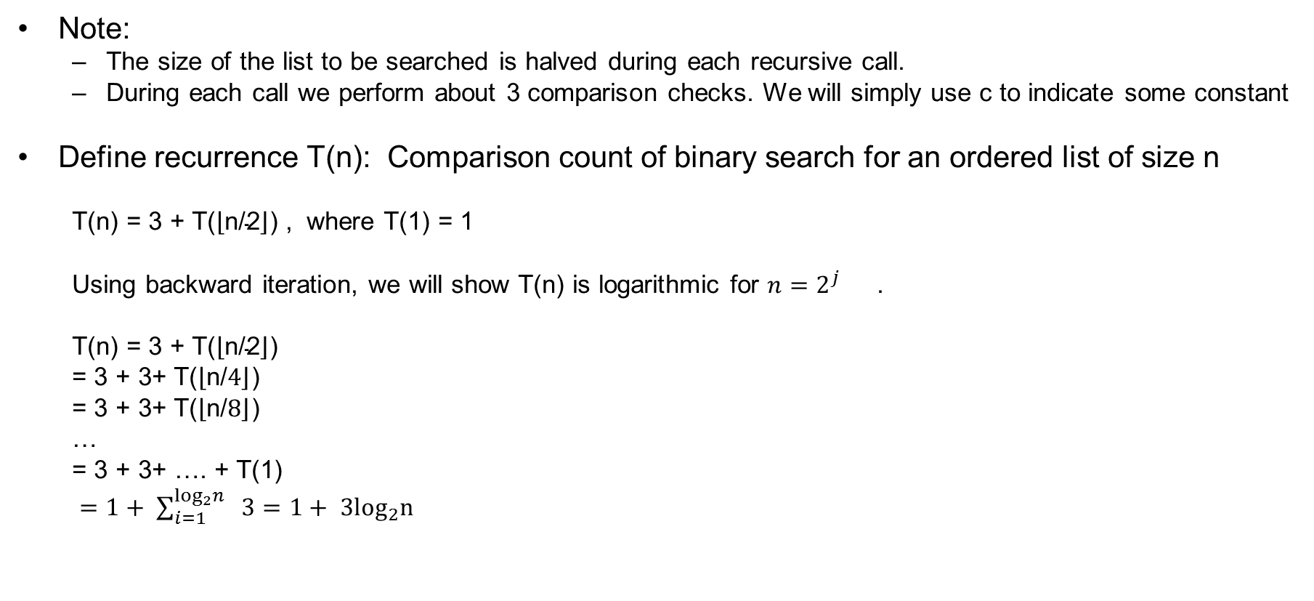
Using Recurrences: Binary Search Time Complexity
Note:
  The size of the list to be searched is halved during each recursive call.
  During each call we perform about 3 comparison checks. We will simply use c to indicate some constant
Define recurrence T(n): Comparison count of binary search for an ordered list of size n
  T(n) = 3 + T($\left\lfloor \text{n}\text{/2}\right\rfloor$) , where T(1) = 1
  Using backward iteration, we will show T(n) is logarithmic for $n=2^{j}{}$ .
  T(n) = 3 + T($\left\lfloor \text{n}\text{/2}\right\rfloor$)
  = 3 + 3+ T($\left\lfloor \text{n}\text{/}4\right\rfloor$)
  = 3 + 3+ T($\left\lfloor \text{n}\text{/}8\right\rfloor$)
  …
  = 3 + 3+ …. + T(1)
  $=1+ \sum_{i=1}^{\log_{2}n{ }}{3}=1+ 3\log_{2}n$
  Try at home: Use substitution method, (induction) prove that T(n) is O(log n)
Observe Pattern / Series:
How many times can we divide n by 2 before reaching our boundary case?
$j=\log_{2}{(n)}$ , or similarly $2^{j}{=n}$

Slide 18
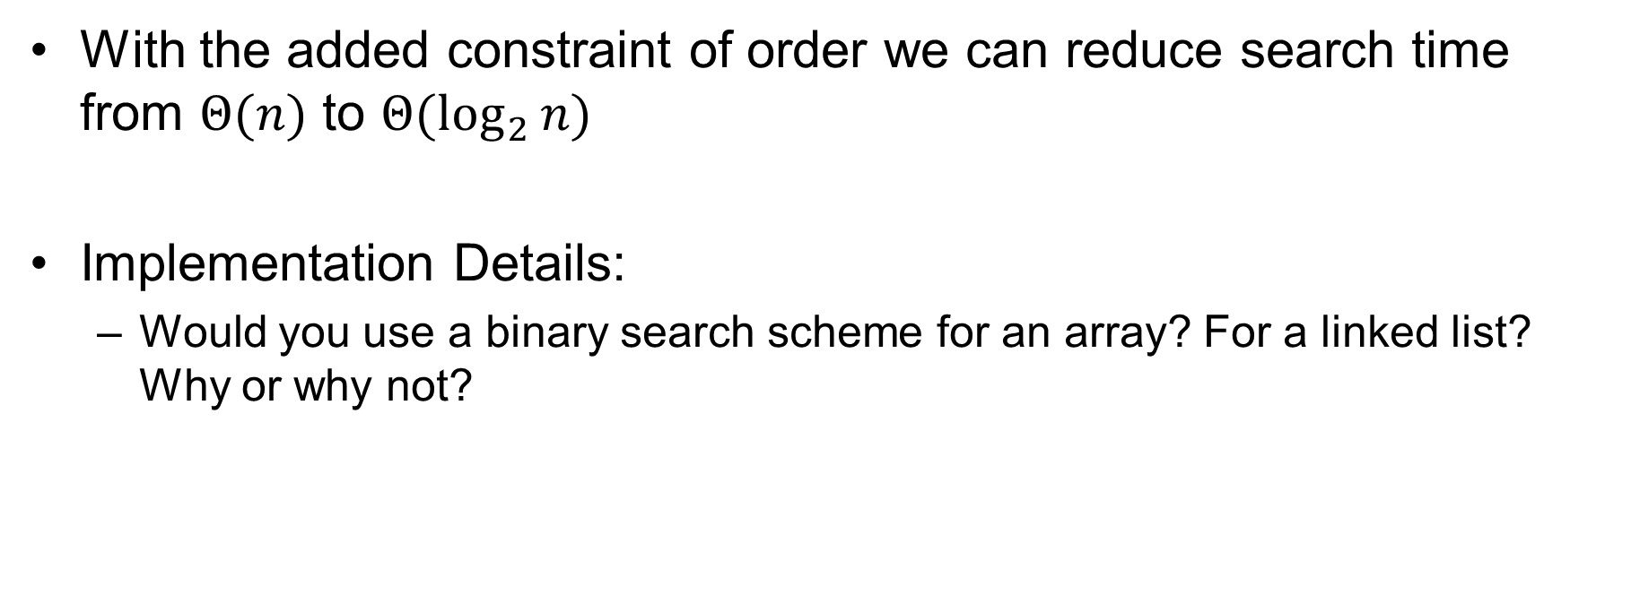
Binary Search vs Sequential Search
With the added constraint of order we can reduce search time from $Θ(n)$ to $Θ(\log_{2}{n})$
Implementation Details:
  Would you use a binary search scheme for an array? For a linked list? Why or why not?

Slide 19
Sorting: Imposing Order
Insertion Sort
  Intuitive and in-place
  But quadratic time complexity in the worst case
Merge Sort
  Uses a “Divide and Conquer” Scheme (similar to binary search) to improve efficiency
We will investigate a few sorting algorithms throughout the course.

Slide 20
Merge Sort
Inputs (practical characterization of domains):
  A: an array of ints of length n
  p: index (begin)
  q: index (end)
Assumptions:
  Precondition: p = 1 AND q = n
Correctness
  Postcondition: elements in A are in increasing order

Slide 21
Merge Sort
Intuition
  Repeatedly divide array in halves until there are multiple arrays of length 1.
    this will take log time
  Repeatedly merge these arrays.
    The merge requires a sequential scan of each subarray, which will be linear in total

Slide 22
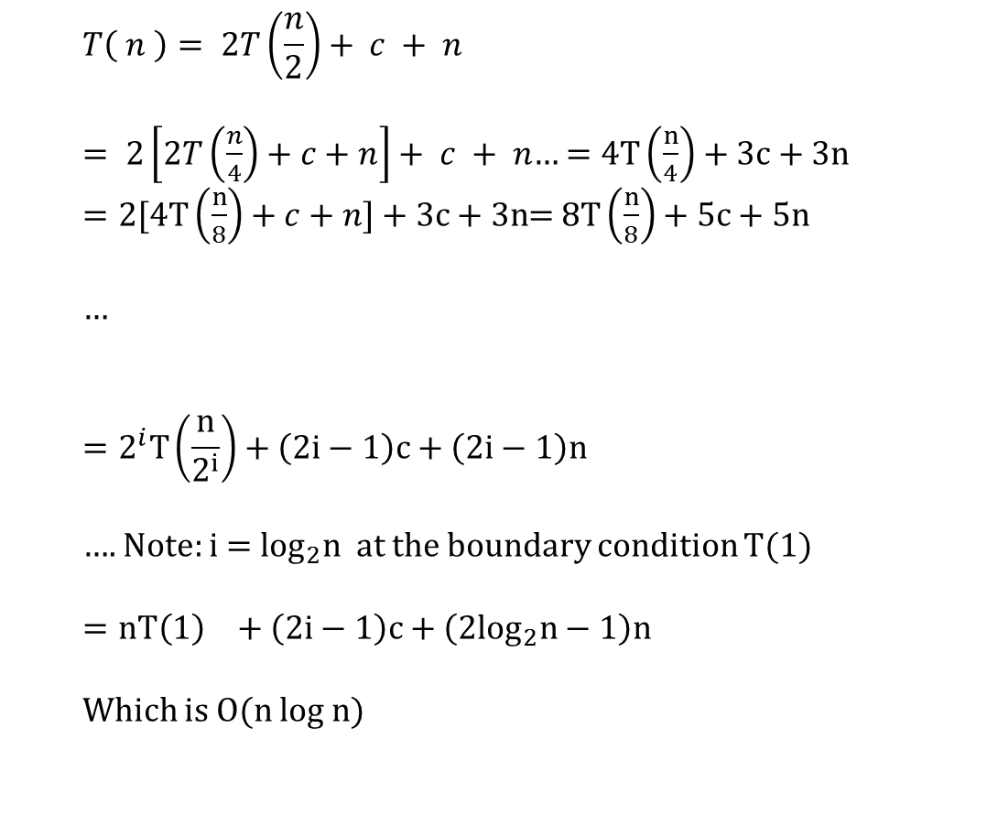
Merge Sort
The worst case time complexity of Merge Sort is O(n log n)
Proof:
  Define step count recurrence
  T( n ) = T(n/2) + T(n/2) + c + M(n/2+n/2)
    c is the constant number of steps needed to check for the base case, compute q, …
    M() is the number of steps needed to merge two subarrays each of length n/2, which can be done in linear time using a sequential scan
    Thus …
  $$T\left( n \right)= 2T\left(\frac{n}{2}\right)+ c + n$$
  $= 2\left[2T\left(\frac{n}{4}\right)+c+n\right]+ c + n$… $=4T\left(\frac{n}{4}\right)+3c+3n$
  $=2[4T\left(\frac{n}{8}\right)+c+n]+3c+3n$= $8T\left(\frac{n}{8}\right)+5c+5n$
  …
  $$=2^{i}T\left(\frac{n}{2^{i}}\right)+\left(2i−1\right)c+\left(2i−1\right)n$$
  …. Note: i = $\log_{2}n$at the boundary condition T(1)
  $$={nT\left(1\right)}_{}+\left(2i−1\right)c+\left(2\log_{2}n−1\right)n$$
  Which is O(n log n)
Observe the pattern. We will reach the boundary condition when i = log n

