Slide 1
COSC160: Data Structures: Lists and Queues
Jeremy Bolton, PhD
Assistant Teaching Professor

Slide 2
Outline
Queues
FIFO Queues
Usage
Implementations
LIFO Queues (Stacks)
Usage
Implementations
Applications / Examples

Slide 3
Queues
Queue is a linear list where data is added and removed at the “ends”
Refers to conceptual behavior (not implementation)
Specifically when (where) data enters the queue, and when (where) data exits the queue
Access is generally limited to the top or the bottom of the queue.
Types of queues are differentiated by operations performed (behaviors)
Common Queues
First In First Out (FIFO)
Applications: traversals, memory buffers, resource sharing, simulations, …
Last In First Out (LIFO)
Stack
Applications: parsers, Runtime environments, traversals, …

Slide 4
FIFO Queue
First In First Out
Describes how data is added and removed
First come first serve
Examples where used:
Check-out line at store
When entities use a shared resource
Memory Buffer
Operations
Insert (item) // inserts item to back of queue
Remove () // removes item at front of queue
Implementation Details
Array or chain structure
Time Complexity implications

Slide 5
FIFO Queue: Add and Remove
Enqueue 4 (add to back)
Enqueue 5 (add to back)
Dequeue (remove from front)
Enqueue 2 (add to back)
Dequeue (remove from front)
Dequeue (remove from front)

Slide 6
FIFO Queue: Array Implementation
Considerations
Front of Queue
Should front of list always be the front of the array
Requires shifting after every dequeue
Circular, dynamic array is efficient
Keep index to front (and back)
Observations:
Since no internal elements in the queue need to be accessed. Both insert (enqueue) and remove (dequeue) operations are efficient.
Time Complexity?

Slide 7
FIFO Queue: Linked List Implementation
Memory Requirements?
Time?
Enqueue
Dequeue

Slide 8
LIFO Queue: aka stack
Last In First Out
Describes how data is added and removed
Last to be added is first to be removed
Examples where used:
Push down plates at cafeteria
Parsing / grammar analysis
Tree or maze traversals
Operations
Insert (to top)
PUSH( item )
Remove (from top)
POP ()
View top
PEEK()
Implementation Details
Array or chain structure
Time Complexity implications

Slide 9
LIFO Queue (Stack): Push and Pop
Push(5)
Push(10)
Push(2)
Pop()
Push(10)
Pop()

Slide 10
Stack: Array Implementations
Observations
Must allocate size initially
No need to keep a base index
Maintain a top index

Slide 11
Stack: Linked List Implementations
Observations
Must maintain pointer to top
Size changes dynamically

Slide 12
Queue Implementation Summary
Both Insert and Remove operations for both Queue types are efficient
Chaining Implementation permits size to change so that “extra” space is not necessarily allocated. This comes at the cost of one extra pointer per item stored.
Array Implementation does not require an extra pointer per item stored, but may use space unnecessarily and may infrequently, require and O(n) reallocation if the Queue is full and an insert is performed.

Slide 13
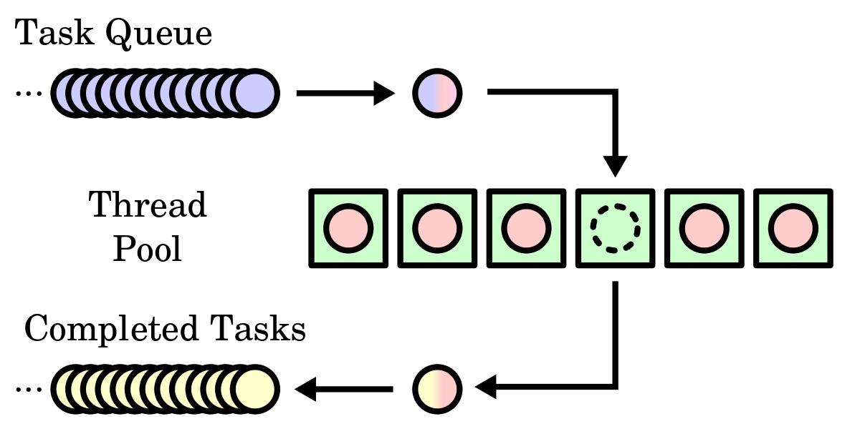
Application of FIFO Queue
Shared Resource Queue

Slide 14
Applications of FIFO queues
Shortest Distance (from a to b) on a grid example
FIFO := initialize empty fifo queue
//Square a is at grid location (0,0)
a.distanceThusFar := 0
FIFO.enqueue(a)
while ( ! FIFO.isEmpty() )
x := FIFO.dequeue()
for each neighboring square n of square x
if square was not previously encountered OR if n.distanceThusFar > x.distanceThusFar + 1
n.distanceThusFar := x.distanceThusFar + 1
if n == b // done
FIFO.clear()
return n.distanceThusFar
FIFO.enqueue(n); and mark square n as encountered
a
 |  |  | *
 | * |  | *
 |  | * | *
 |  |  |  |  | b
a | 1
1 | 1
 |  |  | *
 | * |  | *
 |  | * | *
 |  |  |  |  | b
a | 1 | 2 | 3 | 4 | 5
1 | 1 | 2 | 3 | 4 | 5
2 | 2 | 2 | * | 4 | 5
3 | 3 | 3 | * | 5 | 5
4 | 4 | * | * | 6 | 6
5 | 5 | 5 | 6 | 7 | b

Slide 15
Application of Stacks
Symbol matching (for syntax)
EG: Are all the ‘(‘ and ‘{‘ properly matched with ‘)’ and ‘}’
function f ( arg )
{
while (arg > 0)
{x = arg --;}
}
Symbol matching algorithm
Scan input code (character array) from left to right
for i from 0 to inputLength - 1
if input[ i ] == ‘(‘ OR input[ i ] == ‘{‘ , then stack.push(input[ i ])
else if input[ i ] == ‘)‘ OR input[ i ] == ‘}‘ then
c : = stack.pop()
if c is ‘(‘ and input[ i ] is ‘)’ OR if c is ‘{‘ and input[ i ] is ‘}’
//The symbols are matched!, do nothing
else // the symbols are unmatched
throw a syntax error
if traversal complete and stack.isEmpty() == false, then
Throw error, no matching close symbol found

