Slide 1
COSC160: Data Structures Dynamic and Circular Arrays
Jeremy Bolton

Slide 2
Outline
Dynamic Arrays
Circular Arrays

Slide 3
Arrays
Array limitations
Arrays are stored contiguously in a computer, and thus the size must remain fixed. However, one can implement a dynamic array which provides for an extra level of abstraction (in this case extra memory management behind the scenes)
“Resize” it!
If the array is full, copy items from full array to a new array of larger size

Slide 4
Simple ReSizing Scheme
When initialized, allocate enough memory for a “reasonable” storage amount.
If the array is full and an attempt is made to add an item to the array, simply create a new, larger array and copy over the items from the previous array and then the new item to add.
Since allocating a new array and copying the current list is computationally expensive, it is best to try to reduce the number of times the array reaches its max capacity.
One simple scheme is to assure the new array created (when max capacity is reached) is “large” (double the original is common).
Exercise: Assume the maximum number of entries to be placed into a list is n and is unknown. If a dynamic array is used to implement this list, what is the number of times we would need to re-allocated and copy in the worst case?

Slide 5
Allocation and Copying are slow
Copying a Dynamic Array to increase capacity when full
Minimize the number of copies
Difficult to do without knowing the max capacity needed
Exponential Growth Scheme
Assume the max capacity is N (which is unknown apriori)
Assume array is initialized to size i.
How many copies are needed if we follow the following re-sizing rule? When attempting to add element and capacity is full, allocate a new array with double capacity and copy.
Total number of allocation-copy events: $i log_{2}(N−i)$

Slide 6
Dynamic Array Investigation: Add elements
To the beginning, will result in $Θ(n)$ operations
To the middle, will result in $Θ(n)$ operations (average case)
To the end of the list will result in $Θ(1)$ operations
UNLESS the array is full, then the result would be $Θ(n)$ operations
Good news: we were able to add items to a seemingly full array!
Bad news: the time complexity is poor when the array is copied.
Permits dynamic size change, but improvement can be made upon a standard array.

Slide 7
Dynamic Array Investigation: Remove elements
From the beginning of the list will result in $Θ(n)$ operations
From the middle of the list will result in $Θ(n)$ operations (average case)
From the end of the list will result in $Θ(1)$ operations

Slide 8
Can we improve upon this?
The dynamic array appears to help with some memory issues encountered by the standard array, but some operations are still “slow”
Add to back is fast. Why? Index is generally know.
Add to front. Must copy and make room. Slow.
Reason: beginning of array is assume index 0 (or 1), but what if this was not required?

Slide 9
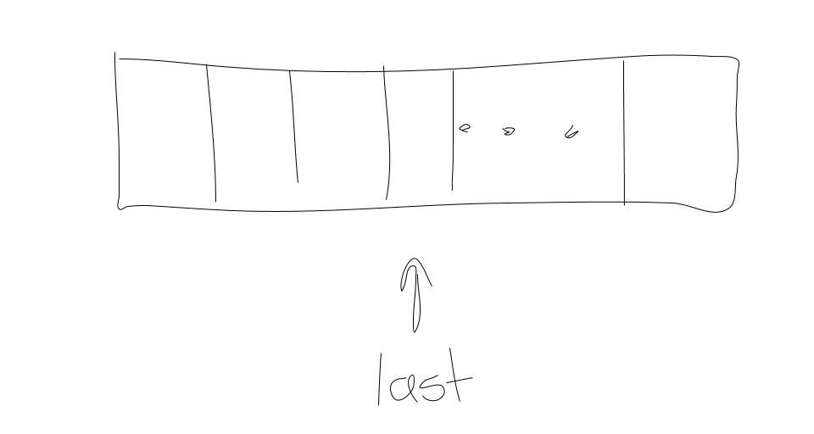
Dynamic Array: Access to Last Item
As with standard arrays we will need to keep track of the number of items in the array – but more specifically we need to have the index of the current last item in the array
Observation: Linked Lists permit efficient additions to beginning and end of lists by maintaining a pointer to the head and tail.
We can apply this same concept to the first element of the array which can improve flexibility and complexity

Slide 10
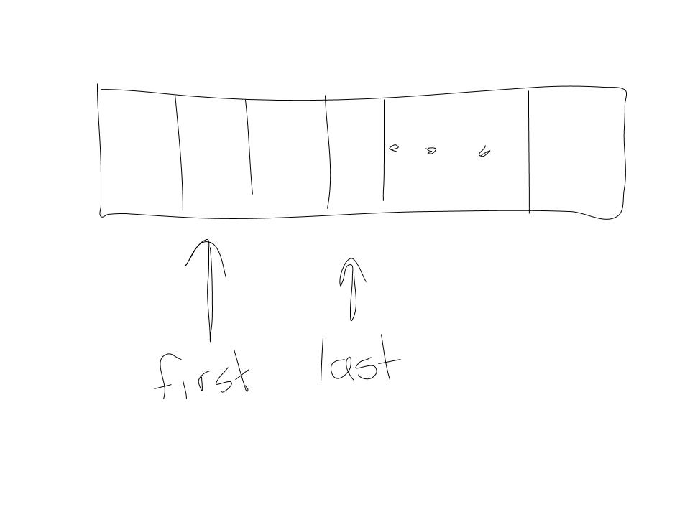
Design Improvement: Circular Arrays
We might also allow access to the first item in the array.
Design decision: if we require the “first” item in the array to be the item located at index zero, we will incur a $Θ(n)$ copies.
Keep the index to the first item in the array (the first item does not need to be at location 0).
Reduces insertions to front and removals from front to $Θ\left(1\right)$ steps. (with some minimal indexing overhead)
Circular Arrays
Allow for both front and last indexes to change
Can use modular arithmetic to find relative indexes

Slide 11
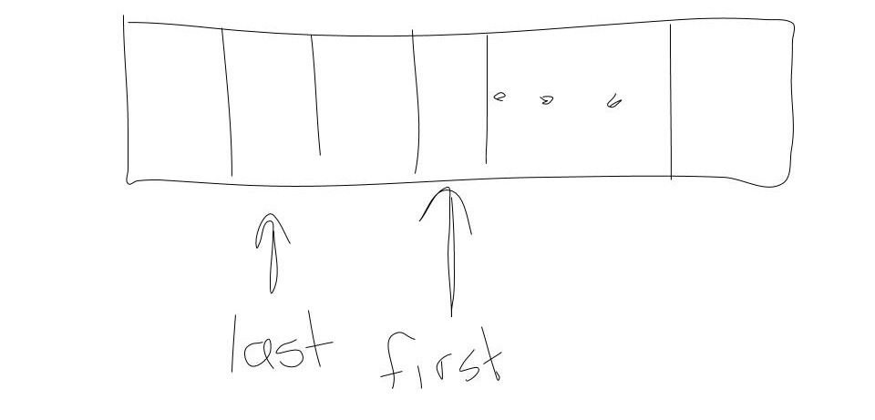
Circular Array: Indexes to both first and last item
Allows easy access to first and last item (with some simple overhead)
There are two keys “states” of the list that should be recognized (for a traversal). ALLOWS “WRAP-AROUND”.

Slide 12
Efficient Arrays: Add To Front
AddToFront(item i, array)
// first check if we have enough space!
if ( mod(first – 1,n) ) == back
array = doubleArray(array)
// assumes firt == last when list is size 0 or 1
if last > first || last < first
first = mod( first-1 , n) //move over
array [first] = i
elseif numItems == 0
first = last = 1
array [first] = i
elseif numItems == 1
first = mod( first-1 , n) //move over
array [first] = i
else
error
numItems++

Slide 13
Dynamic Circular Arrays
At home Exercise. Write Pseudocode for the following:
addToBack(item i)
removeFromFront()
removeFromBack()

Slide 14
Circular Dynamic Arrays: Time Complexity
IMPLEMENTATION |  | CHAINING*** | ARRAYS*
INSERT FRONT |  | $$Θ(1)$$ | $Θ(1)$**
INSERT MIDDLE |  | $$Θ(n)$$ | $$Θ(n)$$
INSERT BACK |  | $$Θ\left(1\right)$$ | $Θ(1)$**
RETRIEVE FRONT |  | $$Θ(1)$$ | $$Θ(1)$$
RETRIEVE MIDDLE |  | $$Θ(n)$$ | $$Θ(1)$$
RETRIEVE BACK |  | $$Θ\left(1\right)$$ | $$Θ(1)$$
REMOVE FRONT |  | $$Θ(1)$$ | $$Θ(1)$$
REMOVE MIDDLE |  | $$Θ(n)$$ | $$Θ(n)$$
REMOVE BACK |  | $$Θ(1)$$ | $$Θ(1)$$
* Assumes first and last index
** Assumes alloc |  | *** Assumes Tail
With the addition of some simple design elements, we can make arrays efficient (in most cases).
If the array is full, we will incur an overhead of $Θ$(n) for the allocation (if doubling size) and $Θ$(n) for the copy.
Space complexity:
Chains use only the memory necessary to store the current list
Unless the size of the list is known at array allocation time and remains static, an array may use an unnecessary amount of memory.

Slide 15
Lists with restricted access
Note: we have identified that we can make efficient use of dynamic arrays if access is restricted to first or last item.
Are lists that restrict access to just the first or last item useful?
Queues…

