Slide 1
COSC160: Data Structures
Linked Lists
Jeremy Bolton, PhD
Assistant Teaching Professor

Slide 2
Outline
Data Structure (lower-level) Implementations
  Chaining (Linked Lists)
    Design Decisions and Implications on Complexity
      Example: Tail Pointer
  Arrays
    Design Decisions and Implications on Complexity
Design Decisions
  Arrays vs. Chaining
Interesting Applications
  Polynomial Arithmetic and Evaluation

Slide 3
Linear Structures
Linear structures are generally implemented using arrays or chaining
  Contiguous vs. non-contiguous in memory
    Static size vs. dynamic size
  When designing a data structure, one must consider these low-level designs
    One major decision: contiguous vs non-contiguous (ie array vs chain)
    This design decision will have implications with respect to usage and efficiency
  There are many design decisions that a programmer must consider
    Some are standard, others may be tailor-made for the problem/solution on-hand.

Slide 4
List Class Implemented by Chaining (Linked Lists)
Design Decisions
  Single Link, next
  Head pointer maintained
Standard Operations
    Insert(item, index)
    Remove(index)
    Retrieve(index)

Slide 5
Inserting into a Linked List
Lets investigate three cases of the insertion operation
  Insert to front of list
  Insert to middle of list
  Insert to end of list

Slide 6
Inserting into front of a Linked List
Insert to front of list
Approximately how many computational steps?
Does the number of computational steps depend on the size of the list?
Time complexity?

Slide 7
Inserting into middle of Linked List
Approximately how many computational steps?
Does the number of computational steps depend on the size of the list?
Time complexity?

Slide 8
Inserting to end of Linked List
Approximately how many computational steps?
Does the number of computational steps depend on the size of the list?
Time complexity?

Slide 9
Design Decisions
One major goal of a data structure is to provide an efficient way to manage data.
Can we improve the efficiency of any of these operations -- YES
Example: Tail pointer
  Notably decrease order of computation for insert to end of list, at the cost of maintaining an extra pointer per list

Slide 10
Insert to End (List with Tail Pointer)
Significant time reduction.
What is the time complexity now?

Slide 11
List Variations:
Singly Linked vs. Doubly Linked Lists
Differences
  Doubly Linked List
    Can traverse a list in both directions at added cost of 1 pointer per node
    Slightly simplify iteration scheme for insertions and removals

Slide 12
Singly Linked vs. Doubly Linked Lists
Singly Linked List
Doubly Linked List

Slide 13
Why a double link?
May be useful in specific situations.
  Remove last node
A prev pointer, may reduce retrieval and insertion times at the cost (space) of 1 extra pointer per node.
  Create an efficient algorithm: Node* get(int index)

Slide 14
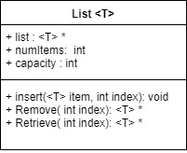
List Class Implemented as Array
Assume the following design decisions
  Array initialized to “large” capacity, chosen appropriately based on application
  No gaps in the list (items shift after a removal)
  Assumes index = 0 is beginning of list
  Should maintain index for end (size) of list or numItems
  Operations
    Insert(item, index)
    Remove(index)
    Retrieve(index)
  Concerns: What happens if insertion exceeds capacity?

Slide 15
Inserting into an Array
Lets investigate three cases of the insertion operation
  Insert to front of array
  Insert to middle of array
  Insert to end of array

Slide 16
Insertion to Front of Array
Approximately how many computational steps?
Does the number of computational steps depend on the size of the list?
Time complexity?

Slide 17
Insert to Middle of Array
Approximately how many computational steps?
Does the number of computational steps depend on the size of the list?
Time complexity?

Slide 18
Insert to End of Array
Approximately how many computational steps?
Does the number of computational steps depend on the size of the list? Note: Assumes there is enough allocated space.
Time complexity?

Slide 19
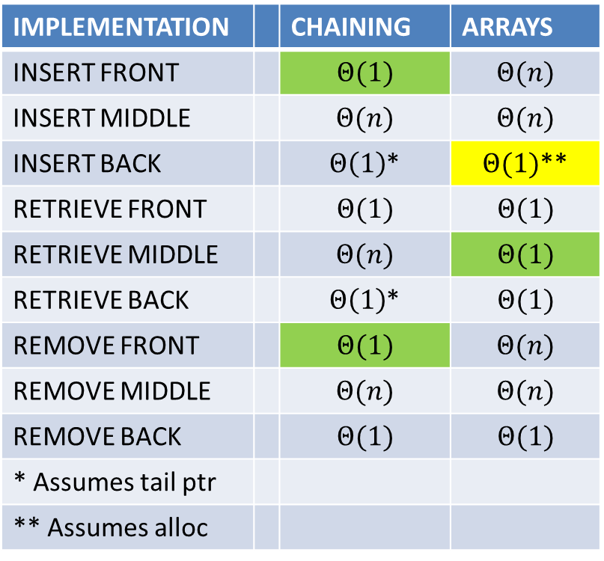
“Worst” Case Time Complexity for a List Class
IMPLEMENTATION |  | CHAINING | ARRAYS
INSERT FRONT |  | $$Θ(1)$$ | $$Θ(n)$$
INSERT MIDDLE |  | $$Θ(n)$$ | $$Θ(n)$$
INSERT BACK |  | $Θ\left(1\right)$* | $Θ(1)$**
RETRIEVE FRONT |  | $$Θ(1)$$ | $$Θ(1)$$
RETRIEVE MIDDLE |  | $$Θ(n)$$ | $$Θ(1)$$
RETRIEVE BACK |  | $Θ\left(1\right)$* | $$Θ(1)$$
REMOVE FRONT |  | $$Θ(1)$$ | $$Θ(n)$$
REMOVE MIDDLE |  | $$Θ(n)$$ | $$Θ(n)$$
REMOVE BACK |  | $$Θ(1)$$ | $$Θ(1)$$
* Assumes tail ptr
** Assumes alloc
Exercise: try to fill out table for best case and average case.

Slide 20
Basic Lists: Array vs Linked List Implementation
Example: Design a list class for use to store information for 250 tenants in apt. building.
Design an aptList Class with the following operations
  Insert(item, location): bool
  Remove(item): bool
  Find(item): int
How would you implement this structure as a class?
  Array or Chain? Why?
  What member variables would you include? Why?
We could keep the data in the list in some order …

