Slide 1
COSC160: Data Structures
Review – Part 2
Jeremy Bolton, PhD
Assistant Teaching Professor

Slide 2
Outline
Computational Complexity
  Time
    Upperbounding Notation
    Formalizing using Recurrences
  Space
    Recursion: Implications on Space Complexity
Implementation Details
  Pointers
  Memory Management
Good Programming Practices
  Design
  Debug

Slide 3
Review: Goals of Data Structures
Computer science is the practice of problem solving.
  Data structures are tools used to help solve a problem or accomplish a task.
  Good Solutions (Algorithms):
    Good solutions are correct.
    Good solutions are practical.
    Good solutions are efficient.
      Efficient in time
      Efficient in space
Low level representations
  Understanding lower level details related to memory management will make you a better programmer (of efficient structures and algorithms)

Slide 4
Computational Complexity Theory
Algorithms on Data Structures are analyzed and assessed using two main factors
  Time Complexity – number of “computational steps” required.
  Space Complexity – number of memory “spaces” required.
Algorithms may depend on size and value of input.
  Value(s) of input
    Cases: Worst Case, Best Case, Average Case.
  Analysis in terms of size of input
    Computational steps and memory requirements are generally a function of size of input.
Analysis
  “Absolute” count: Step count (time) or memory location (space) count
  Count Upper-bound and lower-bound notation:
    Big-O: upper bound
    Big-Omega: lower bound
    Big-Theta: both upper and lower bound

Slide 5
Best Case vs. Worst Case
Cases are generally determined assuming the size of the input is fixed.
  Best Case: Input (of size n) whose corresponding step count (or memory count) is minimum.
  Worst Case: Input (of size n) whose corresponding step count (or memory count) is maximum.
  Average Case: Average step count (or memory count) over all possible inputs (of size n).
Therefore cases are often determined by the value of the input (not the size.)
Example: Assume you have a list (of size n), and you are tasked with searching for an item in the list. What is the best case? Worst case?

Slide 6
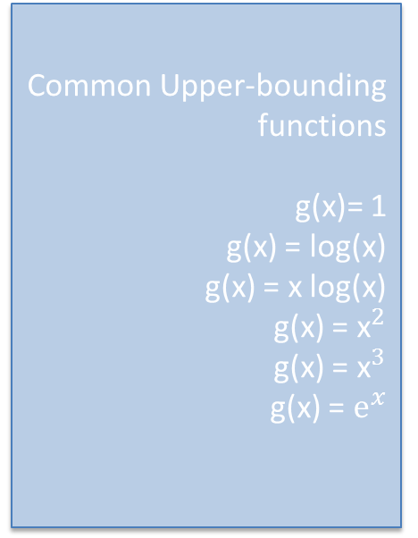
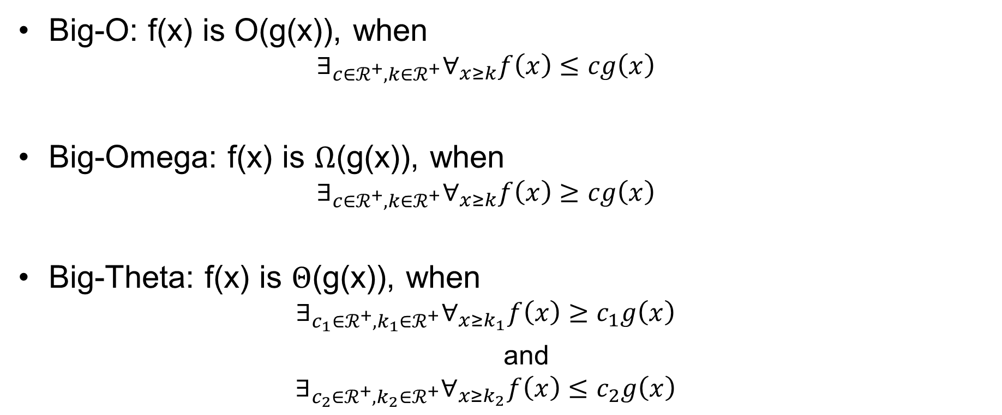
Upper-bounding notation. (Formally)
Big-O: f(x) is O(g(x)), when
  $$∃_{c∈ℛ^{+},k∈ℛ^{+}}∀_{x≥k}f\left(x\right)≤cg\left(x\right)$$
Big-Omega: f(x) is $Ω$(g(x)), when
  $$∃_{c∈ℛ^{+},k∈ℛ^{+}}∀_{x≥k}f\left(x\right)≥cg\left(x\right)$$
Big-Theta: f(x) is $Θ$(g(x)), when
  $$∃_{c_{1}∈ℛ^{+}, k_{1}∈ℛ^{+}}∀_{x≥k_{1}}f\left(x\right)≥c_{1}g\left(x\right)$$
  and
  $$∃_{c_{2}∈ℛ^{+}, k_{2}∈ℛ^{+}}∀_{x≥k_{2}}f\left(x\right)≤c_{2}g\left(x\right)$$
Common Upper-bounding functions
g(x)= 1
g(x) = log(x)
g(x) = x log(x)
g(x) = ${\text{x}}^{2}$
g(x) = ${\text{x}}^{3}$
g(x) = ${\text{e}}^{x}$

Slide 7
Formalizing Time Complexity of An Algorithm
Specify the step-count function by Explicit Counting.
  If code is “simple”, count steps in the loop and determine how many times the loop will execute (depending on case.)
  Use proof by induction (or direct arithmetic) to prove upperbound
Recurrence.
  Define step count function recursively.
  Solve recurrence
    By Iteration; or
    By Substitution; or …
  Use proof by induction (or direct arithmetic) to prove upperbound

Slide 8
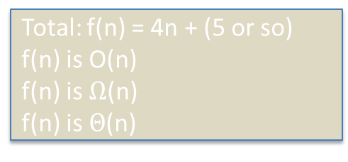
Example: Computational Step Count
Pseudocode for a sequential search algorithm below.
  What is the number of computational steps in the worst case?
  Often assumes all basic operations are 1 step.
// Searches sequentially for x in array. Returns index of first x, else -1 Step Count
Algorithm SequentialSearch (array, x){
n := length(array); 1
index := -1; 1
for i := 1 to n do{ 3n + 2
if x == array[i]{ n
index := i; 1?
break; 1?
}end if
} end for
return index; 1
}end SequentialSearch
Loop overhead:
i=1: 1 step (initial)
i <= n: 1 step (initial)
i++ (i=i+1): 2n steps (post-loop update)
i <= n: n steps (loop re-entry)
Total: 3n+2
Total: f(n) = 4n + (5 or so)
f(n) is O(n)
f(n) is $Ω$(n)
f(n) is $Θ$(n)

Slide 9
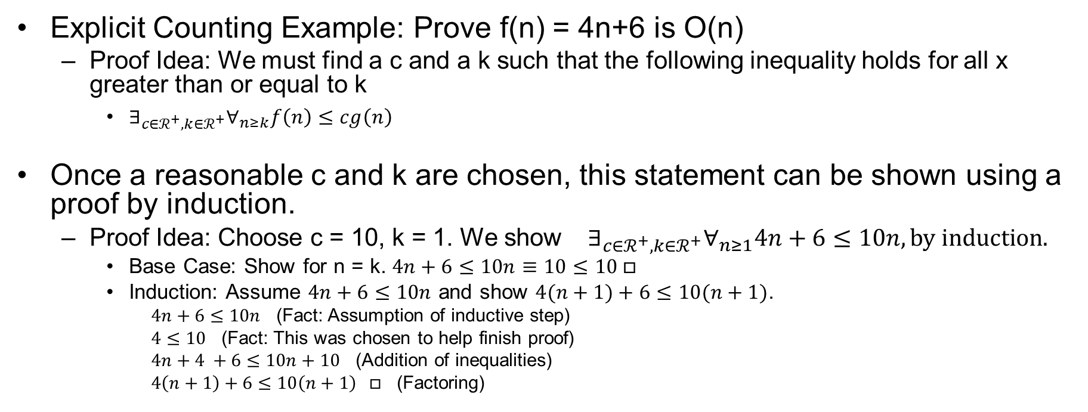
Bounding Proofs
Explicit Counting Example: Prove f(n) = 4n+6 is O(n)
  Proof Idea: We must find a c and a k such that the following inequality holds for all x greater than or equal to k
    $∃_{c∈ℛ^{+},k∈ℛ^{+}}∀_{n≥k}f\left(n\right)≤cg\left(n\right)$
Once a reasonable c and k are chosen, this statement can be shown using a proof by induction.
  Proof Idea: Choose c = 10, k = 1. We show${ ∃}_{c∈ℛ^{+},k∈ℛ^{+}}∀_{n≥1}4n+6≤10n, by induction.$
    Base Case: Show for n = k. $4n+6≤10n≡10≤10 □$
    Induction: Assume $4n+6≤10n$ and show $4(n+1)+6≤10(n+1)$.
      $4n+6≤10n$ (Fact: Assumption of inductive step)
      $4≤10$ (Fact: This was chosen to help finish proof)
      $4n+4 +6≤10n+10$ (Addition of inequalities)
      $4\left(n+1\right)+6≤10\left(n+1\right) □$ (Factoring)

Slide 10
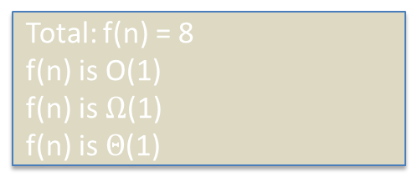
Example: Computational Step Count
Pseudocode for a sequential search algorithm below.
  What is the number of computational steps in the (non-pathological) best case?
// Searches sequentially for x in array. Returns index of first x, else -1 Step Count
Algorithm SequentialSearch (array, x){
n := length(array); 1
index := -1; 1
for i := 1 to n do{ 2
if x == array[i]{ 1
index := i; 1
break; 1
}end if
} end for
return index; 1
}end SequentialSearch
Total: f(n) = 8
f(n) is O(1)
f(n) is $Ω$(1)
f(n) is $Θ$(1)

Slide 11
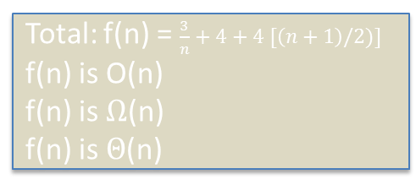
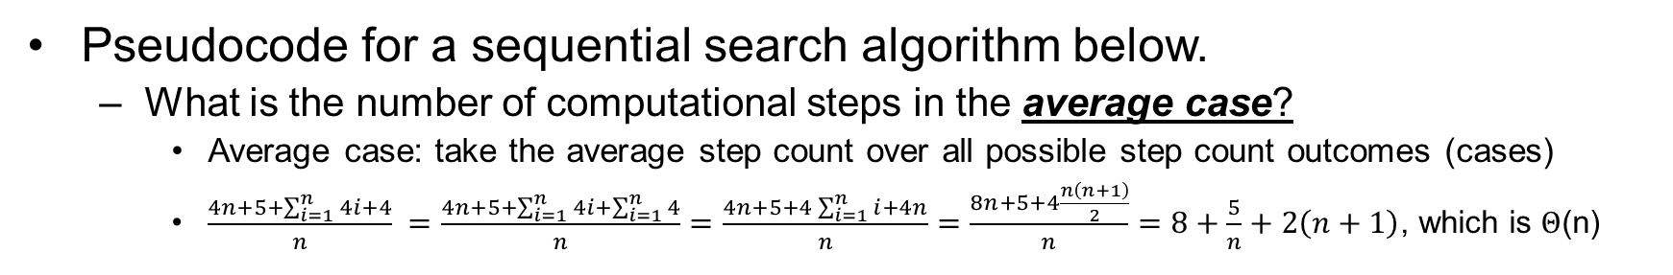
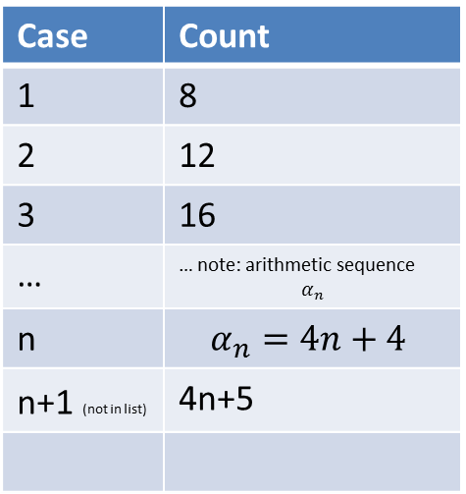
Example: Computational Step Count
Pseudocode for a sequential search algorithm below.
  What is the number of computational steps in the average case?
    Average case: take the average step count over all possible step count outcomes (cases)
    $\frac{4n+5+\sum_{i=1}^{n}{4i+4}}{n} =\frac{4n+5+\sum_{i=1}^{n}{4i}+\sum_{i=1}^{n}{4}}{n}=\frac{4n+5+4\sum_{i=1}^{n}{i}+4n}{n}=\frac{8n+5+4\frac{n\left(n+1\right)}{2}}{n}=8+\frac{5}{n}+2\left(n+1\right)$, which is $Θ$(n)
// Searches sequentially for x in array. Returns index of first x, else -1
Algorithm SequentialSearch (array, x){
n := length(array);
index := -1;
for i := 1 to n do{ if x == array[i]{
index := i;
break;
}end if
} end for
return index;
}end SequentialSearch
Case | Count
1 | 8
2 | 12
3 | 16
… | … note: arithmetic sequence $$α_{n}$$
n | $$α_{n}=4n+4$$
n+1 (not in list) | 4n+5
Tip: organize different step counts in table, then take average.
Total: f(n) = $\frac{3}{n}+4+4 [\left(n+1\right)/2)]$
f(n) is O(n)
f(n) is $Ω$(n)
f(n) is $Θ$(n)

Slide 12
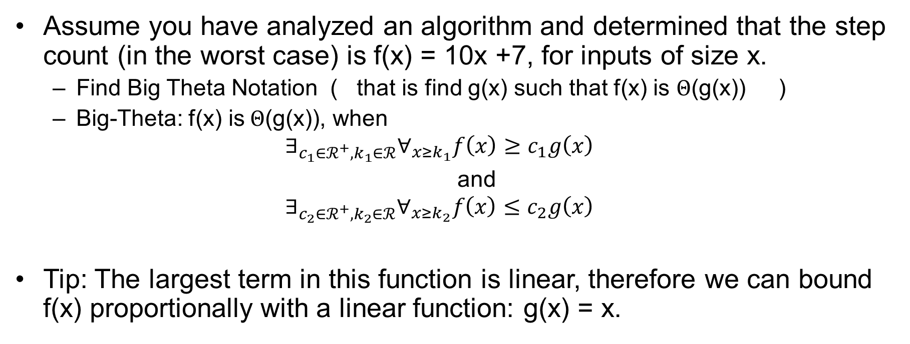
More Examples: Bounding Notation
Assume you have analyzed an algorithm and determined that the step count (in the worst case) is f(x) = 10x +7, for inputs of size x.
  Find Big Theta Notation ( that is find g(x) such that f(x) is $Θ$(g(x)) )
  Big-Theta: f(x) is$Θ$(g(x)), when
  $$∃_{c_{1}∈ℛ^{+}, k_{1}∈ℛ}∀_{x≥k_{1}}f\left(x\right)≥c_{1}g\left(x\right)$$
  and
  $$∃_{c_{2}∈ℛ^{+}, k_{2}∈ℛ}∀_{x≥k_{2}}f\left(x\right)≤c_{2}g\left(x\right)$$
Tip: The largest term in this function is linear, therefore we can bound f(x) proportionally with a linear function: g(x) = x.

Slide 13
Notes about bounding notation
Big-O notation: gives us the upper bound.
  Somewhat informative*
Big-Omega: lower bound
  Somewhat informative*
Big-Theta: identifies the order by which the algorithm will scale (as n become large.)
  Most informative*

Slide 14

Quickly assess the time complexity
  Worst Case: $cn+k+3 , is Θ\text{(}\text{n}\text{)}$
// Searches sequentially for x in array. Returns index of first x, else -1 Step Count
Algorithm SequentialSearch (array, x){
n := length(array); 1
index := -1; 1
for i := 1 to n do{ 3n + 2
if x == array[i]{ n
index := i; 1
break; 1
}end if
} end for
return index; 1
}end SequentialSearch
cn+k
Assuming a constant number of operations per iteration, then the total number of steps is of the form cn+k, where c and k are constants and n is the number of iterations

Slide 15
Time Complexity using Recurrences
Recursion
  Defining an entity in terms of itself
Recurrence
  A relation that characterizes a function in terms of its value on a smaller input
General Idea:
  Many computer science solutions can be defined recursively
  Similarly, many step count functions can be defined using a recurrence

Slide 16
Defining Sequential Search Recursively
Problem: search a list X of length n for some value x
Iterative Perspective
Recursive Perspective
1
3
8
2
0
…
SEARCH for x
1
3
8
2
0
=
…
Compare to x
1
then SEARCH for x
3
8
2
0
…

Slide 17
Time Complexity using Recurrence
Example: Sequential Search
Assess Complexity by Using Recurrence and Induction (using substitution)
  Define algorithm and then step count recursively
    Search(list,x,n) := compare(list[1],x) + Search(remainingList,x,n-1)
      Where remainingList is list less the first item
    T(n) := 1 + T(n-1) , where initial condition T(1) = 1
  “Guess” an upperbound
    E.G. I guess T(n) is O(n)
  Prove it using induction
    Base Case
    Inductive Case
T: recursively defined step count function. T(n) is the total number of comparisons count for searching a list of length n
Notes:
\documentclass[12pt]{exam}
\usepackage[utf8]{inputenc}
\usepackage[margin=1in]{geometry}
\usepackage{amsmath,amssymb,amsfonts}
\usepackage{multicol}
\usepackage{algorithm}
\usepackage[noend]{algpseudocode}
\makeatletter
\def\BState{\State\hskip-\ALG@thistlm}
\makeatother
\begin{document}
\begin{algorithm}[H]
\caption{
\label{no:label}}
\begin{algorithmic}[hhh!]
\Require{X is an array of real numbers of length n, return index of $x \in \mathbb{R}$, else -1}
% \State
\Function{SequentialSearch}{$X, x, n$}
\State $index \gets -1$
\For{$i \gets 1 \textrm{ to } n$}
\If{$x == X[i]$}
\State $index \gets i$
\EndIf
\EndFor
\State \Return{$index$}
\EndFunction
\end{algorithmic}
\end{algorithm}
\end{document}

Slide 18
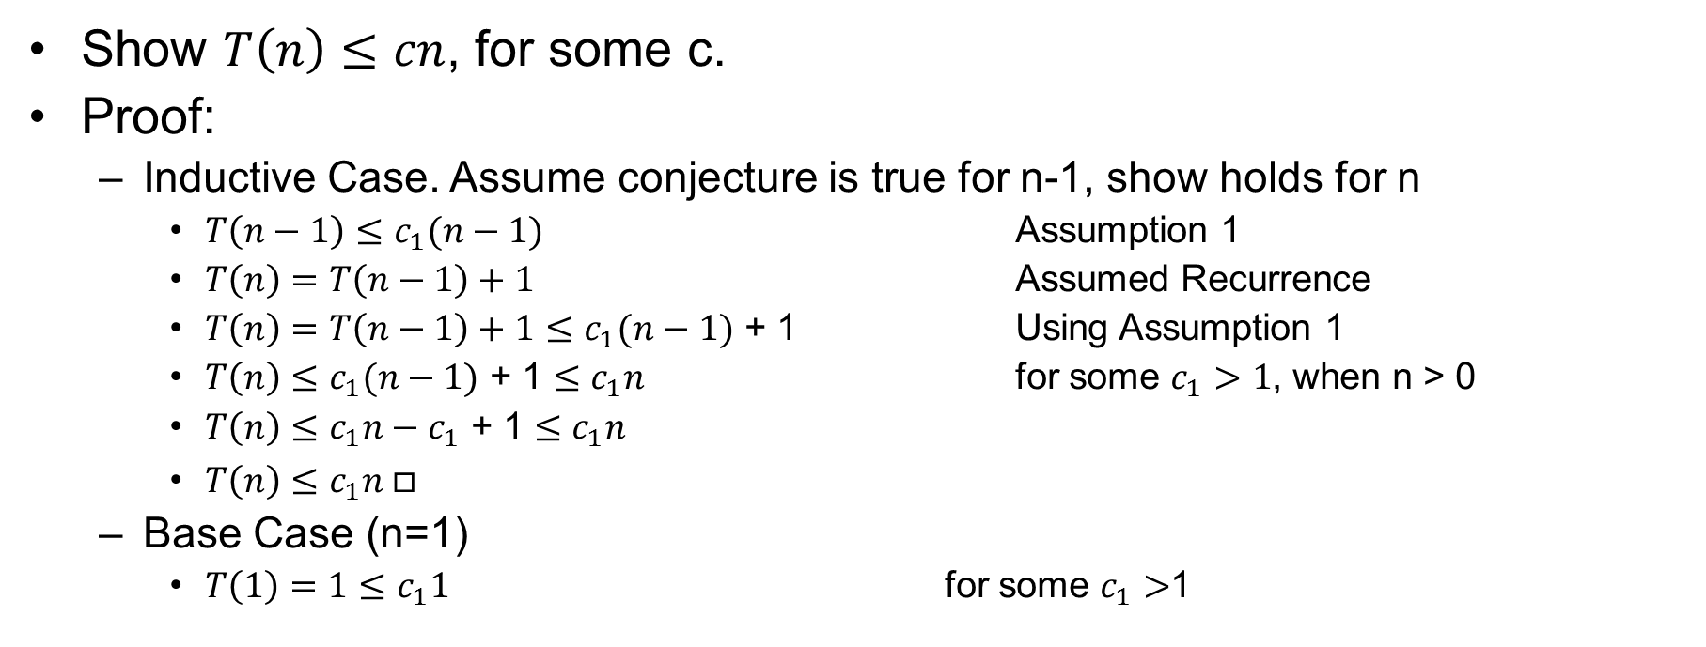
Time Complexity using Recurrence (substitution)
Example: Sequential Search
Show $T\left(n\right)≤cn$, for some c.
Proof:
  Inductive Case. Assume conjecture is true for n-1, show holds for n
    $T\left(n−1\right)≤c_{1}(n−1)$ Assumption 1
    $T\left(n\right)=T\left(n−1\right)+1$ Assumed Recurrence
    $T\left(n\right)=T\left(n−1\right)+1$ $≤c_{1}(n−1)$ + 1 Using Assumption 1
    $T\left(n\right)≤c_{1}(n−1)$ + 1 $≤c_{1}n$ for some $c_{1}>1$, when n > 0
    $T\left(n\right)≤c_{1}n−c_{1}$ + 1 $≤c_{1}n$
    $T\left(n\right)≤c_{1}n □$
  Base Case (n=1)
    $T\left(1\right)=1≤c_{1}1$ for some $c_{1}>$1

Slide 19
Time Complexity using Recurrence
Example: Sequential Search
Assess Complexity by Solving Recurrence (using iteration)
  Define algorithm and then step count recursively
    T(n) := 1 + T(n-1) , where initial condition T(1) = 1
  Enumerate terms in recurrence (forward or backward) until the boundary condition
  Identify sequence or series and use knowledge of series to compute closed form of the total step count. (Solve the recurrence)
  Upperbound if desired.
Notes:
\documentclass[12pt]{exam}
\usepackage[utf8]{inputenc}
\usepackage[margin=1in]{geometry}
\usepackage{amsmath,amssymb,amsfonts}
\usepackage{multicol}
\usepackage{algorithm}
\usepackage[noend]{algpseudocode}
\makeatletter
\def\BState{\State\hskip-\ALG@thistlm}
\makeatother
\begin{document}
\begin{algorithm}[H]
\caption{
\label{no:label}}
\begin{algorithmic}[hhh!]
\Require{X is an array of real numbers of length n, return index of $x \in \mathbb{R}$, else -1}
% \State
\Function{SequentialSearch}{$X, x, n$}
\State $index \gets -1$
\For{$i \gets 1 \textrm{ to } n$}
\If{$x == X[i]$}
\State $index \gets i$
\EndIf
\EndFor
\State \Return{$index$}
\EndFunction
\end{algorithmic}
\end{algorithm}
\end{document}

Slide 20
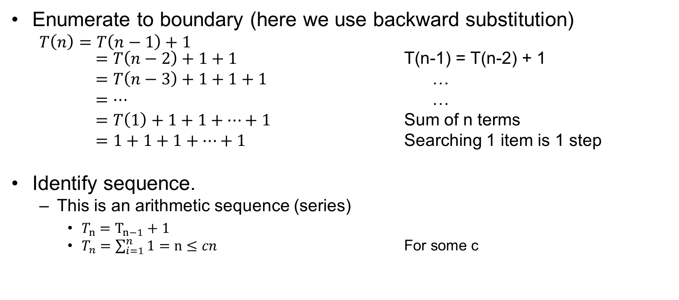
Time Complexity using Recurrence
Example: Sequential Search
Enumerate to boundary (here we use backward substitution)
  $T\left(n\right)=T\left(n−1\right)+1$
  $=T\left(n−2\right)+1+1$ T(n-1) = T(n-2) + 1
  $=T\left(n−3\right)+1+1+1$ …
  $=…$ …
  $=T\left(1\right)+1+1+…+1$ Sum of n terms
  $=1+1+1+…+1$ Searching 1 item is 1 step
Identify sequence.
  This is an arithmetic sequence (series)
    $T_{n}=T_{n−1}+1$
    $T_{n}=\sum_{i=1}^{n}{1}=n≤cn$ For some c

Slide 21
Example: Memory Requirements
Space Complexity
// Searches sequentially for x in array. Returns index of first x, else -1 Memory Count
Algorithm SequentialSearch (array, x){ n+1
n := length(array); 1
index := -1; 1
for i := 1 to n do{ 3
if x == array[i]{ 1
index := i;
break;
}end if
} end for
return index;
}end SequentialSearch

Slide 22
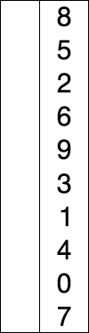
Example: Selection Sort
Selection Sort (conceptually)
  Scan through oldList and find min item
  Remove minItem from oldList and place it next spot at the next index in orderedList
  Repeat
Example
  Lets formalize this algorithm (using pseudocode)
  Lets assess the computational complexity

Slide 23
Recall: Definition of an Algorithm
PROPERTIES OF ALGORITHMS
  Input domain is defined
  Output domain is specified
  The output or result is correct
    Preconditions: logical statements assumed to be true prior to algorithm execution
    Postconditions: logical statements assumed to be true after algorithm execution
  The constituent steps are well-defined
  Each step is performable in finite time

Slide 24
Class Exercise: Lets informally discuss the computational complexity with the goal of improving the efficiency
Sorting Example: Selection Sort
Assess Time and Space Complexities

Slide 25
Sorting Example: Selection Sort
Assess Time and Space Complexities
Space Efficiency: We can perform this operation “in-place”. No need to make another copy of the array.
Observe: we can further improve the efficiency given the new design. We can improve the time efficiency.
Notes:
\documentclass[12pt]{exam}
\usepackage[utf8]{inputenc}
\usepackage[margin=1in]{geometry}
\usepackage{amsmath,amssymb,amsfonts}
\usepackage{multicol}
\usepackage{algorithm}
\usepackage[noend]{algpseudocode}
\makeatletter
\def\BState{\State\hskip-\ALG@thistlm}
\makeatother
\begin{document}
\begin{algorithm}[H]
\caption{
\label{no:label}}
\begin{algorithmic}[hhh!]
\Require{X is an array of real numbers of length n}
% \State
\Function{SelectionSort}{$X, n$}
\For{$i \gets 1 \textrm{ to } n$}
\For{$j \gets i \textrm{ to } 2$}
\If{$X[j-1] > X[j]$}
\State $temp \gets X[j]$
\State $X[j] \gets X[j-1]$
\State $X[j-1] \gets temp$
\EndIf
\EndFor
\EndFor
\State \Return{$Y$}
\EndFunction
\end{algorithmic}
\end{algorithm}
\end{document}

Slide 26
Sorting Example: Selection Sort
Assess Time and Space Complexities

Slide 27
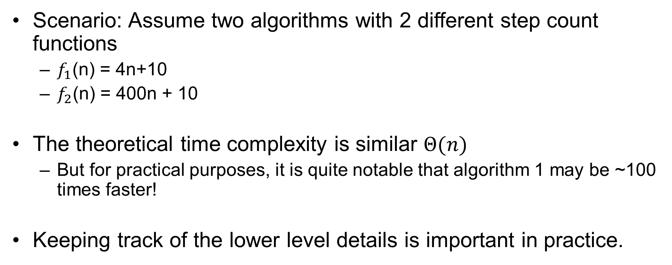
Practical vs Theoretical Complexity Analysis
Scenario: Assume two algorithms with 2 different step count functions
  $f_{1}$(n) = 4n+10
  $f_{2}$(n) = 400n + 10
The theoretical time complexity is similar $Θ(n)$
  But for practical purposes, it is quite notable that algorithm 1 may be ~100 times faster!
Keeping track of the lower level details is important in practice.

Slide 28
Other Practical Notes about Computational Complexity
The process of theoretically analyzing algorithms is (over) simplified.
  Differences in data types may be ignored
    BUT some different data types have significantly different memory requirements and computational requirements
  Differences in operations may be ignored
    BUT not all operations require the same amount of runtime
      Bit-wise operator vs. addition (of ints) vs multiplication (of floats)
  Details in implementation / application may be significant in practice!

Slide 29
The Devil is in the Details
Time
  Not all basic operations have the same computation time!
Memory
  Not all data types take up the same amount of memory!
  Increase in memory used will generally increase computation time!
  Details of implicit memory management details can have drastic effects on space (and time) complexity
    Pass by value vs pass-by-reference
    Deep vs shallow copy
  Memory Constraints
    Virtual memory – hard disk retrieval
    Memory capacity and paging
These details will affect complexity counts (and possibly the order of complexity)
  Using operators and memory management schemes smartly can drastically improve efficiency

Slide 30
Outline
Computational Complexity
  Time
    Upperbounding Notation
    Formalizing using Recurrences
  Space
    Recursion: Implications on Space Complexity
Memory Management and Implementation Details
  Pointers
  Allocation on Stack vs Heap
Good Programming Practices
  Design
  Debug

Slide 31
Memory Requirements
Counting memory requirements of an algorithm
  Where is the data allocated … and who cares!
    Stack vs heap
      A peak into the stack
      Recursion and memory requirements
Memory requirements of data structures
  Indigenous data vs exogenous data
  Deep copy vs shallow copy
Memory Notes:
  Theoretical analysis: some include size of input, some do not
  Practical analysis: are parameters pass by value vs. pass by reference
    The parameters are stored somewhere in memory, but are they going to be copied onto the stack. If so, then you should certainly include the space in your memory requirements
    When should you pass-by-copy?

Slide 32
Basic Designs for Structures
Contiguous vs non-contiguous memory allocation
  Arrays
    Size does not change.
    Data stored contiguously (in memory) in computer.
    Data can be directly accessed.
  Chaining (eg linked lists)
    Size can change dynamically
    Data may not be stored contiguously in memory.
    Data is accessed only by traversing the list.

Slide 33
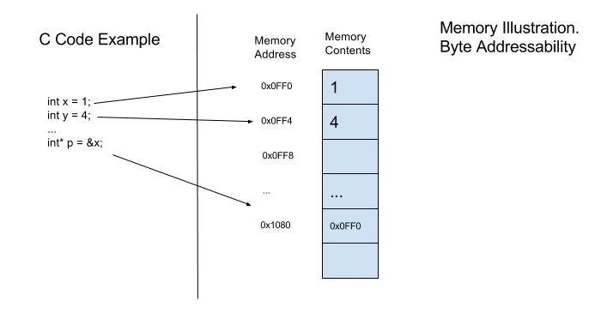
Review: Pointers
Pointers are variables that contain the address of another variable
  Allows for efficient processing of large structures
  Example:
    Assumes 4 byte ints

Slide 34
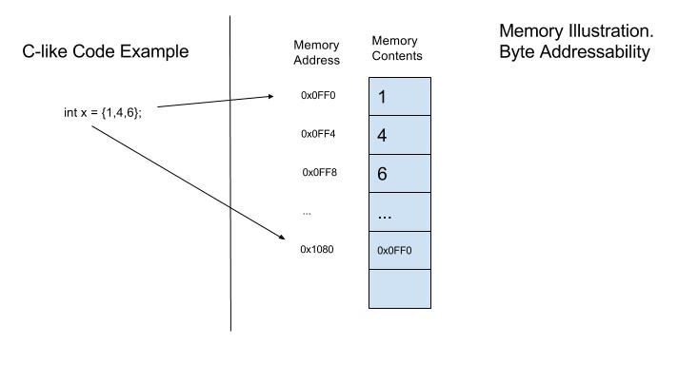
Arrays in Memory
An array is a list of data stored contiguously in memory.
  Its contiguous nature is both an advantage and a disadvantage.
    Pro: items in the list can be quickly accessed given the base address and an offset
    Con: memory must allocated (reserved) when the array is created. As a result, the size cannot change.
In C++, array names are pointers to the base address of the array
  Bracket Notation
    x[1] evaluates to 2
  Pointer Notation
    *(x+1) evaluates to 2

Slide 35
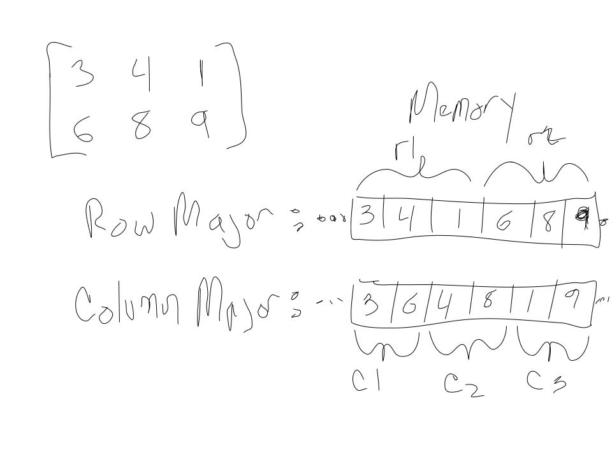
Multi-dimensional Arrays in Memory
Multi-dimensional arrays are stored in memory similarly as one-dimensional arrays
  Memory can be seen as a linear structure.
Row-Major: rows are stored in sequence
Column-Major: columns are stored in sequence

Slide 36
Lists using “Chaining”
Some lists can change size once created. This is generally accomplished by chaining.
  The data cannot necessarily be stored contiguously in memory in this instance (as the memory is not allocated at one time.) Thus the data may not be sequentially contiguous in memory.
    But then how can we can we access items in the list?
    This extra flexibility comes at the cost of storing 1 pointer per data item stored. This pointer will point to the next item in the list, thus facilitating a “linked” list.
A linked (or chained) structure in memory

Slide 37
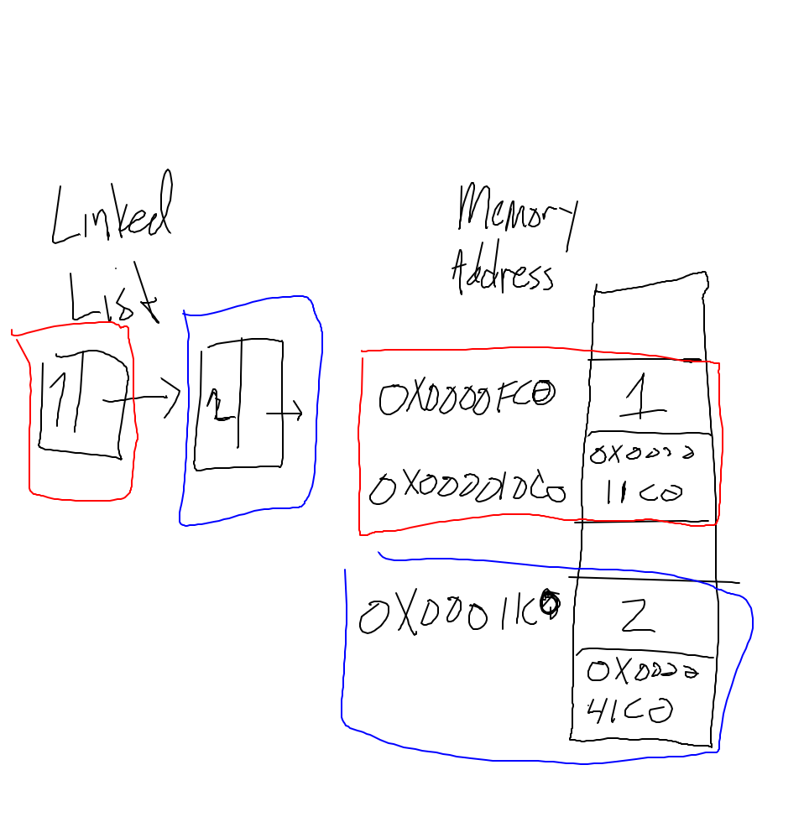
Linked Lists in Memory
A linked list example
  Each node is stored in memory, but subsequent nodes are not necessary contiguous in memory. The “next” field is used to point to the next item in the list. The next field is simply a pointer stored in memory.

Slide 38
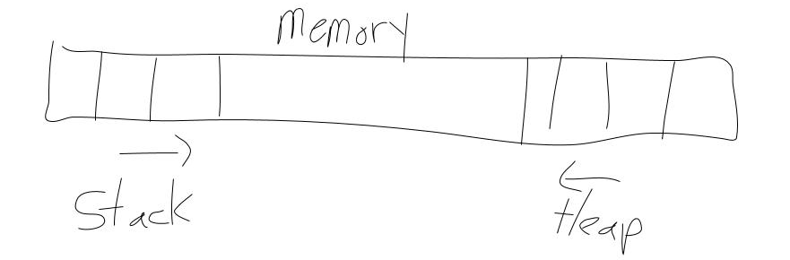
Memory Allocation (in practice)
Memory: Stack vs. Heap
  Most local variables are allocated on the runtime stack.
    The stack is largely “self-managing”.
  If the size of a data structure is not known at compile time, it can be allocated on the heap.
    Often the onus of memory management falls on the programmer
  Memory Management: Managing your data (and structure)
    The run-time stack largely manages itself
    The heap may require explicit deallocation (Garbage Collection).
      Memory Leaks.
      Dangling Pointers
…
…

Slide 39
Memory and the Runtime Stack (in practice)
In most programming languages, when a new scope is opened, (e.g. a function is called), a new frame of memory is reserved for all variables local to that scope (as well as some memory other data / variables such as input parameters, return values, intermediate calculations, … ).
Each scope or frame of memory is reserved on a dynamically-allocated, contiguous portion of memory referred to as the runtime stack.
  Function call chains
  Recursion example

Slide 40
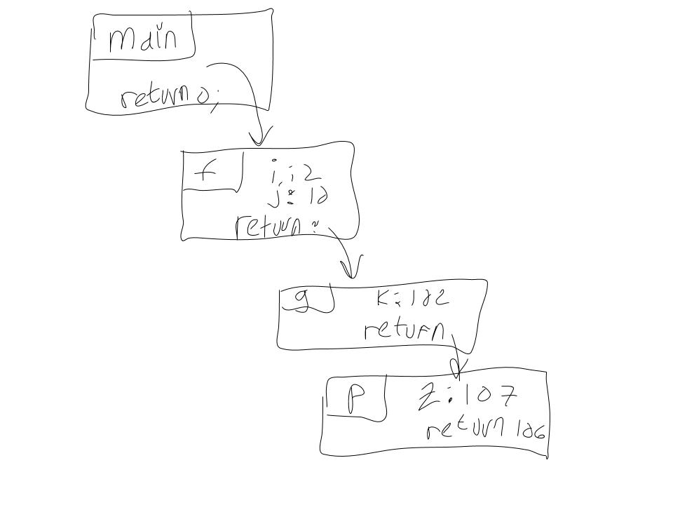
Scope Diagram: A common way to illustrate function call chains (flow of execution and variable values)
int f(int i)
{
int j = 10;
return g(i + 10 * j);
}
int g(int k)
{return p(k + 5);}
int p(int z)
{cout << z;
return z - 1;
}
int main()
{ f(2); return 0; }

Slide 41
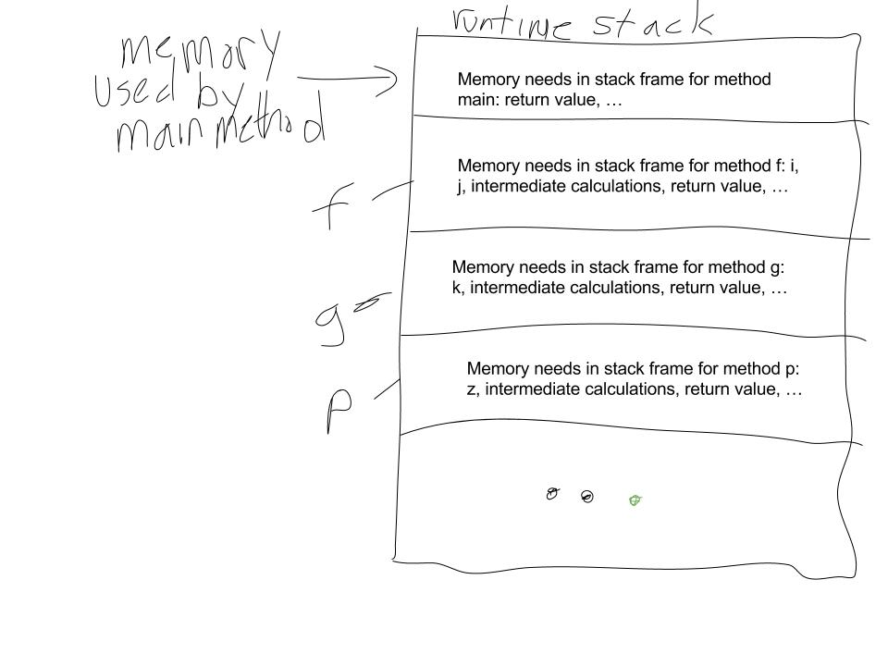
Function call chain and the runtime Stack
int f(int i)
{
int j = 10;
return g(i + 10 * j);
}
int g(int k)
{return p(k + 5);}
int p(int z)
{cout << z;
return z - 1;
}
int main()
{ f(2); return 0; }

Slide 42
Recursion
Recursive methods can greatly impact memory allocation
Recursive methods are methods that are defined in terms of themselves.
Many processes and calculations that involve repetition can be implemented recursively.

Slide 43
Recursion Example: Factorial
Write a function to calculate n! where n is the input argument
n! = n*(n-1)*(n-2)*… *2*1
n! = n*(n-1)!
factorial(n) =n*factorial(n-1)
Note that this calculation is inherently repetitive.
  There is repeated multiplication to be performed
  Further note that the number of multiplications is dependent on “n” that is the input parameter will control the number of repetitive computations (multiplications in this case)

Slide 44
Factorial Examples
int factorial(int n)
{
//Assumes non-negative n
int val = 1;
for (int i = n; i > 1; i--;) // repeatedly take product of values between 1 and n
val = val * i;
return val;
}
int factorial(int n)
{
// Assumes n is non-negative
int val = 1;
if (n == 0 || n == 1) // Base case -- stop repetition
return 1;
else // recursive case -- continue recursive call
return n * factorial(n - 1);
}

Slide 45
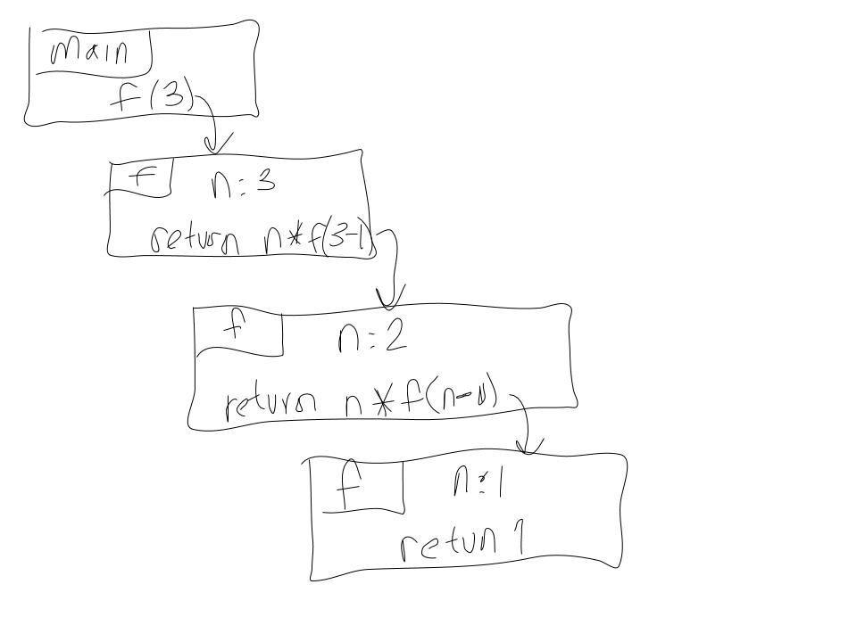
Draw Scope (function chain) diagrams to trace the execution of a recursive function.
int f(int n)
{
// Assumes n is non-negative
int val = 1;
if (n == 0 || n == 1) // Base case -- stop repetition
return 1;
else // recursive case -- continue recursive call
return n * f(n - 1);
}
void main()
{f(3);}

Slide 46
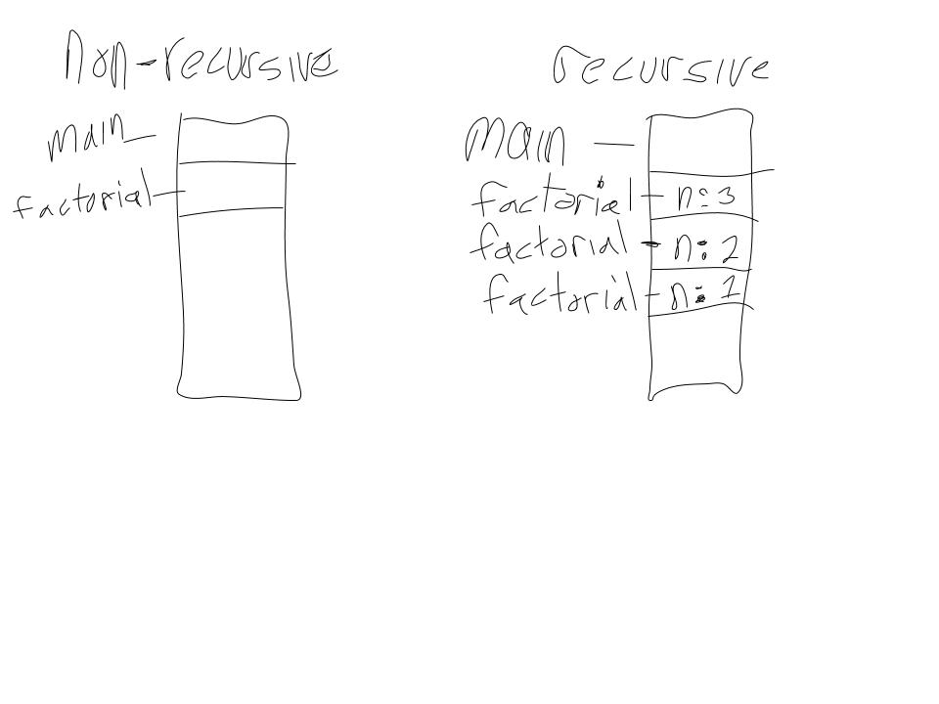
Recursion (and non-recursion) and the Stack
int factorial(int n)
{
//Assumes non-negative n
int val = 1;
for (int i = n; i > 1; i--;) // repeatedly take product of values between 1 and n
val = val * i;
return val;
}
int factorial(int n)
{
// Assumes n is non-negative
int val = 1;
if (n == 0 || n == 1) // Base case -- stop repetition
return 1;
else // recursive case -- continue recursive call
return n * factorial(n - 1);
}

Slide 47
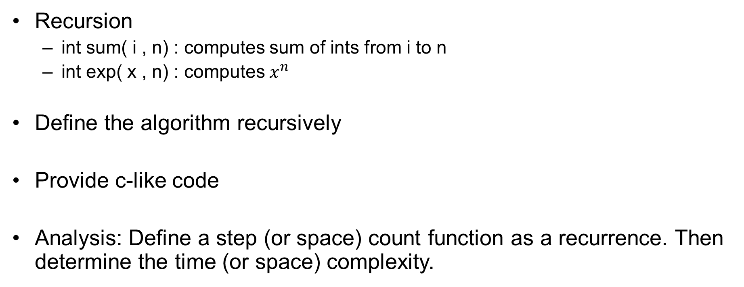
In-Class (or at-home) Example
Recursion
  int sum( i , n) : computes sum of ints from i to n
  int exp( x , n) : computes $x^{n}$
Define the algorithm recursively
Provide c-like code
Analysis: Define a step (or space) count function as a recurrence. Then determine the time (or space) complexity.

Slide 48
Heap Allocation, basic memory management, garbage collection
If the size (memory needed) of a variable (data) is known at compile time, it can be allocated on the stack; otherwise, if the size of the variable is not known at compile time, it can be allocated on the heap.
Variables allocated on the heap are accessed using pointers. Allocation is on the heap is sometimes explicitly declared syntactically. Example: C++ and the keyword “new”.
Data allocated on the heap may be explicitly deallocated (collect the garbage). Example: C++ and the keyword “delete”.

Slide 49
Common Memory Management Issues
Dangling Pointer
  A structure in memory has been deallocated, but the pointer still points to this place in memory.
    Problem: pointer points to some place in memory, but the data there may no longer be valid.
    Corrective Measure: Set pointer to null to clearly indicate pointer points nowhere.
Memory Leak
  When a pointer no longer points to some structure in memory, and the structure has not been deallocated.
    Problem: Data is stored in memory, however it can no longer be accessed (or explicitly deleted!!!)
    Corrective Measure: Pray to the garbage-collection gods.

Slide 50
Memory Usage (cont): Deep vs Shallow Copy
Data is copied often in computer programs
  Assignment
  Parameter passing
  Return values
Shallow copy – a simple bitwise copy.
  May (or may not) be good when dealing with pointers
  EG: pass by reference
Deep copy – pointers are dereferenced and the data pointed to by the pointer is copied.
  EG (C++): overloading the =operator or copy constructor

Slide 51
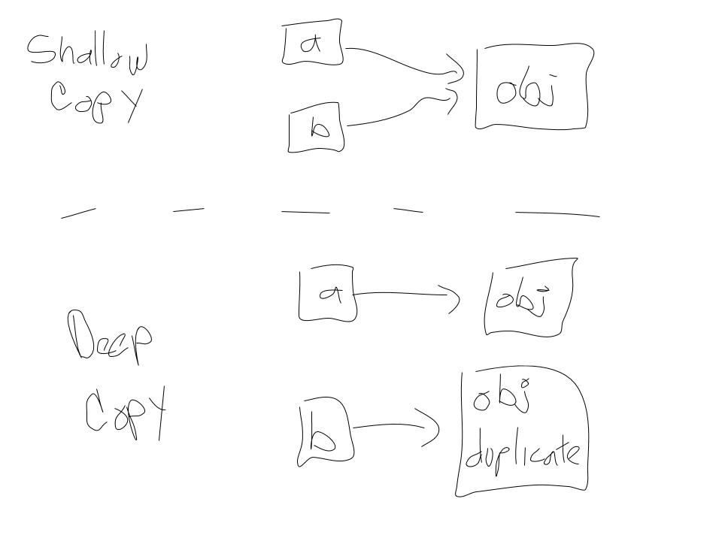
Copy Example
Assume a and b are pointers. Assign b to a.
a := b

Slide 52
Data Storage Hierarchy (in practice)
Another practical issue related to algorithm analysis and implementation is RAM limitations and retrieving data from secondary storage.
  Over-Simplified Summary: Retrieving data from secondary storage is very slow, and thus data is loaded to cache and RAM memory for processing. RAM is very versatile but has limitations. Some data structures may be large enough such that data will need to be continuously retrieved and restored back to secondary storage (thrashing).
  Understanding RAM and Caching limitations and schemes on a computer is important when designing large data structures.
Possible ways to mitigate these issues
  Localize processing to subsets of the data.
  Traverse and organize data smartly
    Row-major vs column major

Slide 53
Code Example: Row Major vs Col. Major
// Efficient Traversal for Row -Major
for (int i = 0;i< numRows; i++)
for (int j = 0; j < numCols; j++)
c[i][j] = i + j;
// Efficient Traversal for Col-Major
for (int j = 0;j< numCols; j++)
for (int i = 0; i < numRows; i++)
c[i][j] = i + j;

Slide 54
Outline
Computational Complexity
  Time
    Upperbounding Notation
    Formalizing using Recurrences
  Space
    Recursion: Implications on Space Complexity
Memory Management and Implementation Details
  Pointers
  Allocation on Stack vs Heap
Good Programming Practices
  Design
  Debug

Slide 55
Good Structure Design Schemes
Project design details are largely up to you, but I encourage you to abide by good coding practices.
  This will benefit you and anyone who might use or read your code.
Design for usability, reusability, efficiency, ….
  Object Oriented Programming Design
    Inheritance (writeability, reusability )
    Encapsulation (reliability)
    (Poly) Dynamic dispatch (writeability, flexibility, reusability)
  Templates
    Explicit “polymorphism” (reusability, writeability)
Some simple computational complexity tips

Slide 56
OOP Design
Classes / Structs provide for a fitting programming construct to represent data structures.
Appropriately designing classes and class hierarchies will improve the effectiveness of your code
  Reusability
  Readability
  Writeablility

Slide 57
Templates in C++
Templates / Generics allow for explicit “polymorphism” which promotes
  Flexibility
  Reusability
  Readability
  Writeablility

Slide 58
Debugging and Testing
Time distribution:
  Planning Designing: 1/3
  Actual Coding: 1/3
  Testing / Debugging: 1/3
Design a good testing scheme for your software.
  Repeatedly code, then test, code, then test, …
  In theory, you want to assure that your program produces the correct output for all possible inputs
  In practice, select a subset of inputs that “efficiently” test your program.
    EG: Include test input values such that each branch in execution flow is tested.

Slide 59
Programming Process (details)
Design
  Structural and procedural schematics
    UML class diagrams for all structures.
    Flow diagrams for all methods / procedures
  Confirm the correctness of your design with some examples.
Iteratively Code and Test
  Start with an empty code file
  Add one line of code (or a few lines of code): compile and if possible run on some sample input.
    If you have a compilation error or a runtime error, you have added a line of code that introduces an error (either syntax error or semantic error).
    The good news – you have found the error: it is on the line you have just added (almost always)! Finding the error is generally the hardest part of debugging – this is indeed good news!
    Fix the error and repeat.
Final Testing
  Once your code seeming runs correctly on the sample input, try on a larger set of sample inputs. In theory, you want to assure that your program produces the correct output for all possible inputs – this is generally not practical, therefore you must create or select a set of inputs that test all or most potential flows of execution of your code.

Slide 60
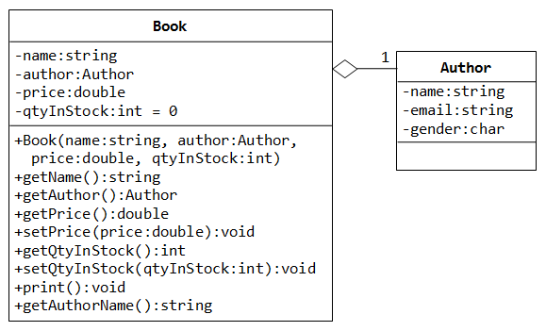
Design
Structural: entities or classes of your program
  UML class diagram
  ERD
  Lists and may describe the attributes of the major components of your program (classes if using OOP)
Procedural: the methods of your program
  Flow diagram
  Identifies the sequence of steps necessary to successfully complete a procedure or function.

Slide 61
Some Final Computational Complexity Tips
Time
  If possible, remove statements from loops.
  If possible, use operators that are fast.
  Avoid excessive recursion.
  Use mathematical properties to your advantage
  Use practical understanding of computers to your advantage.
Memory
  Large structures:
    Pass by reference / global*
    Manage large structures “intelligently” to account for memory / hardware delays
  Use “minimally sufficient” data types
    EG: Don’t use a double if an int will suffice.
  Avoid (excessive) recursion (unnecessary memory usage).
  Use practical understanding of computers to your advantage.

