Slide 1
COSC160: Data Structures
Jeremy Bolton, PhD
Assistant Teaching Professor

Slide 2
Outline
Stereopsis
  Motivation
  Problems
  Image rectification
Matching criteria
  Energy Minimization
    Local Search (heuristic or brute force)
    Dynamic Programming
    Graph Cuts
Discussion: Statistical Approaches
Other non-stereo schemes

Slide 3
Outline
Stereopsis
  Motivation
  Problems
  Image rectification
Matching criteria
  Energy Minimization
    Local Search (heuristic or brute force)
    Dynamic Programming
    Graph Cuts
Discussion: Statistical Approaches
Other non-stereo schemes

Slide 4
Goals of Stereo Matching
Given two or more images of the same scene or object, compute a representation of its shape
What are some possible representations?
  depth maps
  volumetric models
  3D surface models

Slide 5
Stereo
scene point
What is gained from stereo?
  Assuming we know …
    Geometric details (extrinsic and intrinsic parameters), and
    Corresponding pixels in each image,
  We can directly extract depth information.
What could go wrong?
  Geometric details often unknown
  Finding corresponding pixels is difficult!
  Error: Vectors from corresponding image coordinates rarely intersect (perfectly).
    There are many sources of unknowns and error.
image plane
optical center

Slide 6
Stereo
Binocular Reconstruction: Estimating depth from stereo
  Common Approaches:
    Simple Triangulation: Gives reconstruction as intersection of two rays
      Requires camera origins and pixel correspondences (enough information to characterize both rays)
    Inverse Transformation Approach: Project both image coordinates to the 3-D scene using Each Cameras projection matrix
      Requires pixel correspondence and projection matrix of each camera (intrinsic and extrinsic parameters)

Slide 7
Triangulation
Recall, camera projection matrix P, determines homography from point in 3-d scene to image plane.
Conceptually The reverse map projects a point from the image plane, to a line in 3-d
Since these vectors rarely intersect in practice, it is common to find the point nearest to the two lines

Slide 8
Triangulation
The ray v can be determined using the information contained in Camera Matrix or simply using two points c_{j} and x_{j}
The nearest point to p on ray v_{j} is q_{j}
This point can be characterized by a distance and directional vector d_{j} v_{j}, and minimizes the following “error” (deviation from true p).
The squared error r_{j} can be computed, and thus value for p that minimizes this error can be computed using a least squares projection
Minimum is when d_{j} is projection of v_{j} onto (p-c_{j})

Slide 9
Simple Triangulation Solution
Observe: Here we solved for p without using the projection matrix. Only using camera centers c and vectors (corresponding to points x) v.

Slide 10
Algebraic Approach
Algebraically, we can alternatively make use of the camera matrix P (if these parameters are known or have been learned during calibration)
Given known pixel correspondences, (x,y) and (x,y) we can construct a series of linear equations and solve for the 3-D point (homogeneous) p = (X,Y,Z,W).
Note there are 4 unknowns. How many images of the scene are needed to compute the location of point p?

Slide 11
Notes about reconstruction
Requires information about cameras and pixel correspondences.
Finding pixel correspondences is difficult in practice
  Search over all pairs of pixels looking for similar pixel values?
  Can we simplify this search?

Slide 12
Outline
Stereopsis
  Motivation
  Problems
  Image rectification
    Essential Matrix
Matching criteria
  Energy Minimization
    Local Search (heuristic or brute force)
    Dynamic Programming
    Graph Cuts
Discussion: Statistical Approaches
Other non-stereo schemes

Slide 13
Epipoles
Background
  For two images (or images with collinear camera centers), can find epipolar lines
  Epipolar lines are the projection of the pencil of planes passing through the centers

Slide 14
Epipoles
A pixel in one image x₀ exists at some point along a line in 3D.
Thus its corresponding point in another image x₁ will be found somewhere along that lines projection into the second images plane (epipolar line segment).
  Reduces search to find correspondence
Points p, x₁, x₂, c₁, c₂, e₁, and e₂ lie on the epipolar plane.
  x: coordinates in image plane
  c: camera centers
  e: epipoles

Slide 15
Image Rectification
Rectification: Warp the input images (perspective transformation) so that epipolar lines are horizontal
  Simplifies stereo correspondence search along horizontal lines
  Simplifies disparity (and therefore depth) computation

Slide 16
Stereo correspondence
Determine Pixel Correspondence
  Pairs of points that correspond to same scene point
epipolar line
epipolar plane
epipolar line
Epipolar Constraint
  Reduces correspondence problem to 1D search along conjugate epipolar lines

Slide 17
Image Warping for Image Rectification
Goal: Warp image(s) so corresponding epipolar lines are horizontal and/or co-align.
  Choose coordinate system to map both images … or for simplification… Choose one of the image coordinate systems (and warp the other image to this coordinate system, rather than warping both).
  Using knowledge of Camera Matrix, Homography, and Epipolar Constraint compute the appropriate Warping Matrix (Essential or Fundamental).
    Camera Motion Model: Instrinsics are known, working in normalized image space
    General model: accounts for intrinsics, scale, skew, …
    Simple Solution 1: Choose a plane parallel to the baseline.
    SS 2, Weak perspective assumption: Project onto planar scene
  Perform Warp.

Slide 18
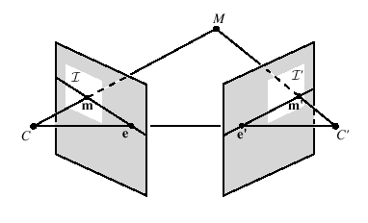
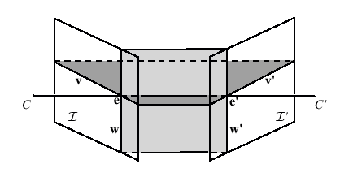
Rectification
Project each image onto same plane, which is parallel to the epipole
Resample (interpolate) lines (and shear/stretch) to place lines in correspondence, and minimize distortion
[Loop and Zhang, CVPR’99]

Slide 19
Deriving the Epipolar Constraint
Find projection matrix from one image to the other.
Conceptually, given a camera matrix P, we can map a point to the image plane. The reverse transformation will map the image coordinate to a line (or point if we know the depth)
If the Camera matrix for the second image is known, we can then map to the second image

Slide 20
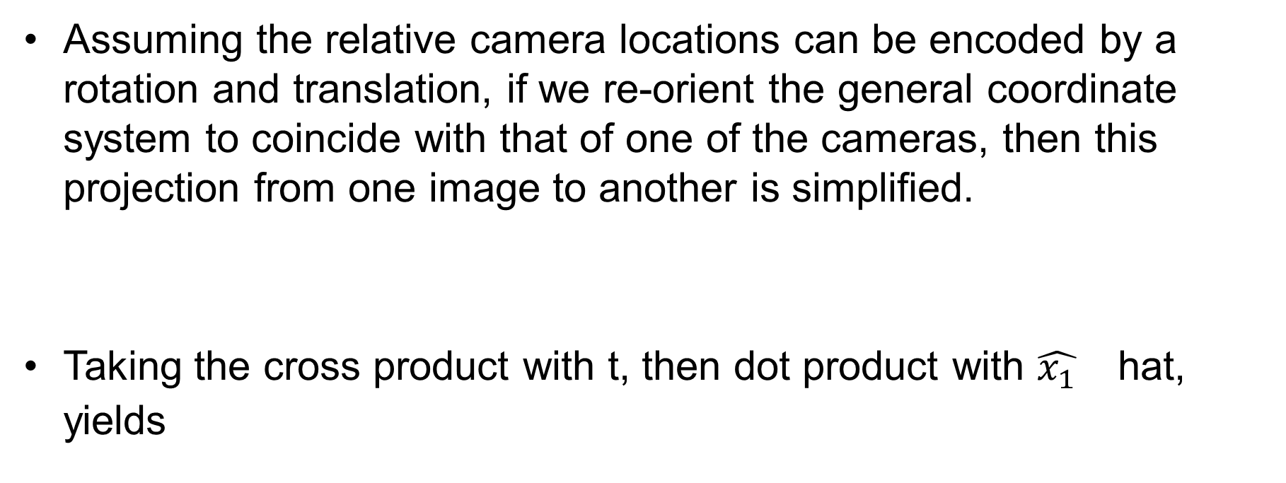
Deriving the Epipolar Constraint
Assuming the relative camera locations can be encoded by a rotation and translation, if we re-orient the general coordinate system to coincide with that of one of the cameras, then this projection from one image to another is simplified.
Taking the cross product with t, then dot product with ${\hat{x_{1}}}_{}$ hat, yields

Slide 21
Thus the Epipolar constraint
E is referred to as the Essential Matrix
Observe that E projects some point in image 1 to a line in image two. Give the equation above, E can be learned using point correspondences.

Slide 22

Fundamental matrix
These matrices E and F are called
  the “Essential Matrix”
    when image intrinsic parameters are known
  the “Fundamental Matrix”
    more generally (uncalibrated case)
Can solve for E or F from point correspondences
  Each (p, p’) pair gives one linear equation in entries of F

Slide 23
Stereo image rectification

Slide 24
Stereo image rectification
Image projection
  project image planes onto common (there are two degrees of freedom for this projection)
  Goal: projection results in epipolar lines being horizontal image scans
    plane parallel to line between optical centers
  a homography (3x3 transform)
  applied to both input images
  pixel motion is horizontal after this transformation
  C. Loop and Z. Zhang. Computing Rectifying Homographies for Stereo Vision. IEEE Conf. Computer Vision and Pattern Recognition, 1999.

Slide 25
Stereo: epipolar geometry
Match features along epipolar lines
epipolar line
epipolar plane
viewing ray

Slide 26
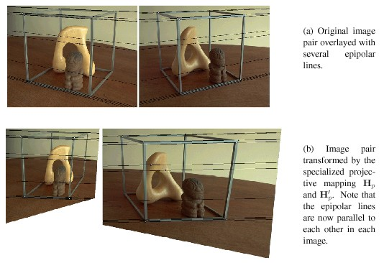
Rectification: Examples
BAD!

Slide 27
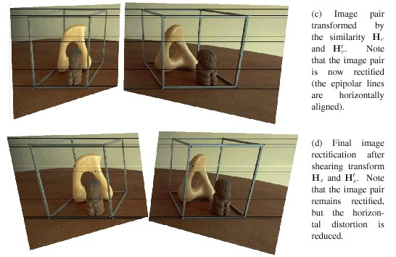
Rectification: Examples
GOOD!

Slide 28
Outline
Stereopsis
  Motivation
  Problems
  Image rectification
Matching criteria
  Local Search (heuristic or brute force)
  Energy Functional Minimization
    Dynamic Programming
  Graph Cuts
    Min cuts
Discussion: Statistical Approaches
Other non-stereo schemes

Slide 29
Stereo Matching
What are some possible algorithms?
  match “features” and interpolate
  match edges and interpolate
  match all pixels with windows (coarse-fine)
  Pose as optimization problem:
    iterative updating
    dynamic programming
    energy minimization (regularization, stochastic)
    graph algorithms

Slide 30
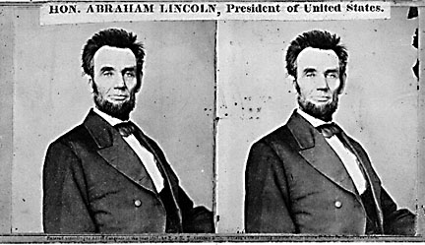
Your basic stereo algorithm
For each epipolar line
For each pixel in the left image
    compare with every pixel on same epipolar line in right image
    pick pixel with minimum “match” cost
Improvement: match windows
  Can use Lukas-Kanade (will discuss later!)

Slide 31
Stereo matching algorithms
Match Pixels in Conjugate Epipolar Lines
  Assume brightness constancy
  This is a tough problem
  Numerous approaches
    dynamic programming [Baker 81,Ohta 85]
    smoothness functionals
    more images (trinocular, N-ocular) [Okutomi 93]
    graph cuts [Boykov 00]
  A good survey and evaluation: http://www.middlebury.edu/stereo/

Slide 32
Matching criteria
Raw pixel values (correlation)
Band-pass filtered images [Jones & Malik 92]
“Corner” like features [Zhang, …]
Edges [many people…]
Gradients [Seitz 89; Scharstein 94]
Rank statistics [Zabih & Woodfill 94]

Slide 33
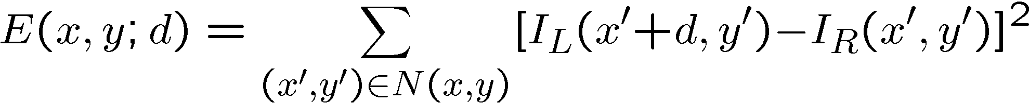
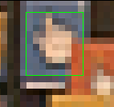
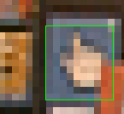
Parameterize using disparity d
How do we determine correspondences?
  block matching or SSD (sum squared differences)
  d is the disparity (horizontal motion)
How big should the neighborhood be?
Why is disparity d so important?
Notes:
The key to image mosaicing is how to register two images.
And the simplest case for image registration is block matching, or estimating the translational motion between two images. Suppose a template (for example, the green box) or even the whole image moves with the same translation, we can estimate the motion by minimize the squared difference between two images. For instance, we can search the minimum squared error by shifting the template window around its neighborhood.

Slide 34
Stereo matching as energy minimization
Matching Cost Formulated as Energy
  “data” term penalizing bad matches
  “neighborhood term” encouraging spatial smoothness

Slide 35
Outline
Stereopsis
  Motivation
  Problems
Approaches
  Image rectification
Matching criteria
  Energy Minimization
    Local Search (heuristic or brute force)
    Dynamic Programming
    Graph Cuts
Discussion: Statistical Approaches
Other non-stereo schemes

Slide 36
Dynamic Programming Solution
Finding image pixel correspondences across epipolar lines is analogous to finding a min path across a graph where nodes are all possible pairwise correspondences.
The path cost is the energy or error function.
Smoothness constraints limit the nature of the path on the graph.
Dynamic programming assumption:
  Optimal path consists of optimal subpaths,
  assuming ordering constraint holds.

Slide 37
Ordering Constraint
Ordering Constraint: Point correspondences should have the same relative order to other correspondences.
  Not necessarily true in all cases, but assumed here.

Slide 38
Finding the optimal path
Assume two images with epipolar lines with only 6 pixels (or 6 features). Find correspondences. Assume C(1,1) = 0, as boundary condition.
Cost of adding an edge to the path
  Pixel or feature difference (+ smoothness)

Slide 39
Pseudo-code for DP Stereo Correspondence
Forward – Backward Algorithm
Repeatedly, scan forward and find next correspondence based on cost/energy function.
Keep track of back pointer and trace back to find optimal path.

Slide 40
Dynamic programming
Can we apply this trick in 2D as well?
d_{x-1,y}
d_{x,y}
d_{x-1,y-1}
d_{x,y-1}
Not really: d_{x,y-1} and d_{x-1,y} may depend on different values of d_{x-1,y-1}

Slide 41
Outline
Stereopsis
  Motivation
  Problems
Approaches
  Image rectification
Matching criteria
  Energy Functional Minimization
    Local Search (heuristic or brute force)
    Dynamic Programming
    Graph Cuts
Discussion: Statistical Approaches
Other non-stereo schemes

Slide 42
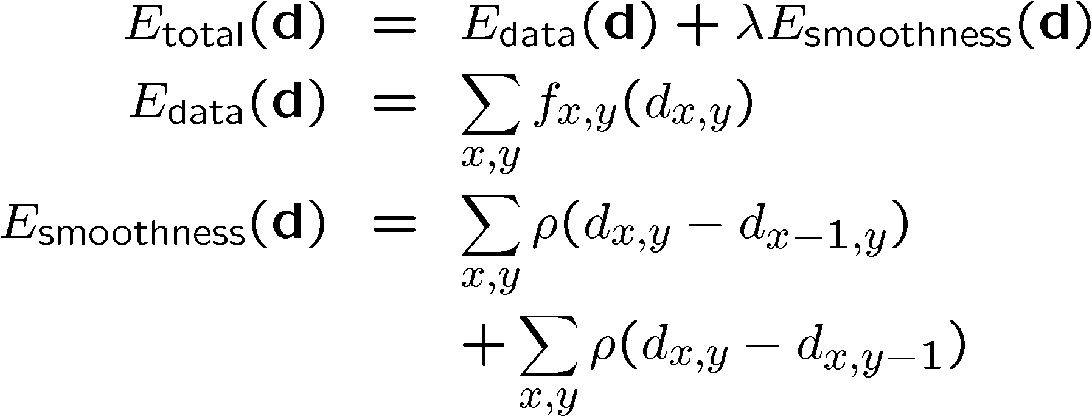
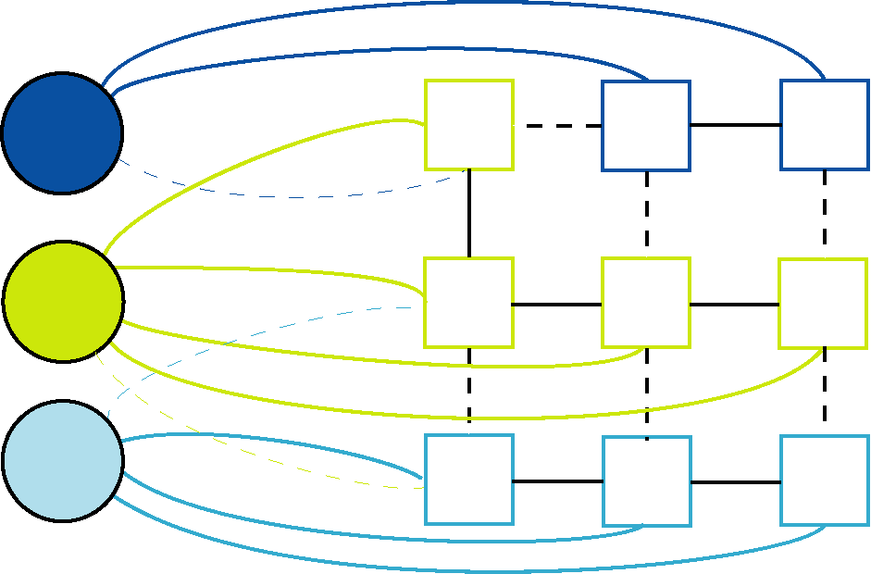
Graph cuts
Solution technique

Slide 43
Stereo as a graph problem [Boykov, 1999]
edge weight
d₃
d₂
d₁
edge weight
Labels
(disparities)
Pixels

Slide 44
Graph definition
d₃
d₂
d₁
Initial state
  Each pixel connected to it’s immediate neighbors
  Each disparity label connected to all of the pixels

Slide 45
Stereo matching by graph cuts
d₃
d₂
d₁
Graph Cut
  Delete enough edges so that
    each pixel is (transitively) connected to exactly one label node
  Cost of a cut: sum of deleted edge weights
  Finding min cost cut equivalent to finding global minimum of the energy function

Slide 46
Computing a multiway cut
With two labels: classical min-cut problem
  Solvable by standard network flow algorithms
More than 2 labels: NP-hard [Dahlhaus et al., STOC ‘92]
  But efficient approximation algorithms exist
    Yuri Boykov, Olga Veksler and Ramin Zabih, Fast Approximate Energy Minimization via Graph Cuts, International Conference on Computer Vision, September 1999.
  Basic idea
    reduce to a series of 2-way-cut sub-problems

Slide 47
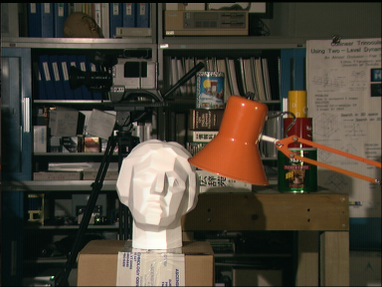
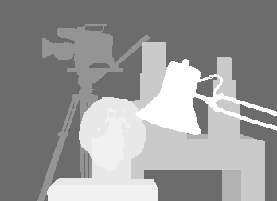
Stereo results
  Data from University of Tsukuba
  Similar results on other images without ground truth
Scene
Ground truth

Slide 48
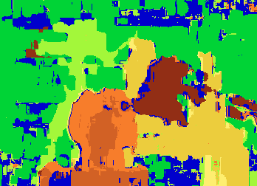

Results with window search
Window-based matching
(best window size)
Ground truth

Slide 49
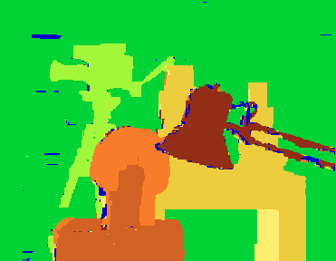
Better methods exist...
State of the art method
  Boykov et al., Fast Approximate Energy Minimization via Graph Cuts,
  International Conference on Computer Vision, September 1999.
Ground truth

Slide 50
Outline
Stereopsis
  Motivation
  Problems
Approaches
  Image rectification
Matching criteria
  Energy Functional Minimization
    Local Search (heuristic or brute force)
    Dynamic Programming
  Graph Cuts
    Min cuts
Discussion: Other Approaches

Slide 51
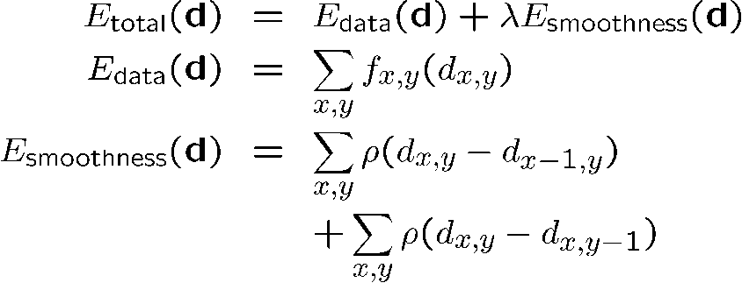
Other Approaches
Variational Approach
  Find function that optimizes energy functional
  Common vision constraints are interpreted as constraints on kth derivatives of the function.
    Regularization
Probabilistic Approach
  Energy minimization is analogous to maximizing probabilities

Slide 52
Example: Bayesian inference
Formulate as statistical inference problem
Prior model p_{P}(d)
Measurement model p_{M}(I_{L}, I_{R}| d)
Posterior model
p_{M}(d | I_{L}, I_{R}) ∝ p_{P}(d) p_{M}(I_{L}, I_{R}| d)
Maximum a Posteriori (MAP estimate):
maximize p_{M}(d | I_{L}, I_{R})

Slide 53
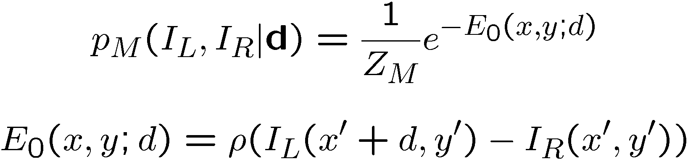
Measurement model
Likelihood of intensity correspondence
Corresponds to Gaussian for quadratic ρ

Slide 54
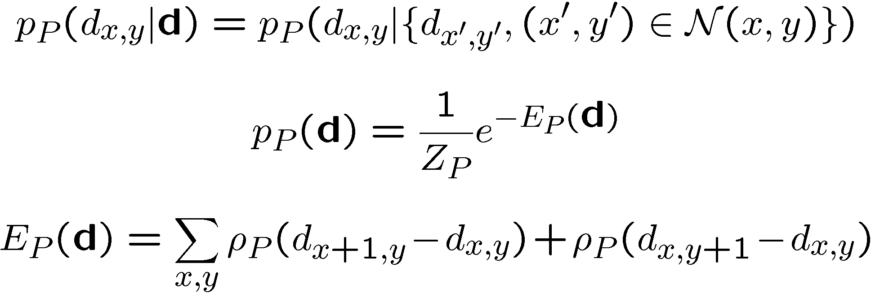
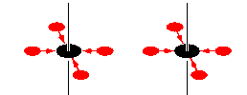
Markov Random Field
Probability distribution on disparity field d(x,y)
Enforces smoothness or coherence on field

Slide 55
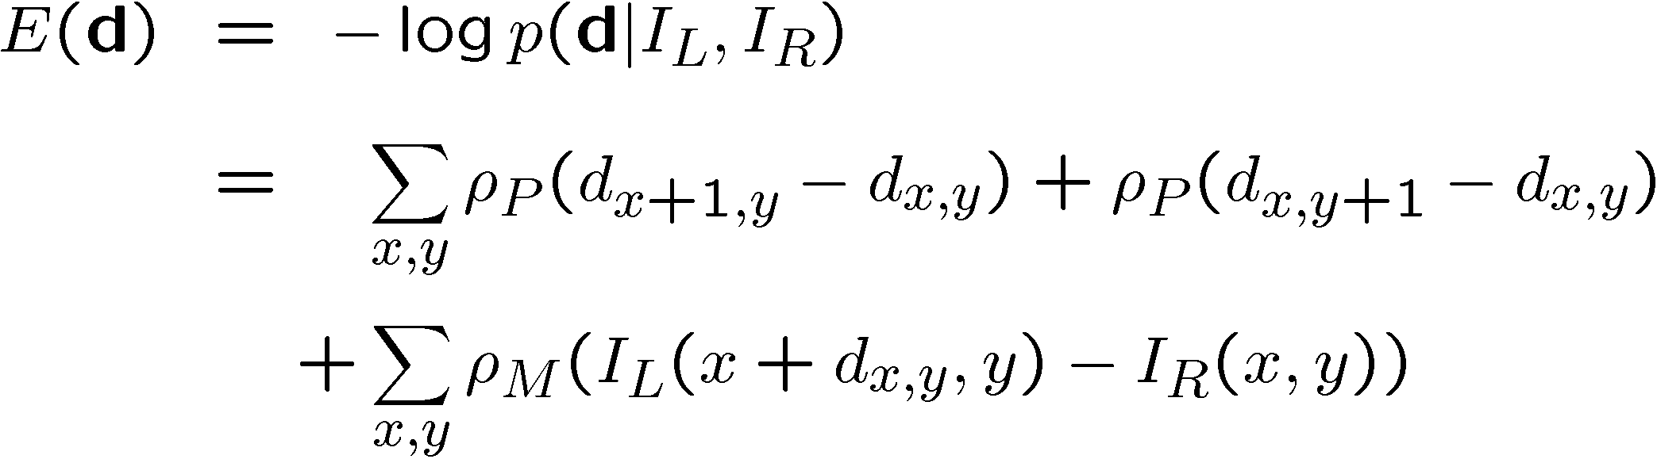
MAP estimate
Maximize posterior likelihood
Equivalent to regularization (energy minimization with smoothness constraints)

Slide 56
Why probabilistic estimation?
Principled way of determining cost function
Explicit model of noise and prior knowledge
Admits a wider variety of optimization algorithms:
  gradient descent (local minimization)
  stochastic optimization (Gibbs Sampler)
  mean-field optimization
  graph theoretic (actually deterministic) [Zabih]
  [loopy] belief propagation
  large stochastic flips [Swendsen-Wang]

Slide 57
Other Methods for Extracting Depth Information
When stereo imagery is not available, we can rely on other image characteristics to infer depth information
Depth from
  Texture
  Shading
  Motion
  Focus
  Visual Cues (and Scene Understanding)

Slide 58
Appendix
Jeremy Bolton, PhD
Assistant Teaching Professor

