Slide 1
COSC579: Image Morphing
Jeremy Bolton, PhD
Assistant Teaching Professor

Slide 2
Outline
Multi-Image Vision: Example Morphing
  Finding Correspondences
  Global vs Local Warping
    Mesh
    Delaunay triangulation
  Intermediate Warp Representations
    Linear Interpolation
  Morphing

Slide 3
Morphing Examples
500 years of female portraits
  https://youtu.be/nUDIoN-_Hxs
Michael Jackson
  https://youtu.be/4jd6dNrJRh4

Slide 4
Morphing Problem
Can we use image warping techniques to “morph” one image into another?
Yes, but some problems will be encountered
  Morph is a seamless transition but a warp is a (instant) transformation: How can we seamlessly transition from one image to another?
  Point correspondences: Finding point correspondences in two images of the same scene is hard enough! When the images are of different scenes … What can be used as correspondences and how can we find them?

Slide 5
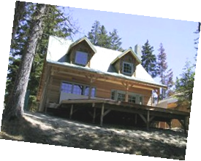
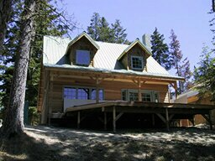
Recall: Recovering Transformations
?
T(x,y)
y
y’
x
x’
f(x,y)
g(x’,y’)
What if we know f and g and want to recover the transform T?
  Assuming user provides correspondences
    How many do we need?

Slide 6
Translation: # correspondences?
?
T(x,y)
y
y’
x
x’
How many correspondences needed for translation?
How many Degrees of Freedom?
What is the transformation matrix?

Slide 7
Euclidian: # correspondences?
?
T(x,y)
y
y’
x
x’
How many correspondences needed for translation+rotation?
How many DOF?

Slide 8
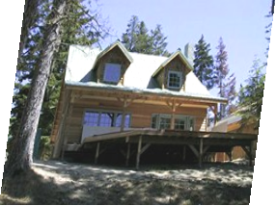
Affine: # correspondences?
?
T(x,y)
y
y’
x
x’
How many correspondences needed for affine?
How many DOF?

Slide 9
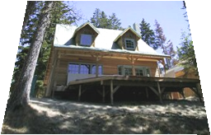
Projective: # correspondences?
?
T(x,y)
y
y’
x
x’
How many correspondences needed for projective?
How many DOF?

Slide 10
Facilitating Seamless Transition
Simple idea.
  Slowly cross-fade or cross-dissolve via interpolation, one image into another using some time index t, which is a sampling of the values between 0 and 1.
    Monotonic
    Uniform
  Image_{halfway} = (1-t)*Image₁ + t*image₂

Slide 11
Averaging Points
Q
What’s the average
of P and Q?
v = Q - P
P
P + 1.5v
= P + 1.5(Q – P)
= -0.5P + 1.5 Q
(extrapolation)
P + 0.5v
= P + 0.5(Q – P)
= 0.5P + 0.5 Q
Linear Interpolation
(Affine Combination):
New point aP + bQ,
defined only when a+b = 1
So aP+bQ = aP+(1-a)Q
P and Q can be anything:
  points on a plane (2D) or in space (3D)
  Colors in RGB or HSV (3D)
  Whole images (m-by-n D)… etc.

Slide 12
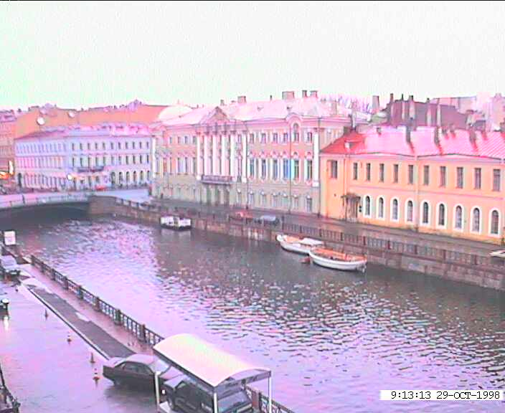
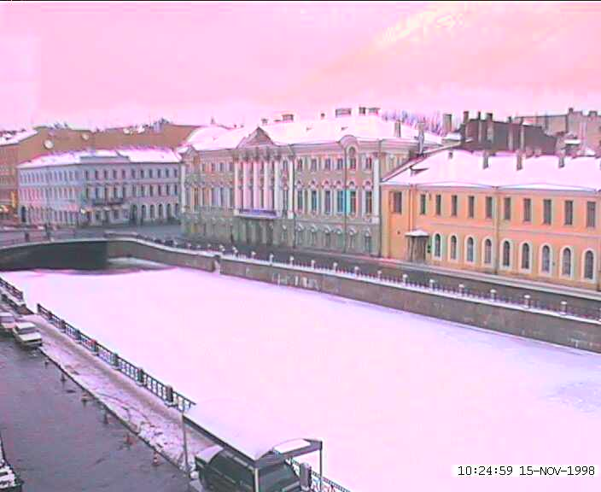
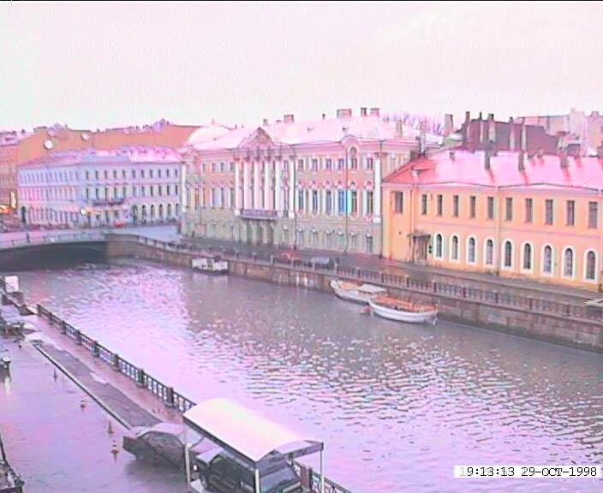
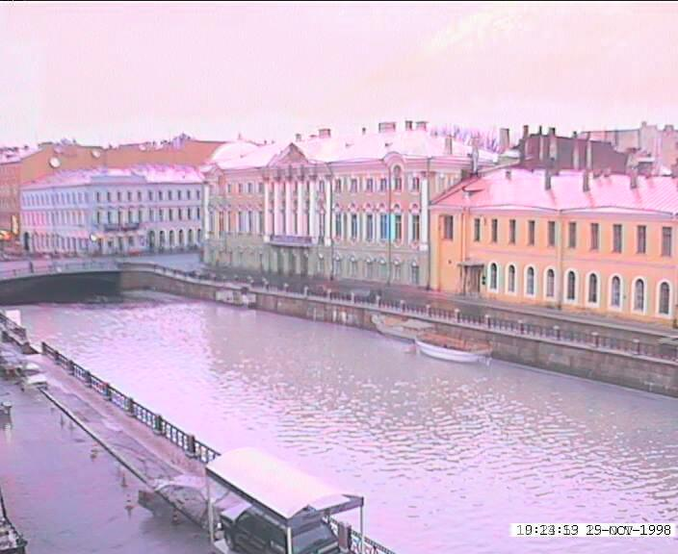
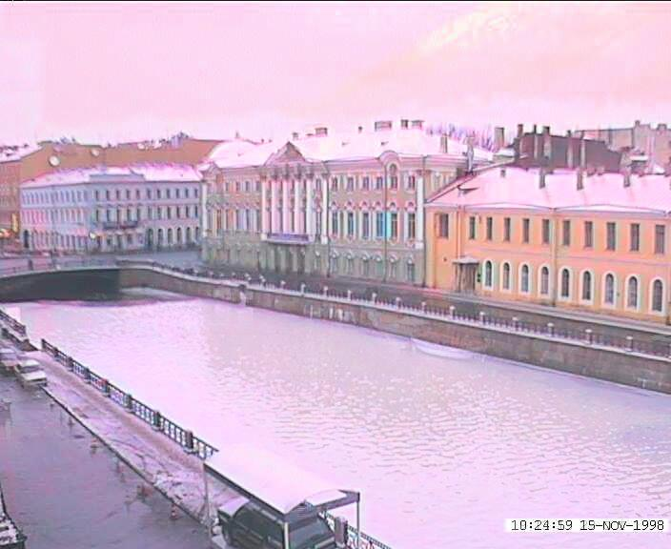
Idea #1: Cross-Dissolve
Interpolate whole images:
Image_{halfway} = (1-t)*Image₁ + t*image₂
This is called cross-dissolve in film industry
But what is the images are not aligned?

Slide 13
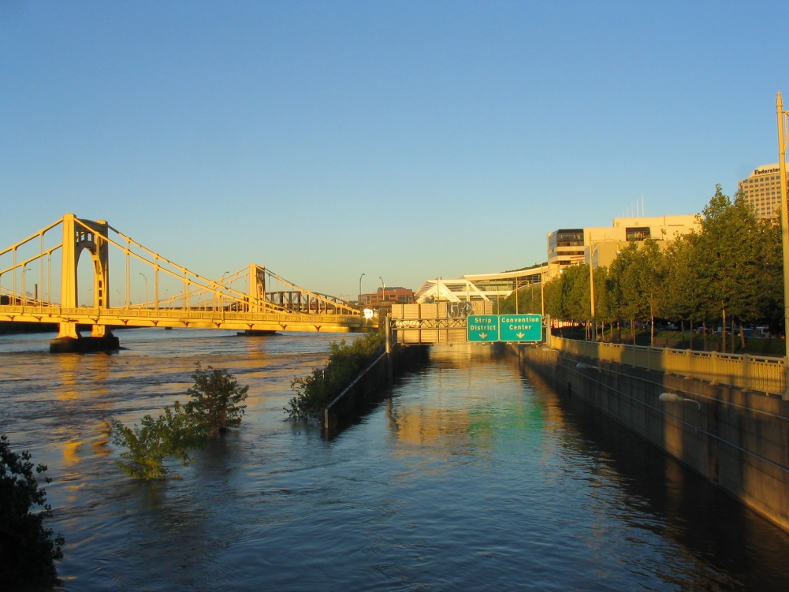
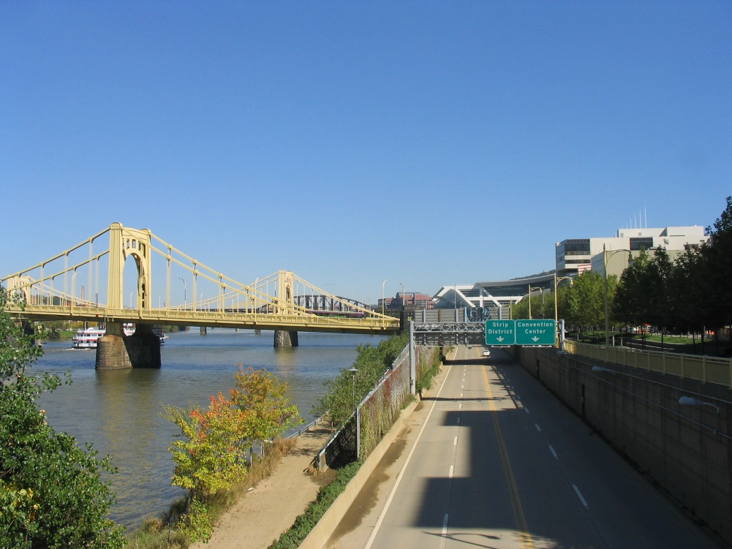
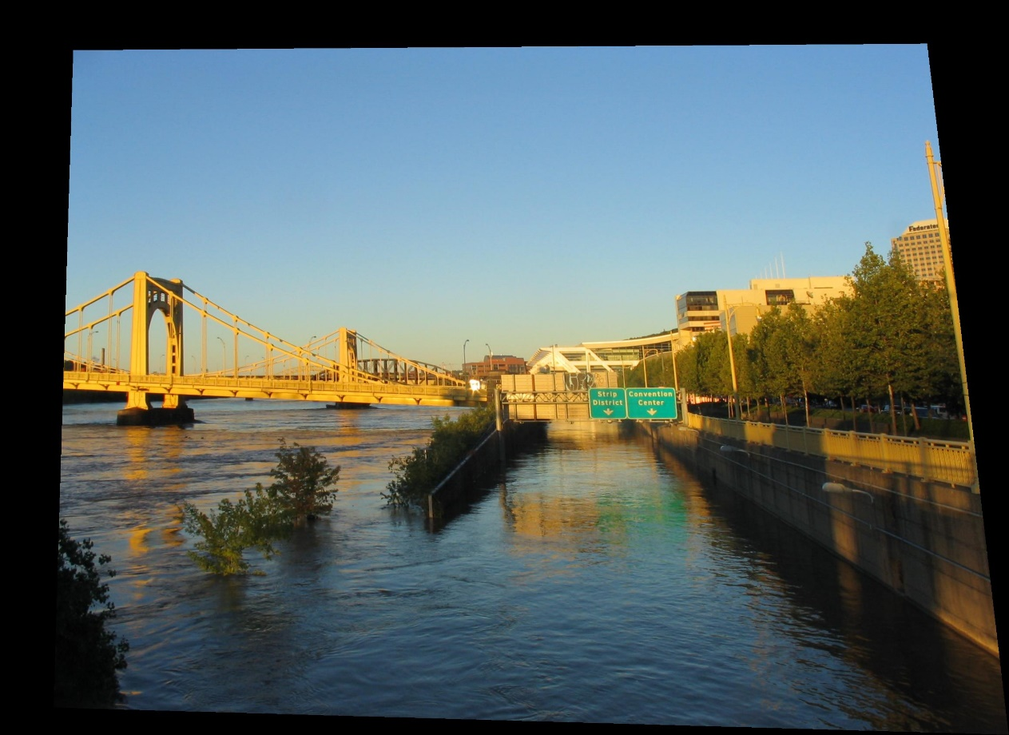
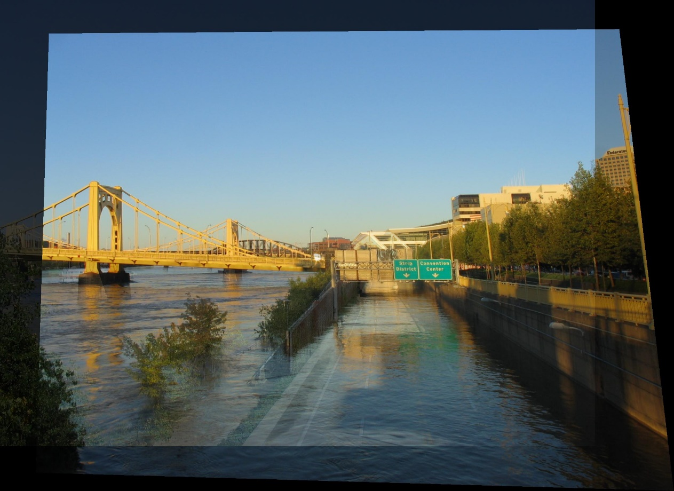
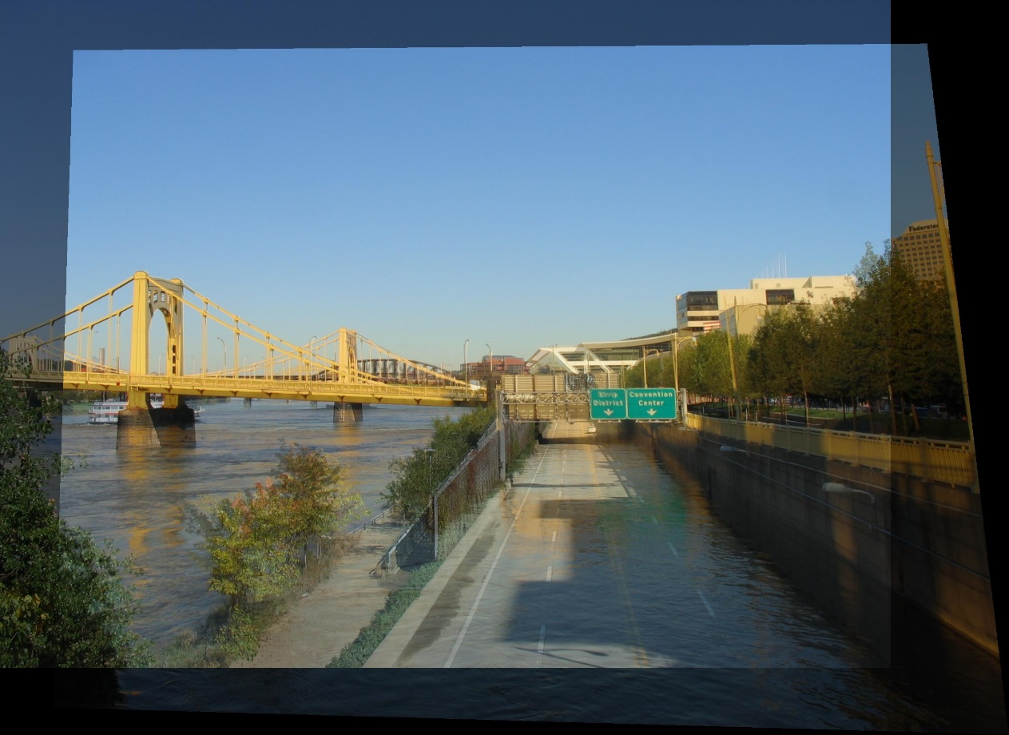
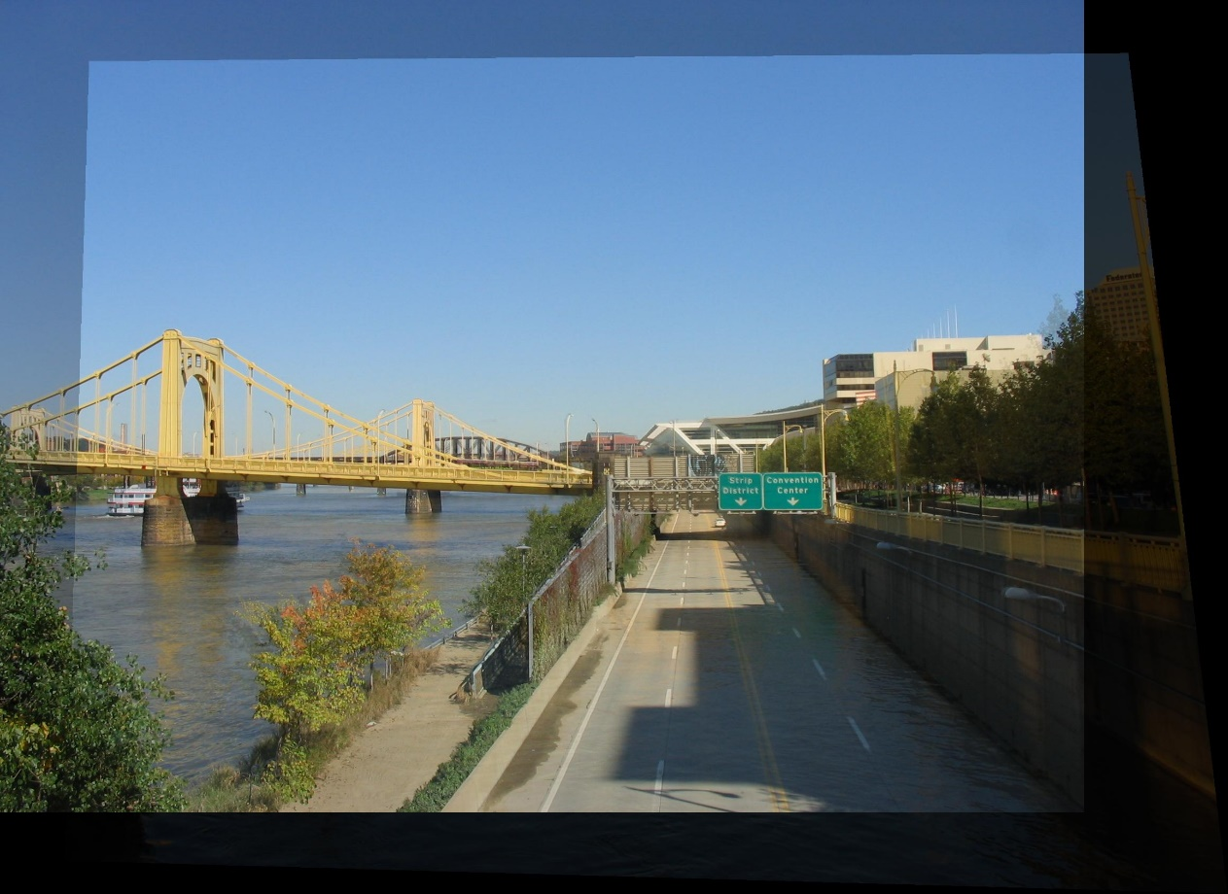
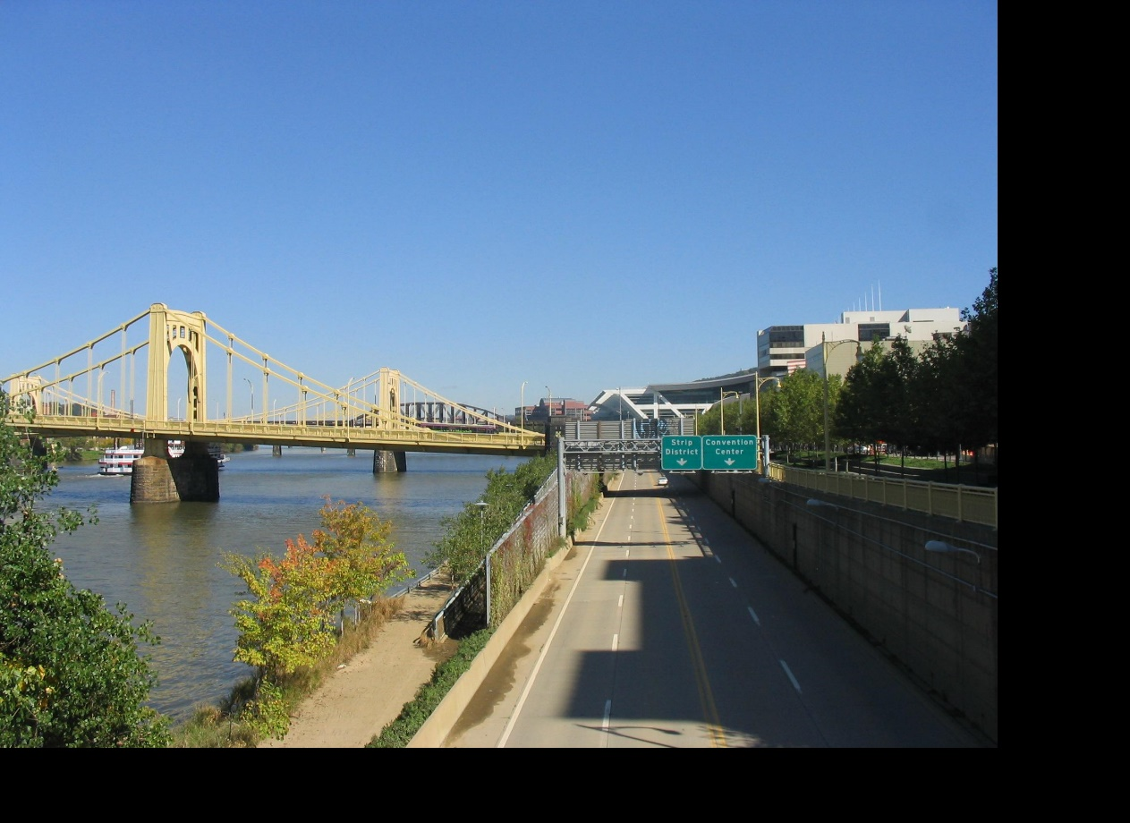
Idea #2: Align, then cross-disolve
Align first, then cross-dissolve
  Alignment using global warp – picture still valid

Slide 14
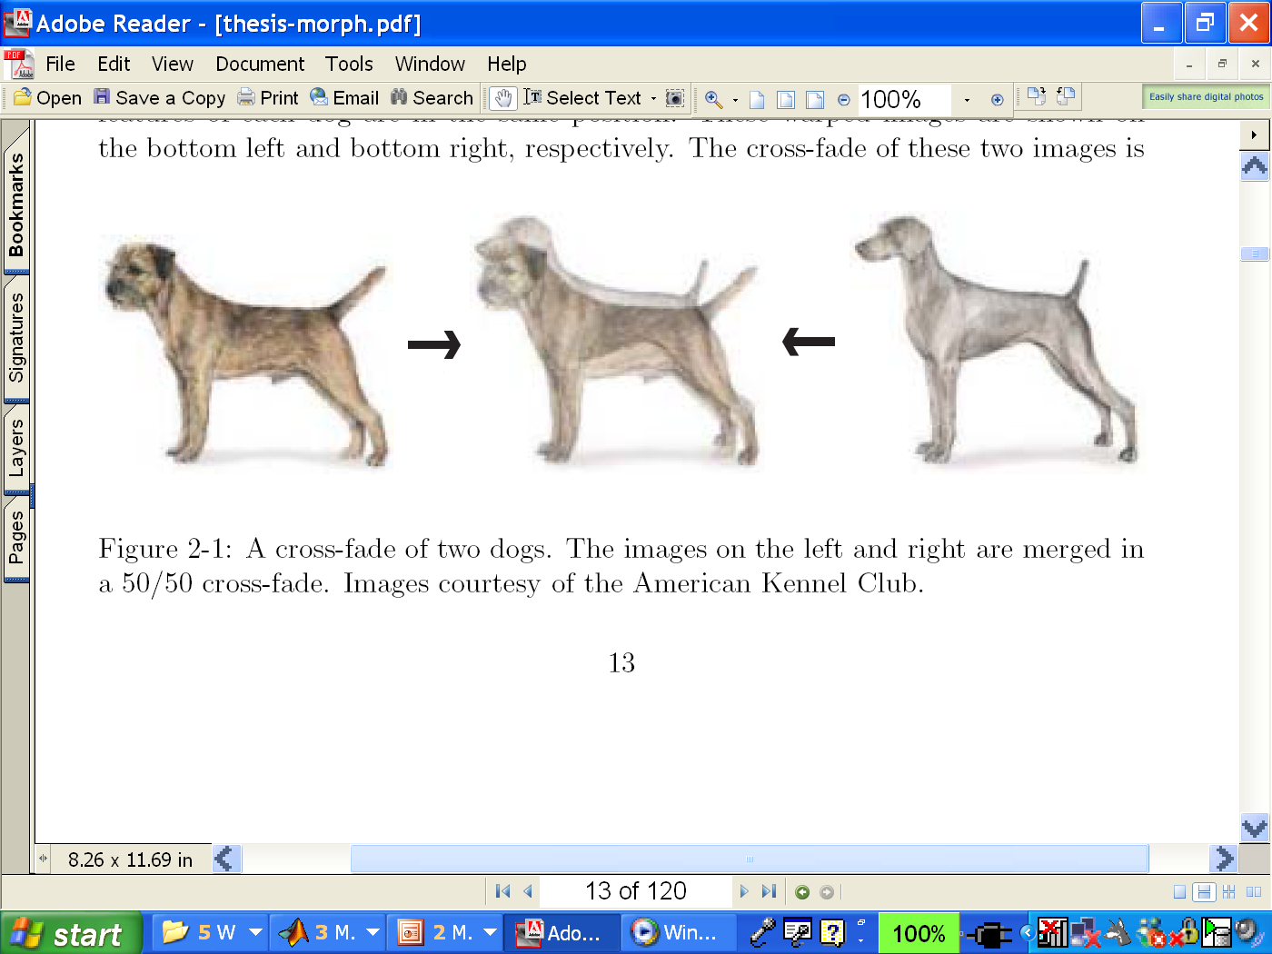
Dog Averaging
What to do?
  Cross-dissolve doesn’t work
  Global alignment doesn’t work
    Cannot be done with a global transformation (e.g. affine)
  Any ideas?
Feature matching!
  Nose to nose, tail to tail, etc.
  This is a local (non-parametric) warp

Slide 15
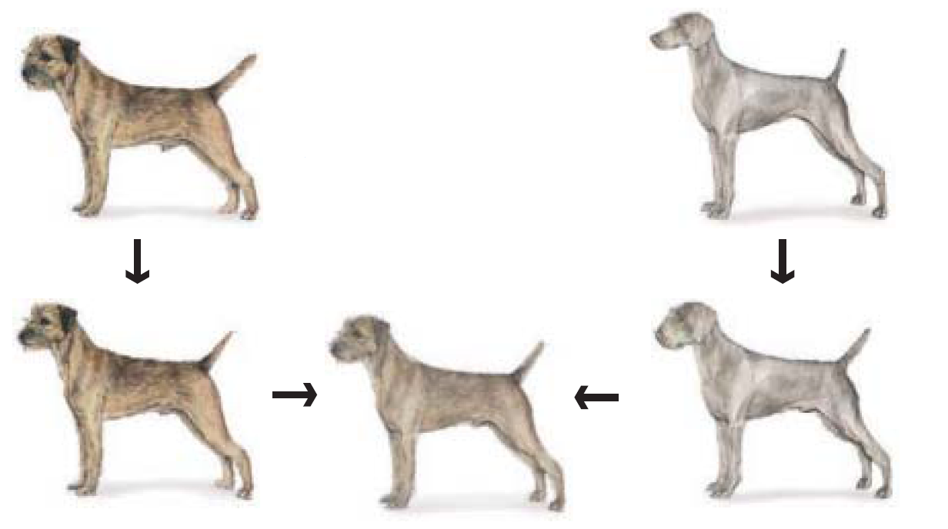
Idea #3: Local warp, then cross-dissolve
Morphing procedure:
for every t,
Find the average shape (the “mean dog”)
  local warping
Find the average color
  Cross-dissolve the warped images

Slide 16
Local (non-parametric) Image Warping
Need to specify a more detailed warp function
  Global warps were functions of a few parameters
  Non-parametric warps u(x,y) and v(x,y) can be defined independently for every single location x,y!
  Once we know vector field u,v we can easily warp each pixel (use backward warping with interpolation)

Slide 17
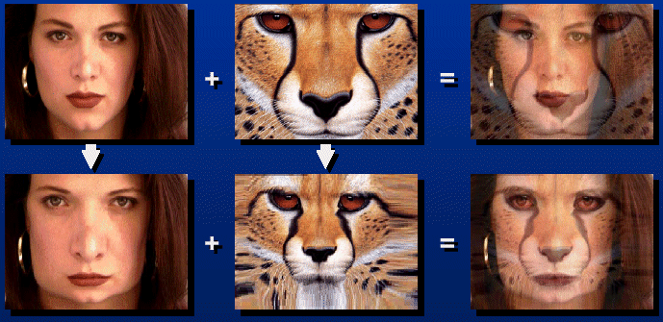
Morphing
?
T(x,y)
How can we define a warp between images of two different scenes? What’s our goal?
Identify correspondences so as to achieve desired effect
  Is there a single homography that will map each pixel correctly in this instance?
  Will a global warping scheme work?

Slide 18

Morphing = Object Averaging
The aim is to find “an average” between two objects
  Not an average of two images of objects…
  …but an image of the average object!
  How can we make a smooth transition in time?
    Do a “weighted average” over time t
How do we know what the average object looks like?
  We haven’t a clue!
  But we can often fake something reasonable
    Usually required user/artist input

Slide 19
Image Morphing
We know how to warp one image into the other, but how do we create a morphing sequence?
  Create an intermediate shape (by interpolation)
  Warp both images towards it
  Cross-dissolve the colors in the newly warped images

Slide 20
Creating a Warp Sequence

Slide 21
Creating a Warp Sequence

Slide 22
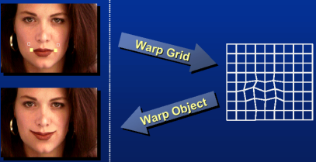
Image Warping – non-parametric
Move control points to specify a spline warp
Spline produces a smooth vector field

Slide 23
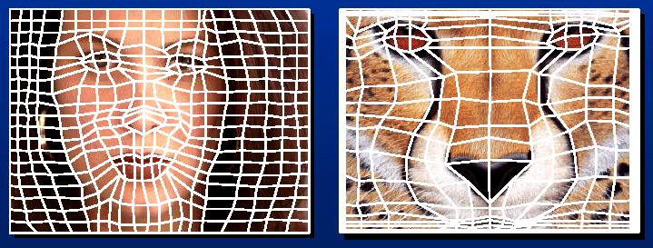
Warp specification - dense
How can we specify the warp?
  Specify corresponding spline control points
    interpolate to a complete warping function
But we want to specify only a few points, not an entire grid.

Slide 24
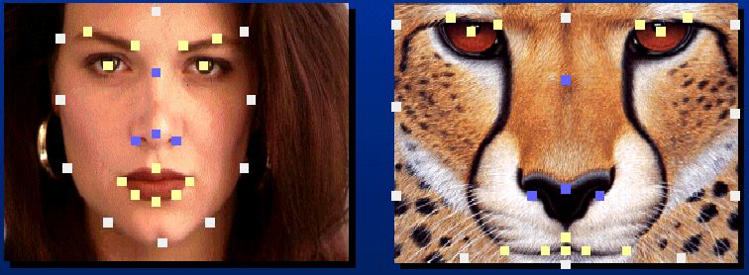
Warp specification - sparse
How can we specify the warp?
  Specify corresponding points
    interpolate to a complete warping function
    How do we do it?
How do we go from feature points to pixels?

Slide 25
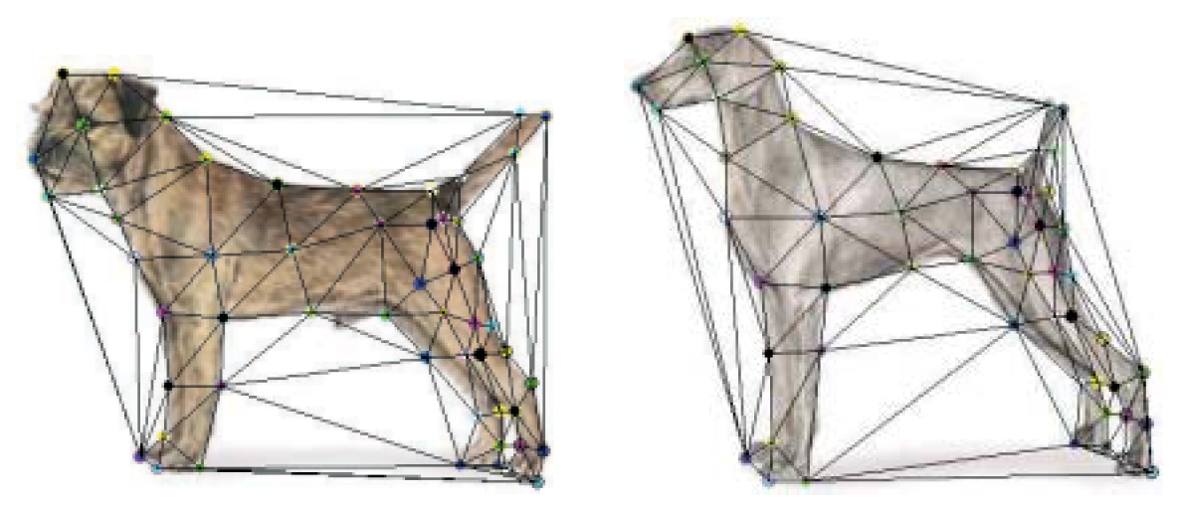
Triangular Mesh
Input correspondences at key feature points
Define a triangular mesh over the points
  Same mesh in both images!
  Now we have triangle-to-triangle correspondences
Warp each triangle separately from source to destination
  How do we warp a triangle?
  3 points = affine warp!

Slide 26
Triangulations
A triangulation of set of points in the plane is a partition of the convex hull to triangles whose vertices are the points, and do not contain other points.
There are an exponential number of triangulations of a point set.

Slide 27
An O(n³) Triangulation Algorithm
Repeat until impossible:
  Select two sites.
  If the edge connecting them does not intersect previous edges, keep it.

Slide 28
“Quality” Triangulations
Let α(T) = (α₁, α₂ ,.., α_{3t}) be the vector of angles in the triangulation T in increasing order.
A triangulation T₁ will be “better” than T₂ if α(T₁) > α(T₂) lexicographically.
The Delaunay triangulation is the “best”
  Maximizes smallest angles
good
bad

Slide 29
Improving a Triangulation
In any convex quadrangle, an edge flip is possible. If this flip improves the triangulation locally, it also improves the global triangulation.
If an edge flip improves the triangulation, the first edge is called illegal.

Slide 30
Illegal Edges
Lemma: An edge pq is illegal iff one of its opposite vertices is inside the circle defined by the other three vertices.
Proof: By Thales’ theorem.
p
q
Theorem: A Delaunay triangulation does not contain illegal edges.
Corollary: A triangle is Delaunay iff the circle through its vertices is empty of other sites.
Corollary: The Delaunay triangulation is not unique if more than three sites are co-circular.

Slide 31
Naïve Delaunay Algorithm
Start with an arbitrary triangulation. Flip any illegal edge until no more exist.
Could take a long time to terminate.

Slide 32
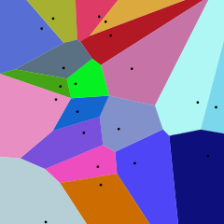
Delaunay Triangulation by Duality
General position assumption: There are no four co-circular points.
Draw the dual to the Voronoi diagram by connecting each two neighboring sites in the Voronoi diagram.
Corollary: The DT may be constructed in O(nlogn) time.
This is what Matlab’s delaunay function uses.
Given a set of points in a plane, a Voronoi diagram partitions the space such that the boundary lines are equidistant from neighboring points. Left is an example of a Voronoi diagram calculated from the points shown as black dots. You will notice that every boundary line passes through the center of two points. If you connect the points in neighboring Voronoi regions, you get a Delaunay triangulation!

Slide 33
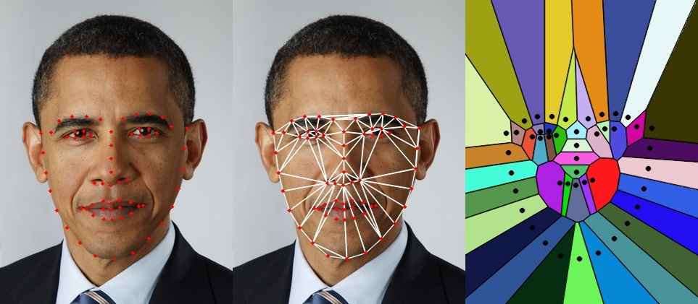
Voronoi (and Delaunay) Partitions in Python
OpenCV:
  https://www.learnopencv.com/delaunay-triangulation-and-voronoi-diagram-using-opencv-c-python/

Slide 34

Example: warping triangles
B
B’
?
T(x,y)
C’
A
C
A’
Source
Destination
Given two triangles: ABC and A’B’C’ in 2D
Need to find transform T to transfer all pixels from one to the other.
Affine Assumption?
How can we compute the transformation matrix?
  Least Squares

Slide 35
HINT: warping triangles
(0,1)
(0,0)
(1,0)
B
B’
Inverse
change
of basis
change
of basis
C’
A
C
A’
Source
Destination
Don’t forget to move the origin too!

Slide 36
Warp interpolation
How do we create an intermediate warp at time t?
  Assume t = [0,1]
  Simple linear interpolation of each feature pair
  (1-t)*p1+t*p0 for corresponding features p0 and p1

Slide 37
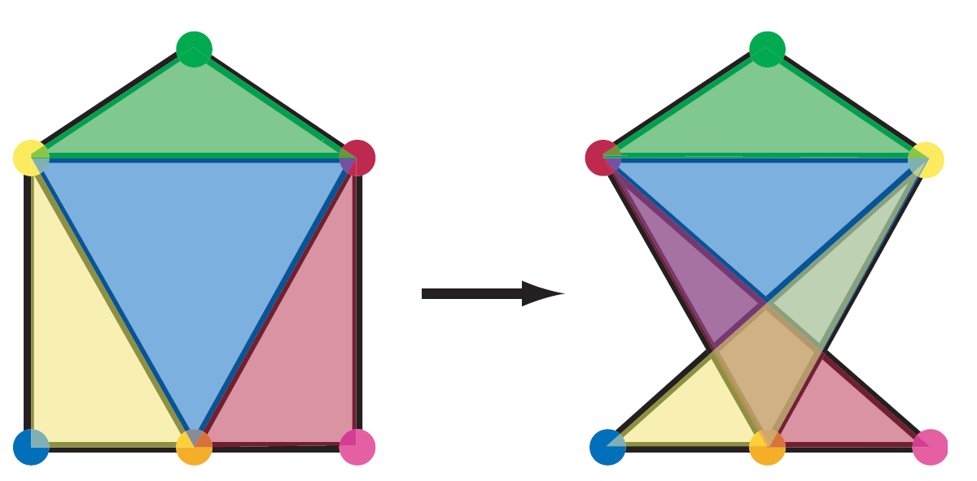
Other Issues
Beware of folding
  You are probably trying to do something “weird” (3D folding)
Remember to interpolate an intermediate coordinate system (for each triangle)
  Map both images to the intermediate representation.
  Implement as an inverseWarp to avoid “holes”
    (inverse wrt the intermediate coordinate system)
Extrapolation can sometimes produce interesting effects

