Slide 1
COSC579: Edge Detection
Jeremy Bolton, PhD
Assistant Teaching Professor

Slide 2
Outline
Edge Detection
  Gradient
  Laplacian
  Marr - Hildreth
  Sobel
  Canny
  Harris Structure
  Smooth first ( … ask questions later). Witkins
Filtering as Matrix Multiplication
(Detection) Thresholding Schemes

Slide 3
Readings
Read
  Marr and Hildreth Theory of Edge Detection
  Witkins: Gaussian Smoothing
  Skip* Cipolla (on edge detection)
  Szeliski 3.4.1 – 3.4.2
TexPoint fonts used in EMF.
Read the TexPoint manual before you delete this box.: AAA

Slide 4
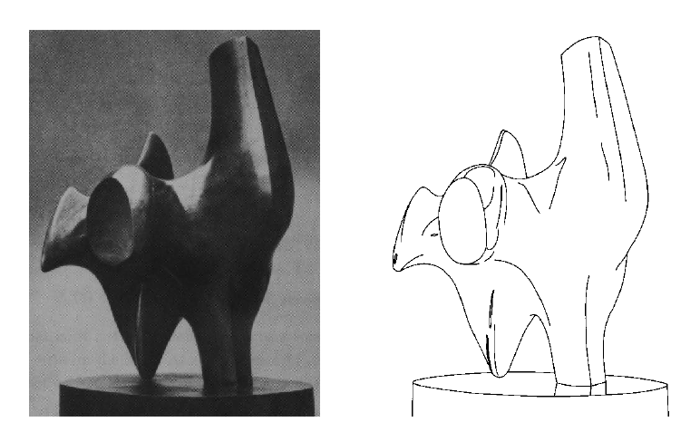
Edge detection
Convert a 2D image into a set of curves
  Extracts salient features of the scene
  More compact than pixels
TexPoint fonts used in EMF.
Read the TexPoint manual before you delete this box.: AAA

Slide 5
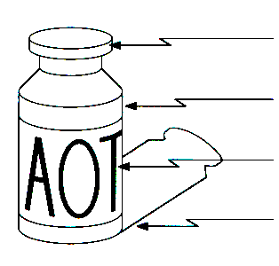
Origin of Edges
surface normal discontinuity
depth discontinuity
surface color discontinuity
illumination discontinuity
Edges are caused by a variety of factors

Slide 6

Characterizing edges
An edge is a place of rapid change (discontinuity) in the image intensity function
Observe: Extrema of first derivative are characterized by “zero-crossings” of second derivative.
intensity function
(along horizontal scanline)
image
first derivative
edges correspond to
extrema of derivative
Source: L. Lazebnik

Slide 7
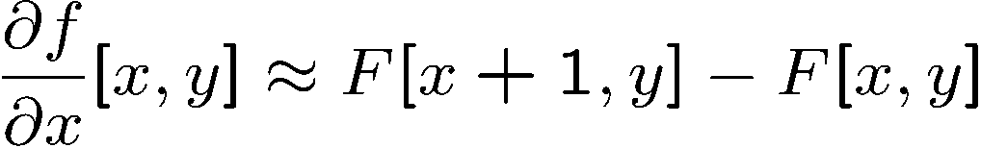




Image derivatives
How can we differentiate a digital image F[x,y]?
  Option 1: reconstruct a continuous image, f, then compute the derivative
  Option 2: take discrete derivative (finite difference)
How would you implement this as a linear filter?
1 | -1
 | -1
 | 1
:
:
Source: S. Seitz

Slide 8
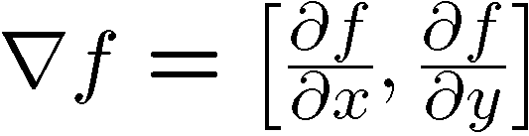
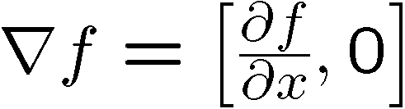
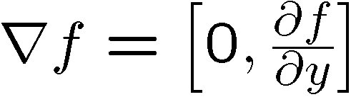
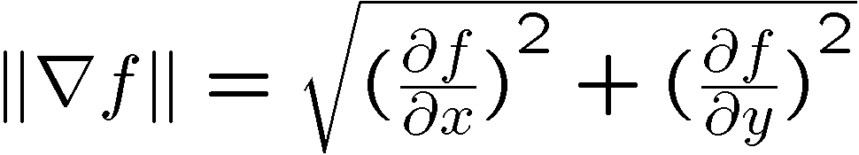
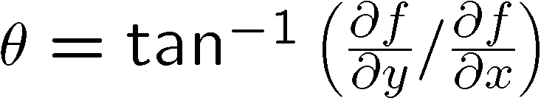
Image gradient
The gradient of an image:
The gradient points in the direction of most rapid increase in intensity
The edge strength is given by the gradient magnitude:
The gradient direction is given by:
  how does this relate to the direction of the edge?
Source: Steve Seitz
Notes:
give definition of partial derivative: lim h->0 [f(x+h,y) – f(x,y)]/h

Slide 9
Image gradient
Source: L. Lazebnik

Slide 10
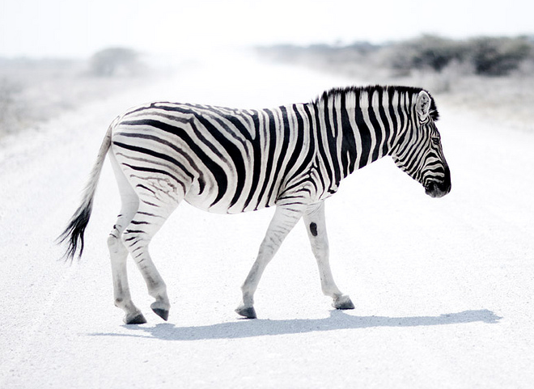
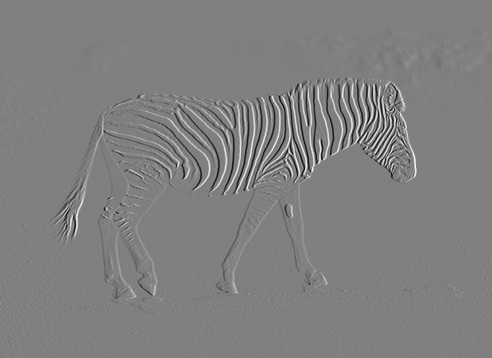

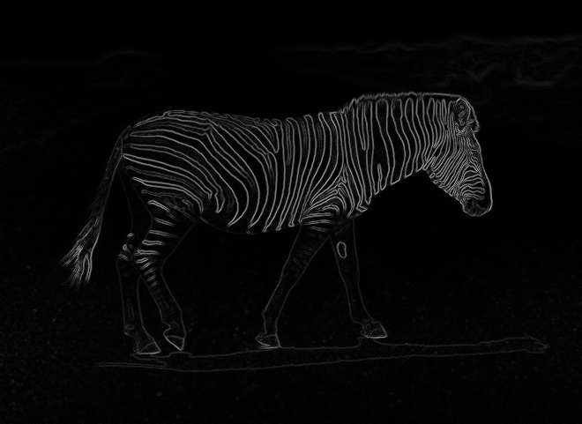
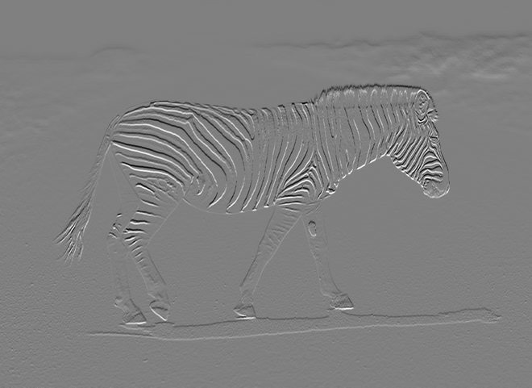

Image gradient

Slide 11


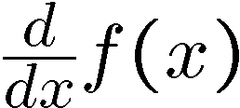
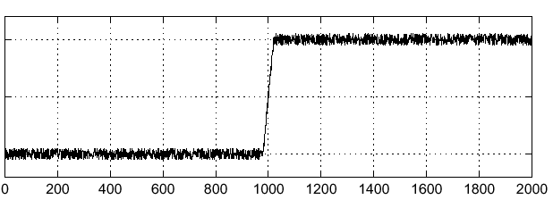
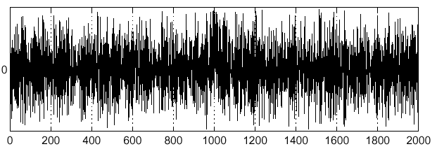
Effects of noise
Noisy input image
Where is the edge?
Source: S. Seitz
Notes:
How to fix?

Slide 12
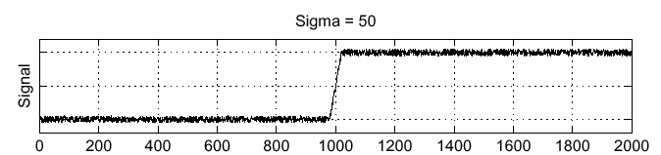
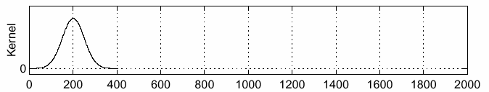
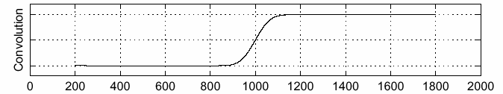
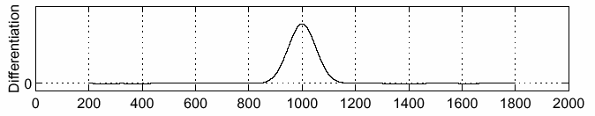
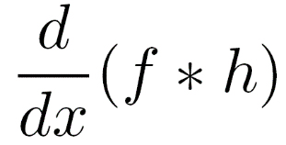

Solution: smooth first
f
h
f * h
To find edges, look for peaks in
Source: S. Seitz

Slide 13
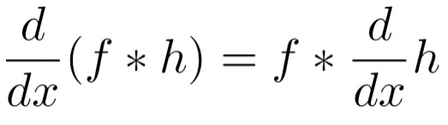
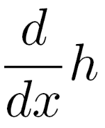
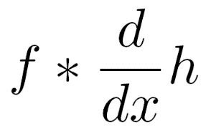
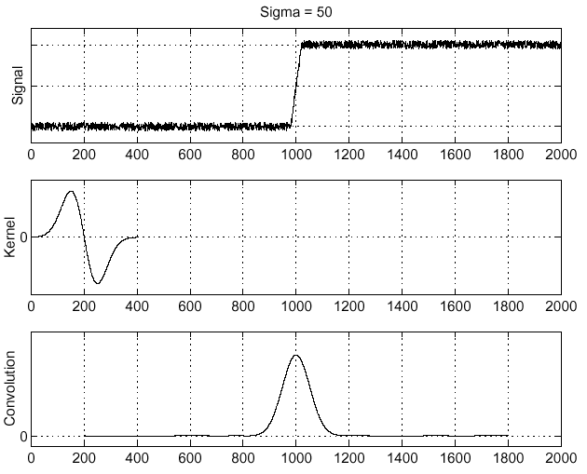
Associative property of convolution
Differentiation is convolution, and convolution is associative:
This saves us time:
f
Source: S. Seitz

Slide 14
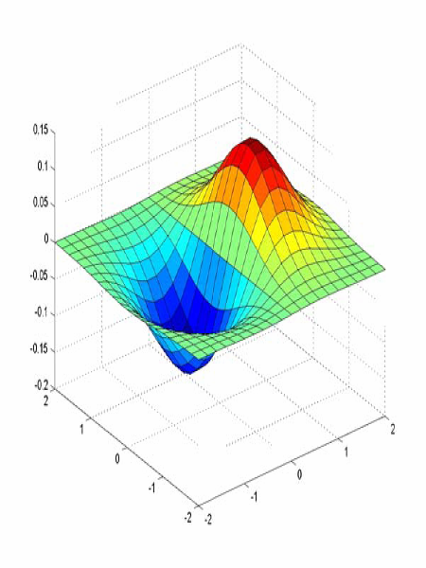
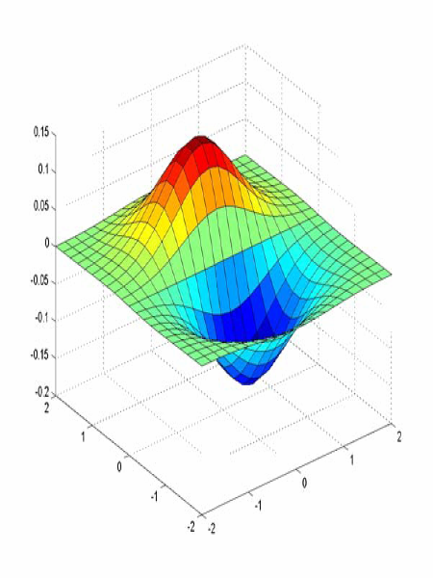


Derivative of Gaussian filter
x-direction
y-direction

Slide 15









Side note: How would you compute a directional derivative?
(From vector calculus)
Directional deriv. is a linear combination of partial derivatives
= ?
+
=

Slide 16

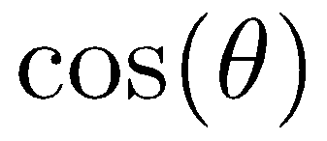
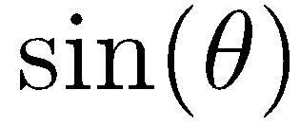
Derivative of Gaussian filter
x-direction
y-direction
+
=

Slide 17
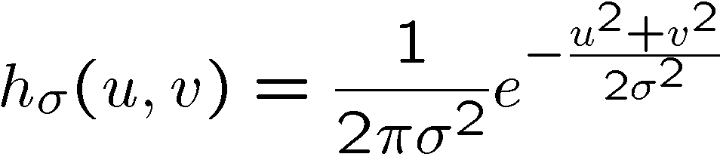
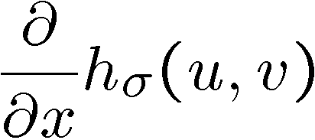
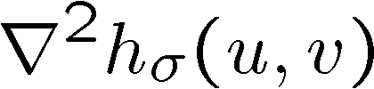

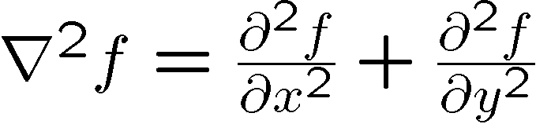
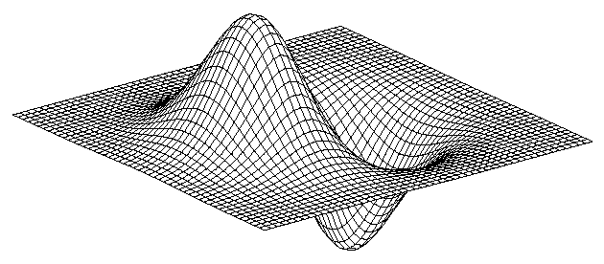
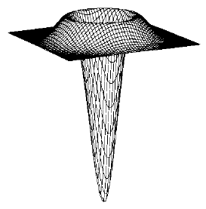
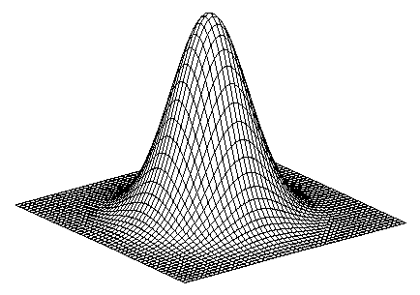
2D edge detection filters
Laplacian of Gaussian
Gaussian
derivative of Gaussian
is the Laplacian operator:
Notes:
How many 2nd derivative filters are there? There are four 2nd partial derivative filters.
In practice, it’s handy to define a single 2nd derivative filter—the Laplacian

Slide 18



The Sobel operator
Common approximation of derivative of Gaussian
-1 | 0 | 1
-2 | 0 | 2
-1 | 0 | 1
1 | 2 | 1
0 | 0 | 0
-1 | -2 | -1
  The standard defn. of the Sobel operator omits the 1/8 term
    doesn’t make a difference for edge detection
    the 1/8 term is needed to get the right gradient value
Notes:
18
Q: Why might these work better?
A: more stable when there is noise

Slide 19
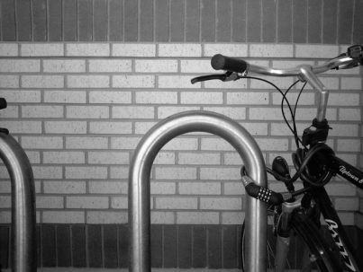
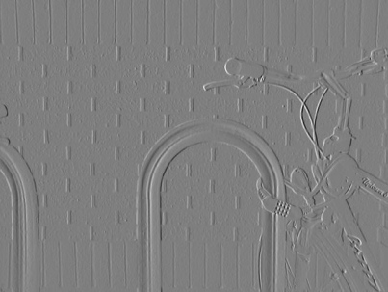
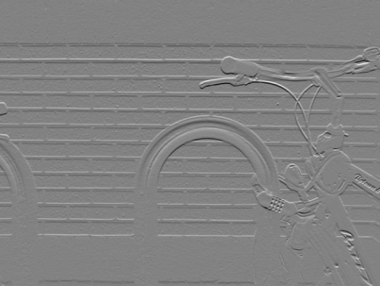
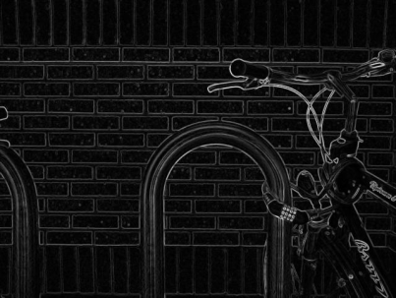

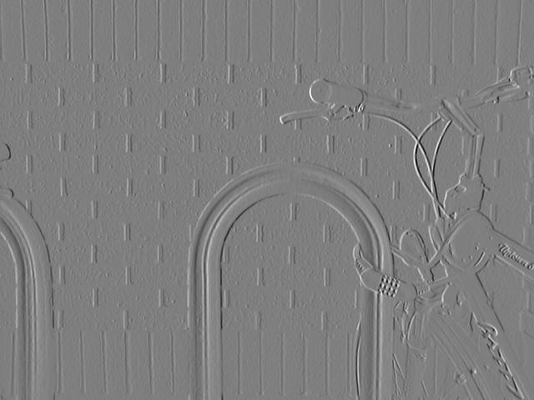
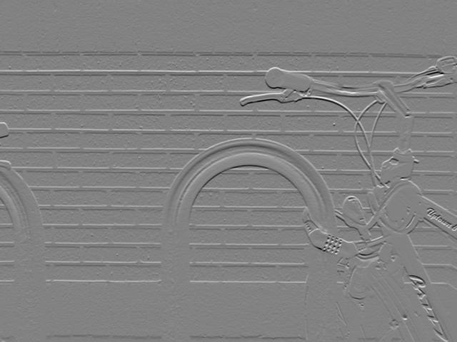
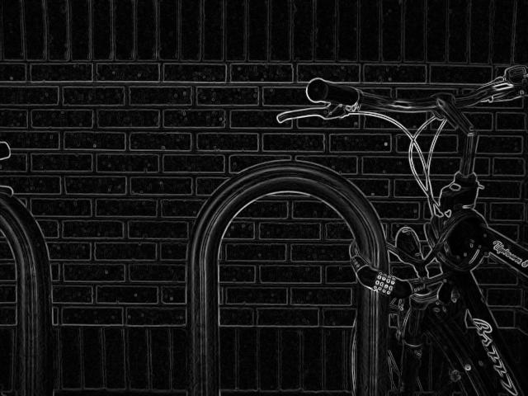
Sobel operator: example
Source: Wikipedia

Slide 20

Example
original image (Lena)

Slide 21
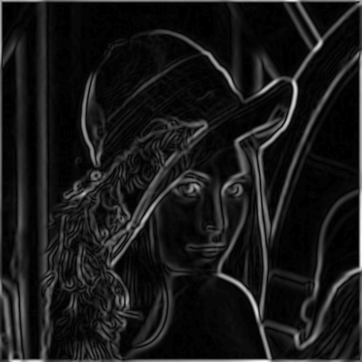
Finding edges
gradient magnitude

Slide 22
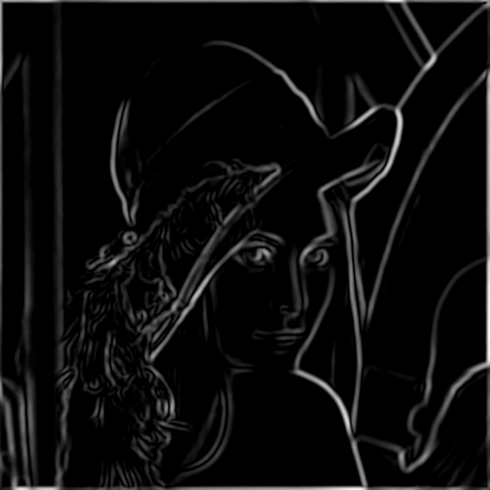
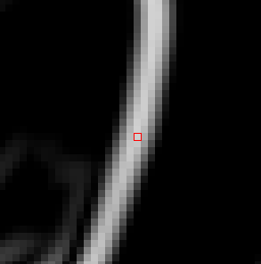
Finding edges
where is the edge?
thresholding

Slide 23

Non-maximum supression
Check if pixel is local maximum along gradient direction
  requires interpolating pixels p and r

Slide 24
Finding edges
thresholding

Slide 25
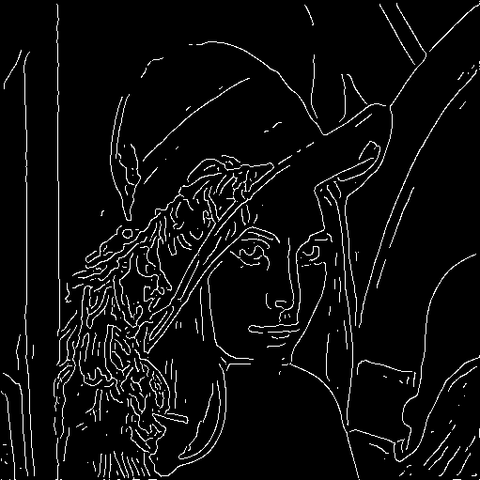
Finding edges
thinning
(non-maximum suppression)

Slide 26

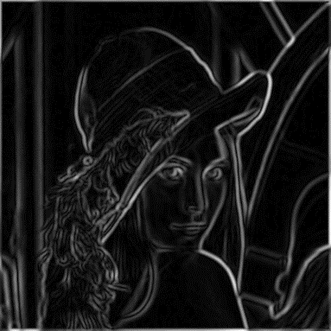
Canny edge detector
MATLAB: edge(image,‘canny’)
Filter image with derivative of Gaussian
Find magnitude and orientation of gradient
Non-maximum suppression
Linking and thresholding (hysteresis):
  Define two thresholds: low and high
  Use the high threshold to start edge curves and the low threshold to continue them
Source: D. Lowe, L. Fei-Fei

Slide 27

Canny edge detector
Still one of the most widely used edge detectors in computer vision
Depends on several parameters:
J. Canny, A Computational Approach To Edge Detection, IEEE Trans. Pattern Analysis and Machine Intelligence, 8:679-714, 1986.
: width of the Gaussian blur
high threshold
low threshold

Slide 28
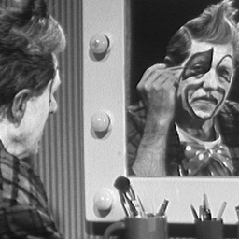
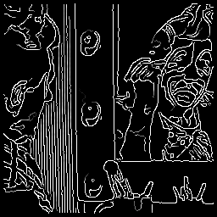
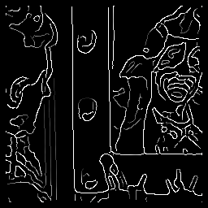



Canny edge detector
original
Canny with
Canny with
The choice of depends on desired behavior
  large detects “large-scale” edges
  small detects fine edges
Source: S. Seitz

Slide 29


Images as vectors
Very important idea!
1
0
2D image
Scanline (1D signal)
(A 2D, n x m image can be represented by a vector of length nm formed by concatenating the rows)
Vector

Slide 30

Multiplying row and column vectors
= ?

Slide 31

Filtering as matrix multiplication
What kind of filter is this?

Slide 32

Filtering as matrix multiplication
=

Slide 33


Another matrix transformation
2D DCT basis
1D Discrete cosine transform (DCT) basis

Slide 34


Another matrix transformation
2D DCT basis
1D Discrete cosine transform (DCT) basis

Slide 35

Scale Space
Recall: Edges can be identified by zero-crossings of first derivative.
Observe derivative filter may be “fixed” (in size).
But edges may exist at various levels of fineness.
1 | -1

Slide 36




Scale space (Witkin 83)
first derivative peaks
larger
Gaussian filtered signal
Observe: Each “zero-contour” (set of (x,$σ$) pairs) characterizes an edge
Properties of scale space (w/ Gaussian smoothing)
  edge position may shift with increasing scale (σ)
  two edges may merge with increasing scale
  an edge may not split into two with increasing scale

Slide 37
Interval Tree Representation
Each entity or event may have “a beginning and an end”
  Interval bounded by zero-crossings
  The scale of the event can be determined by the zero-contour representation.
  Zero-contours can be reduced to a hierarchical representation or a simple partition of the contour space.
  Tree representation: each interval is simply a node in a tree.
Uses:
  Image characterization
  Course to fine localization

Slide 38

Some times we want many resolutions
Known as a Gaussian Pyramid [Burt and Adelson, 1983]
  A precursor to wavelet transform
Gaussian Pyramids have all sorts of applications in computer vision

Slide 39
Gaussian pyramid construction
filter kernel
Repeat
  Filter
  Subsample
Until minimum resolution reached
  can specify desired number of levels (e.g., 3-level pyramid)
  Can find edges (or features) at fine and gross scales.
  Analyze an image at multiple scales
    Referred to as Scale Space analysis
Observe: The whole pyramid is only 4/3 the size of the original image!

Slide 40



Subsampling with Gaussian pre-filtering
G 1/8
G 1/4
Gaussian 1/2
Filter the image, then subsample

Slide 41
Subsampling with Gaussian pre-filtering
Gaussian 1/2
G 1/4
G 1/8
Filter the image, then subsample

Slide 42



Subsampling without pre-filtering
1/2
1/4 (2x zoom)
1/8 (4x zoom)

Slide 43

Sampling and the Nyquist rate
Aliasing can arise when you sample a continuous signal or image
  occurs when your sampling rate is not high enough to capture the amount of detail in your image
  Can give you the wrong signal/image—an alias
  formally, the image contains structure at different scales
    called “frequencies” in the Fourier domain
  the sampling rate must be high enough to capture the highest frequency in the image
To avoid aliasing:
  sampling rate ≥ 2 * max frequency in the image
    said another way: ≥ two samples per cycle
  This minimum sampling rate is called the Nyquist rate

Slide 44


Image resampling
So far, we considered only power-of-two subsampling
  What about arbitrary scale reduction?
  How can we increase the size of the image?
d = 1 in this
example
1
2
3
4
5
Recall how a digital image is formed
  It is a discrete point-sampling of a continuous function
  If we could somehow reconstruct the original function, any new image could be generated, at any resolution and scale

Slide 45
Image resampling
So far, we considered only power-of-two subsampling
  What about arbitrary scale reduction?
  How can we increase the size of the image?
d = 1 in this
example
1
2
3
4
5
Recall how a digital image is formed
  It is a discrete point-sampling of a continuous function
  If we could somehow reconstruct the original function, any new image could be generated, at any resolution and scale

Slide 46





Image resampling
So what to do if we don’t know
  Answer: guess an approximation
  Can be done in a principled way: filtering
1
d = 1 in this
example
1
2
2.5
3
4
5
Image reconstruction
  Convert to a continuous function
  Reconstruct by cross-correlation:

Slide 47




Resampling filters
What does the 2D version of this hat function look like?
performs
linear interpolation
(tent function) performs
bilinear interpolation
Often implemented without cross-correlation
Better filters give better resampled images
  Bicubic is common choice
    fit 3rd degree polynomial surface to pixels in neighborhood

Slide 48
Summary

