Slide 1
COSC579: Image Processing Basics
Jeremy Bolton, PhD
Assistant Teaching Professor

Slide 2
Outline
Point Operators
  Color Transforms
  Normalization / Whitening
  Histogram Normalization
Linear Filters
  Mathematical Formulation
    Cross Correlation
    Convolutions
  Common Filters
    Average
    Gaussian
    Laplacian

Slide 3
Reading
Szeliski, Chapter 3.1-3.2
Prince, Chapter 13.1.1 – 13.1.2

Slide 4
Our Progression Through Topics
Scene
Image Formation
Image Processing
Feature Generation
Models for
Recognition,
Tracking, etc
High Level Scene Understanding
Machine Learning

Slide 5

What is an image?

Slide 6
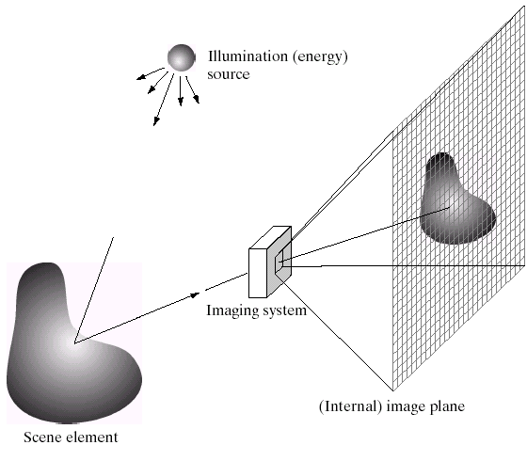
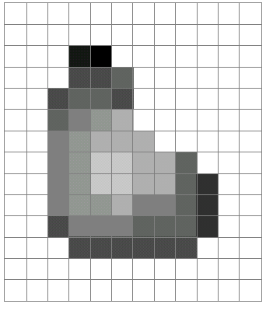
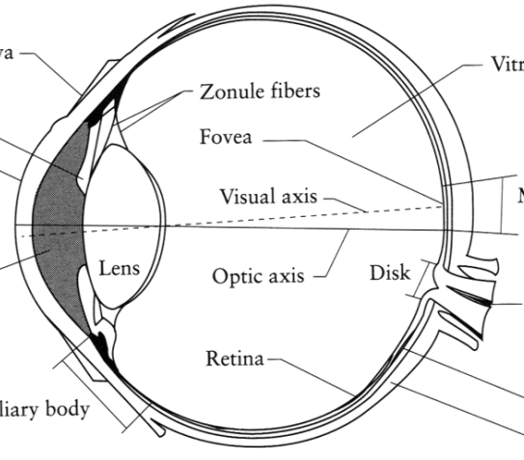
What is an image?
Digital Image
The Eye
Source: A. Efros

Slide 7
What is an image?
A grid (matrix) of intensity values
(common to use one byte per value: 0 = black, 255 = white)
255 | 255 | 255 | 255 | 255 | 255 | 255 | 255 | 255 | 255 | 255 | 255
255 | 255 | 255 | 255 | 255 | 255 | 255 | 255 | 255 | 255 | 255 | 255
255 | 255 | 255 | 20 | 0 | 255 | 255 | 255 | 255 | 255 | 255 | 255
255 | 255 | 255 | 75 | 75 | 75 | 255 | 255 | 255 | 255 | 255 | 255
255 | 255 | 75 | 95 | 95 | 75 | 255 | 255 | 255 | 255 | 255 | 255
255 | 255 | 96 | 127 | 145 | 175 | 255 | 255 | 255 | 255 | 255 | 255
255 | 255 | 127 | 145 | 175 | 175 | 175 | 255 | 255 | 255 | 255 | 255
255 | 255 | 127 | 145 | 200 | 200 | 175 | 175 | 95 | 255 | 255 | 255
255 | 255 | 127 | 145 | 200 | 200 | 175 | 175 | 95 | 47 | 255 | 255
255 | 255 | 127 | 145 | 145 | 175 | 127 | 127 | 95 | 47 | 255 | 255
255 | 255 | 74 | 127 | 127 | 127 | 95 | 95 | 95 | 47 | 255 | 255
255 | 255 | 255 | 74 | 74 | 74 | 74 | 74 | 74 | 255 | 255 | 255
255 | 255 | 255 | 255 | 255 | 255 | 255 | 255 | 255 | 255 | 255 | 255
255 | 255 | 255 | 255 | 255 | 255 | 255 | 255 | 255 | 255 | 255 | 255
=

Slide 8
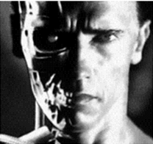
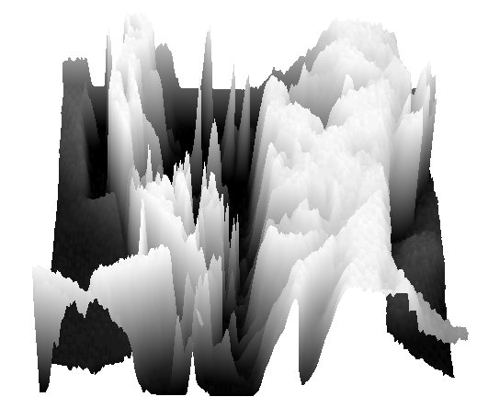
What is an image?
We can think of a (grayscale) image as a function, f, from R² to R (or a 2D signal):
  f (x,y) gives the intensity at position (x,y)
  A digital image is a discrete (sampled, quantized) version of this function
f (x, y)
x
y

Slide 9
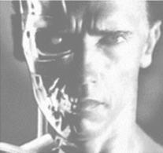
Image transformations
As with any function, we can apply operators to an image
Operators
  Point Operators
    Histogram equalization
    Color or intensity transformations
  Linear Filtering: convolution and cross correlation
  g (x,y) = f (x,y) + 20
  g (x,y) = f (-x,y)

Slide 10
Pixel (intensity) transformation
Transformation can be constant for each pixel
  g (i,j) = a f (i,j) + b
Transform can vary from pixel-by-pixel
  g (i,j) = a(i,j) f (i,j) + b(i,j)
  g (i,j) = f (i,j) + 20

Slide 11
Pixel Transforms based on image statistics
Often an image is assumed to be a collection of observations of some random variable (a sample).
Image statistics can provide a means for a data-based transformation (rather than some arbitrary scaling).

Slide 12
Histogram Equalization
Problem: Image has undesirable histogram.
  Distribution of intensity values.
Solution: Map intensities to a desirable histogram using Histogram (PDF) and Cumulative Histogram (CDF)
An often desired histogram is a Uniform distribution (all intensities are equal in frequency)

Slide 13
Histogram Equalization
MATLAB
I = imread('tire.tif');
J = histeq(I); %Enhance the contrast of an intensity image using histogram equalization
imshowpair(I,J,'montage') %Display the original image and the adjusted image
axis off
figure;
imhist(I,64)
imhist(J,64)

Slide 14
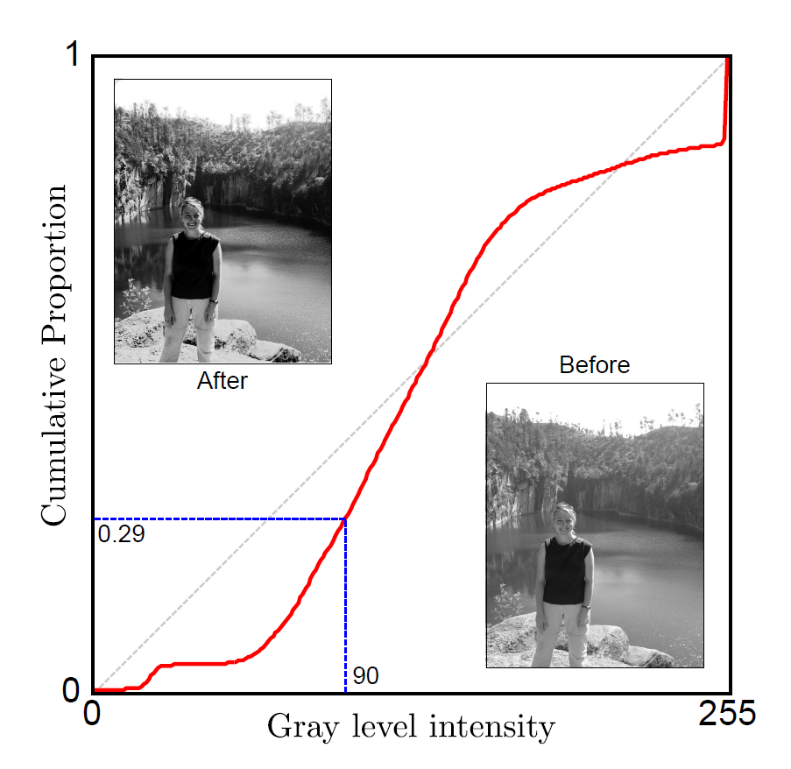
Histogram Equalization
Compute Image Histogram (PDF)
Compute CDF
Compute CDF of desired histogram. (Assume Uniform)
Transform to desired CDF
Map back to the original domain if you do not wish to change the range of intensities
14

Slide 15
Histogram Equalization
Compute Image Histogram (for all possible values k)
Compute CDF
Compute inverse of CDF of desired histogram.
  Some CDFs are invertible (some are not)
  If no closed form exists, then simply build a lookup table
Transform to desired CDF
$$f_{new}(x,y)=CDF_{desired}^{−1}(CDF(f(x,y)))$$
Map back to the original domain if you do not wish to change the range of intensities
15

Slide 16


Whitening
Compute Image Statistics
  Mean and standard deviation
Apply transform to each pixel
  Use mean and standard deviation to “whiten” each pixel

Slide 17
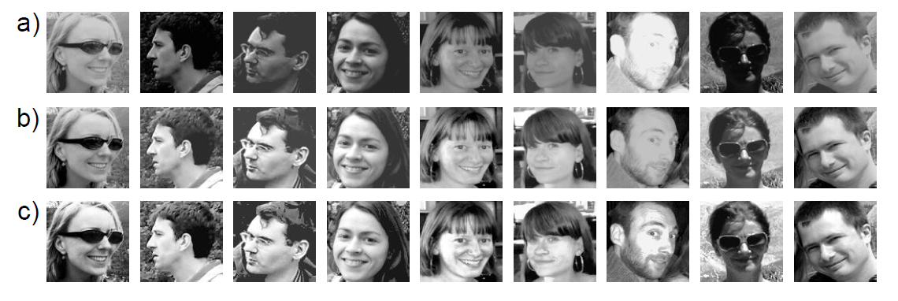
Normalization Via Whitening
Fix first and second moments to standard values
Reduces contrast and constant additive luminance variations
Before
After
Computer vision: models, learning and inference. ©2011 Simon J.D. Prince
17

Slide 18
Normalization and Histogram Equalization
Make all of the moments the same by forcing the histogram of intensities to be the same
Before/ normalized/ Histogram Equalized
Computer vision: models, learning and inference. ©2011 Simon J.D. Prince
18

Slide 19
Linear Filter
Basic Point Operators perform the same operation on each pixel
  Not necessarily based on image data (local or global)
Normalization / Whitening
  Processing based on global (or local) image statistics
Local Operators AKA (neighborhood operators)
  Often implemented as Linear Filters
  Local or neighborhood information is used in transformation

Slide 20
Image filtering
Modify the pixels in an image based on some function of a local neighborhood of each pixel
  Example: 3x3 neighborhood
10
5
3
Some function
4
5
1
7
1
1
7
Local image data
Modified image data
Source: L. Zhang

Slide 21
Linear filtering
One simple version: linear filtering (cross-correlation, convolution)
  Replace each pixel by a linear combination of its neighbors
This linear combination is an binary operator which maps two functions to one function.
  First operand is the input image
  Second operand is called the “kernel” (or “mask”, “filter”)
  The resulting function is the output image
10
5
3
0
0
0
4
6
1
0
0.5
0
8
1
1
8
0
1
0.5
Local image data
kernel
Modified image data
Source: L. Zhang

Slide 22



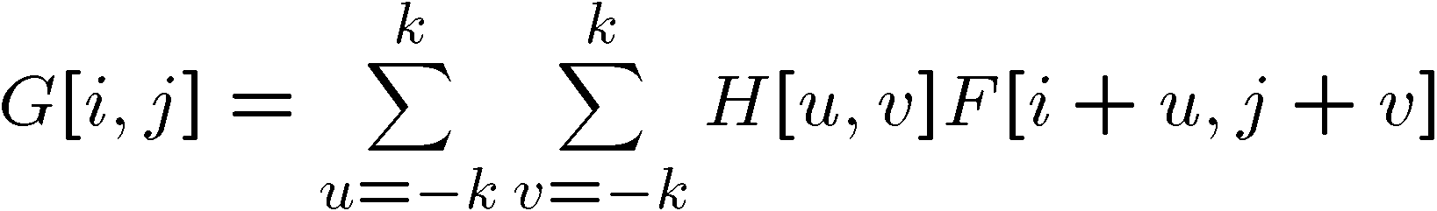

Cross-correlation
Let be the image, be the kernel (of size 2k+1 x 2k+1), and be the output image
This is called a cross-correlation operation:

Slide 23
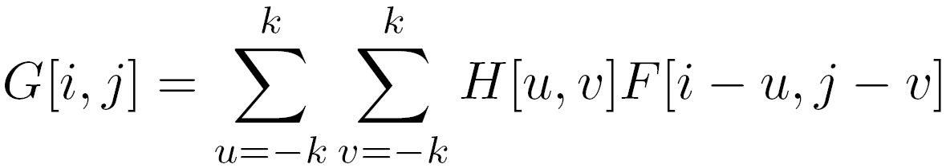

Convolution
Same as cross-correlation, except that the kernel is “flipped” (horizontally and vertically)
Convolution is commutative and associative
This is called a convolution operation:

Slide 24



Convolution
Adapted from F. Durand

Slide 25

Mean filtering
0 | 0 | 0 | 0 | 0 | 0 | 0 | 0 | 0 | 0
0 | 0 | 0 | 0 | 0 | 0 | 0 | 0 | 0 | 0
0 | 0 | 0 | 90 | 90 | 90 | 90 | 90 | 0 | 0
0 | 0 | 0 | 90 | 90 | 90 | 90 | 90 | 0 | 0
0 | 0 | 0 | 90 | 90 | 90 | 90 | 90 | 0 | 0
0 | 0 | 0 | 90 | 0 | 90 | 90 | 90 | 0 | 0
0 | 0 | 0 | 90 | 90 | 90 | 90 | 90 | 0 | 0
0 | 0 | 0 | 0 | 0 | 0 | 0 | 0 | 0 | 0
0 | 0 | 90 | 0 | 0 | 0 | 0 | 0 | 0 | 0
0 | 0 | 0 | 0 | 0 | 0 | 0 | 0 | 0 | 0
 | 0 | 10 | 20 | 30 | 30 | 30 | 20 | 10
 | 0 | 20 | 40 | 60 | 60 | 60 | 40 | 20
 | 0 | 30 | 60 | 90 | 90 | 90 | 60 | 30
 | 0 | 30 | 50 | 80 | 80 | 90 | 60 | 30
 | 0 | 30 | 50 | 80 | 80 | 90 | 60 | 30
 | 0 | 20 | 30 | 50 | 50 | 60 | 40 | 20
 | 10 | 20 | 30 | 30 | 30 | 30 | 20 | 10
 | 10 | 10 | 10 | 0 | 0 | 0 | 0 | 0
*
=
1 | 1 | 1
1 | 1 | 1
1 | 1 | 1

Slide 26
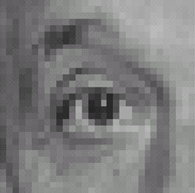
Linear filters: examples
*
0
0
0
=
0
1
0
0
0
0
Original
Identical image
Source: D. Lowe

Slide 27
Linear filters: examples
*
0
0
0
=
1
0
0
0
0
0
Original
Shifted left
By 1 pixel
Source: D. Lowe

Slide 28
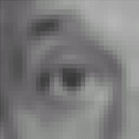

Linear filters: examples
*
1
1
1
=
1
1
1
1
1
1
Original
Blur (with a mean filter)
Source: D. Lowe

Slide 29
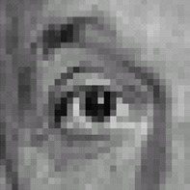



Linear filters: examples
*
0
0
0
-
1
1
1
=
0
2
0
1
1
1
0
0
0
1
1
1
Sharpening filter (accentuates edges)
Original
Source: D. Lowe

Slide 30
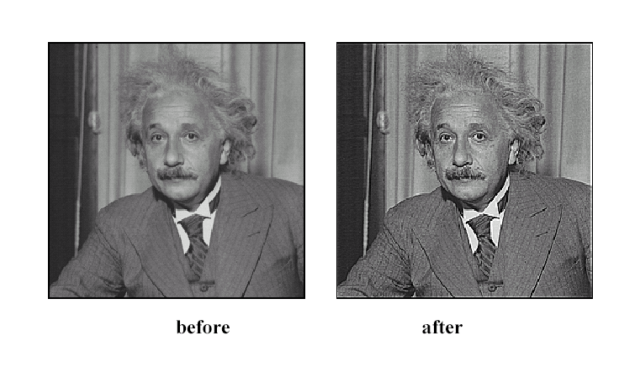
Sharpening
Source: D. Lowe

Slide 31
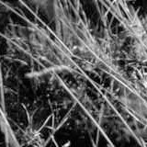
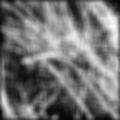
Smoothing with box filter revisited
Source: D. Forsyth
Notes:
I always walk through the argument on the left rather carefully; it gives some insight into the
significance of impulse responses or point spread functions.

Slide 32
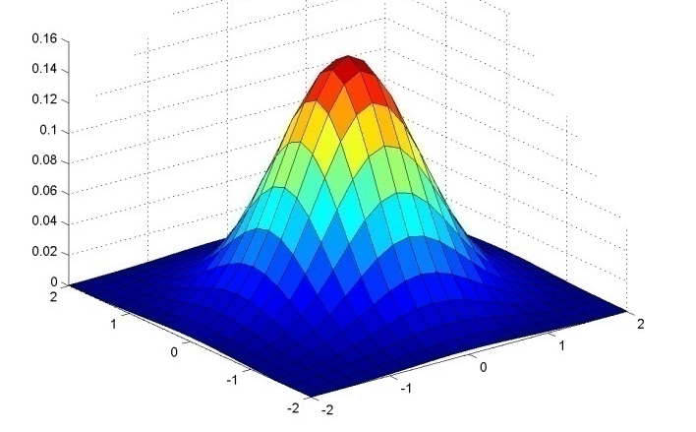
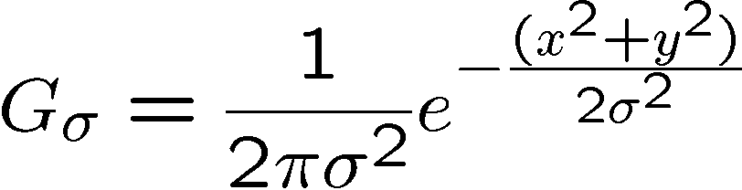
Gaussian Kernel
Source: C. Rasmussen

Slide 33
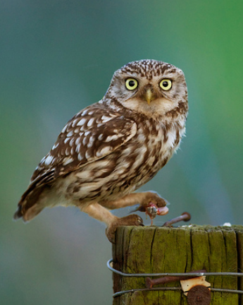
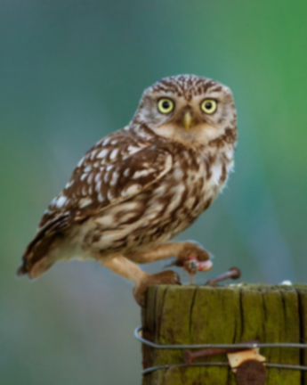








Gaussian filters
= 1 pixel
= 5 pixels
= 10 pixels
= 30 pixels

Slide 34
Sharpening
Source: D. Lowe

Slide 35

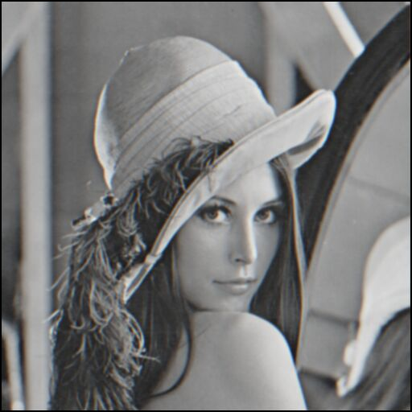
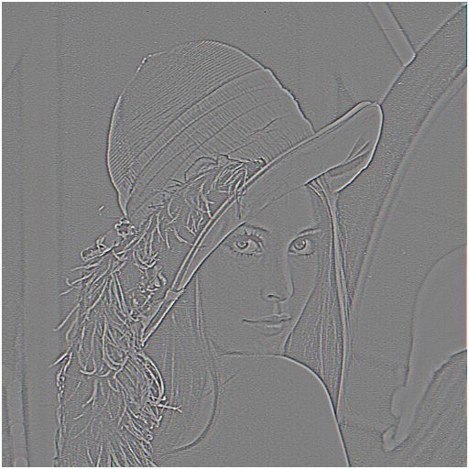

Sharpening revisited
What does blurring take away?
–
=
original
smoothed (5x5)
detail
Let’s add it back:
+ α
=
original
detail
sharpened
Source: S. Lazebnik

Slide 36
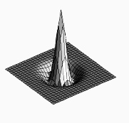

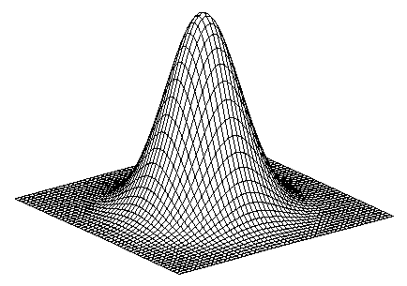
Sharpen filter
blurred
image
image
unit impulse
(identity)
scaled impulse
Gaussian
Laplacian of Gaussian
Notes:
f + a(f - f * g) = (1+a)f-af*g = f*((1+a)e-g)

Slide 37

Sharpen filter
unfiltered
filtered

Slide 38
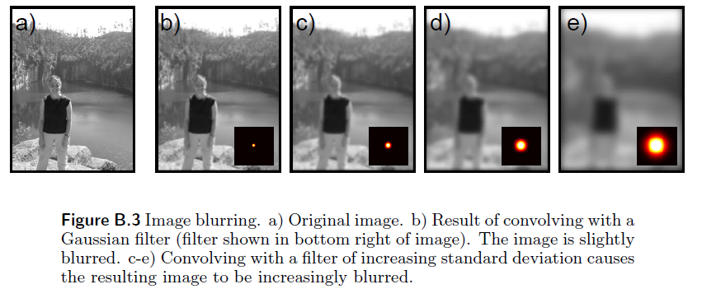
Blurring (convolve with Gaussian)
Computer vision: models, learning and inference. ©2011 Simon J.D. Prince
38

Slide 39
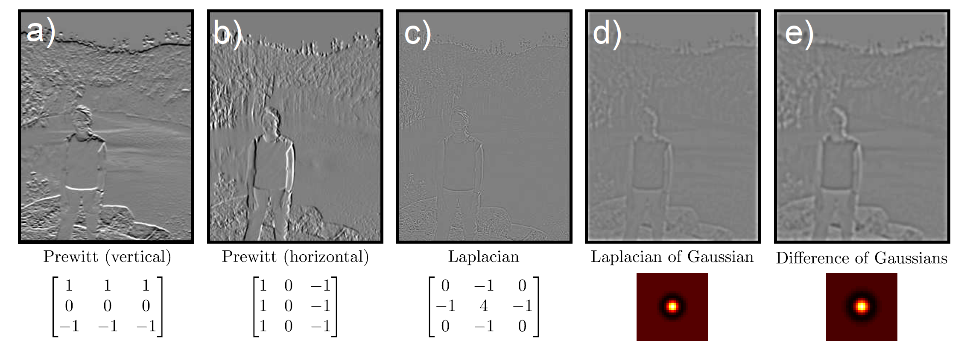
Looking Ahead: Gradient Filters (Edge Detection)
Rule of thumb: big response when image matches filter
Computer vision: models, learning and inference. ©2011 Simon J.D. Prince
39

Slide 40
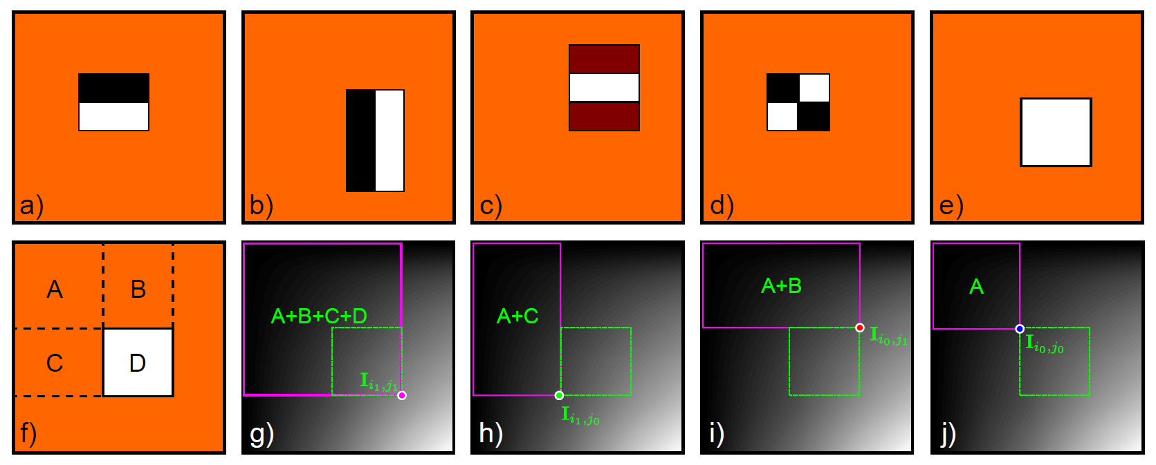
Haar Filters
Computer vision: models, learning and inference. ©2011 Simon J.D. Prince
40

Slide 41
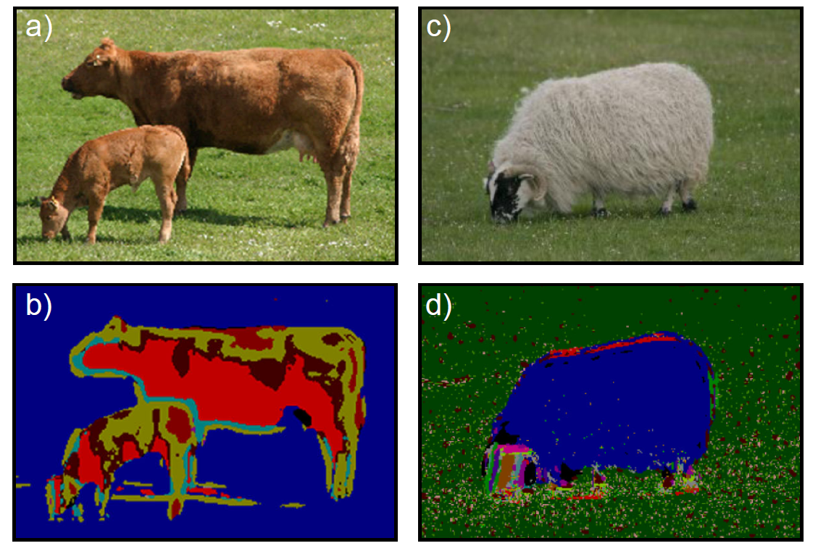
Looking Ahead: Filtering for Texture (Textons)
An attempt to characterize texture
Replace each pixel with integer representing the texture ‘type’
Computer vision: models, learning and inference. ©2011 Simon J.D. Prince
41

Slide 42
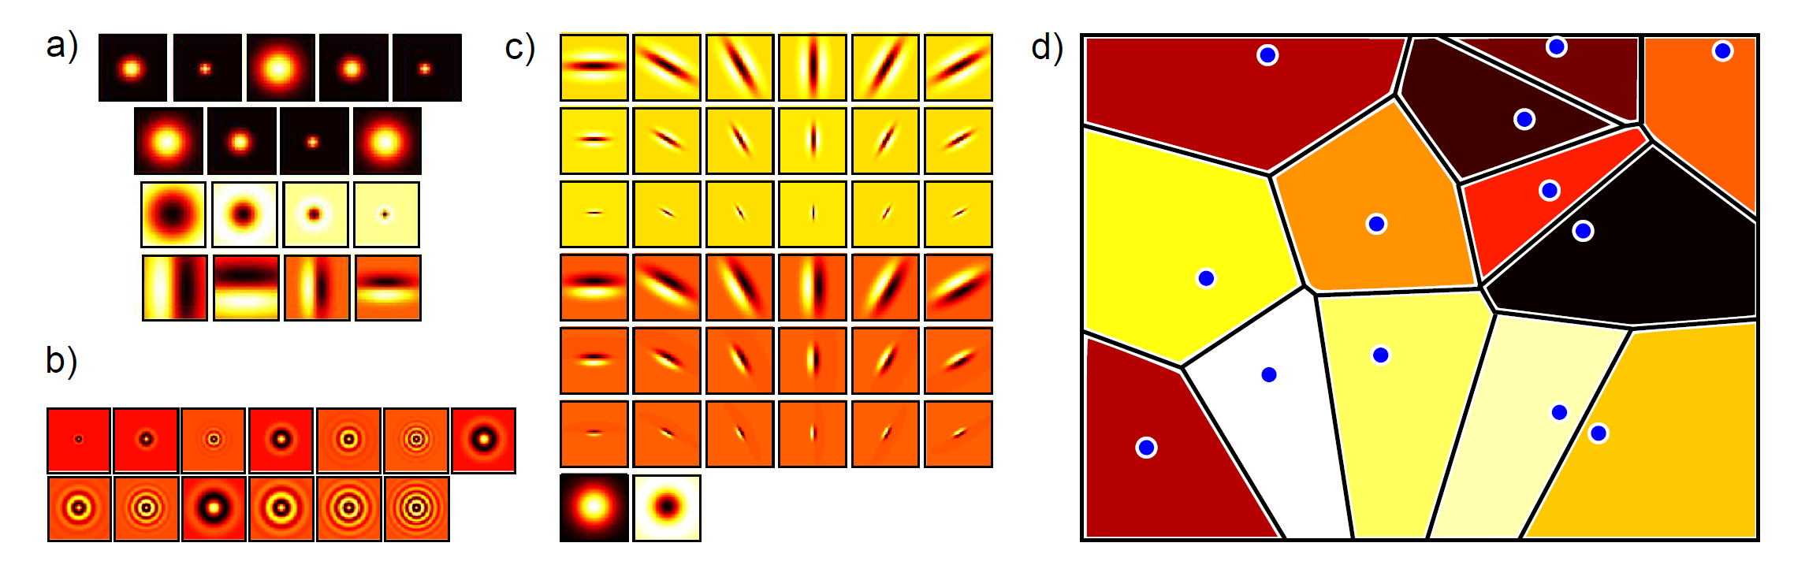
Computing Textons
Take a bank of filters and apply to lots of images
Cluster in filter space
For new pixel, filter surrounding region with same bank, and assign to nearest cluster
Computer vision: models, learning and inference. ©2011 Simon J.D. Prince
42

