Slide 1
COSC579: Image Align, Mosaic, Stitch
Jeremy Bolton, PhD
Assistant Teaching Professor

Slide 2
Outline
Multi-Image Vision
  Mosaic and Align
  Morphing
Revisit scene geometry
Image Warping
  Finding the appropriate transformation (warp)
  Forward Warping
  Backward Warping
  Implementation Details
    Holes
    Feathering

Slide 3
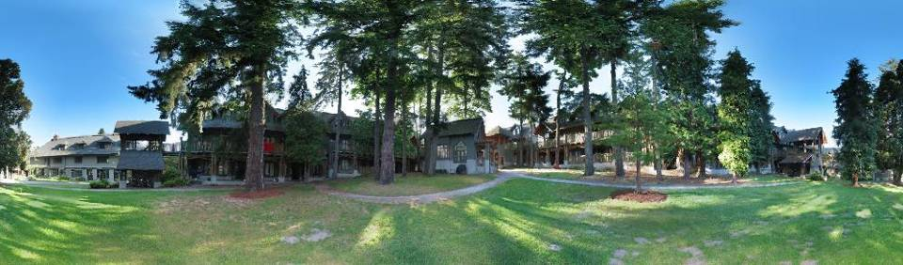
Image alignment
Full screen panoramas (cubic): http://www.panoramas.dk/
Mars: http://www.panoramas.dk/fullscreen3/f2_mars97.html
2003 New Years Eve: http://www.panoramas.dk/fullscreen3/f1.html

Slide 4

Why Mosaic?
Are you getting the whole picture?
  Compact Camera FOV = 50 x 35°
Slide from Brown & Lowe

Slide 5
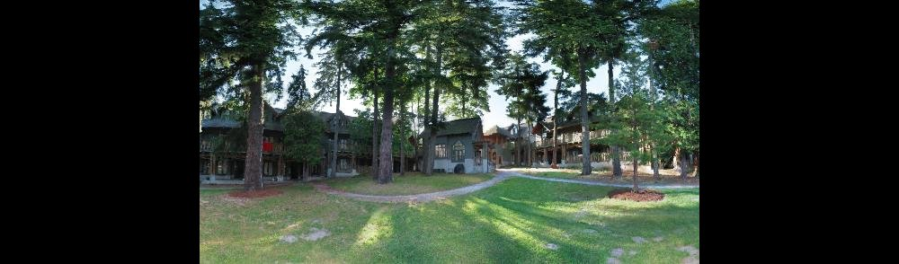
Why Mosaic?
Are you getting the whole picture?
  Compact Camera FOV = 50 x 35°
  Human FOV = 200 x 135°
Slide from Brown & Lowe

Slide 6
Why Mosaic?
Are you getting the whole picture?
  Compact Camera FOV = 50 x 35°
  Human FOV = 200 x 135°
  Panoramic Mosaic = 360 x 180°
Slide from Brown & Lowe

Slide 7
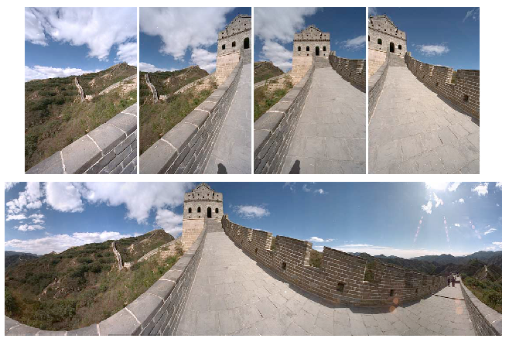
Mosaics: stitching images together

Slide 8
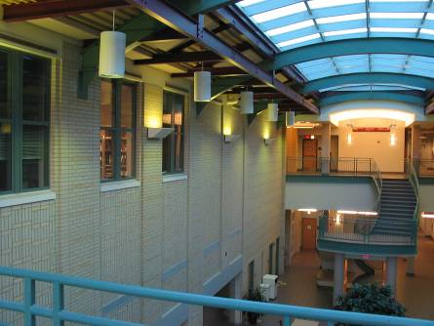
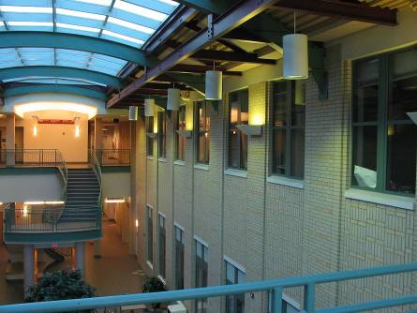
Image alignment
Image taken from same viewpoint, just rotated.
Can we line them up?

Slide 9
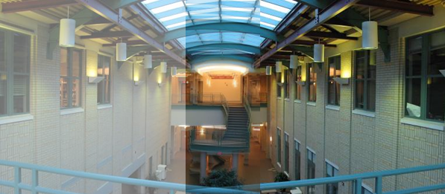
Image alignment
Why don’t these image line up exactly?

Slide 10
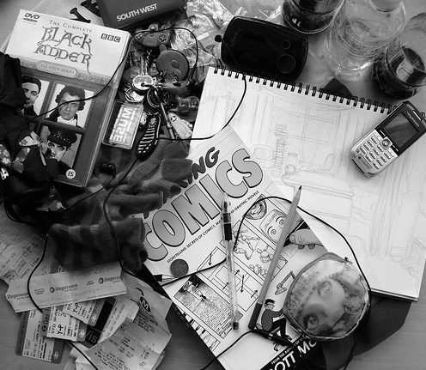
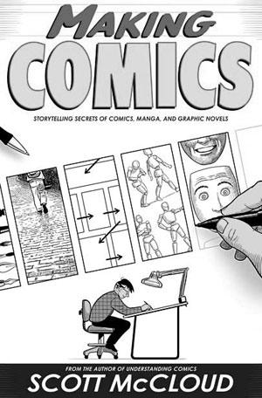
What is the geometric relationship between these two images?
?

Slide 11
What is the geometric relationship between these two images?
?

Slide 12
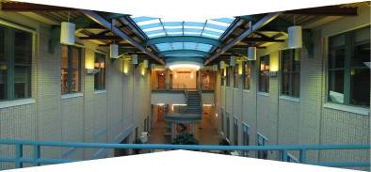
Is this an affine transformation?

Slide 13
Problem: Transforming from one image to another
Conceptually, given a camera matrix P, we can map a point to the image plane. The reverse transformation will map the image coordinate to a line (or point if we know the disparity or depth)
If the Camera matrix for the second image is known, we can then map to the second image

Slide 14
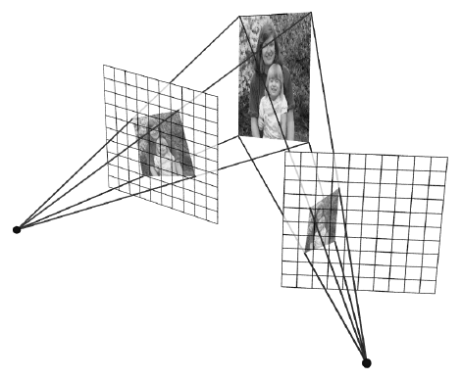
Image reprojection
Observation
  Rather than thinking of this as a 3D reprojection, think of it as a 2D image warp from one image to another

Slide 15
Transforming from one image to another
Simplifying Assumption: Planar Scene
Simplifying Assumption:
  Choose a plane to project back onto (planar scene)
  Analogous to replacing last row of P0 with homogeneous plane equation
  Observe the points map onto a plane, so we are not concerned about the depth (d=0)
  Thus we can ignore the last column of M₁₀
Observe: This sequence of matrix operations can be collapsed into one 3x3 homography.

Slide 16
Transforming from one image to another
Simplifying Assumption: Pure Rotation
Assume no translation and only pure rotation (eg panorama)
  Assume the scene is “large”, points are at infinity.
  Assume no translation
  Assume simple Intrinsics Matrix
This further simplification results in less parameters, since the rotation matrix entries can be calculated using 3 angles.

Slide 17
Homographies
Perspective projection of a plane
  Lots of names for this:
  Modeled as a 2D warp using homogeneous coordinates
p’
H
p
To apply a homography H
  Compute p’ = Hp (regular matrix multiply)
  Convert p’ from homogeneous to image coordinates
    divide by w (third) coordinate

Slide 18
Image reprojection for mosaicing
mosaic PP
The mosaic has a natural interpretation in 3D
  The images are reprojected onto a common plane
    idea: replace camera with slide projector, project onto new PP
  The mosaic is formed on this plane

Slide 19
An Image Alignment Scheme (mosaic)
Given images A and B
Find corresponding points between images (You will manually do this for your assignment)
  Compute image features for A and B (Later!)
  Match features between A and B (Later!)
Solve for homography between A and B using least squares on set of matches.
Blend images (composite)
What could go wrong?

Slide 20


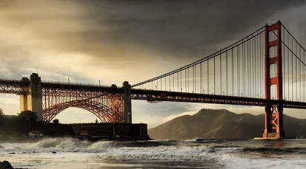
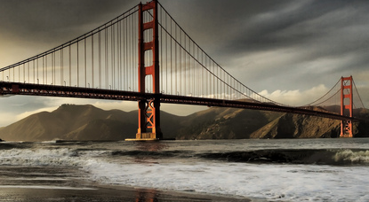




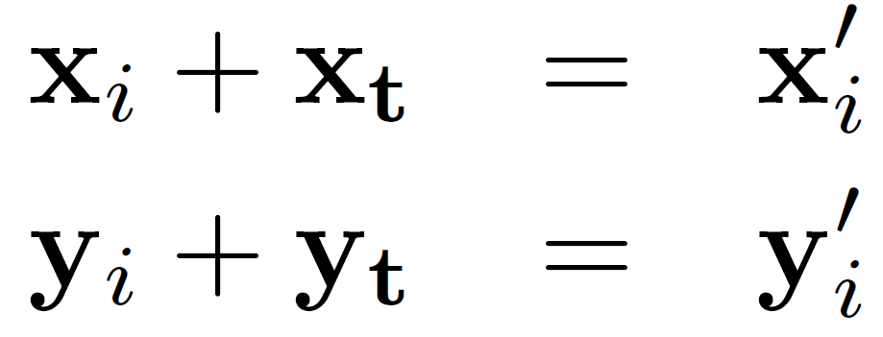
Estimating Translations
Problem: more equations than unknowns
  “Overdetermined” system of equations
  We will find the least squares solution

Slide 21
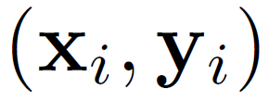
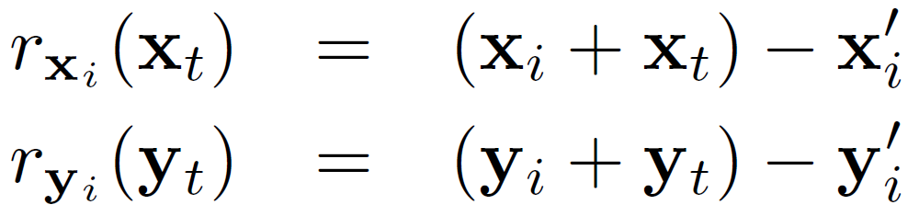
Simplified Least squares formulation
For each point
we define the residuals as

Slide 22
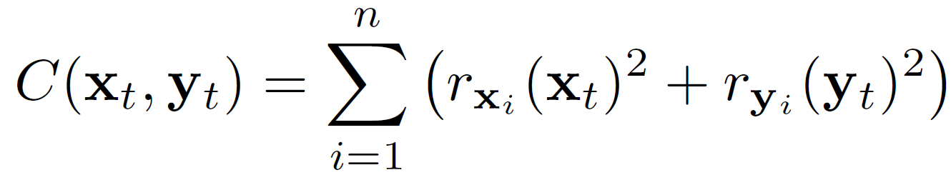
Least squares formulation
Goal: minimize sum of squared residuals
“Least squares” solution
For translations, is equal to mean displacement

Slide 23
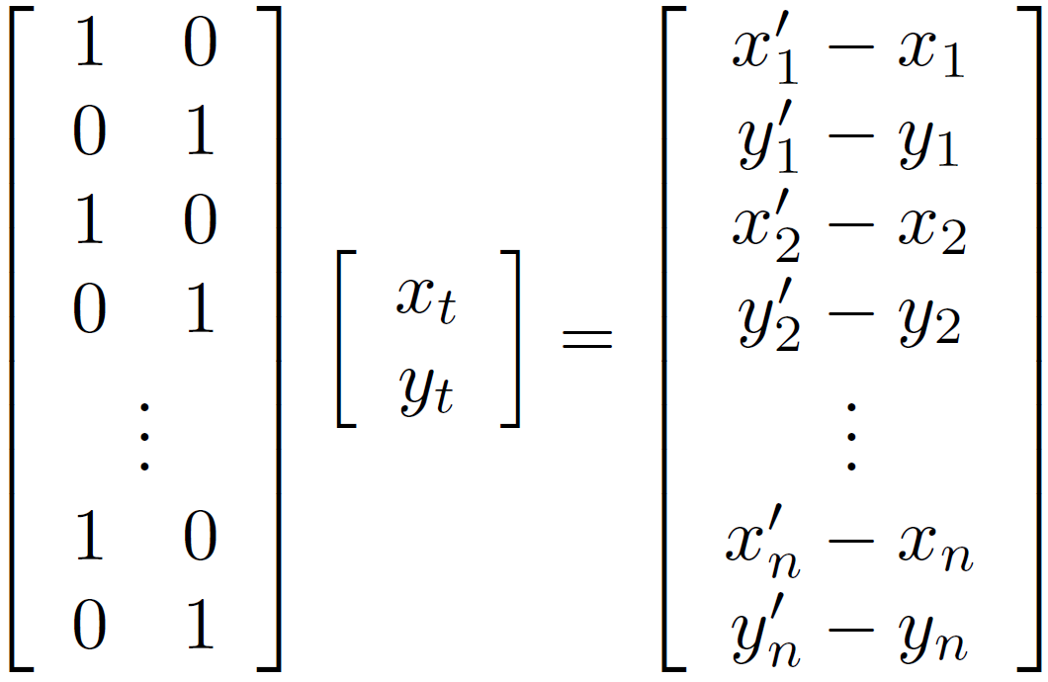




Simplified Least squares formulation
Can also write as a matrix equation
2n x 2
2 x 1
2n x 1

Slide 24

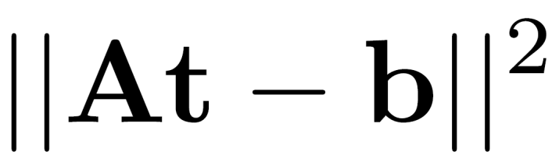
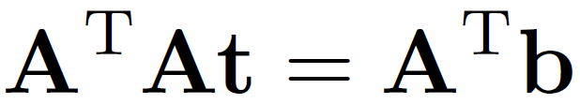
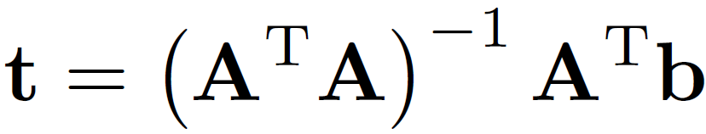
Least squares
Find t that minimizes
To solve, form the normal equations

Slide 25
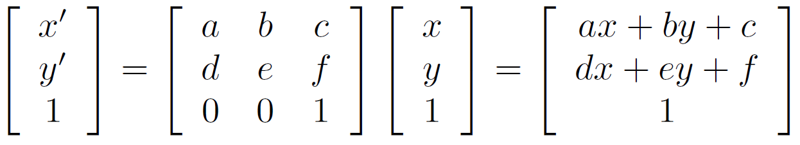
Affine Assumption:
Oversimplification
How many unknowns?
How many equations per match?
How many matches do we need?

Slide 26
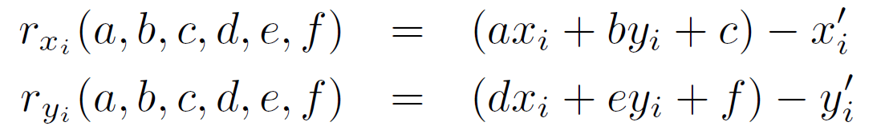

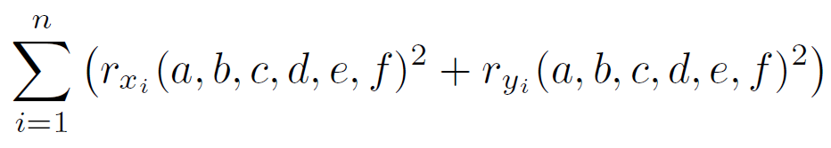
Affine transformations
Residuals:
Cost function:

Slide 27
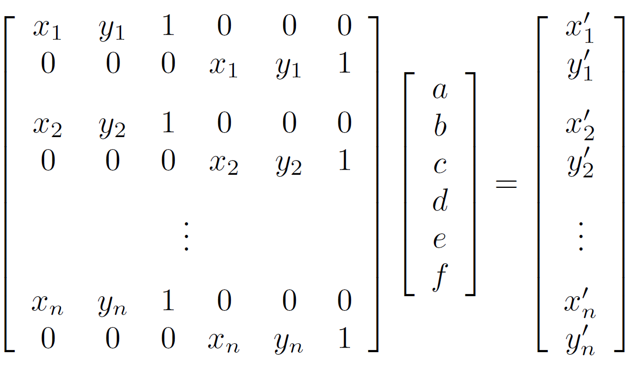




Affine transformations
Matrix form
2n x 6
6 x 1
2n x 1

Slide 28
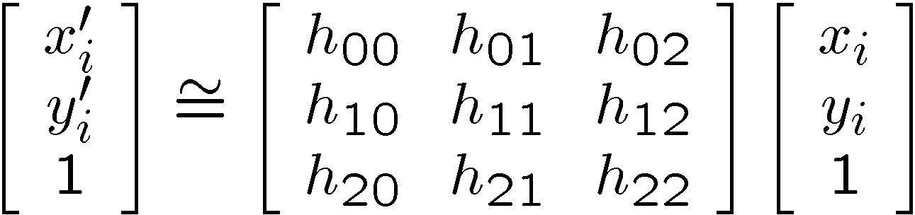
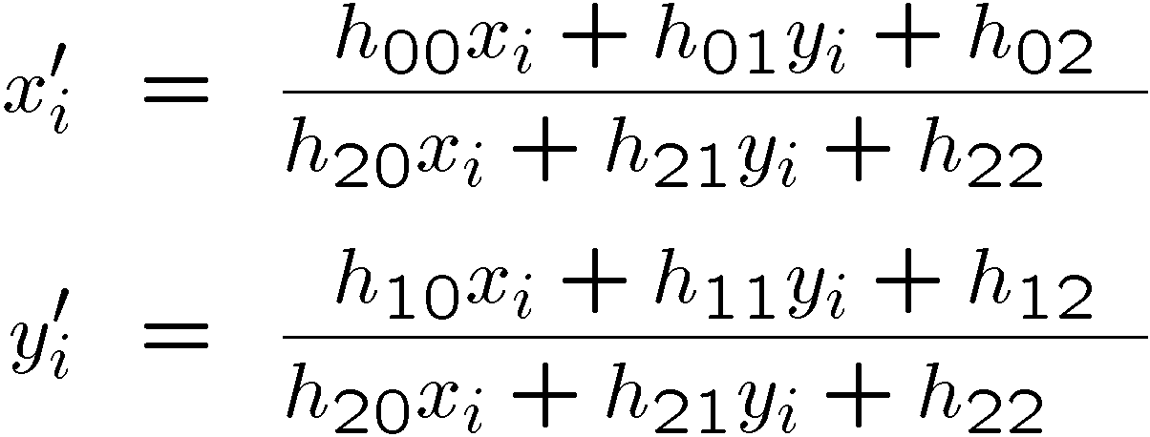
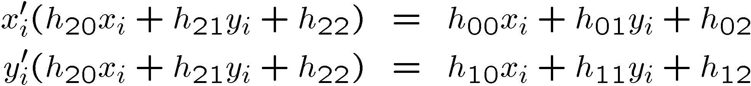
Solving for homographies

Slide 29
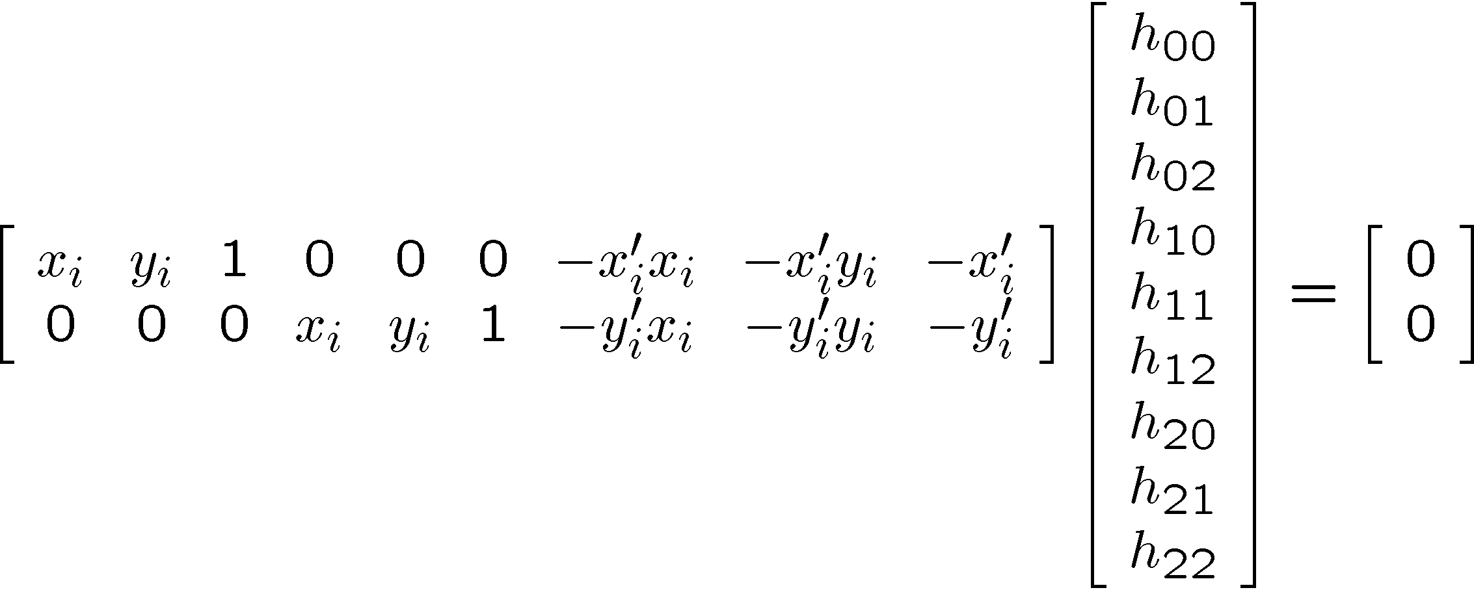
Solve for transformation parameters
Observe: here we construct the A matrix differently (such that the linear combination with the transformation parameters yields 0). This is a different way to formulate the system of equations.

Slide 30
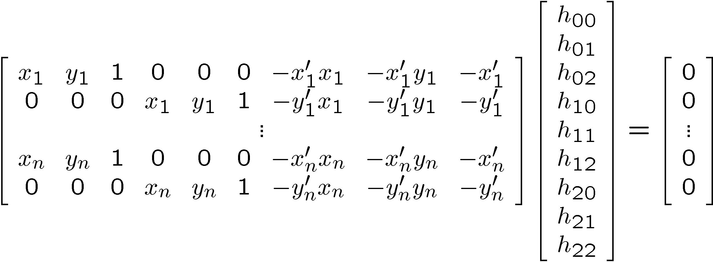






Solving for homographies
2n × 9
9
2n
Defines a least squares problem:
  Since is only defined up to scale, solve for unit vector
  Solution: = eigenvector of with smallest eigenvalue
  Works with 4 or more points

Slide 31
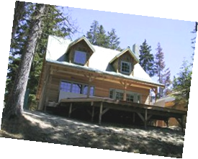
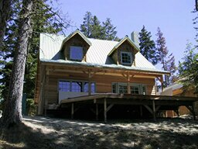
We have now learned how to solve for warping transformation … Done?
h(x,y)
y
y’
x
x’
f(x,y)
g(x’,y’)
Given a coordinate transform (x’,y’) = h(x,y) and a source image f(x,y), how do we compute a transformed image g(x’,y’) = f(h(x,y))?

Slide 32
Forward warping
h(x,y)
y
y’
x
x’
f(x,y)
g(x’,y’)
Send each pixel f(x,y) to its corresponding location
(x’,y’) = h(x,y) in the second image
Q: what if pixel lands “between” two pixels?

Slide 33
Forward warping
h(x,y)
y
y’
x
x’
f(x,y)
g(x’,y’)
Send each pixel f(x,y) to its corresponding location
(x’,y’) = h(x,y) in the second image
Q: what if pixel lands “between” two pixels?
A: distribute color among neighboring pixels (x’,y’)
  Known as “splatting”

Slide 34
Inverse warping
h⁻¹(x,y)
y
y’
x
x
x’
f(x,y)
g(x’,y’)
Get each pixel g(x’,y’) from its corresponding location
(x,y) = h⁻¹(x’,y’) in the first image
Q: what if pixel comes from “between” two pixels?

Slide 35
Inverse warping
h⁻¹(x,y)
y
y’
x
x
x’
f(x,y)
g(x’,y’)
Get each pixel g(x’,y’) from its corresponding location
(x,y) = h⁻¹(x’,y’) in the first image
Q: what if pixel comes from “between” two pixels?
A: “resample” color value
  Resampling techniques before
    nearest neighbor, interpolation, …

Slide 36
Forward vs. inverse warping
Q: which is better?
A: usually inverse—eliminates holes
  however, it requires an invertible warp function

Slide 37
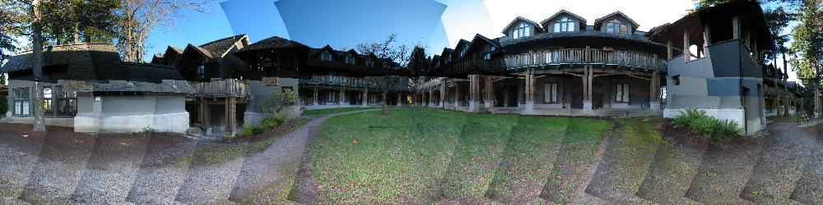
Blending
We’ve aligned the images – now what?

Slide 38
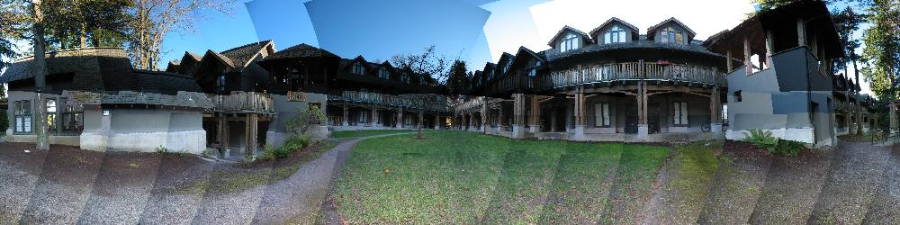
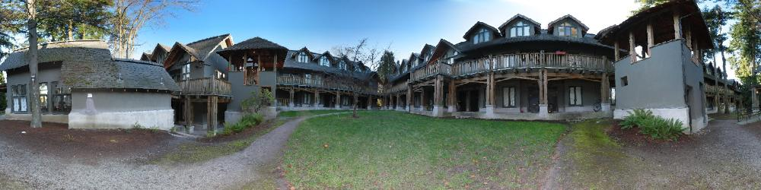
Blending
Want to seamlessly blend them together

Slide 39
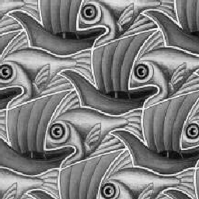
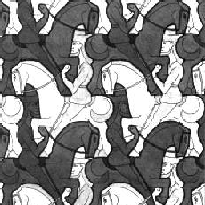
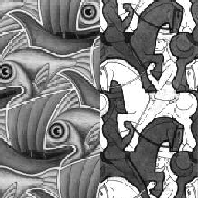
Image Blending

Slide 40
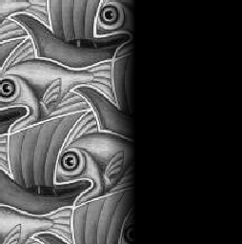
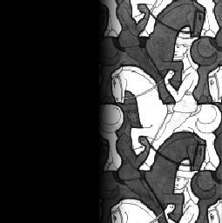

Feathering
+
1
1
0
0
=

Slide 41
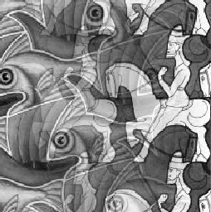
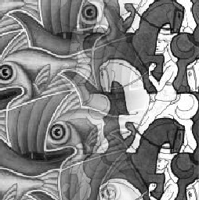
Effect of window size
1
left
1
right
0
0

Slide 42


Effect of window size
1
1
0
0

Slide 43

Good window size
1
0
“Optimal” window: smooth but not ghosted
  Doesn’t always work...

Slide 44
Alpha Blending
I₃
p
I₁
Optional: see Blinn (CGA, 1994) for details:
http://ieeexplore.ieee.org/iel1/38/7531/00310740.pdf?isNumber=7531&prod=JNL&arnumber=310740&arSt=83&ared=87&arAuthor=Blinn%2C+J.F.
I₂
Encoding blend weights: I(x,y) = (αR, αG, αB, α)
color at p =
Implement this in two steps:
  1. accumulate: add up the (α premultiplied) RGBα values at each pixel
  2. normalize: divide each pixel’s accumulated RGB by its α value
    Q: what if α = 0?
Notes:
A: render as black

Slide 45
Other Fun Applications of Compositing and Blending

Slide 46
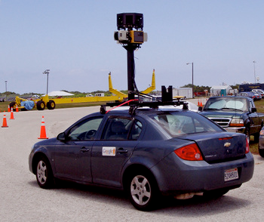
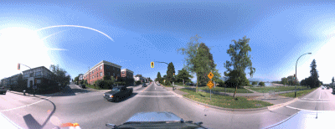
Some panorama examples
Every image on Google Streetview

Slide 47
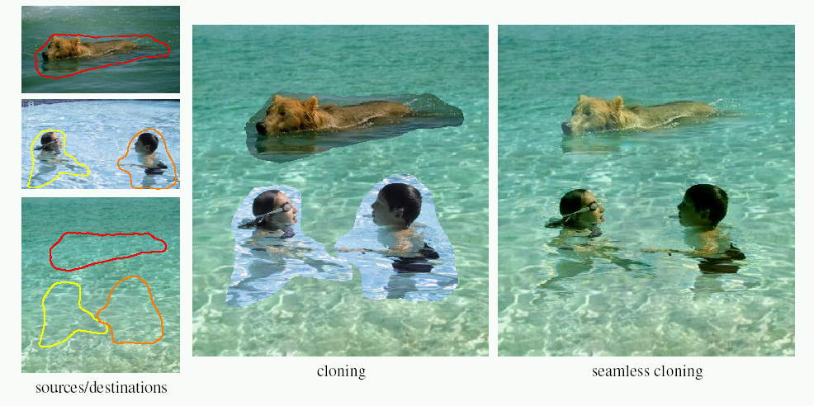
Poisson Image Editing
For more info: Perez et al, SIGGRAPH 2003
  http://research.microsoft.com/vision/cambridge/papers/perez_siggraph03.pdf

Slide 48
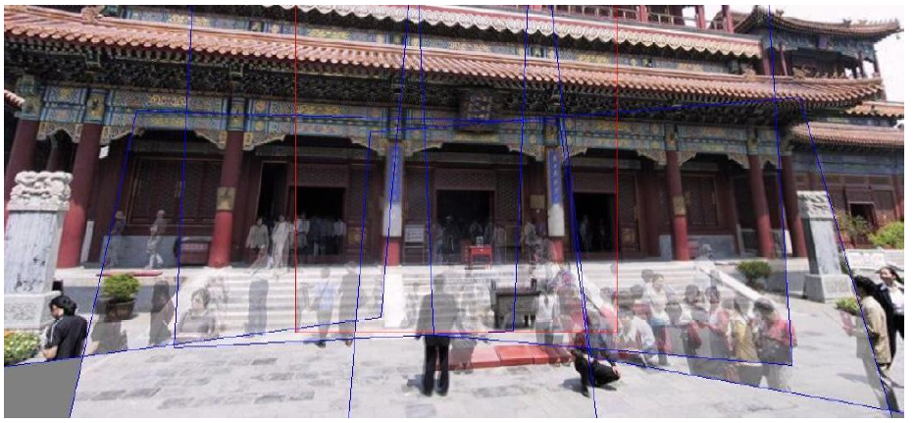
Magic: ghost removal
M. Uyttendaele, A. Eden, and R. Szeliski.
Eliminating ghosting and exposure artifacts in image mosaics.
In Proceedings of the Interational Conference on Computer Vision and Pattern Recognition,
volume 2, pages 509--516, Kauai, Hawaii, December 2001.

Slide 49
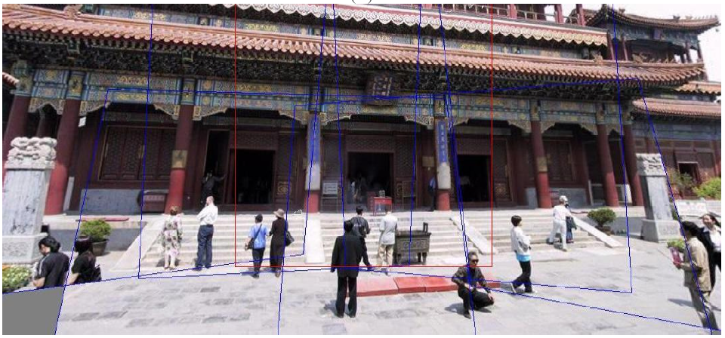
Magic: ghost removal
M. Uyttendaele, A. Eden, and R. Szeliski.
Eliminating ghosting and exposure artifacts in image mosaics.
In Proceedings of the Interational Conference on Computer Vision and Pattern Recognition,
volume 2, pages 509--516, Kauai, Hawaii, December 2001.
Notes:
How to handle motion?

