Slide 1
COSC579: Image Formation
Jeremy Bolton, PhD
Assistant Teaching Professor

Slide 2
Outline
The journey: from scene to image
Digital Cameras
Color vs Grayscale images
Concerns

Slide 3
Camera is not a photometer!
Limited dynamic range
8 bits captures only 2 orders of magnitude of light intensity
We can see ~10 orders of magnitude of light intensity
Unknown, nonlinear response
pixel intensity ≠ amount of light (# photons, or “radiance”)
Notes:
4

Slide 4
Camera pipeline

Slide 5
Camera pipeline

Slide 6
Camera pipeline

Slide 7
Camera pipeline

Slide 8
Camera pipeline

Slide 9
Camera pipeline
8 bits

Slide 10
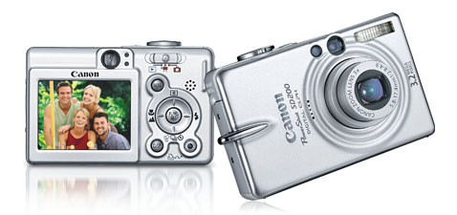
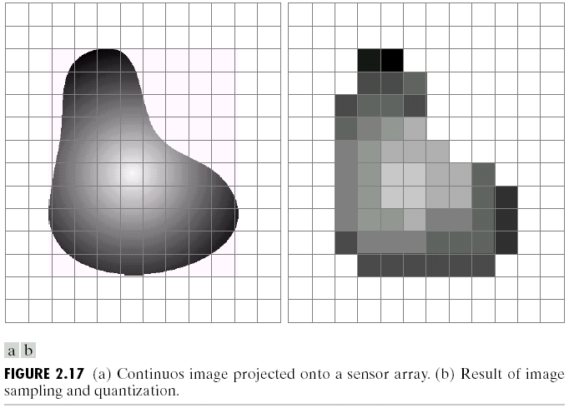
Digital camera
A digital camera replaces film with a sensor array
Each cell in the array is light-sensitive diode that converts photons to electrons
Two common types
Charge Coupled Device (CCD)
Complementary metal oxide semiconductor (CMOS)
Slide by Steve Seitz

Slide 11
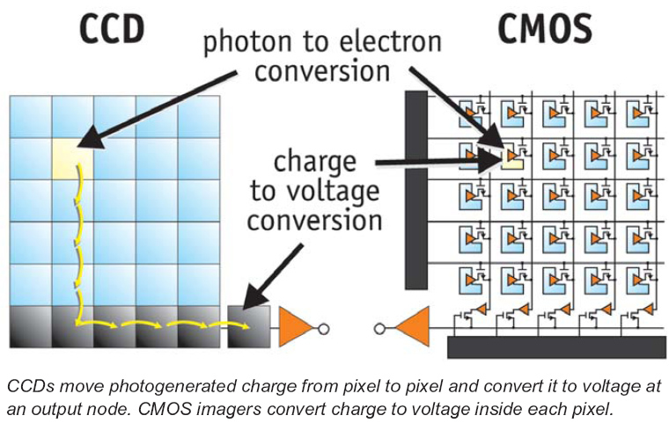
CCD vs. CMOS
CCD: transports the charge across the chip and reads it at one corner of the array. An analog-to-digital converter (ADC) then turns each pixel's value into a digital value by measuring the amount of charge at each photosite and converting that measurement to binary form
CMOS: uses several transistors at each pixel to amplify and move the charge using more traditional wires. The CMOS signal is digital, so it needs no ADC.
http://electronics.howstuffworks.com/digital-camera.htm

Slide 12
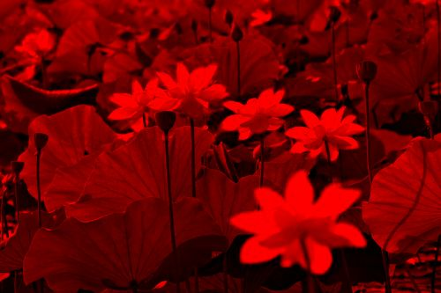
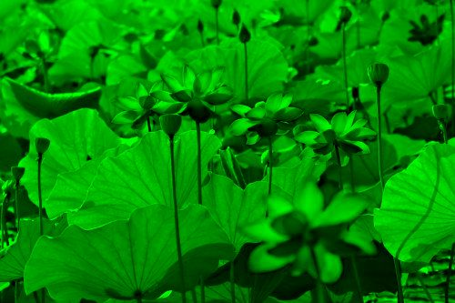
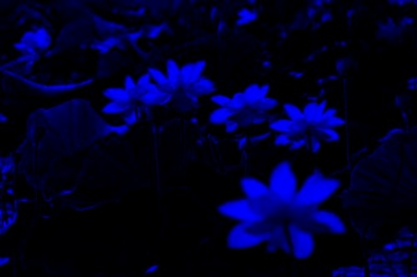
Color
What about color?
Most digital images are comprised of three color channels – red, green, and, blue – which combine to create most of the colors we can see
Why are there three?
=

Slide 13
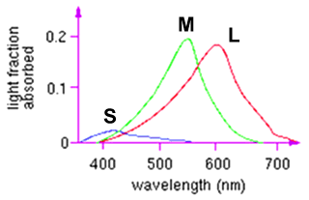
Color perception
L response curve
Three types of cones
Each is sensitive in a different region of the spectrum
but regions overlap
Short (S) corresponds to blue
Medium (M) corresponds to green
Long (L) corresponds to red
Different sensitivities: we are more sensitive to green than red
varies from person to person (and with age)
Colorblindness—deficiency in at least one type of cone

Slide 14
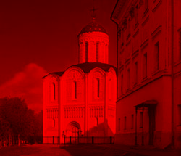
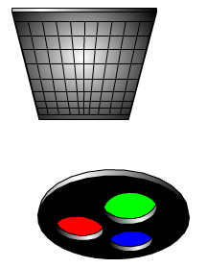
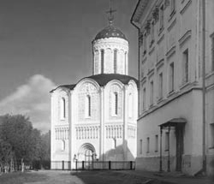
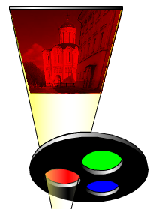
Field sequential
YungYu Chuang’s slide

Slide 15
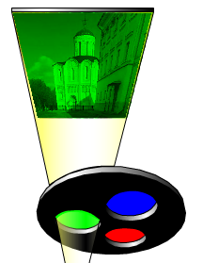
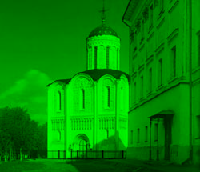
Field sequential
YungYu Chuang’s slide

Slide 16
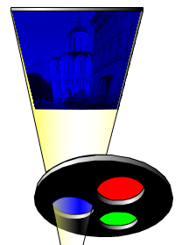
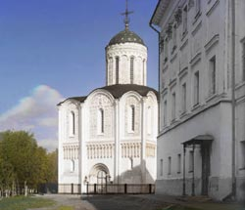
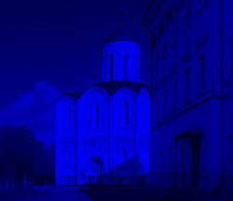
Field sequential
YungYu Chuang’s slide

Slide 17
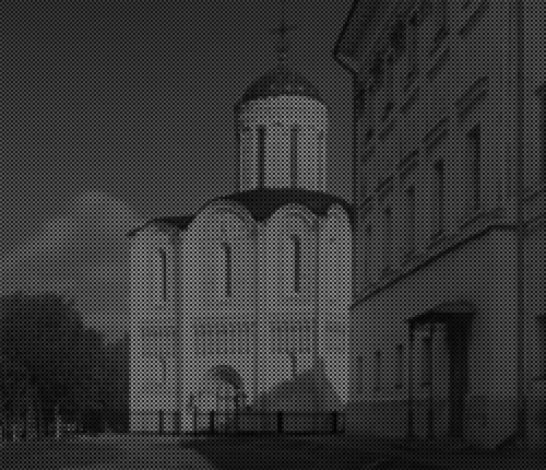
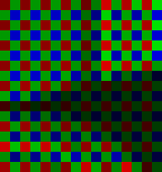
Bayer’s pattern
YungYu Chuang’s slide

Slide 18
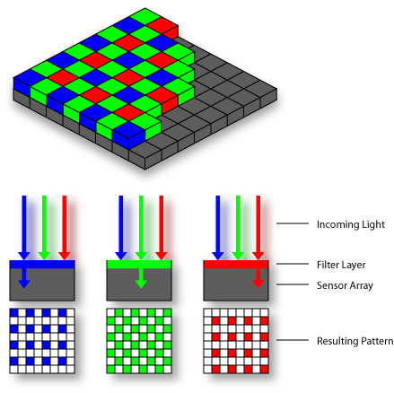
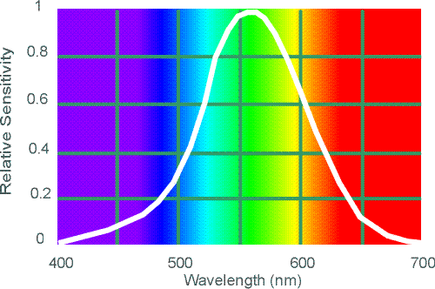
Color sensing in camera: Color filter array
Bayer grid
Estimate missing components from neighboring values (demosaicing)
Why more green?
Human Luminance Sensitivity Function
Source: Steve Seitz

Slide 19
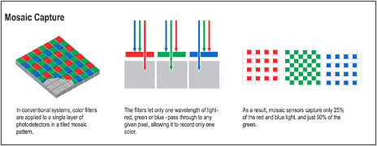
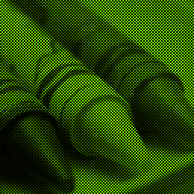
Color filter array
red
green
blue
output
YungYu Chuang’s slide

Slide 20
Color images
We’ll treat color images as a vector-valued function:
Common equation to convert to grayscale
(0.3 * r + 0.59 * g + 0.11 * b)
Note: To do this, each pixel is composed of multiple sensors responses from a Bayer grid. This process is called demosaicing.
Each pixels value is a result of a set of neighboring sensors

Slide 21
Problem with demosaicing: color moire
Slide by F. Durand

Slide 22
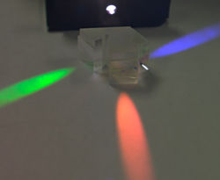
Color sensing: Separate colors using Prism (rather than filter)
Requires three chips and precise alignment
Pro
Records rgb measurements for each point in image plane
Con
more expensive
CCD(R)
CCD(G)
CCD(B)

Slide 23
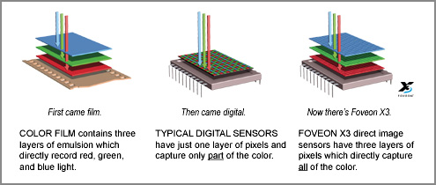
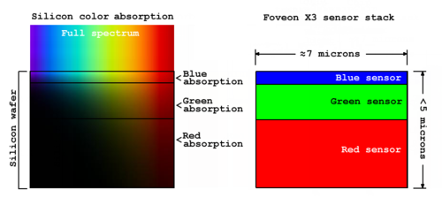
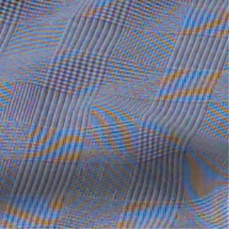
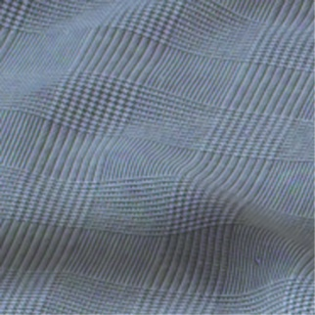
Color sensing in camera: Foveon X3
CMOS sensor
Takes advantage of the fact that red, blue and green light penetrate silicon to different depths
http://www.foveon.com/article.php?a=67
http://en.wikipedia.org/wiki/Foveon_X3_sensor
better image quality
Source: M. Pollefeys

Slide 24
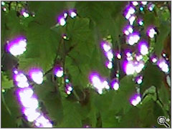
Issues with digital cameras
Noise
low light is where you most notice noise
light sensitivity (ISO) / noise tradeoff
stuck pixels
Resolution: Are more megapixels better?
requires higher quality lens
noise issues
In-camera processing
oversharpening can produce halos
RAW vs. compressed
file size vs. quality tradeoff
Blooming
charge overflowing into neighboring pixels
Color artifacts
purple fringing from microlenses, artifacts from Bayer patterns
white balance
More info online:
http://electronics.howstuffworks.com/digital-camera.htm
http://www.dpreview.com/
Slide by Steve Seitz

Slide 25
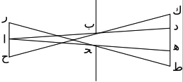
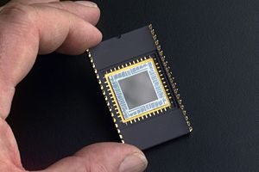
Historical context
Pinhole model: Mozi (470-390 BCE), Aristotle (384-322 BCE)
Principles of optics (including lenses): Alhacen (965-1039 CE)
Camera obscura: Leonardo da Vinci (1452-1519), Johann Zahn (1631-1707)
First photo: Joseph Nicephore Niepce (1822)
Daguerréotypes (1839)
Photographic film (Eastman, 1889)
Cinema (Lumière Brothers, 1895)
Color Photography (Lumière Brothers, 1908)
Television (Baird, Farnsworth, Zworykin, 1920s)
First consumer camera with CCD: Sony Mavica (1981)
First fully digital camera: Kodak DCS100 (1990)
Alhacen’s notes
Niepce, “La Table Servie,” 1822
CCD chip

Slide 26
Some Issues (Segue to Image Processing)
Brightness issues
Skewed Histograms
Compositing
Histogram Normalization (soon … but later!)
Color Mapping
Color transforms
Others Discussed
Noise
Distortion

Slide 27
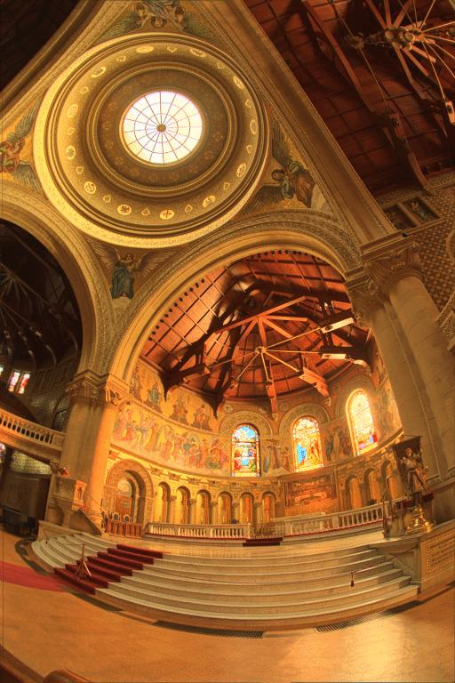
What do we see?
Vs.

Slide 28
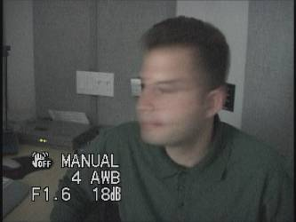
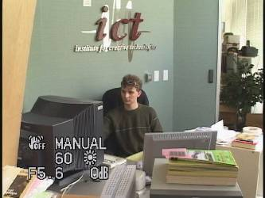
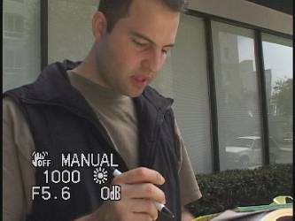
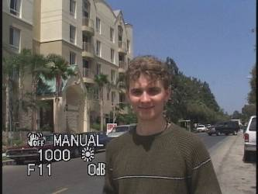
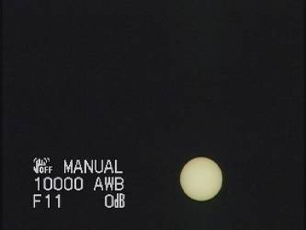
Problem: Dynamic Range
The real world has high dynamic range.

Slide 29
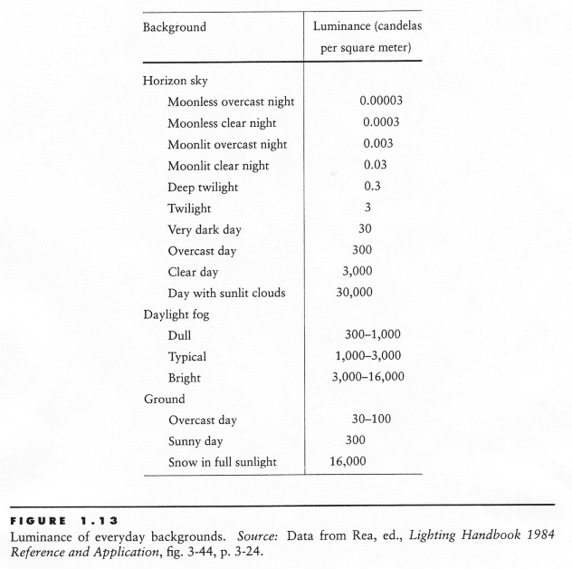
Visual dynamic range

Slide 30
Dynamic range
Our total dynamic range is high (~10⁹)
Our dynamic range at a given time is still pretty high (~10⁴)
A camera’s dynamic range for a given exposure is relatively low (2⁸ = 256 tonal values, range of about ~10³)

Slide 31
Long Exposure
10⁻⁶
High dynamic range
10⁶
Real world
10⁻⁶
10⁶
Picture
^{0 to 255}

Slide 32
Short Exposure
10⁻⁶
High dynamic range
10⁶
Real world
10⁻⁶
10⁶
Picture
^{0 to 255}

Slide 33
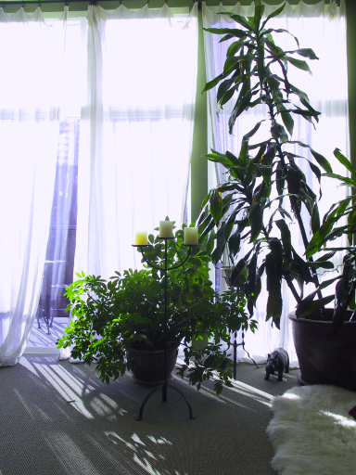
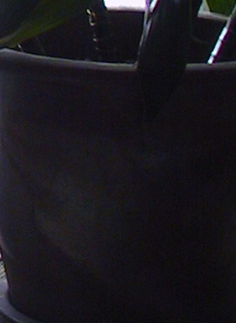
Dynamic Range
Typical cameras have limited dynamic range

Slide 34
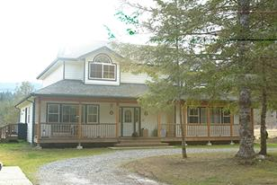
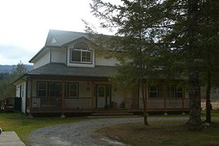
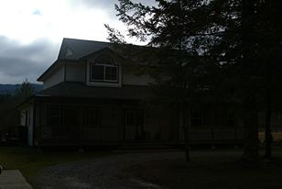
HDR images — merge multiple inputs
Pixel count
Scene Radiance

Slide 35
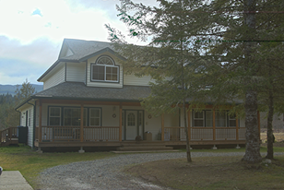
HDR images — merged
Pixel count
Radiance

Slide 36
Dynamic range
What is the range of light intensity that a camera can capture?
Called dynamic range
Digital cameras have difficulty capturing both high intensities and low intensities in the same image

Slide 37
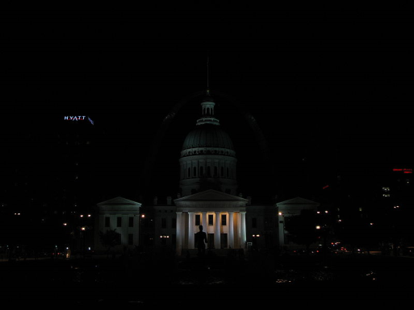
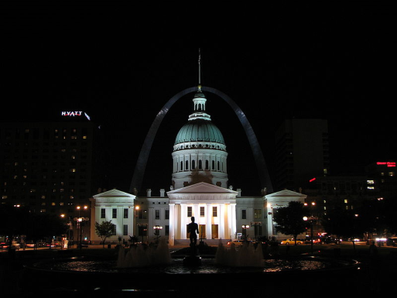
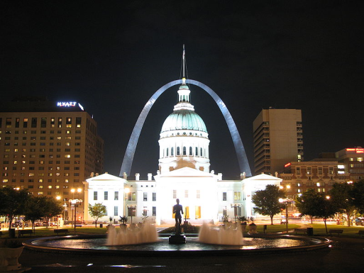
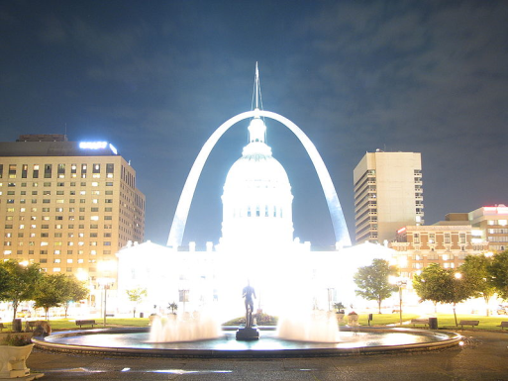
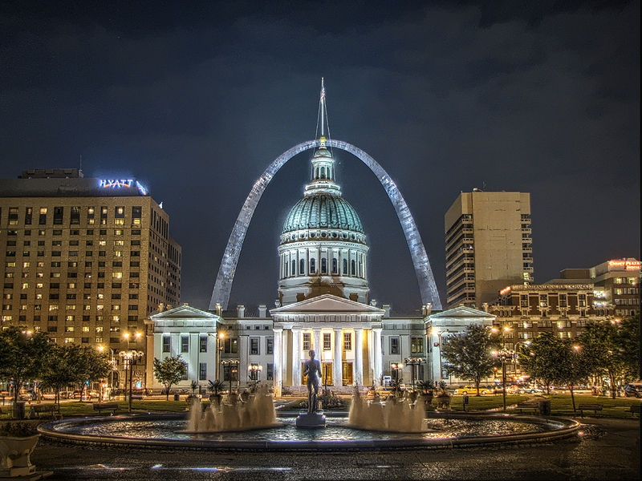
High dynamic range imaging

