Slide 1
COSC579: Color and Perception
Jeremy Bolton, PhD
Assistant Teaching Professor

Slide 2
Outline
Human perception of color.
Formalizing color?
Color Models

Slide 3
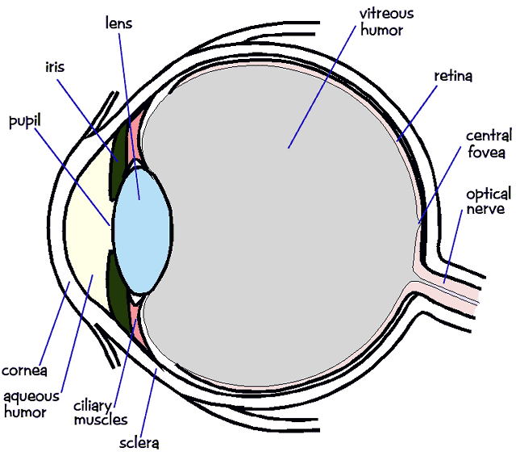
Capturing and Sensing Light: The human visual system
Light and Color perception
  Light hits the retina, which contains photosensitive cells
    rods and cones
  These cells convert the spectrum into a few discrete values

Slide 4
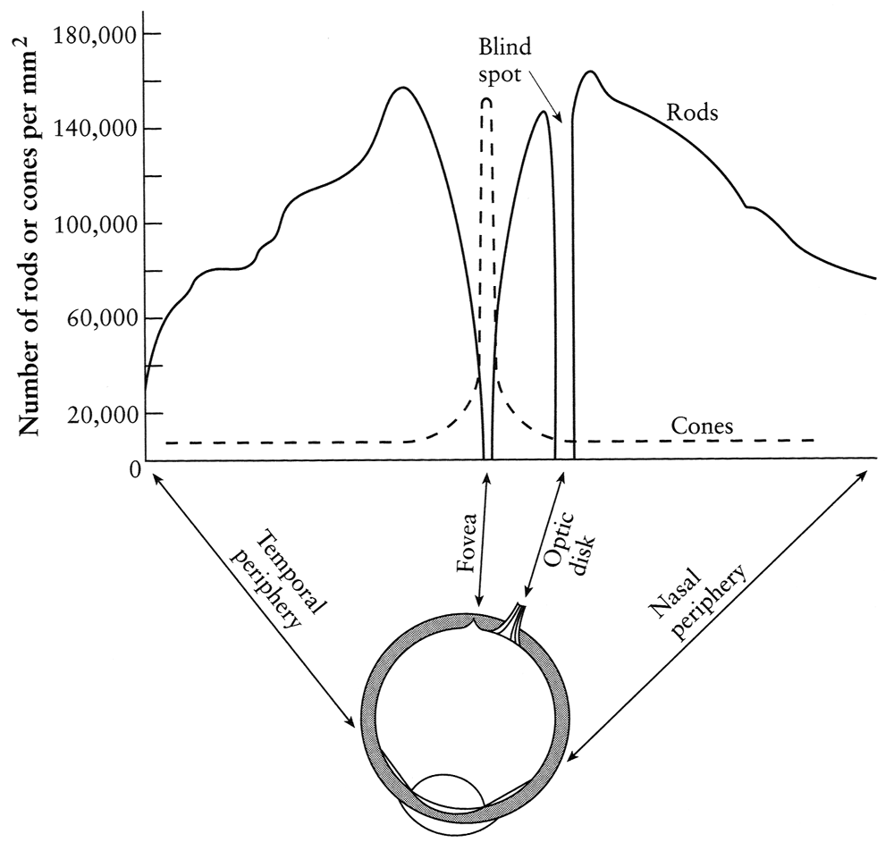
Density of rods and cones
Rods and cones are non-uniformly distributed on the retina
  Rods responsible for intensity, cones responsible for color
  Fovea - Small region (1 or 2°) at the center of the visual field containing the highest density of cones (and no rods).
  Less visual acuity in the periphery—many rods wired to the same neuron

Slide 5
Light response is nonlinear
Our visual system has a large dynamic range
  We can resolve both light and dark things at the same time
  One mechanism for achieving this is that we sense light intensity on a logarithmic scale
    an exponential intensity ramp will be seen as a linear ramp
  Another mechanism is adaptation
    rods and cones adapt to be more sensitive in low light, less sensitive in bright light.

Slide 6
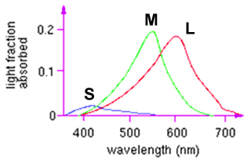
Color perception
L response curve
Three types of cones
  Each is sensitive in a different region of the spectrum
    but regions overlap
    Short (S) corresponds to blue
    Medium (M) corresponds to green
    Long (L) corresponds to red
  Different sensitivities: we are more sensitive to green than red
  Colorblindness—deficiency in at least one type of cone

Slide 7
Color perception
M
L
Power
S
Wavelength
Rods and cones act as filters on the spectrum
  To get the output of a filter, multiply its response curve by the spectrum, integrate over all wavelengths
    Each cone yields one number
  Q: How can we represent an entire spectrum with 3 numbers?
  A: We can’t! Most of the information is lost.
    As a result, two different spectra may appear indistinguishable
      such spectra are known as metamers
      http://www.cs.brown.edu/exploratories/freeSoftware/repository/edu/brown/cs/exploratories/applets/spectrum/metamers_guide.html

Slide 8
The appearance of colors
Color appearance is based on the sensing mechanism
  As we have discussed … it has been shown, it is possible to match almost all colors, viewed in film mode using only three primary sources - the principle of trichromacy.
Color appearance is affected by the “compression” and “post processing” of an objects albedo
  “Post processing” in visual cortex is complex process
  Hering, Helmholtz: Color appearance is strongly affected by other nearby colors, by adaptation to previous views, and by “state of mind”
  Adaptation phenomena
See neuroscience related research by Poggio et al.

Slide 9
Notes:
This is the Stroop effect. You should ask for volunteers. First should read the color names of the column of xxxxxxs. Second should read the color names of the right hand column (where word and color name are the same). Third should read the colors of that column; fourth should read the words of the center column; and fifth should read the colors of that column. In each case, people should read out loud, as fast as possible. Fifth volunteer will struggle --- hence, your ability to name the colors is being interfered with by some input from reading. There is no reason to describe what; this is a clear demonstration that color naming is affected by more than just physics.

Slide 10
Notes:
Ask if the grey figures are the same color

Slide 11
Notes:
They are, but they don’t look it, because the contrasting backgrounds affect the perceived colors of the regions. This means, again, that pure physics is not a particularly good guide to perceived color --- we would need more. To get a system of color names, we must rule out this sort of nonsense, and we do so with the film color mode.

Slide 12
Adaptation phenomena
The response of your color system depends both on spatial contrast and what it has seen before (adaptation)
This seems to be a result of coding constraints --- receptors appear to have an operating point that varies slowly over time, and to signal some sort of offset. One form of adaptation involves changing this operating point.
Common example: walk inside from a bright day; everything looks dark for a bit, then takes its conventional brightness.

Slide 13
Notes:
Stare fixedly at the slide for a minute or so, fixing your gaze. Now look at the next slide; you should see an image of opponent colors (blue->yellow, red->green, etc.) which forms a South African flag. This
Is a color afterimage.

Slide 14
Notes:
Stare at the circle for about a minute, now look at the circle in the next slide.
Are the colors on top and bottom the same?

Slide 16
Notes:
This is a demonstration of a spatial phenomenon, caused by the fact that we have relatively few S cones in our retina. In turn, this means that S cones alias signals that have high spatial frequency. The most obvious signs of this are that narrow blue stripes look green (and blue text is notoriously hard to read). Look at the sets of stripes in the next three slides --- do the narrow ones look greener?

Slide 19
Notes:
Here’s a chance to see them all together; again, narrower ones should look greener. You can also demonstrate adaptation with this slide.

Slide 20
Perception summary
The mapping from radiance to perceived color is quite complex!
  We throw away most of the data
  We apply a logarithm
  Brightness affected by pupil size
  Brightness contrast and constancy effects
  Afterimages
The same is true for cameras
  But we have tools to correct for these effects
    Coming soon….

Slide 21
Outline
Human perception of color
Formalizing Color
Color Models

Slide 22
So why specify color numerically?
Accurate color reproduction is commercially valuable
  Many products are identified by color (“golden” arches;
Few color names are widely recognized by English speakers -
  About 10; other languages have fewer/more, but not many more.
  It’s common to disagree on appropriate color names.
Color reproduction problems increased by prevalence of digital imaging - eg. digital libraries of art.
  How do we ensure that everyone sees the same color?

Slide 23
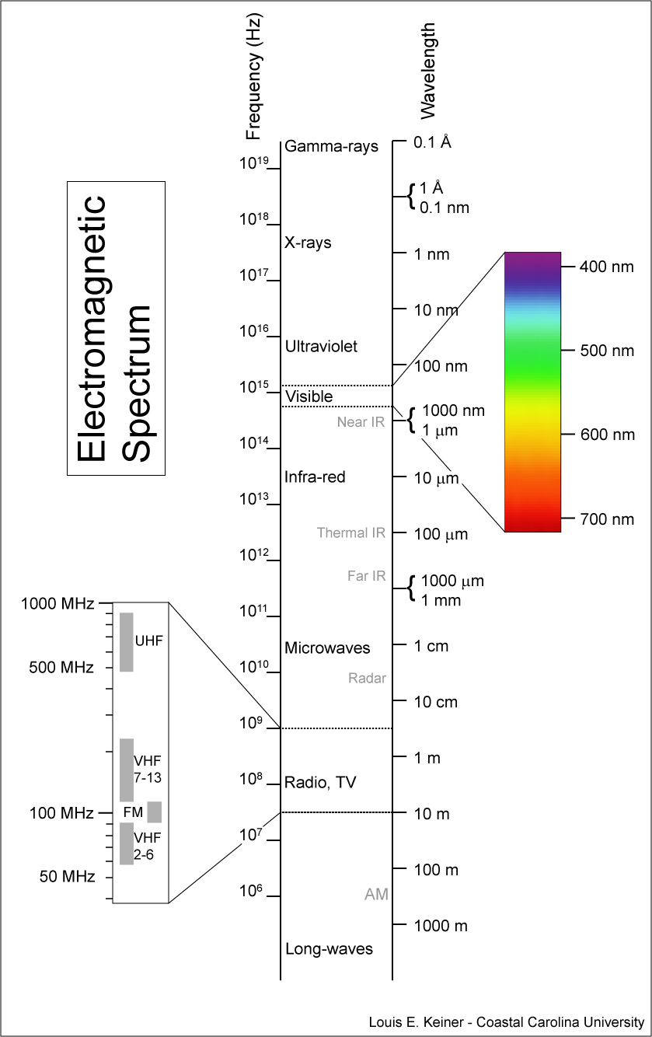
Visible light
This physics-based phenomenon is quantifiable

Slide 24
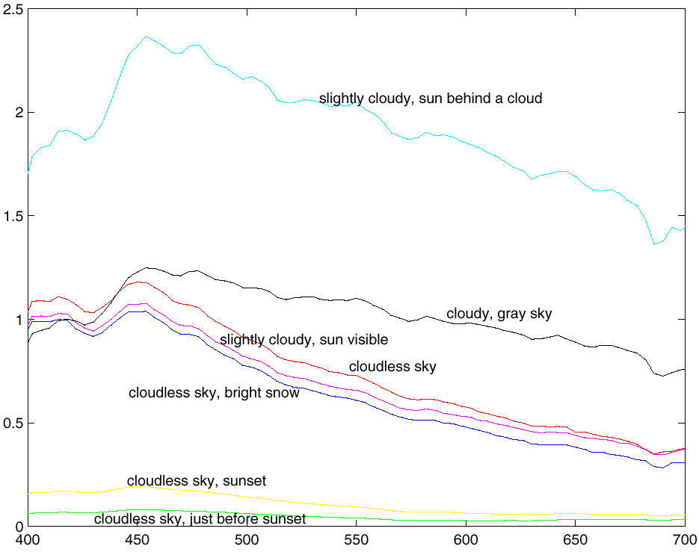
Measurements of relative spectral power of sunlight, made by J. Parkkinen and P. Silfsten. Relative spectral power is plotted against wavelength in nm. The visible range is about 400nm to 700nm. The color names on the horizontal axis give the color names used for monochromatic light of the corresponding wavelength --- the “colors of the rainbow”. Mnemonic is “Richard of York got blisters in Venice”.
Violet Indigo Blue Green Yellow Orange Red

Slide 25
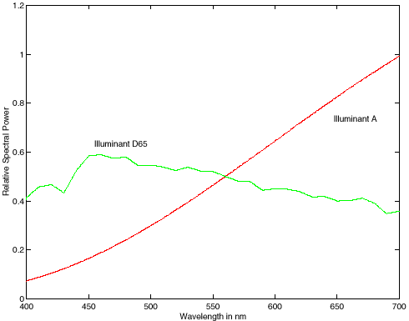
Relative spectral power of two standard illuminant models --- D65 models sunlight,and illuminant A models incandescent lamps. Relative spectral power is plotted against wavelength in nm. The visible range is about 400nm to 700nm. The color names on the horizontal axis give the color names used for monochromatic light of the corresponding wavelength --- the “colors of the rainbow”.
Violet Indigo Blue Green Yellow Orange Red

Slide 26
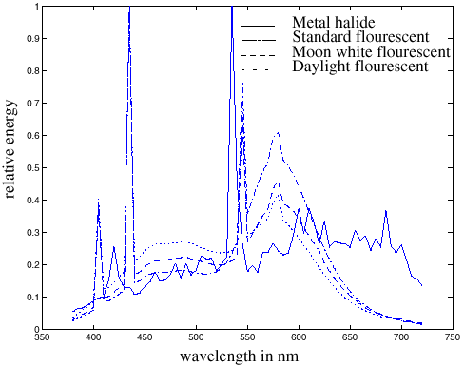
Measurements of relative spectral power of four different artificial illuminants, made by H.Sugiura. Relative spectral power is plotted against wavelength in nm. The visible range is about 400nm to 700nm.

Slide 27
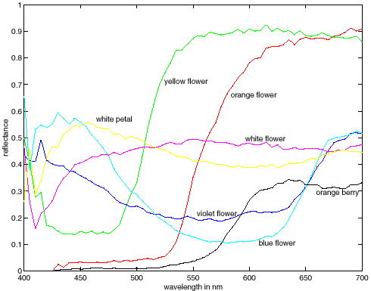
Spectral albedoes for several different leaves, with color names attached. Notice that different colours typically have different spectral albedo, but that different spectral albedoes may result in the same perceived color (compare the two whites). Spectral albedoes are typically quite smooth functions. Measurements by E.Koivisto.

Slide 28
Quantifying Color
“Visible” can be characterized by a spectral signature
A spectral signature is a mapping from wavelength to observed intensity

Slide 29
Outline
Human perception of color
Formalizing Color
Color Models

Slide 30
Why specify color numerically?
Accurate color reproduction is commercially valuable
  Many products are identified by color (“golden” arches;
Few color names are widely recognized by English speakers -
  About 10; other languages have fewer/more, but not many more.
  It’s common to disagree on appropriate color names.
Color reproduction problems increased by prevalence of digital imaging - eg. digital libraries of art.
  How do we ensure that everyone sees the same color?

Slide 31
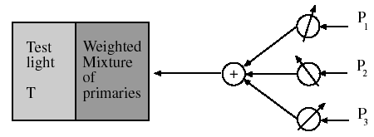
Color matching experiments - I
Show a split field to subjects; one side shows the light whose color one wants to measure, the other a weighted mixture of primaries (fixed lights).

Slide 32
Color matching experiments - II
Many colors can be represented as a mixture of A, B, C
write M=a A + b B + c C
where the = sign should be read as “matches”
This is additive matching.
Gives a color description system - two people who agree on A, B, C need only supply (a, b, c) to describe a color.

Slide 33
Subtractive matching
Some colors can’t be matched like this: instead, must write
M+a A = b B+c C
This is subtractive matching.
Interpret this as (-a, b, c)
Problem for building monitors: Choose R, G, B such that positive linear combinations match a large set of colors

Slide 34
Color Matching
Additive and Subtractive Models
  Note: Colors are not “created” by combining (adding and subtracting) wavelengths
But I thought primary colors can be used to create all colors?
  Based on human visual system.
  Recall the eye has 3 types of cones (which respond to different portions of color spectrum) used to perceive all visible color.
Although color can be technically specified by wavelength, it is often considered to be “in your head” – based on perception.

Slide 35
Common Color Spaces
Color spaces are therefore often based on mixtures of 3 primaries.
RGB Color Space: Given the nature of these mixings, the chosen primary spectra may have negative components
  For example: to correctly perceive colors in the blue-green range, some “red” is often subtracted.
XYZ Color Space is non-negative.

Slide 36
Color Vectors
Thus each point or pixel is a 3-d spectral vector (or 3-tuple)
Note: we can transform from RGB to XYZ
The pixels may be unnormalized. Normalize to get a unit color vector.

Slide 37
Summary
Color appearance is a complex process.
Color can be quantified using albedo or spectral signatures.
Color Models:
  Additive or Subtractive Models
  Color Space Models
    RGB
    XYZ
The illusion of color monitors
  https://jakubmarian.com/the-illusion-of-rgb-screens/

Slide 38
Appendix
Jeremy Bolton, PhD
Assistant Teaching Professor

