Slide 1
COSC579: Radiometry
Jeremy Bolton, PhD
Assistant Teaching Professor
A special thanks to professors and researchers professor and researchers Yung-Yu Chuang, Fredo Durand, Alexei Efros, William Freeman, James Hays, Svetlana Lazebnik, Andrej Karpathy, Fei-Fei Li, Srinivasa Narasimhan, Silvio Savarese, Steve Seitz, Noah Snavely, Richard Szeliski, and Li Zhang.

Slide 2
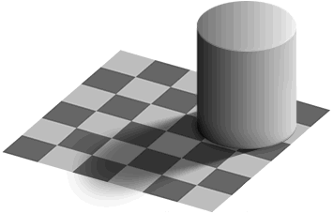
Light
Readings
  Szeliski, 2.2, 2.3.2

Slide 3
Properties of light
Today
  What is light?
  How do we measure it?
  How does light propagate?
  How does light interact with matter?

Slide 4
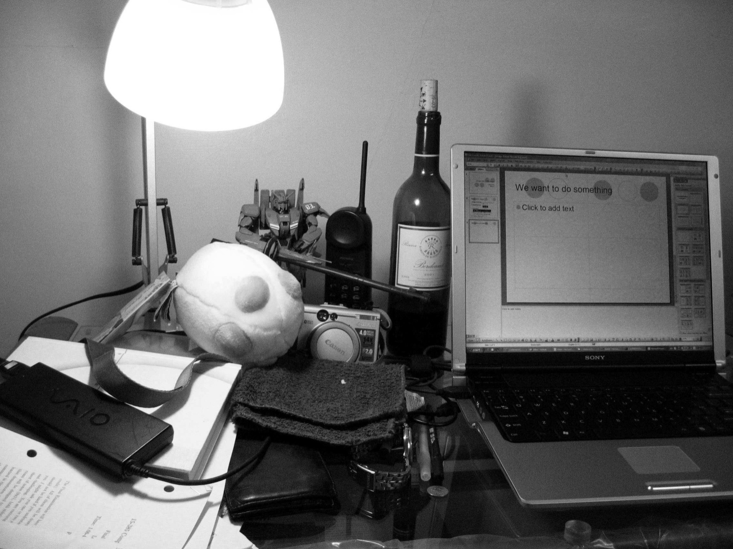
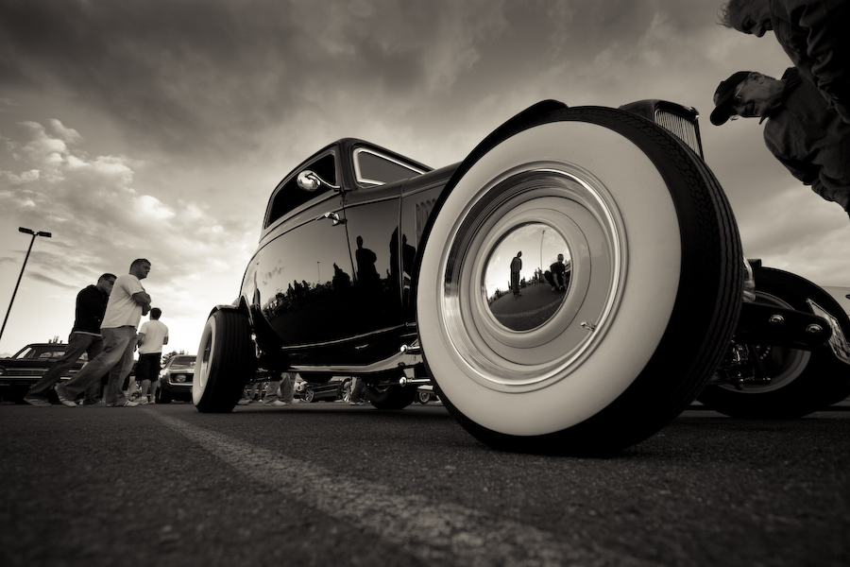
Radiometry
What determines the brightness of an image pixel?
Light source properties
Surface properties
Surface properties

Slide 5
Reflectance Models
Reflection: An Electromagnetic Phenomenon
Two approaches to derive Reflectance Models:
  Physical Optics (Wave Optics)
  Geometrical Optics (Ray Optics)
  Geometrical models are approximations to physical models
  But they are easier to use!

Slide 6
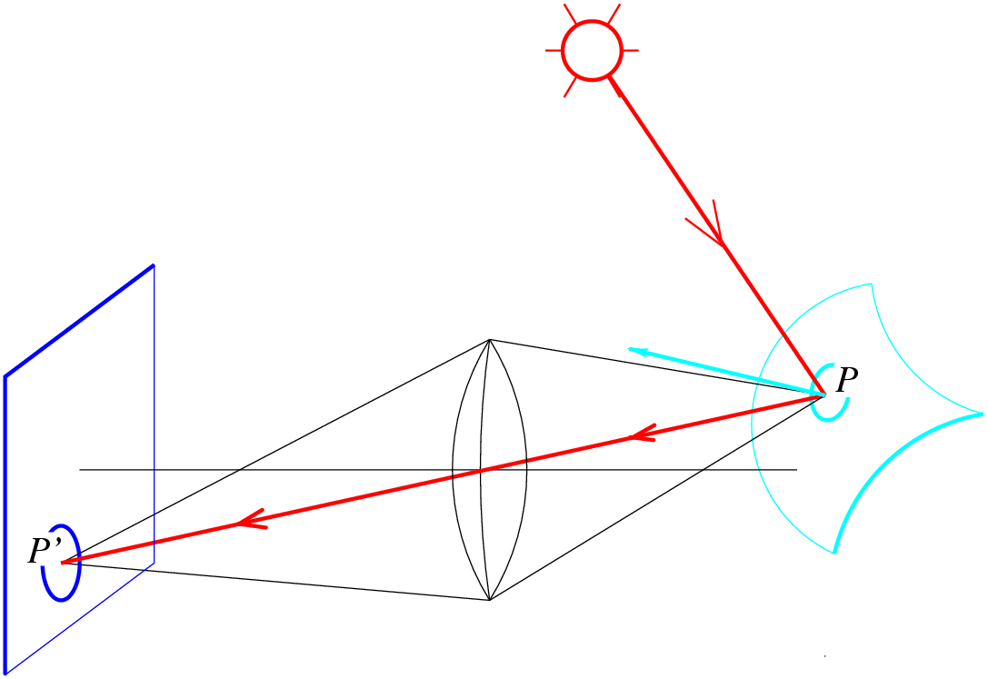
Radiometry
What determines the brightness of an image pixel?
Light source
properties
Sensor characteristics
Surface
shape
Exposure
Surface reflectance
properties
Optics
Slide by L. Fei-Fei

Slide 7
What is light?
Electromagnetic radiation (EMR) moving along rays in space
  Radiance L(λ) is EMR, measured in units of power (watts)
    λ is wavelength
Perceiving light
  How do we convert radiation into “color”?
  What part of the spectrum do we see?

Slide 8
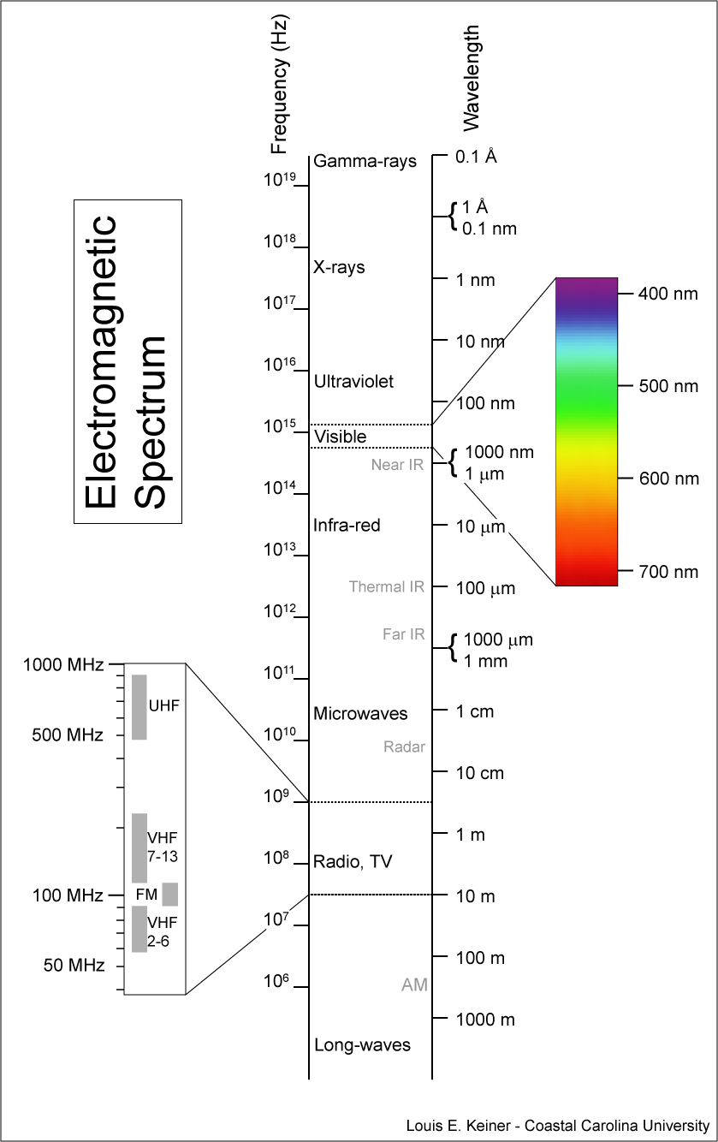
Visible light
We “see” electromagnetic radiation in a range of wavelengths

Slide 9
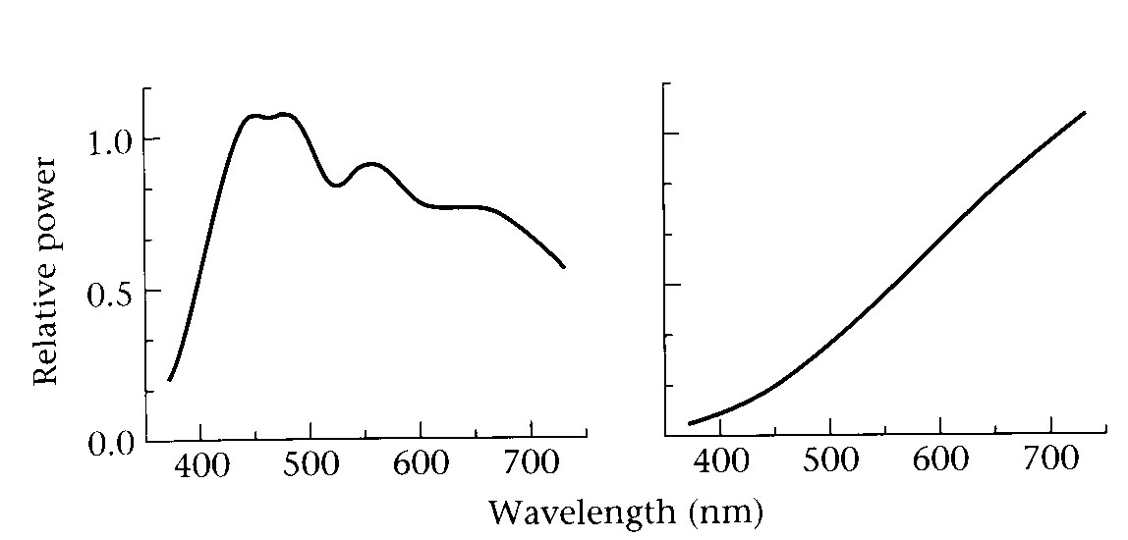
Light spectrum
The appearance of light depends on its power spectrum
  How much power (or energy) at each wavelength
daylight
tungsten bulb
Our visual system converts a light spectrum into “color”
  This is a rather complex transformation

Slide 10
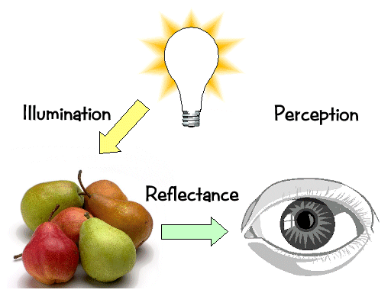
Light transport

Slide 11
Light sources
Basic types
  point source
  directional source
    a point source that is infinitely far away
  area source
    a union of point sources
More generally
  a light field can describe *any* distribution of light sources
What happens when light hits an object?

Slide 12
What happens when a light ray hits an object?
Some of the light gets absorbed
  converted to other forms of energy (e.g., heat)
Some gets transmitted through the object
  possibly bent, through “refraction”
  a transmitted ray could possible bounce back
Some gets reflected
  as we saw before, it could be reflected in multiple directions (possibly all directions) at once
Let’s consider the case of reflection in detail

Slide 13
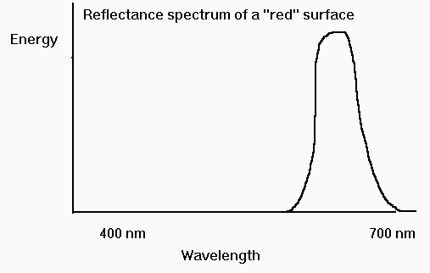
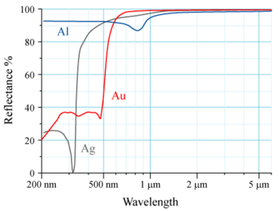
Reflectance spectrum (albedo)
To a first approximation, surfaces absorb some wavelengths of light and reflect others
These spectra are multiplied by the spectra of the incoming light, then by the spectra of the sensors

Slide 14
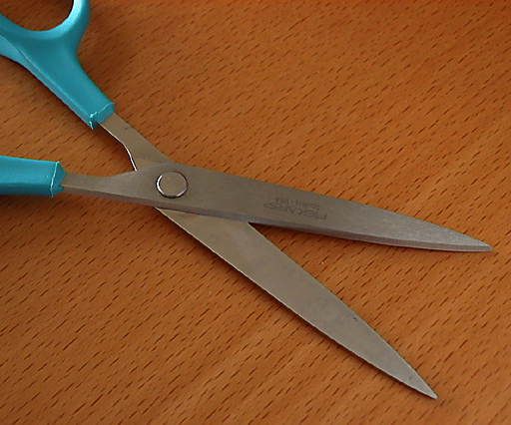
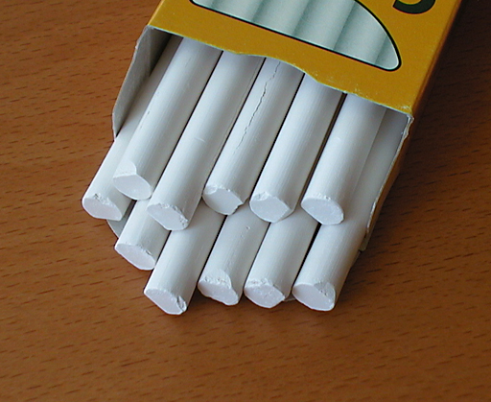
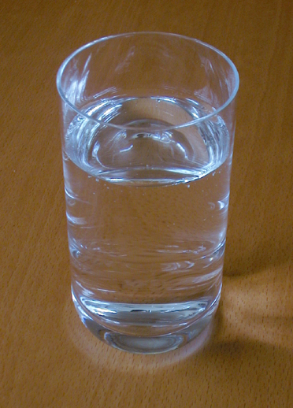
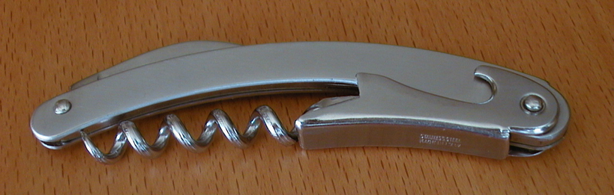
Material Properties

Slide 15

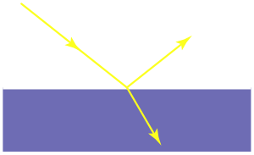
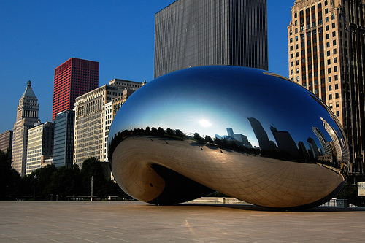
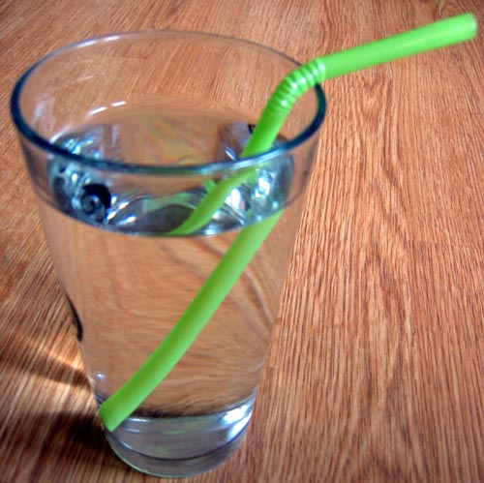


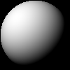
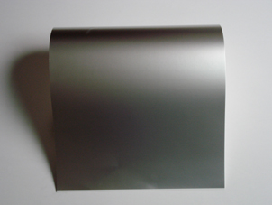
Classic reflection behavior
ideal specular
rough specular
Lambertian
from Steve Marschner

Slide 16



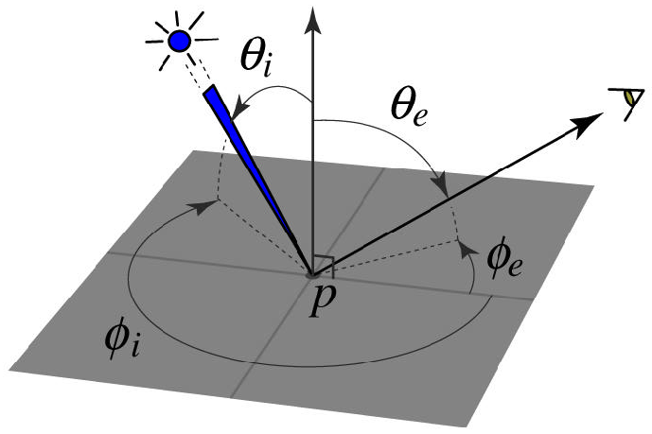
The BRDF
The Bidirectional Reflection Distribution Function
  Given an incoming ray and outgoing ray
  what proportion of the incoming light is reflected along outgoing ray?
surface normal
Answer given by the BRDF:

Slide 17
Constraints on the BRDF
Energy conservation
  Quantity of outgoing light ≤ quantity of incident light
    integral of BRDF ≤ 1
Helmholtz reciprocity
  reversing the path of light produces the same reflectance
=

Slide 18
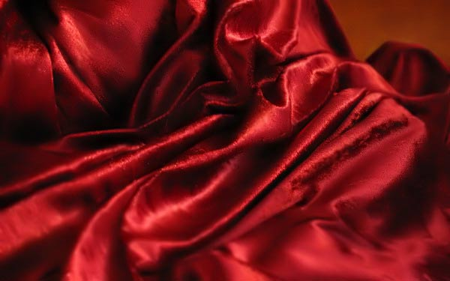
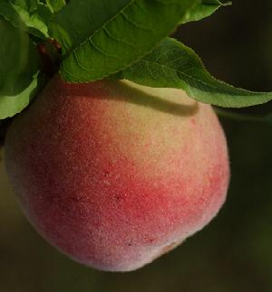
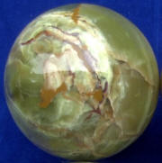
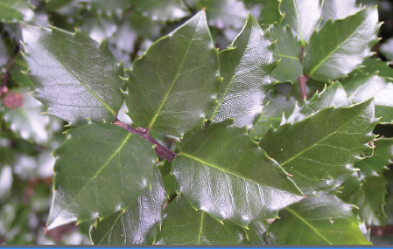
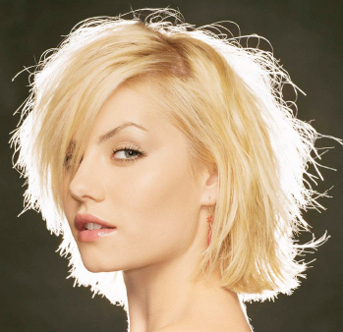
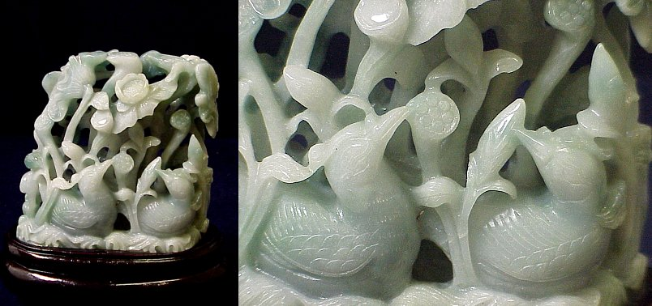
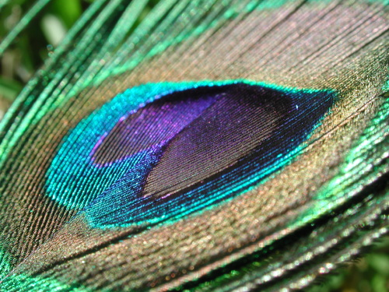
BRDF’s can be incredibly complicated…

Slide 19
Diffuse reflection
Diffuse reflection
  Dull, matte surfaces like chalk or latex paint
  Microfacets scatter incoming light randomly
  Effect is that light is reflected equally in all directions

Slide 20
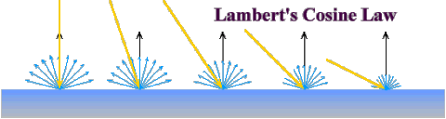






Diffuse reflection
Diffuse reflection governed by Lambert’s law
  Viewed brightness does not depend on viewing direction
  Brightness does depend on direction of illumination
  This is the model most often used in computer vision
Lambert’s Law:
L, N, V unit vectors
I_{e} = outgoing radiance
I_{i} = incoming radiance
BRDF for Lambertian surface

Slide 21





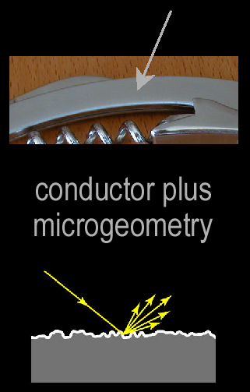
Specular reflection
For a perfect mirror, light is reflected about N
Exponent n_{s} characterizes the mirror-like quality of surface s.
See Phong et al.
Near-perfect mirrors have a highlight around R
  common model:

Slide 22
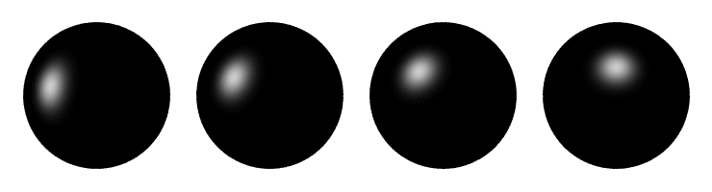
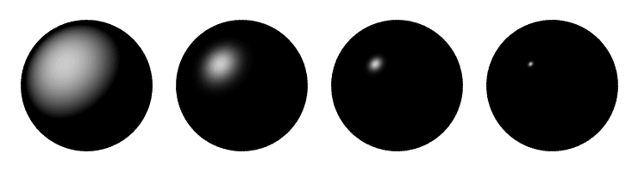
Specular reflection
Moving the light source
Changing n_{s}

Slide 23
BRDF models
Phenomenological
  Phong [75]
  Ward [92]
  Lafortune et al. [97]
  Ashikhmin et al. [00]
Physical
  Cook-Torrance [81]
  Dichromatic [Shafer 85]
  He et al. [91]
Here we’re listing only some well-known examples

Slide 24
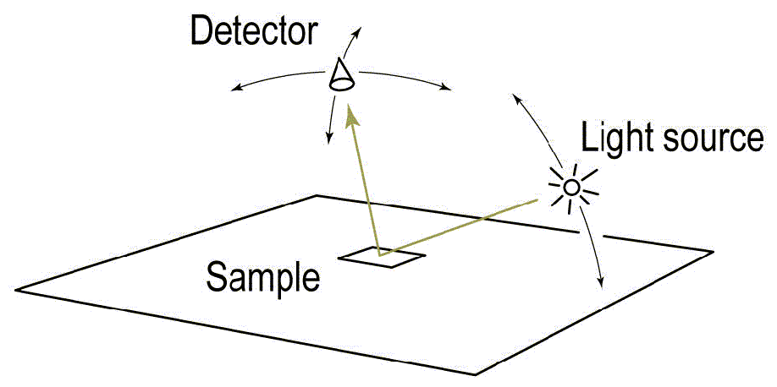
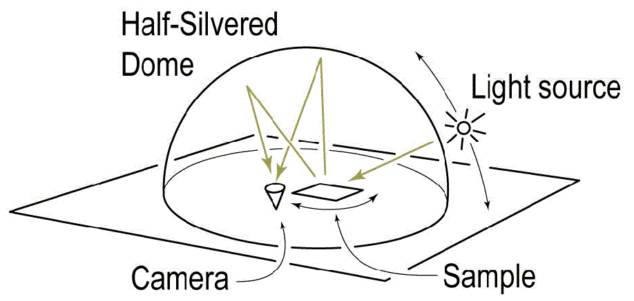
Measuring the BRDF
traditional
design by Greg Ward
Gonioreflectometer
  Device for capturing the BRDF by moving a camera + light source
  Need careful control of illumination, environment

Slide 25
Why models for light?
Why model these complex processes?
Vision is all about extracting information about a scene from its 2-d representation
  Shape from shading
  Surface Properties
  Texture Features
  Information from reflections
  Atmosphere

Slide 26

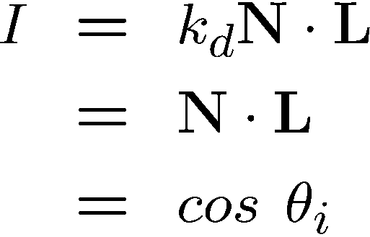
Shape from shading
Suppose
You can directly measure angle between normal and light source
  Not quite enough information to compute surface shape
  But can be if you add some additional info, for example
    assume a few of the normals are known (e.g., along silhouette)
    constraints on neighboring normals—“integrability”
    smoothness
  Hard to get it to work well in practice

Slide 27



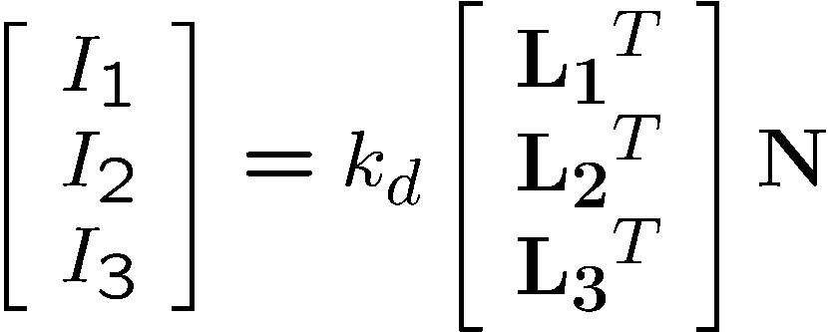
Photometric stereo: for estimating surface normal (shape!)
N
L₃
L₂
L₁
V
Can write this as a matrix equation:

Slide 28
Light and Shadows

Slide 29
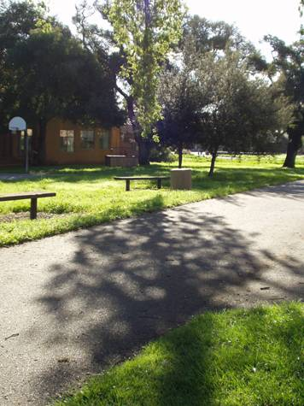

Slide 30
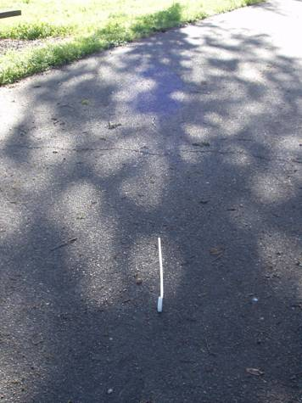
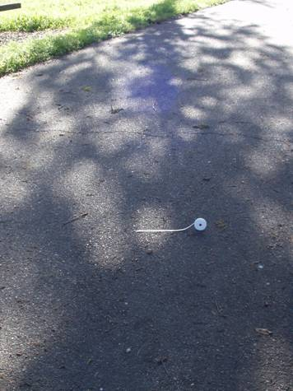

Slide 31
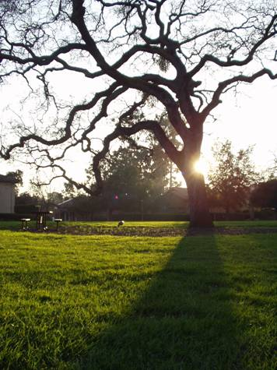

Slide 32
Reflections

Slide 33
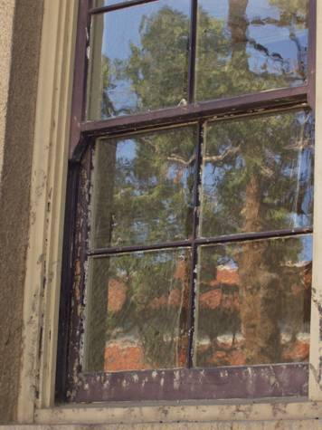
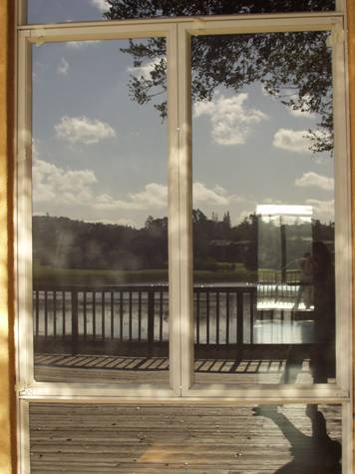

Slide 34
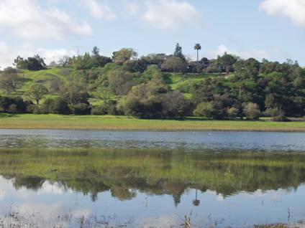

Slide 35
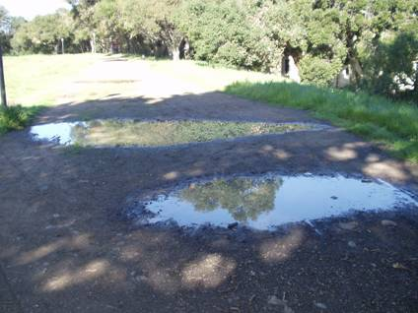

Slide 36
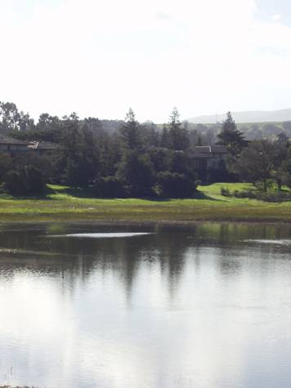

Slide 37
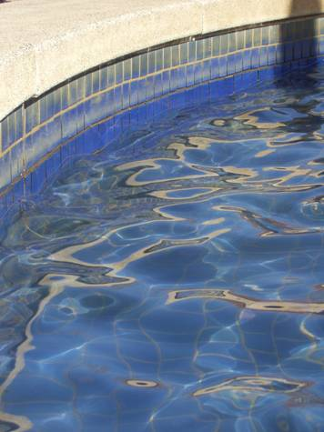

Slide 38
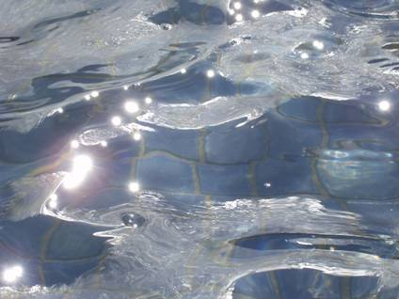
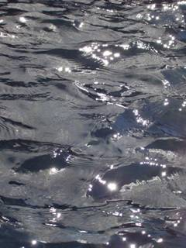

Slide 39
Refractions

Slide 40
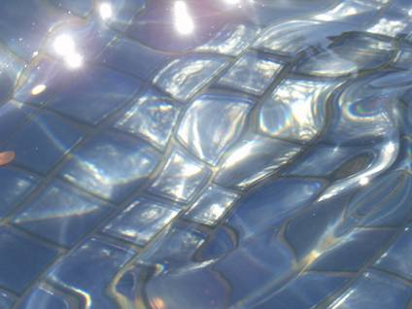

Slide 41
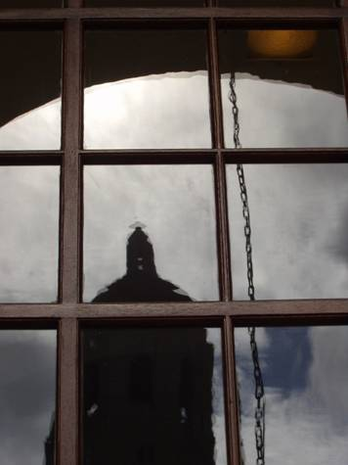

Slide 42
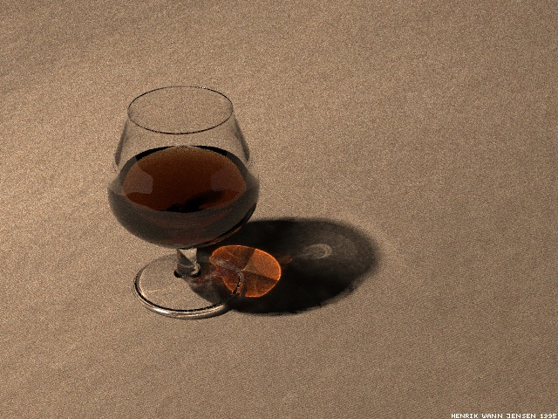
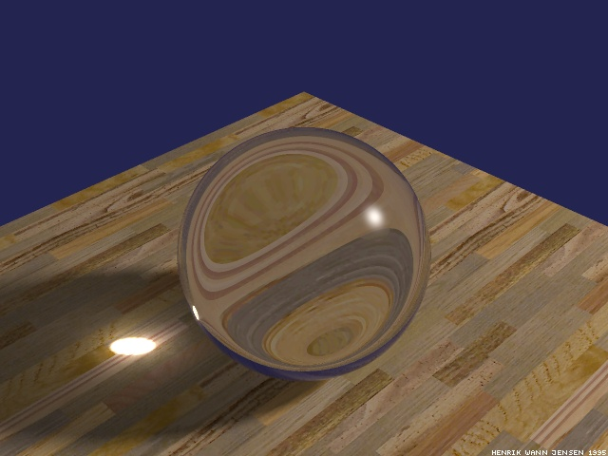

Slide 43


Slide 44
Interreflections

Slide 45


Slide 46
Scattering

Slide 47



Slide 48


Slide 49

Haze
De-hazed

Slide 50


Slide 51


Slide 52


Slide 53


Slide 54


Slide 55
More Complex Appearances

Slide 56




Slide 57


Slide 58






Slide 59
Appendix: Measuring Light
Jeremy Bolton, PhD
Assistant Teaching Professor
A special thanks to many contributors over the years: Szeliski, Snavely, Adelson

