Slide 1
COSC579: Scene Geometry
Jeremy Bolton, PhD
Assistant Teaching Professor

Slide 2
Overview
Linear Algebra Review
  Homogeneous vs non-homogeneous representations
  Projections and Transformations
Scene Geometry
The pinhole projection model
  Qualitative properties
  Perspective projection matrix
Cameras with lenses
  Depth of focus
  Field of view
  Lens aberrations

Slide 3

Scene Geometry, Projection, and Perspective
Readings
  Szeliski 2.1

Slide 4
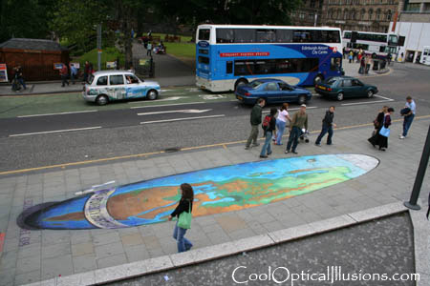
Projection
Readings
  Szeliski 2.1

Slide 5
Dimensionality Reduction (3D to 2D)
3D world
2D image
What have we lost?
  Angles
  Distances (lengths)
Slide by A. Efros
Figures © Stephen E. Palmer, 2002

Slide 6
Linear Algebra and Projections
Before we dive into camera geometry, lets introduce some notation and review linear algebra.
2-D points will be used to represent pixel coordinates: points in a (image) plane. (non-homogeneous)

Slide 7
Homogeneous and Non-homogeneous Vectors
2-D points can be represented by a vector and a weight.
  Homogeneous
  P² is the 2-d projective space

Slide 8
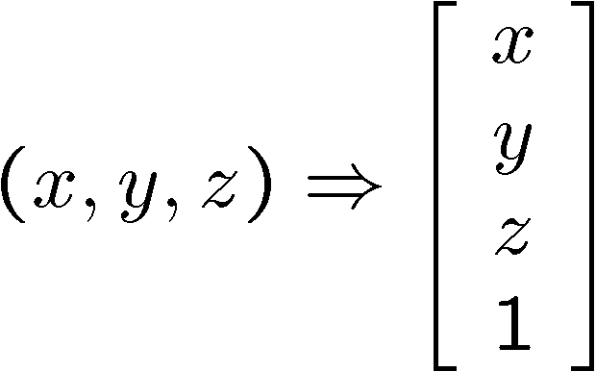
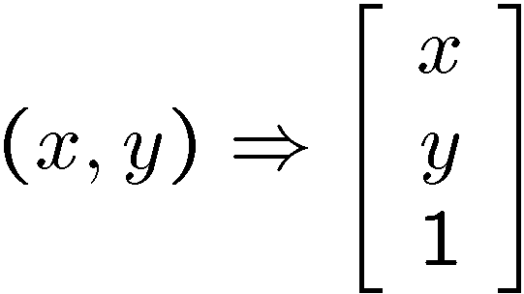
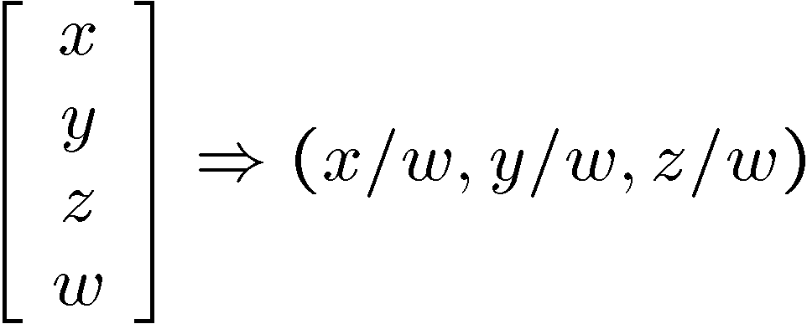
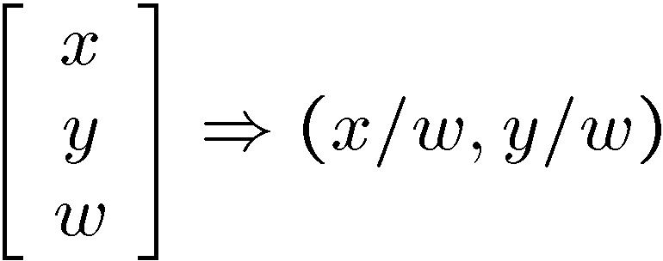
Why Homogeneous Coordinates?
Homogeneous representation permits linear matrix operations for transformations used in Computer Vision
How? add one more coordinate:
homogeneous image
coordinates
homogeneous scene
coordinates
Converting from homogeneous coordinates

Slide 9
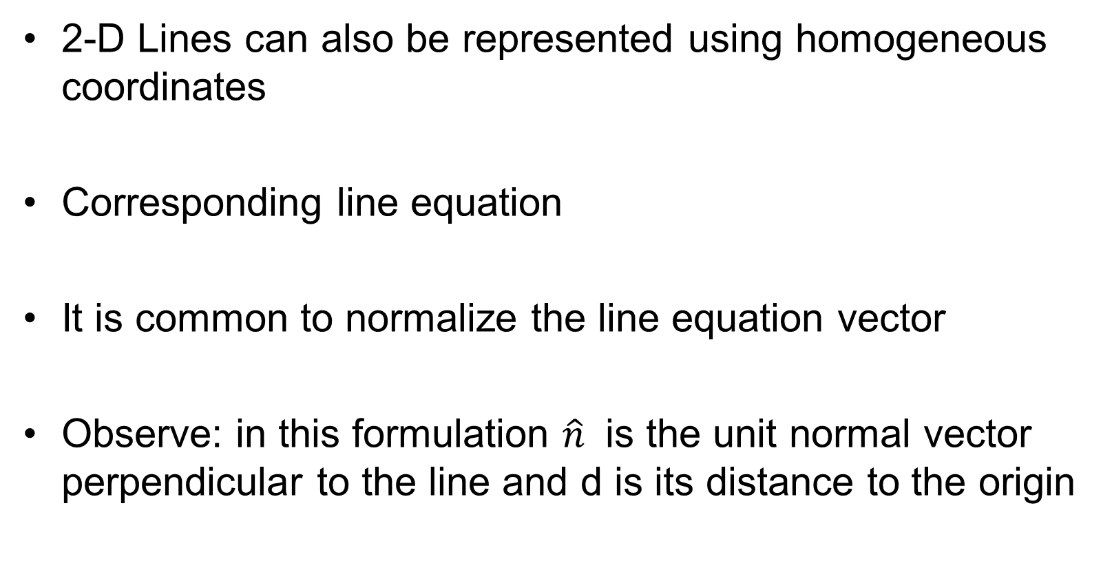
Lines
2-D Lines can also be represented using homogeneous coordinates
Corresponding line equation
It is common to normalize the line equation vector
Observe: in this formulation $\hat{n}$ is the unit normal vector perpendicular to the line and d is its distance to the origin

Slide 10
Lines
Computing the intersection of 2 lines using homogeneous coordinates
Computing the line joining two points using homogeneous coordinates

Slide 11
3-D
Similar representations exist to model 3-D points: points in a scene.
3-D planes specification using homogeneous coordinates
Equation of plane
Normalized

Slide 12
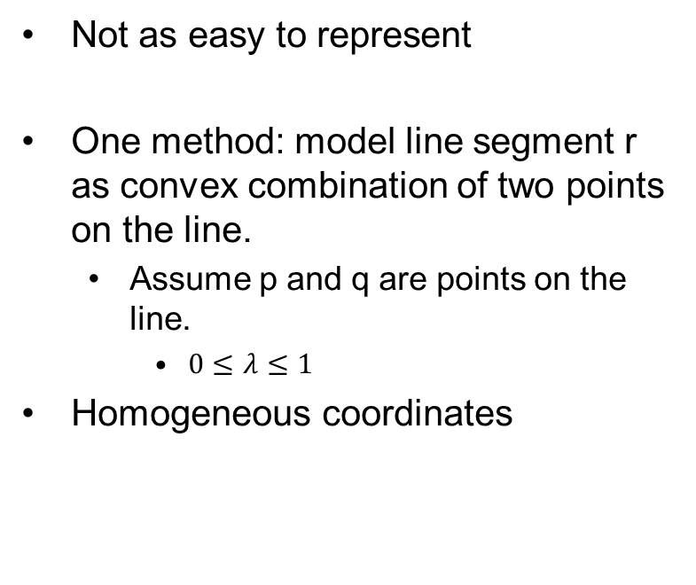
Lines in 3-D
Not as easy to represent
One method: model line segment r as convex combination of two points on the line.
  Assume p and q are points on the line.
    $0≤λ≤1$
Homogeneous coordinates

Slide 13


Lines in 3-D
More generally, we can represent a line in 3-D using a point and a gradient
$$r=p+λ \hat{d}$$
$$\hat{d}=[Δx, Δy,Δz]$$

Slide 14
2D Planar Transformations

Slide 15
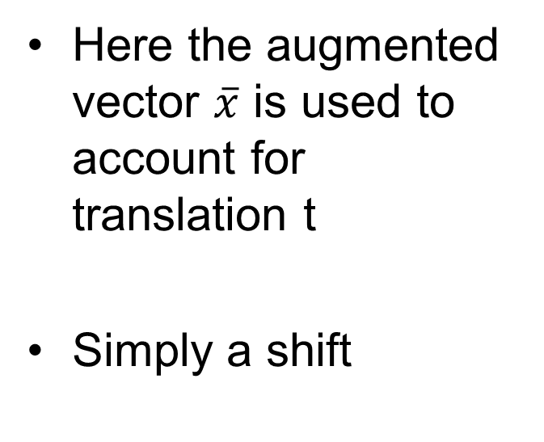
Translations
Here the augmented vector $\overline{x}$ is used to account for translation t
Simply a shift

Slide 16
Euclidean Transformations

Slide 17
Scaled Rotations

Slide 18
Affine

Slide 19
Projective Transformation (Homography)

Slide 20
Properties of Transformations

Slide 21
3D transformations

Slide 22
3D Euclidean Transformation

Slide 23
3D similarity transformation

Slide 24
3D Affine Transformation

Slide 25
Projective Transformation

Slide 26
3D Rotations
Sequential Rotations Approach (Euler Angle).
  Perform 3 sequential rotations around 3 cardinal axes.
  Cons
    Result depends on order of rotations.
    Not always practical
Axis / Angle Approach
  Rotation can be determined by 1 rotation axis and 1 angle

Slide 27
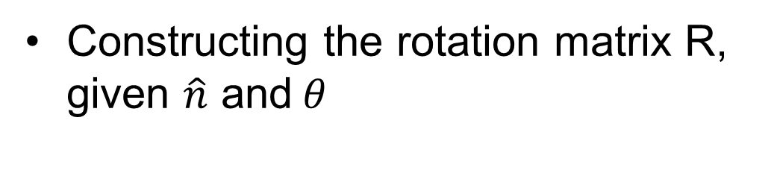
3D Axis/Angle Rotation
Constructing the rotation matrix R, given $\hat{n}$ and$θ$

Slide 28
Projecting from 3D to 2D
Projections
  Orthographic and scaled orthographic (weak perspective) projection
  Para-perspective projection
  Perspective projection
These projects are used often during image formation.

Slide 29
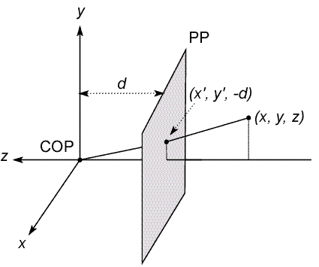
Modeling projection
The coordinate system
  We will use the pin-hole model as an approximation
  Put the optical center (Center Of Projection) at the origin
  Put the image plane (Projection Plane) in front of the COP
    Why?
  The camera looks down the negative z axis
    we need this if we want right-handed-coordinates
Notes:
This way the image is right-side-up

Slide 30
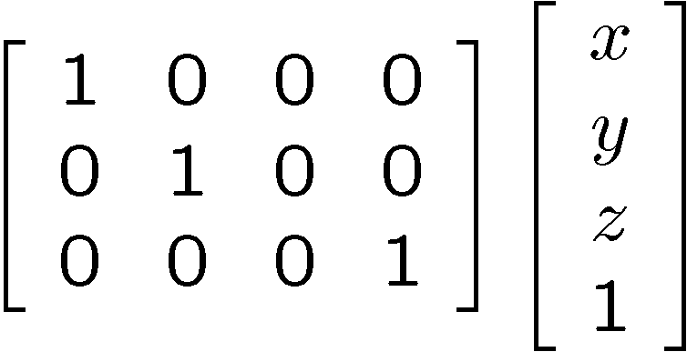
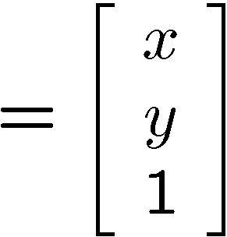

Orthographic projection
Special case of perspective projection
  Distance from the COP to the PP is infinite (ignore z-axis)
  Good approximation for telephoto optics
  Also called “parallel projection”: (x, y, z) → (x, y)
  What’s the projection matrix?
Image
World

Slide 31
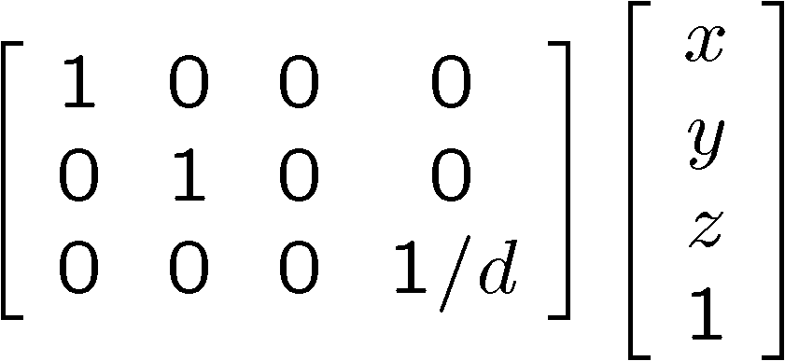
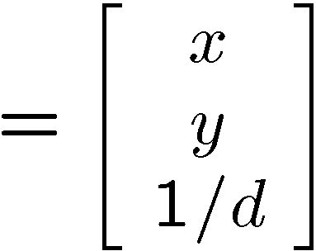

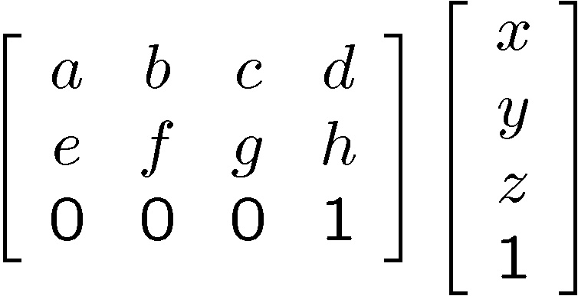
Variants of orthographic projection
Scaled orthographic
  Also called “weak perspective”
Affine projection
  Also called “para-perspective”

Slide 32
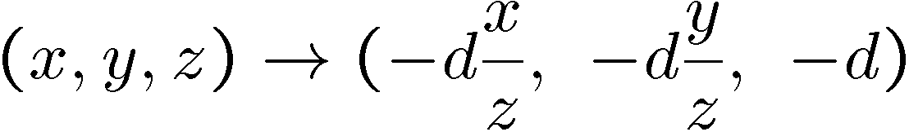
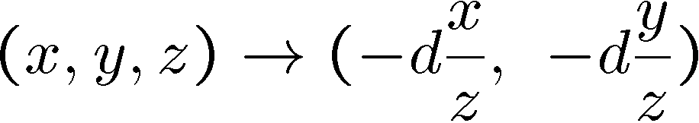
Modeling projection
Projection equations
  Compute intersection with PP of ray from (x,y,z) to COP
  Derived using similar triangles (Try this at Home!)
  We get the projection by throwing out the last coordinate:

Slide 33
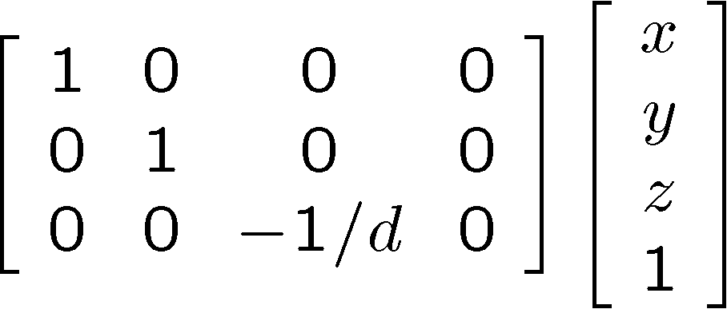
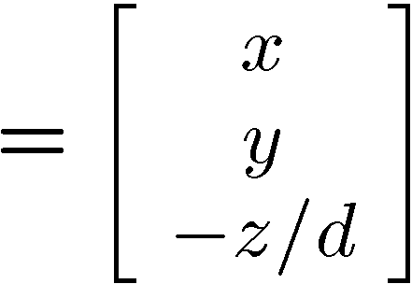
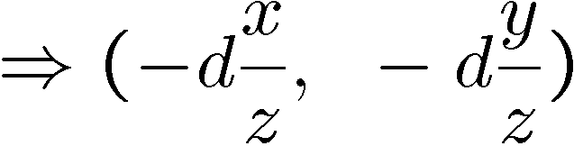
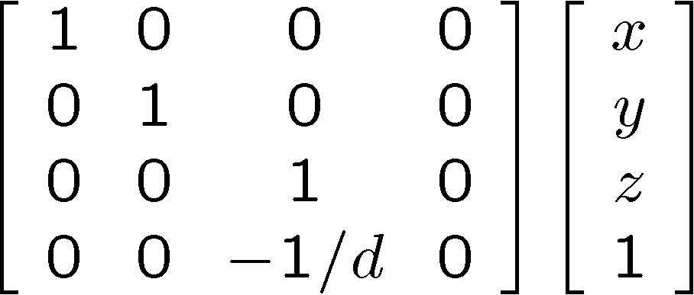
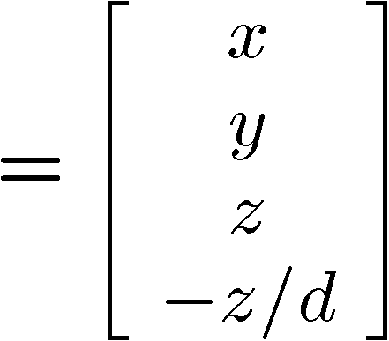
Perspective Projection
Projection is a matrix multiply using homogeneous coordinates:
divide by third coordinate
This is known as perspective projection
  The matrix is the projection matrix
  Can also formulate as a 4x4
divide by fourth coordinate

Slide 34
Projection Review
Reviewed
  Linear algebra and notation
  Projections
Projections are used to model image formation and analysis
To see where projections fit in, lets investigate camera models

Slide 35
Camera Models
Jeremy Bolton, PhD
Assistant Teaching Professor

Slide 36
Image formation
Let’s design a camera
  Idea 1: put a piece of film in front of an object
  Do we get a reasonable image?
Notes:
Light comes from everywhere. Without of means of focus, everything is a blur

Slide 37
Pinhole camera
Add a barrier to block off most of the rays
  This reduces blurring
  The opening known as the aperture
  How does this transform the image?
Notes:
It gets inverted

Slide 38
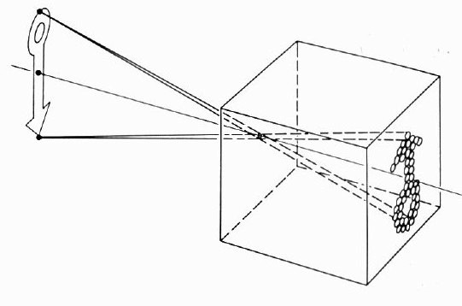
Camera Obscura: Pinhole model
The first camera
  Known to Aristotle
  How does the aperture size affect the image?
Pinhole model:
  Captures pencil of rays – all rays through a single point
  The point is called Center of Projection (focal point)
  The image is formed on the Image Plane

Slide 39
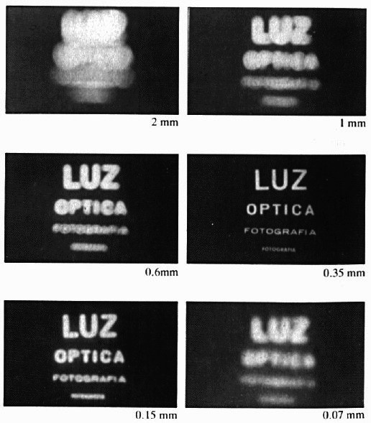
Shrinking the aperture
Why not make the aperture as small as possible?
  Less light gets through
  Diffraction effects...

Slide 40
Shrinking the aperture

Slide 41
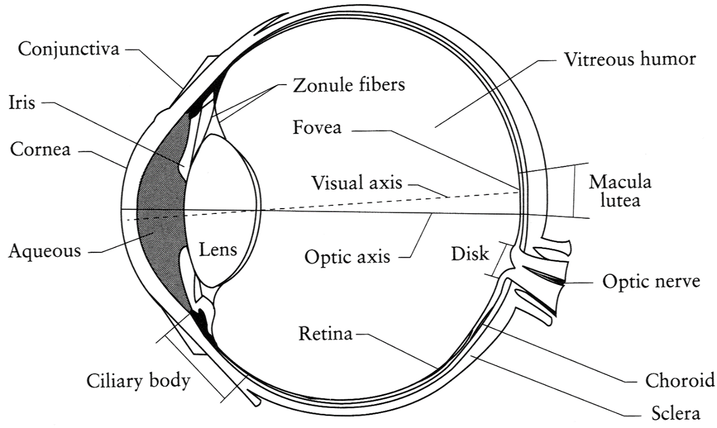
The eye
The human eye is a camera
  Iris - colored annulus with radial muscles
  Pupil - the hole (aperture) whose size is controlled by the iris
  What’s the “film”?
    photoreceptor cells (rods and cones) in the retina
Notes:
Note that the retina is curved

Slide 42
Different Camera (and Projection) Models
Pinhole Camera (Central Perspective)
  Weak Perspective Projection
  Orthographic Projection
Thin Lens Camera

Slide 43
Pinhole Camera Model
A simplistic yet convenient projective model.
  Also known as central perspective model.
  Most cameras have lenses however, this model often provides an acceptable approximation to an imaging system in many applications.
  Image coordinates can be computed using similar triangles
  Convenient virtual image plane.

Slide 44
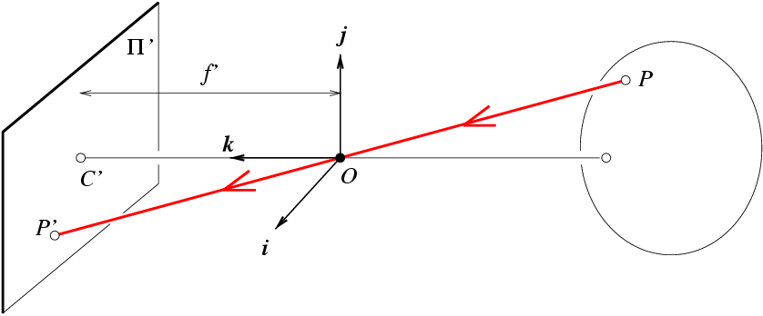
Pinhole: Modeling projection
y
d
z
x
The coordinate system
  Assumption: use the pinhole model as a reasonable approximation
  Put the optical center (O) at the origin
  Put the image plane (Π’) in front of O
Source: J. Ponce, S. Seitz
Notes:
This way the image is right-side-up

Slide 45
Pinhole: Modeling projection
y
d
z
x
Projection equations
  Compute intersection with Π’ of ray from P = (x,y,z) to O
  Derived using similar triangles
  We get the projection by “throwing” out the last coordinate:
Source: J. Ponce, S. Seitz

Slide 46
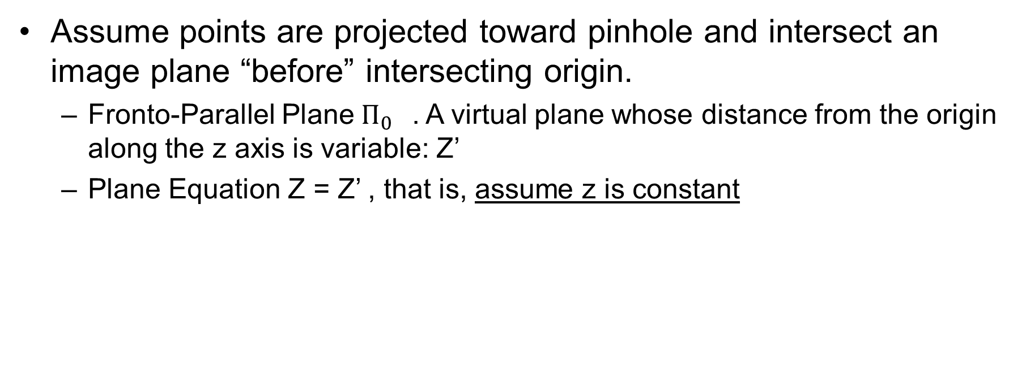
Weak Perspective (Scaled Orthography)
Assume points are projected toward pinhole and intersect an image plane “before” intersecting origin.
  Fronto-Parallel Plane${ Π}_{0}$. A virtual plane whose distance from the origin along the z axis is variable: Z’
  Plane Equation Z = Z’ , that is, assume z is constant

Slide 47
Weak Perspective (Scaled Orthography)
Substituting into pinhole equation, we see that image coordinates can be estimated from a magnification factor m.
Thus image coordinates are estimated by using factor m

Slide 48
Orthographic Perspective
Assume magnification is 1, that is d = Z’
  Interpretation: Planar scene at constant distance which is always known
  Often unrealistic assumption unless points are very very far away.
  Simply ignore Z component

Slide 49
Lens Models
Lens model
  Most cameras have lenses
  Permits larger aperture while refractive properties focus the light
Thin lens model
  Lens is flat (no length along optical axis)
Thick lens or spherical lens models (ignored)
  Assumes lens has volume

Slide 50
Adding a lens
A lens focuses light onto the film
  Rays passing through the center are not deviated
Slide by Steve Seitz

Slide 51
Adding a lens
“circle of
confusion” resulting in blur
A lens focuses light onto the film
  There is a specific distance at which objects are “in focus”
    other points project to a “circle of confusion” in the image
  Changing the shape of the lens changes this distance

Slide 52
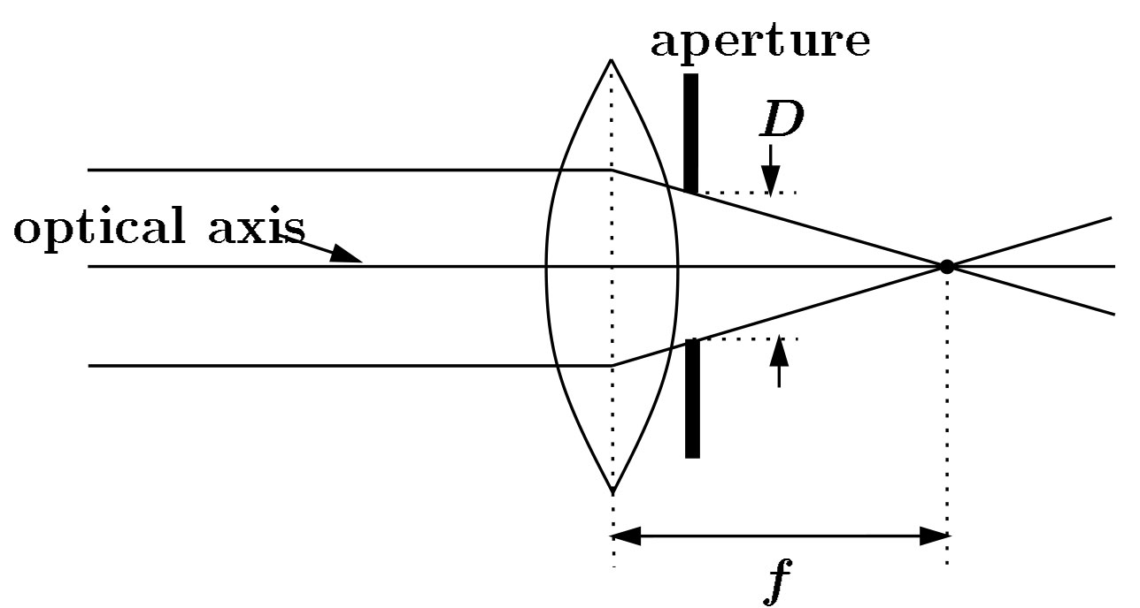
Lenses
F
focal point
optical center
(Center Of Projection)
A lens focuses parallel rays onto a single focal point
  focal point at a distance f beyond the plane of the lens
    f is a function of the shape and index of refraction of the lens
  Aperture of diameter D restricts the range of rays
    aperture may be on either side of the lens
  Lenses are typically spherical (easier to produce)

Slide 53
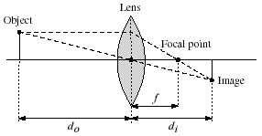
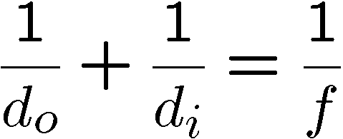
Thin lenses
Thin lens equation:
  Any object point satisfying this equation is in focus
  What is the shape of the focus region?
  How can we change the focus region?
  Thin lens applet: http://www.phy.ntnu.edu.tw/java/Lens/lens_e.html (by Fu-Kwun Hwang )

Slide 54
Pinhole vs Thin Lens
Observe: Similar to pinhole model when d = z. Only admitting ray of light passing through O. However, using a lens, images will only be in focus if z is appropriately chosen using thin lens equation.
Thus we can compute image coordinates via pinhole model using d = z.
Note: In many camera models the assumption that f = z = d is made. This simplifies the geometry, and is analogous to assuming the camera is focused at inf. In general, the image will not be in focus with this assumption.

Slide 55
Normalized Image Plane
Choosing a normalized image plane can be useful in many applications.
  Although the actual sensor is located at some distance d from optical center, we can choose a similar (up to a scale) image plane d = 1

Slide 56
Projections based on Models
We can derive projection matrices based on the camera models
These projection matrices include factors intrinsic to the model and necessary to compute image coordinates
  Some may be known, some are not

Slide 57
Central Perspective (standard pinhole)
Recall (by similar triangles):
Or Similarly …

Slide 58
Adding Weak Perspective
Recall:
Instrinsics
Weak
Perspective Projection
Notes:
These two matrices can be easily collapsed into one

Slide 59
Intrinsic Matrix
Transformation Matrix called Intrinsic Matrix as it includes some factors intrinsic to the camera
  distance to sensor
  translation to image center.
  (image coordinates often assume (0,0) is lower corner of image)
  skew factor: sensor axes are not orthogonal, …

Slide 60
Adding factors for shift and skew
Skew can be due to manufacturing error
Shift may be desired as often, image coordinates begin in lower left corner of image (not where optical axes intersects)
Instrinsics
Weak
Perspective Projection

Slide 61

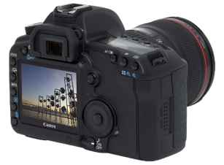
Adding Extrinsics
Previous models assume coordinates of camera and scene are the same.
If this is not true, we can map coordinate systems using extrinsic parameters which define the orientation of the camera relative to the scene.
v
y
w
COP
u
Camera
o
x
Two important coordinate systems:
1. World coordinate system
2. Camera coordinate system
z
“The World”

Slide 62
Camera parameters
To project a point (x,y,z) in world coordinates into a camera
First transform (x,y,z) into camera coordinates
Need to know
  Camera position (in world coordinates)
  Camera orientation (in world coordinates)

Slide 63
Perspective Projection Matrix
Observe: We can solve for image coordinates in terms of real-world coordinates and transformation parameters
Projection is a matrix multiplication using homogeneous coordinates:
divide by the third coordinate
In practice: lots of coordinate transformations…
World to
camera coord.
trans. matrix
(4x4)
3D
point
(4x1)
2D
point
(3x1)
Camera to
pixel coord.
trans. matrix
(3x3)
Perspective
projection matrix
(3x4)
=

Slide 64
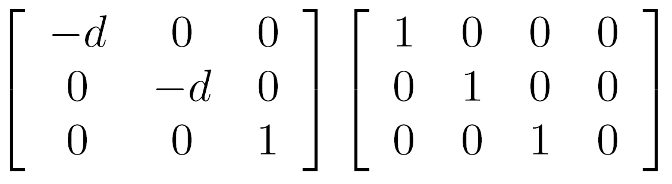
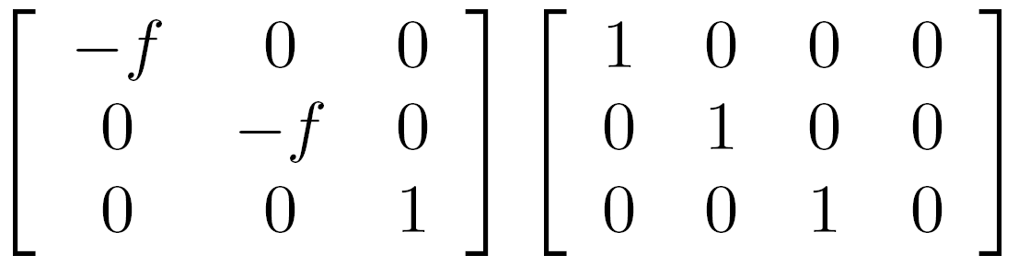

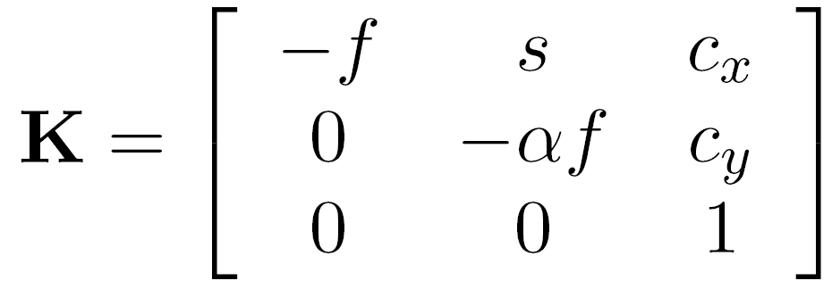



Perspective projection (Intrinsics)
(converts from 3D rays in camera coordinate system to pixel coordinates)
(intrinsics)
in general,
(upper triangular matrix)
: aspect ratio (1 unless pixels are not square)
: skew (0 unless pixels are shaped like rhombi/parallelograms)
: principal point ((0,0) unless optical axis doesn’t intersect projection plane at origin)

Slide 65










Projection matrix (Extrinsics)
=
$$Pq$$
0
(in homogeneous image coordinates)

Slide 66
Extrinsics
How do we get the camera to “canonical form”?
  (Center of projection at the origin, x-axis points right, y-axis points up, z-axis points backwards)
Step 1: Translate by -c
0

Slide 67
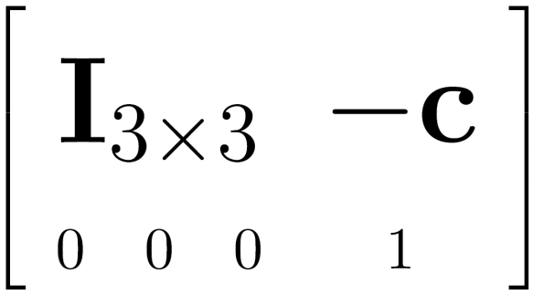

Extrinsics
How do we get the camera to “canonical form”?
  (Center of projection at the origin, x-axis points right, y-axis points up, z-axis points backwards)
Step 1: Translate by -c
How do we represent translation as a matrix multiplication?
0

Slide 68
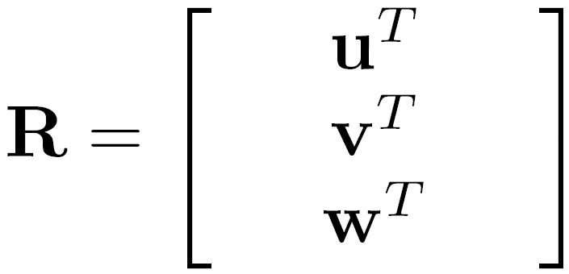
Extrinsics
How do we get the camera to “canonical form”?
  (Center of projection at the origin, x-axis points right, y-axis points up, z-axis points backwards)
Step 1: Translate by -c
Step 2: Rotate by R
0
3x3 rotation matrix

Slide 69
Extrinsics
How do we get the camera to “canonical form”?
  (Center of projection at the origin, x-axis points right, y-axis points up, z-axis points backwards)
Step 1: Translate by -c
Step 2: Rotate by R
0

Slide 70





Camera parameters
A camera is described by several parameters
  Translation t of the optical center from the origin of world coords
  Rotation R of the image plane
  focal length f = d, principle point (x’_{c}, y’_{c}),
  blue parameters are called “extrinsics,” red are “intrinsics”
This assumption is common though may be unrealistic
Projection equation
  The projection matrix models the cumulative effect of all parameters
  Useful to decompose into a series of operations
rotation
translation
Weak
Perspective
Extrinsics
Intrinsics
  Note: The definitions of these parameters are not completely standardized

Slide 71
Camera Models
Scene geometry consists of internal and external parameters
Observed light is focused onto an image plane
The image is then captured (Image Acquisition)
But first we will review radiometry: physics of LIGHT and COLOR

Slide 72
Appendix
Jeremy Bolton, PhD
Assistant Teaching Professor

Slide 73
Pinhole Camera Model
Using Princes Notation.

Slide 74
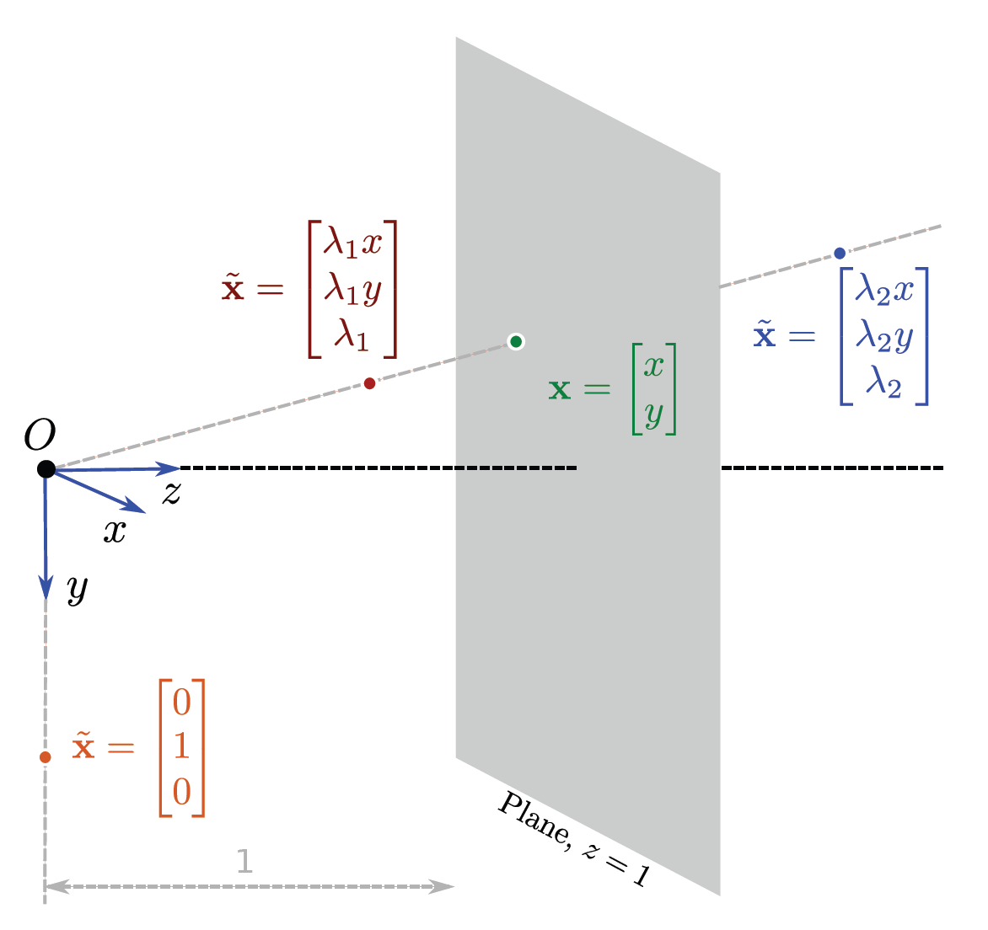
Geometric interpretation of homogeneous coordinates

Slide 75
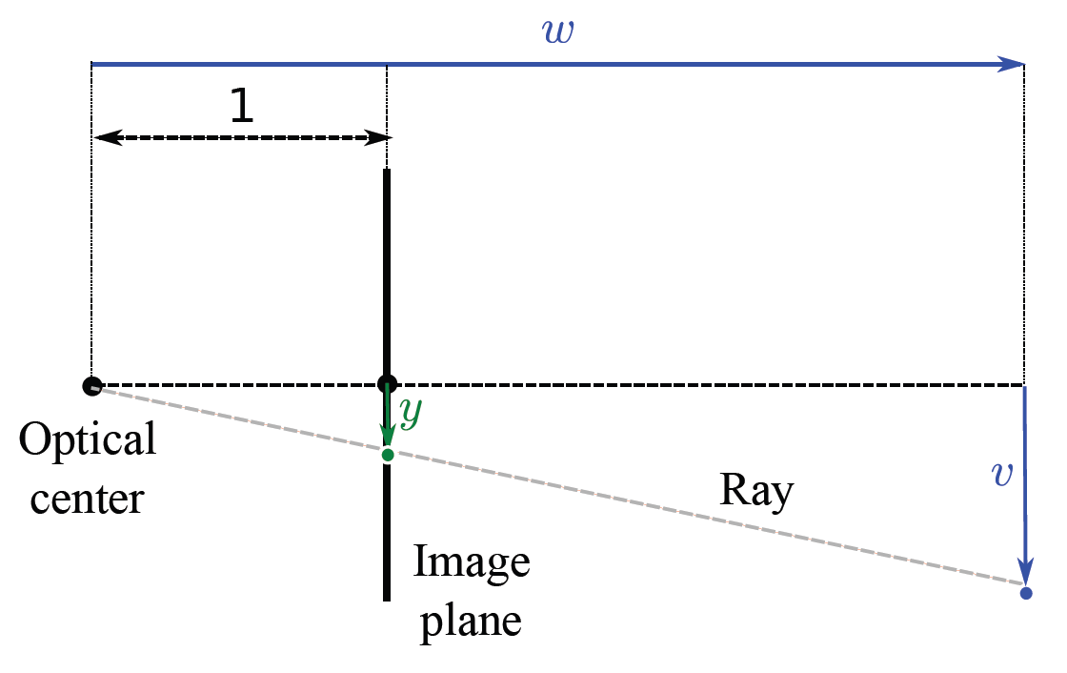
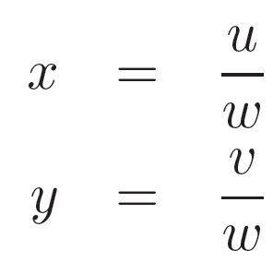
Normalized Camera
By similar triangles:

Slide 76
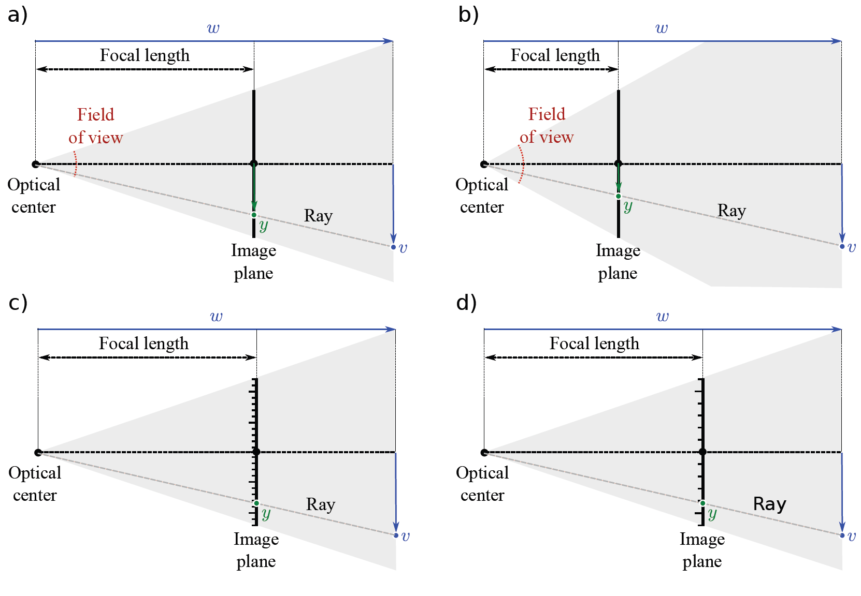
Focal length parameters

Slide 77
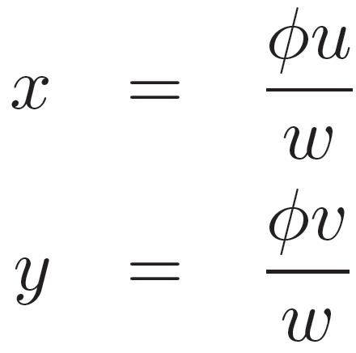
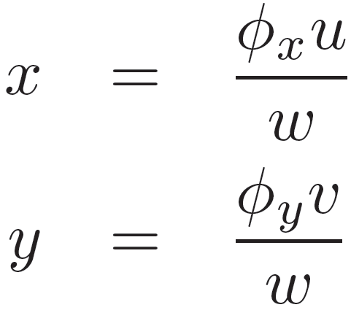
Focal length parameters
Can model both
  the effect of the distance to the focal plane
  the density of the receptors
with a single focal length parameter f = d = φ
To be overly cumbersome note: In practice, the receptors may not be square:
So use different focal length parameter for x and y dims

Slide 78
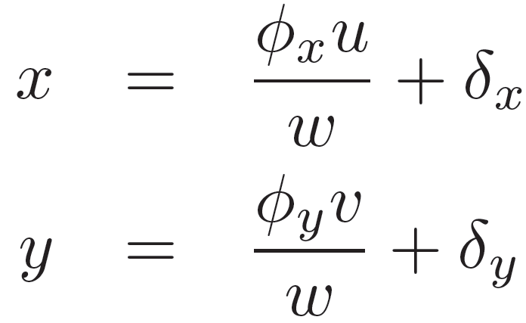
Offset parameters
Current model assumes that pixel (0,0) is where the principal ray strikes the image plane (i.e. the center)
Model offset to center

Slide 79
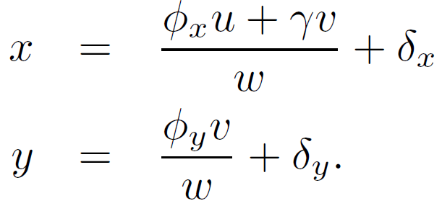
Skew parameter
Finally, add skew parameter
Accounts for image plane being not exactly perpendicular to the principal ray

Slide 80
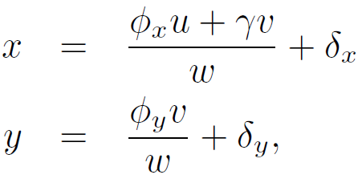
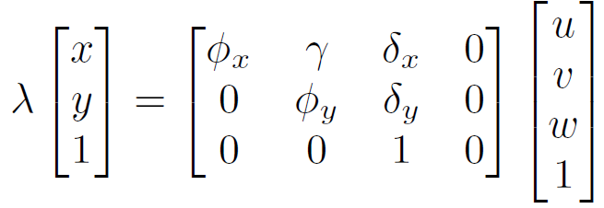
Pinhole camera in homogeneous coordinates
Camera model:
In homogeneous coordinates:
(linear!)

Slide 81
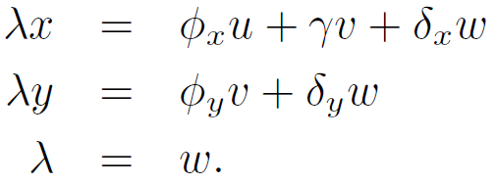
Pinhole camera in homogeneous coordinates
Writing out these three equations
Eliminate λ to retrieve original equations

Slide 82
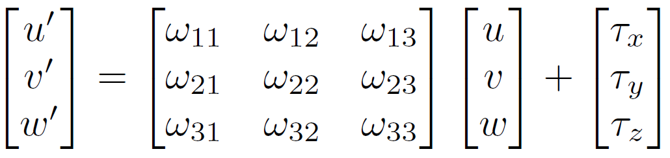

Position and orientation of camera
Position w=(u,v,w)^{T} of point in the world is generally not expressed in the frame of reference of the camera.
Transform using 3D transformation
or
Point in frame of reference of camera
Point in frame of reference of world

Slide 83
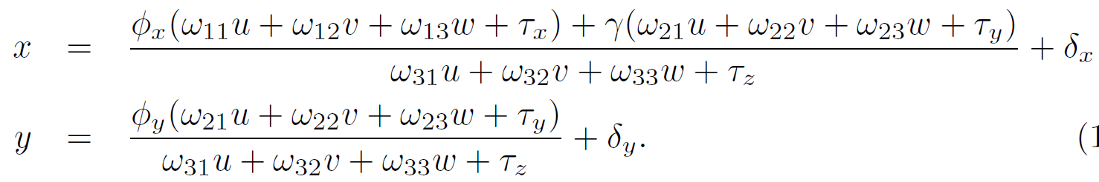
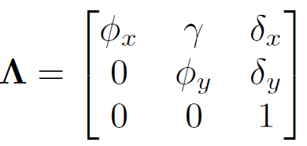


Complete pinhole camera model
Intrinsic parameters (stored as intrinsic matrix)
Extrinsic parameters

