Slide 1
COSC579: Computer Vision
Jeremy Bolton, PhD
Assistant Teaching Professor
A very special thanks to those who have contributed to this area of research over the years. Some slides used are from their research and efforts: the following professor and researchers Yung-Yu Chuang, Fredo Durand, Alexei Efros, William Freeman, James Hays, Svetlana Lazebnik, Andrej Karpathy, Fei-Fei Li, Srinivasa Narasimhan, Silvio Savarese, Steve Seitz, Noah Snavely, Richard Szeliski, and Li Zhang.

Slide 2
Outline
Welcome!
Course Overview and Administration
Topics and Goals
Fun Examples

Slide 3
Welcome!
COSC-579: Computer Vision
Instructor: Jeremy Bolton, Ph.D.
Assistant Teaching Professor
Department of Computer Science
Email: jeremy.bolton@georgetown.edu
Office Hours: Daily hours will be entered on Canvas calendar
(or by appointment)
TAs: TBD (see Canvas calendar for office hours)

Slide 4
Course Summary
Course Description: This course provides a comprehensive introduction to computer vision including image acquisition, low-level vision, and high-level vision. Image acquisition topics may include camera geometry, radiometry, illumination, noise, stereopsis, and affine transformations. Low-level vision topics may include, convolution, Fourier Transform, filters, operators, and feature generation. High-level vision topics may include detection, classification, segmentation, spatial relations, spatio-temporal models, object tracking, deformable models, and graph-based models.
Required Prerequisites: Mathematical Statistics and Linear Algebra
Some existing knowledge of Machine Learning and Image Processing is preferable, but a brief review will be provided.

Slide 5
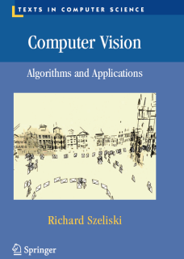
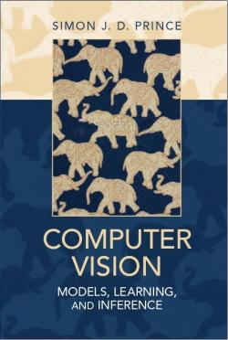
Texts
Szeliski, Computer Vision: Algorithms and Applications, Springer, 2010
  http://szeliski.org/Book/
Prince, Computer Vision: Models, Learning, and Inference, Cambridge, 2012
  www.computervisionmodels.com
Goodfellow, Bengio and Courville, Deep Learning, MIT Press, 2016.
  http://www.deeplearningbook.org
Nielsen, Neural Networks and Deep Learning, 2015.
  http://neuralnetworksanddeeplearning.com/
Horn, Berthold K.P. Robot Vision. The MIT Press, 1986.
Other References
Forsyth and Ponce, Computer Vision: A Modern Approach, Prentice Hall, 2011.
Bishop, Pattern Recognition and Machine Learning, Springer 2006.
Vapnik, Statistical Learning Theory, Wiley, 2006.
Duda, Hart, Stork, Pattern Classification, 2nd edition, Wiley, 2000.

Slide 6
Course Website
Link can also be found on Canvas or my department page.
http://jeremybolton.georgetown.domains/courses/cv/

Slide 7
Exercises and Final Project
Exercises
  Theory (math and stats) and Application (coding).
Final Project: Implement Computer Vision Solution
  Report
  Presentation

Slide 8
Notes about Coding
Recommended Languages: Matlab or Python
  Request approval for use of another language.
Coding Exercises are an integral part of this course! It is assumed that you have a proficient understanding of a programming language. Students are responsible for learning and/or reviewing, as needed, the programming language chosen.
Matlab and Python have many packages which perform Computer Vision tasks. Depending on the exercise, you may or may not be permitted to use these built-ins (pre-existing code). Details will be provided in exercise instructions. If you have any questions about a built-in, simply ask.
Cheating will not be tolerated. Any form of cheating will be reported to the GU honor council. Please read the following guidelines for project submissions:
  Discussion among students pertaining to project content and general methodology is encouraged; however, students are NOT PERMITTED to share code, copy code, or use code composed by others.
  A student may be asked to present, demonstrate, or explain a project submission at any time, without notice. At my sole discretion, a student’s project grade can be adjusted based on this presentation, demonstration, and/or explanation. If a student does not sufficiently understand or explain their submission, further action may be taken.
  Due Dates will be posted in Canvas or announced in class.

Slide 9
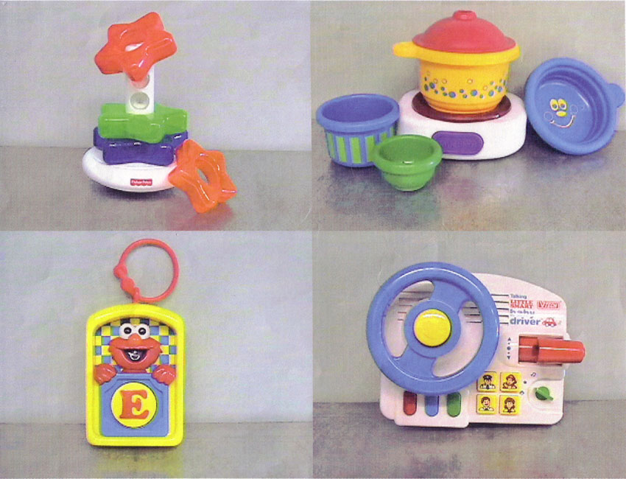
A Picture is Worth 100 Words

Slide 10
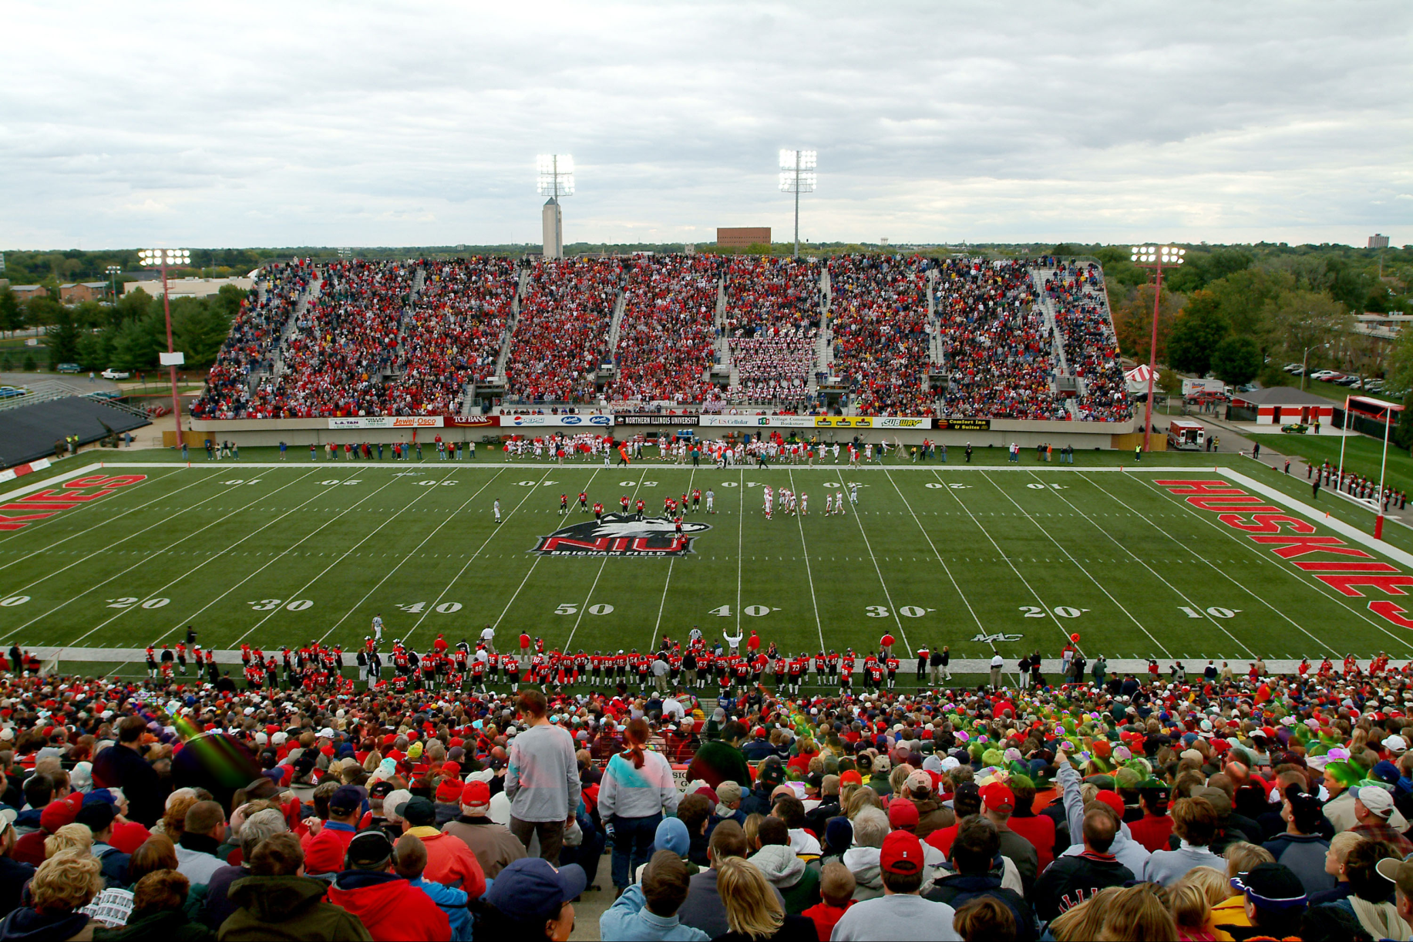
A Picture is Worth 10,000 Words

Slide 11
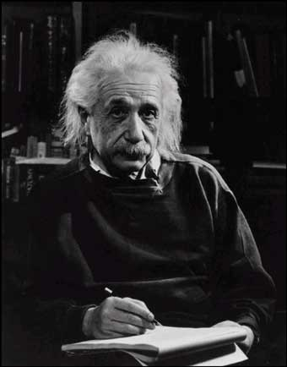
A Picture is Worth a Million Words

Slide 12
Human Vision
Can do amazing things like:
  Recognize people and objects
  Navigate through obstacles
  Understand mood in the scene
  Imagine stories
But still is not perfect:
  Suffers from Illusions
  Ignores many details
  Ambiguous description of the world
  Doesn’t care about accuracy of world

Slide 13
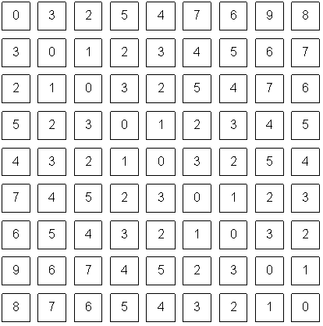
Computer Vision
What we see
What a computer sees

Slide 14
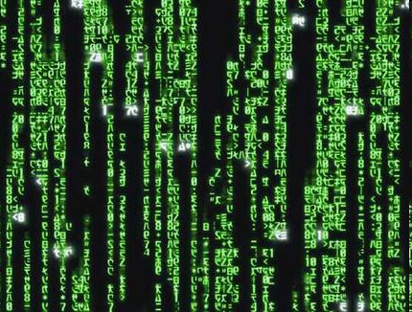
Computer Vision
What we see
What a computer sees

Slide 15
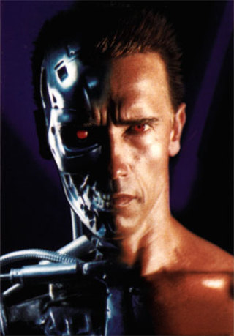
What is computer vision?
Terminator 2
Notes:
Clips: terminator 2, enemy of the state (from UCSD “Fact or Fiction” DVD)

Slide 16
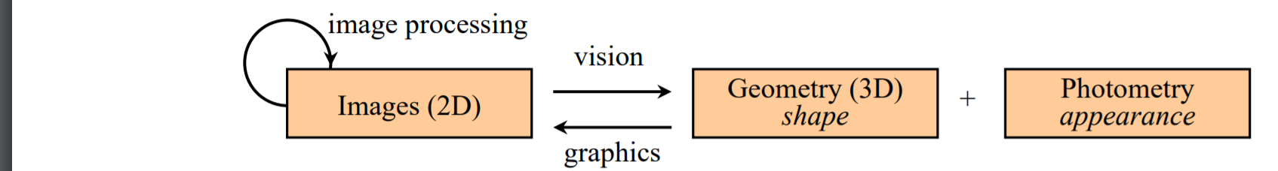
What is Computer Vision?
Computer Vision
  Inverse problem: Hard
  Image Processing
Graphics
  Forward problem

Slide 17
What is Computer Vision?
Inverse Optics
Intelligent interpretation of Imagery
Building a Visual Cortex
No matter what your definition is…
  Vision is hard.
  But is fun...

Slide 18

Components of a Computer Vision System
Camera
Lighting
Computer
Scene
Scene Interpretation

Slide 19
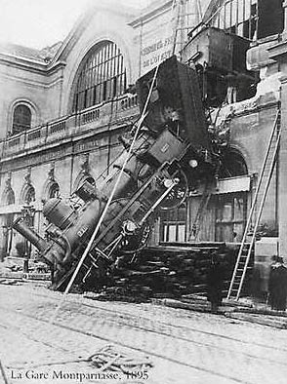
Every picture tells a story
Goal of computer vision is to write computer programs that can interpret images

Slide 20
Can computers match (or beat) human vision?
Yes and no (but mostly no!)
  humans are much better at “hard” things
  computers can be better at “easy” things
Notes:
If you can write a formula for it, computers can excel
Computer vision can’t solve the whole problem (yet), so breaks it down into pieces.
Many of the pieces have important applications.

Slide 21
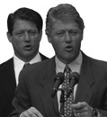
Human perception has its shortcomings…
Sinha and Poggio, Nature, 1996
Notes:
Example where humans make mistakes that computers can avoid

Slide 22
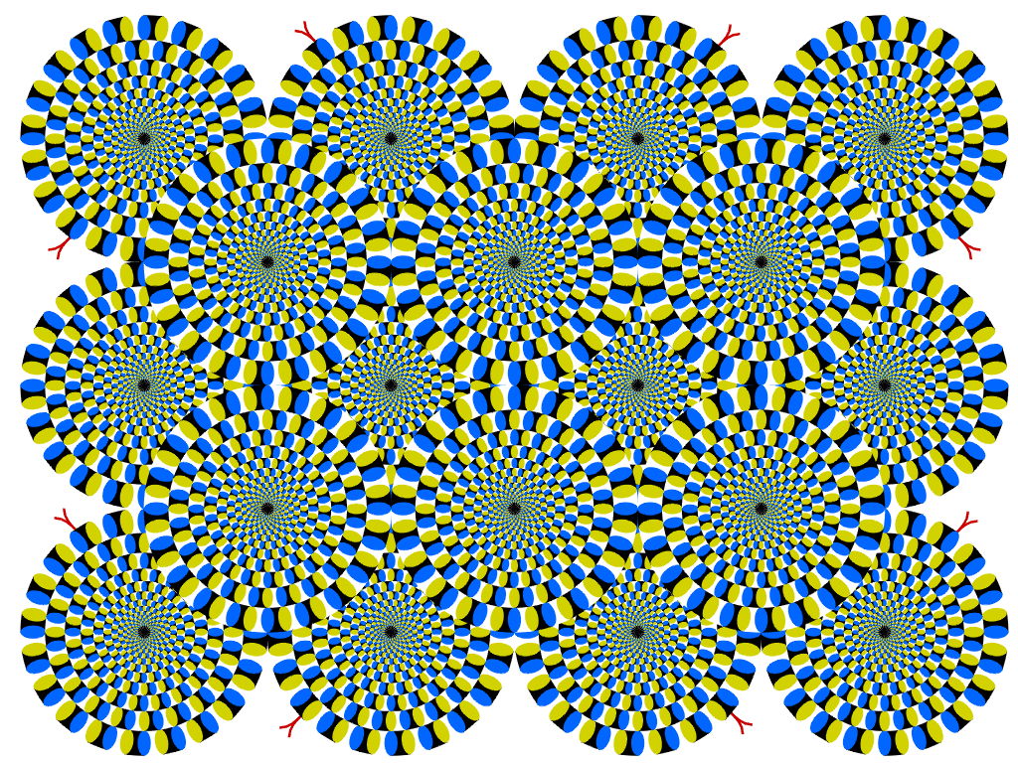
Is this image in motion?
Look at the image as a whole. Are the wheels in motion?
Now focus on one wheel in particular. Is that one in motion?
Copyright A.Kitaoka 2003

Slide 23
Some Topics in Computer Vision

Slide 24
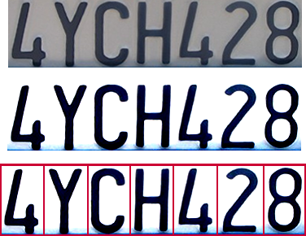
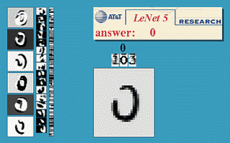
Optical character recognition (OCR)
Technology to convert scanned docs to text
  If you have a scanner, it probably came with OCR software
Digit recognition, AT&T labs
http://www.research.att.com/~yann/
License plate readers
http://en.wikipedia.org/wiki/Automatic_number_plate_recognition

Slide 25
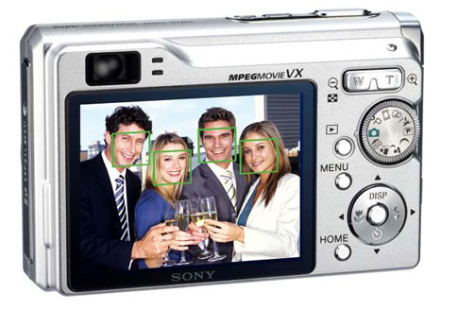
Face detection
Many new digital cameras now detect faces
  Canon, Sony, Fuji, …
Notes:
Why would this be useful? Main reason is focus. Also enables “smart” cropping.

Slide 26
Smile detection?
Sony Cyber-shot® T70 Digital Still Camera

Slide 27
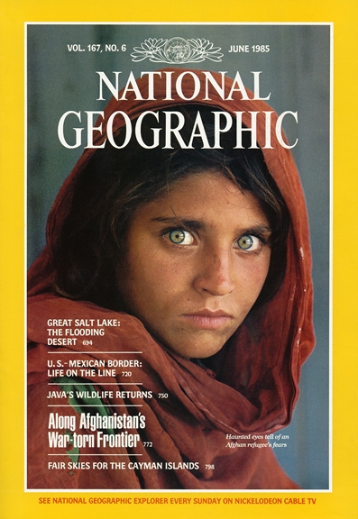
Face recognition
Who is she?

Slide 28
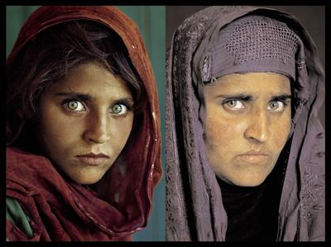
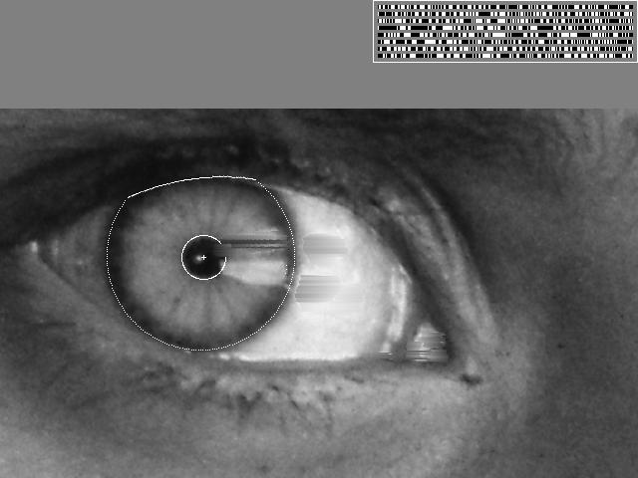
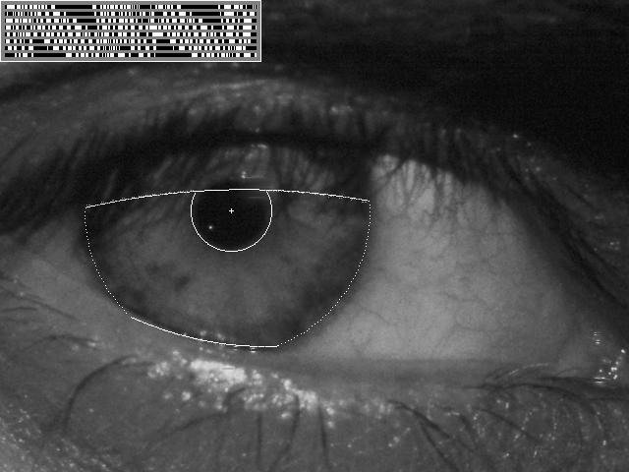
Vision-based biometrics
“How the Afghan Girl was Identified by Her Iris Patterns” Read the story

Slide 29
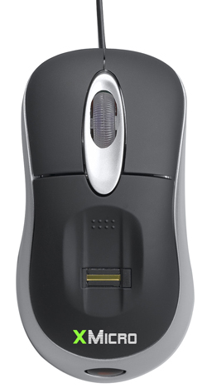
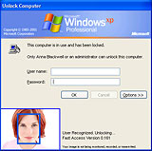
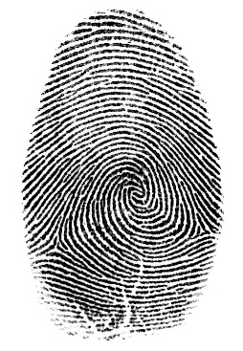

Login without a password…
Fingerprint scanners on many new laptops,
other devices
Face recognition systems now beginning to appear more widely
http://www.sensiblevision.com/

Slide 30
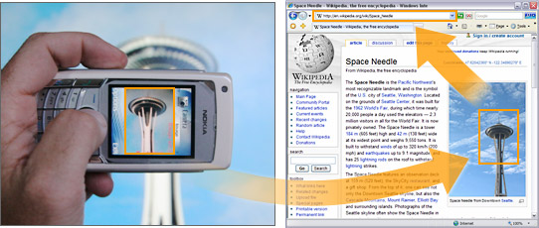

Object recognition (in mobile phones)
This is becoming real:
  Microsoft Research
  Point & Find, Nokia
  https://www.google.com/intl/en_us/insidesearch/features/images/searchbyimage.html

Slide 31
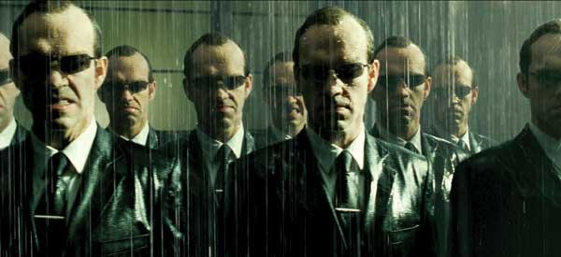
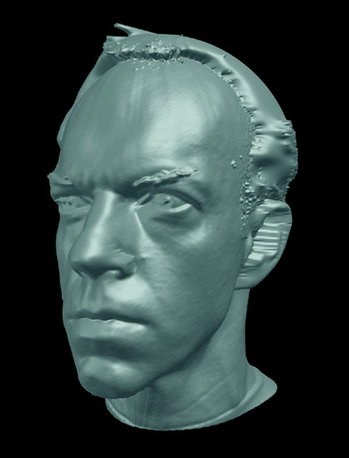
Shape and Morphology: Deformable Models
The Matrix movies, ESC Entertainment, XYZRGB, NRC

Slide 32
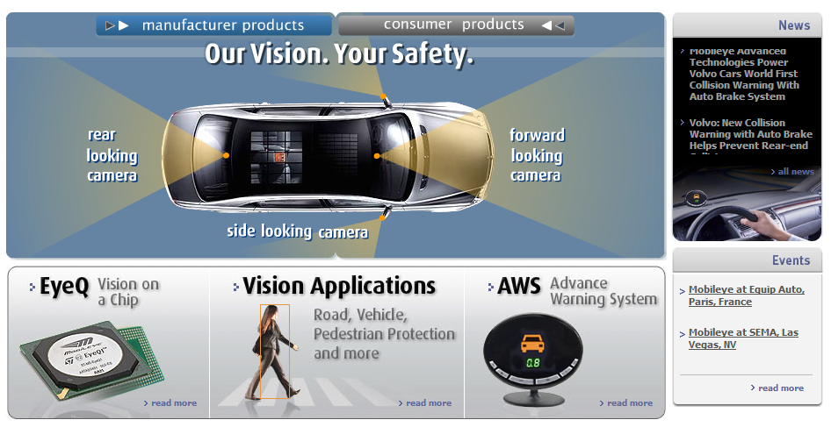
Smart cars
Slide content courtesy of Amnon Shashua
Mobileye
  Vision systems currently in high-end BMW, GM, Volvo models
  By 2010: 70% of car manufacturers.
  Video demo

Slide 33
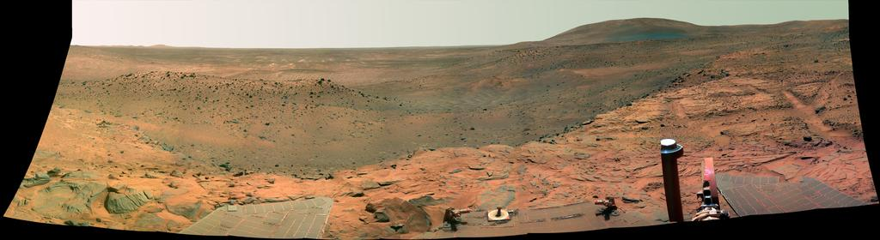
Vision in space
NASA'S Mars Exploration Rover Spirit captured this westward view from atop
a low plateau where Spirit spent the closing months of 2007.
Vision systems (JPL) used for several tasks
  Panorama stitching
  3D terrain modeling
  Obstacle detection, position tracking
  For more, read “Computer Vision on Mars” by Matthies et al.

Slide 34
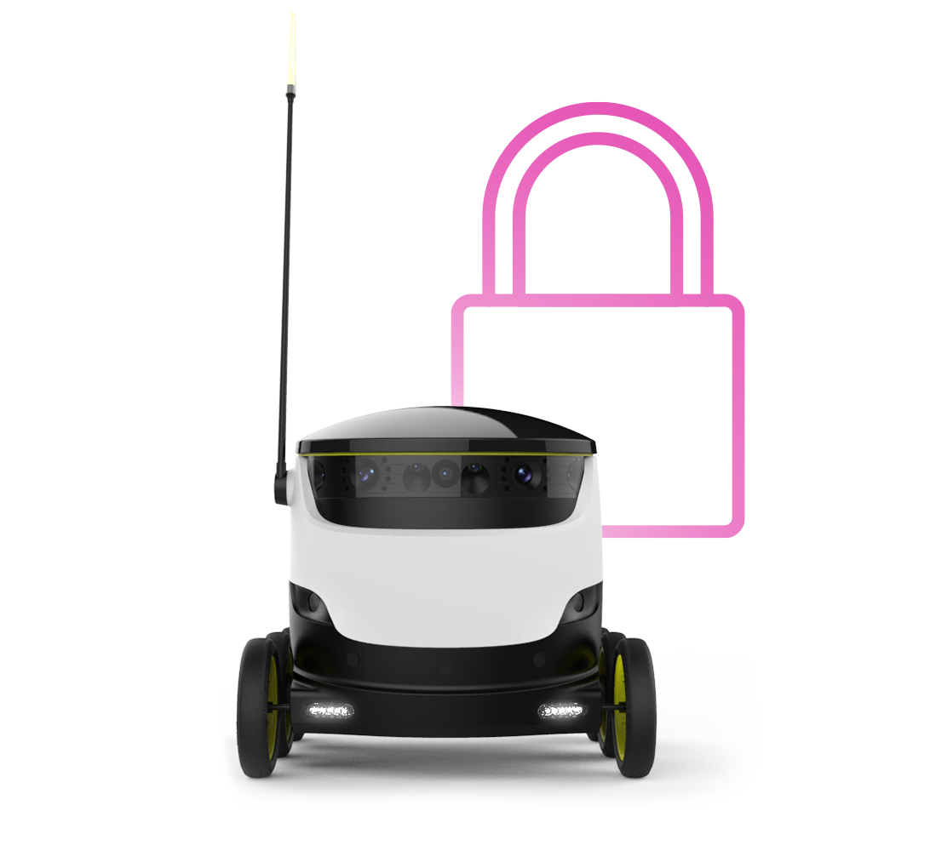
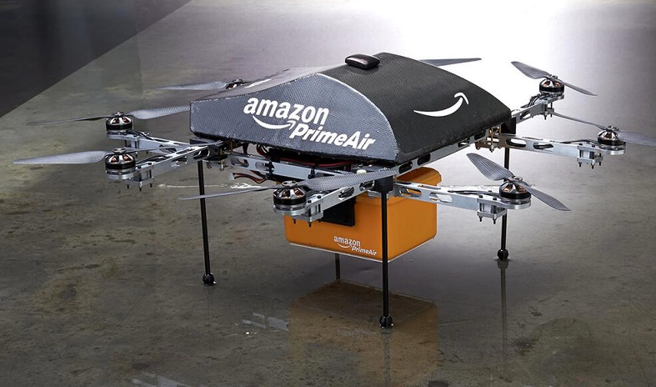
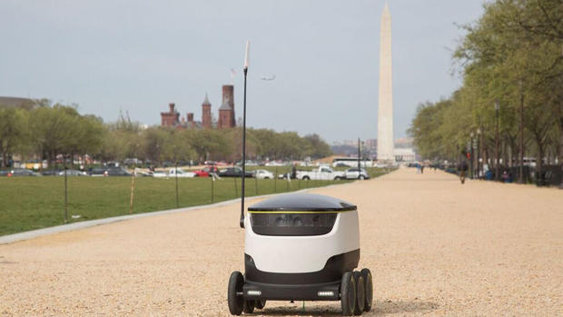
Delivery Robots: Starship Technologies and more
Computer Vision will transform the delivery industry

Slide 35
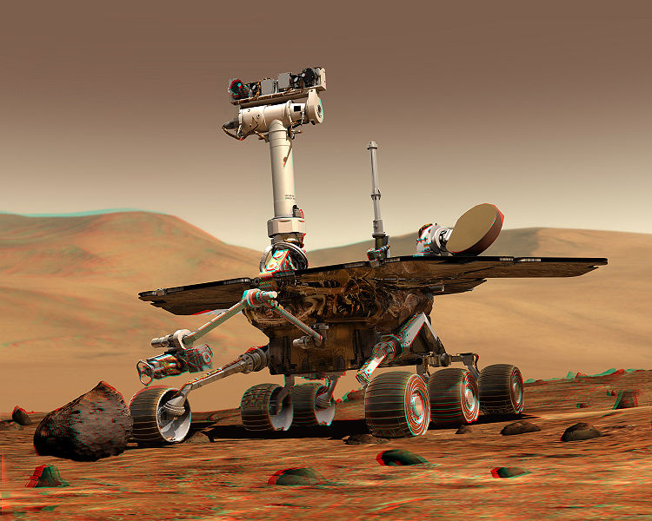
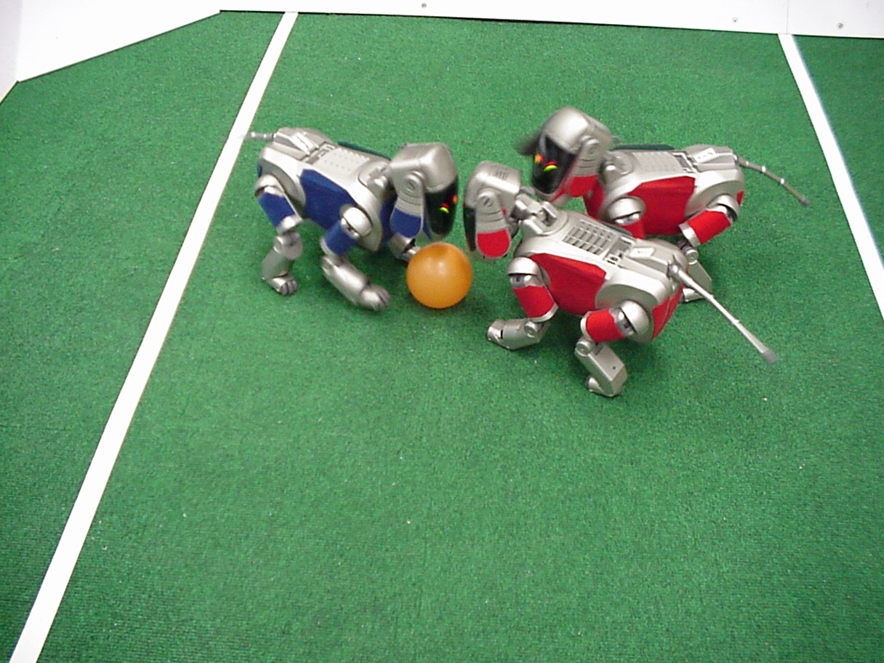
Robotics
NASA’s Mars Spirit Rover
http://en.wikipedia.org/wiki/Spirit_rover
http://www.robocup.org/

Slide 36
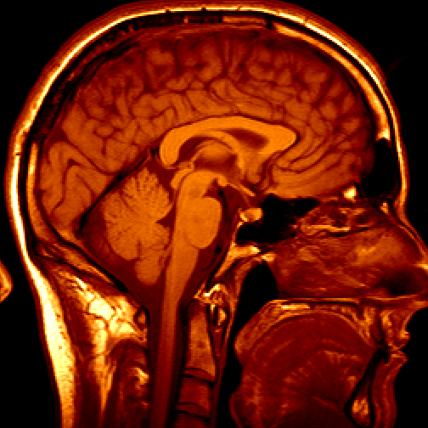
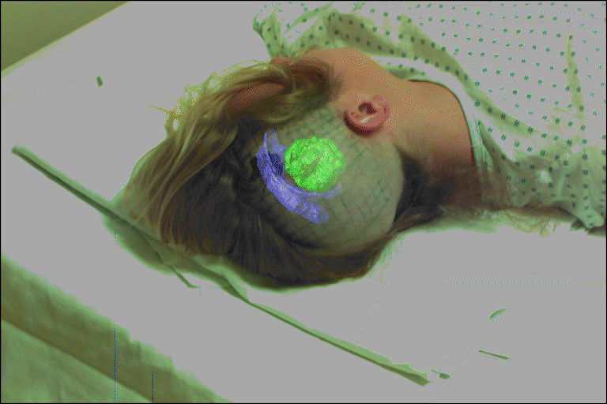
Medical imaging
3D imaging
MRI, CT
Image guided surgery
Grimson et al., MIT

Slide 37
Other Computer Vision Applications
Some industrial applications of computer vision:
  automotive monitoring, car counting http://www.mobileye.com/;
    https://youtu.be/Y3ac5rFMNZ0?t=283
  Surveillance. Fight, Flight Detection / Target Tracking
    https://youtu.be/QcCjmWwEUgg
    https://youtu.be/InqV34BcheM
  Sports Data: https://www.secondspectrum.com/
  Morphing:
    https://youtu.be/pqpS6BN0_7k
    https://youtu.be/nUDIoN-_Hxs

Slide 38
Current state of the art
You just saw examples of current applications.
  Many of these are less than 5 years old
This is a very active research area, and rapidly changing
  Many new apps in the next 5 years
To learn more about vision applications and companies
  David Lowe maintains an excellent overview of vision companies
    http://www.cs.ubc.ca/spider/lowe/vision.html

Slide 39
Topics covered

Slide 40
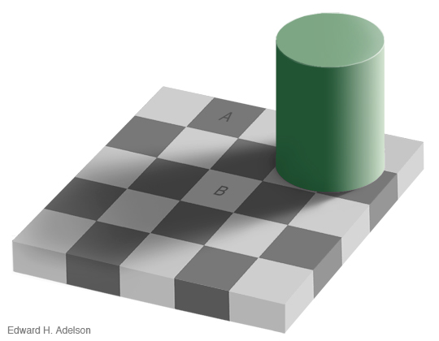
Lightness and Perception

Slide 41
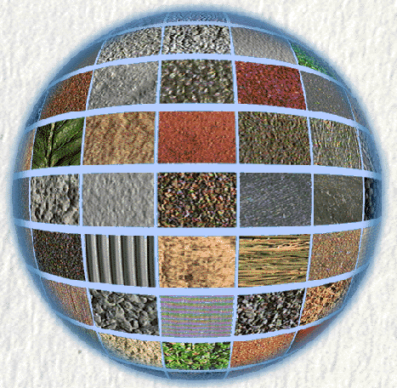
Surface Reflectance
[CURET]

Slide 42
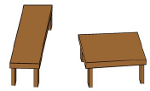
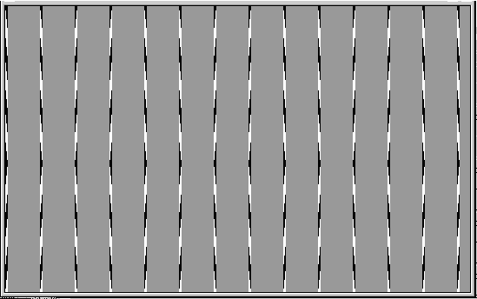
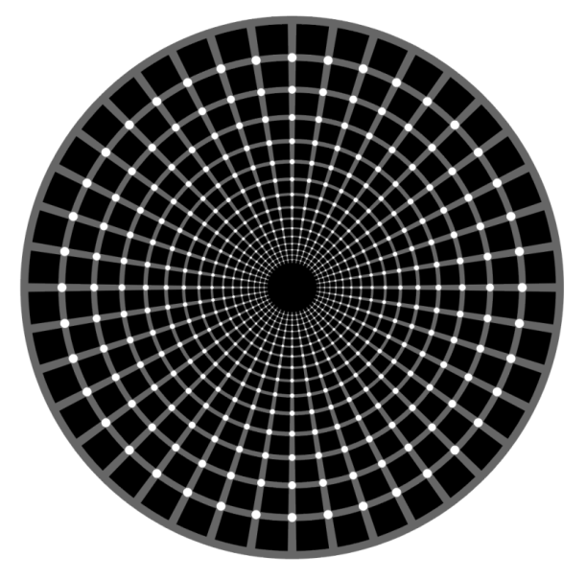
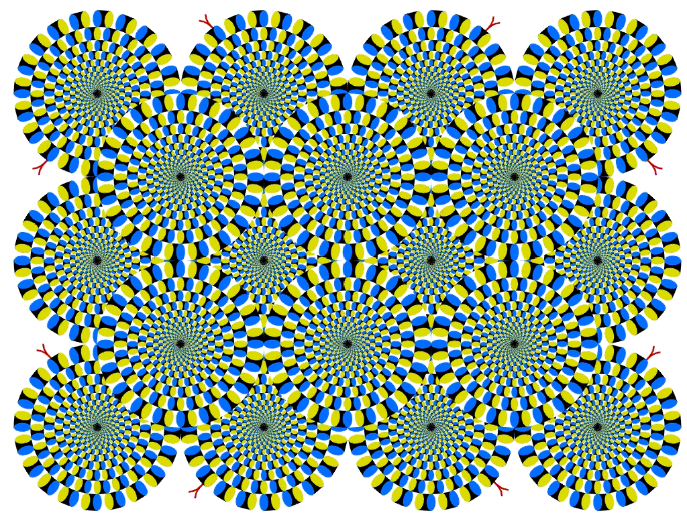
Human Vision: Optical Illusions
Which is bigger?
Straight Lines?
Dots White? Or Black?
Spinning Wheels?

Slide 43
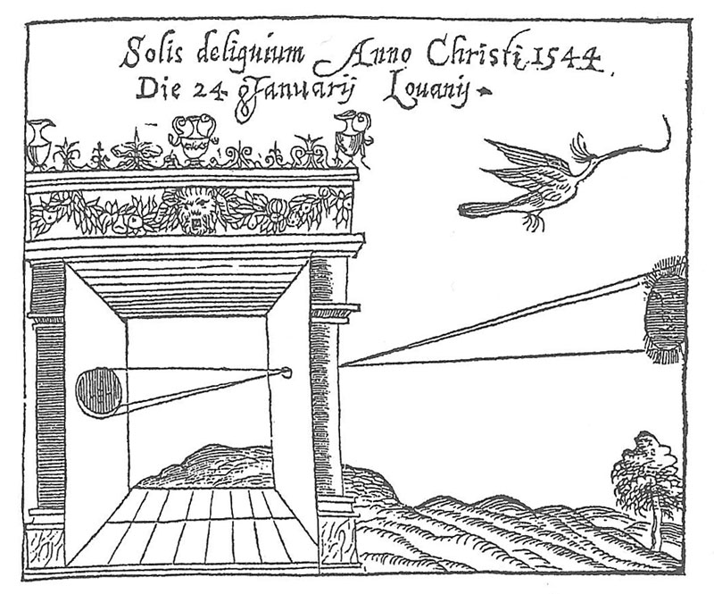
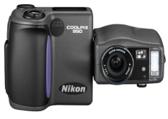
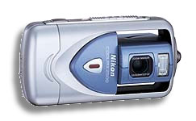
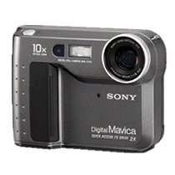
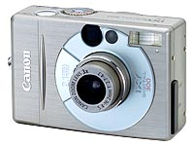
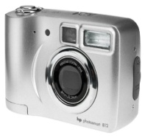
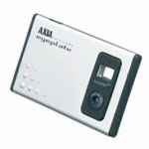
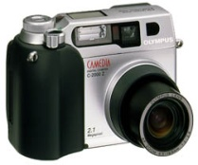
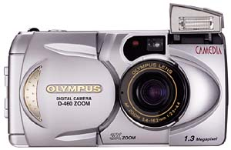
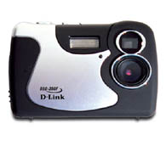
Cameras and their Optics
Today’s Digital Cameras
The Camera Obscura

Slide 44


Binocular Stereo

Slide 45





Image Processing
Image enhancement
Feature detection
Fourier Transform
Sampling, Convolution

Slide 46

Statistical Techniques
Least Squares Fitting

Slide 47

Face detection

Slide 48

Face Recognition
Principle Components Analysis (PCA)
Face Recognition

Slide 49


Tracking

Slide 50


Optical Flow

Slide 51








Some Recent Trends in Vision

Slide 52
Computer Vision … the journey
Attaining scene understanding is a long journey
Our course will largely develop these concepts in their intuitive order
Scene
Image Formation
Image Processing
Feature Generation
Models for
Recognition,
Tracking, etc
High Level Scene Understanding
Machine Learning

Slide 53
Appendix

