Slide 1
COSC121: Computer Systems. Managing Memory
Jeremy Bolton, PhD
Assistant Teaching Professor
Constructed using materials:
- Patt and Patel Introduction to Computing Systems (2nd)
- Patterson and Hennessy Computer Organization and Design (4th)
**A special thanks to Eric Roberts and Mary Jane Irwin

Slide 2
Notes
Read PH.5 and PH.6

Slide 3
Outline
Memory
Technology
Speed
Schemes for efficiency
Cache hierarchy
Virtual Memory
How to manage and efficiently use cache
…

Slide 4
This week … our journey takes us …
COSC 121: Computer Systems
Application (Browser)
Operating
System
(Win, Linux)
Compiler
COSC 255: Operating Systems
Software
Assembler
Drivers
Instruction Set
Architecture
Hardware
Processor
Memory
I/O system
Datapath & Control
Digital Design
COSC 120: Computer Hardware
Circuit Design
transistors

Slide 5
Virtual Memory
Use main memory as a “cache” for secondary (disk) storage
Managed jointly by CPU hardware and the operating system (OS)
Programs share main memory
Each gets a private virtual address space holding its frequently used code and data
Protected from other programs
CPU and OS translate virtual addresses to physical addresses
VM “block” is called a page
VM translation “miss” is called a page fault

Slide 6
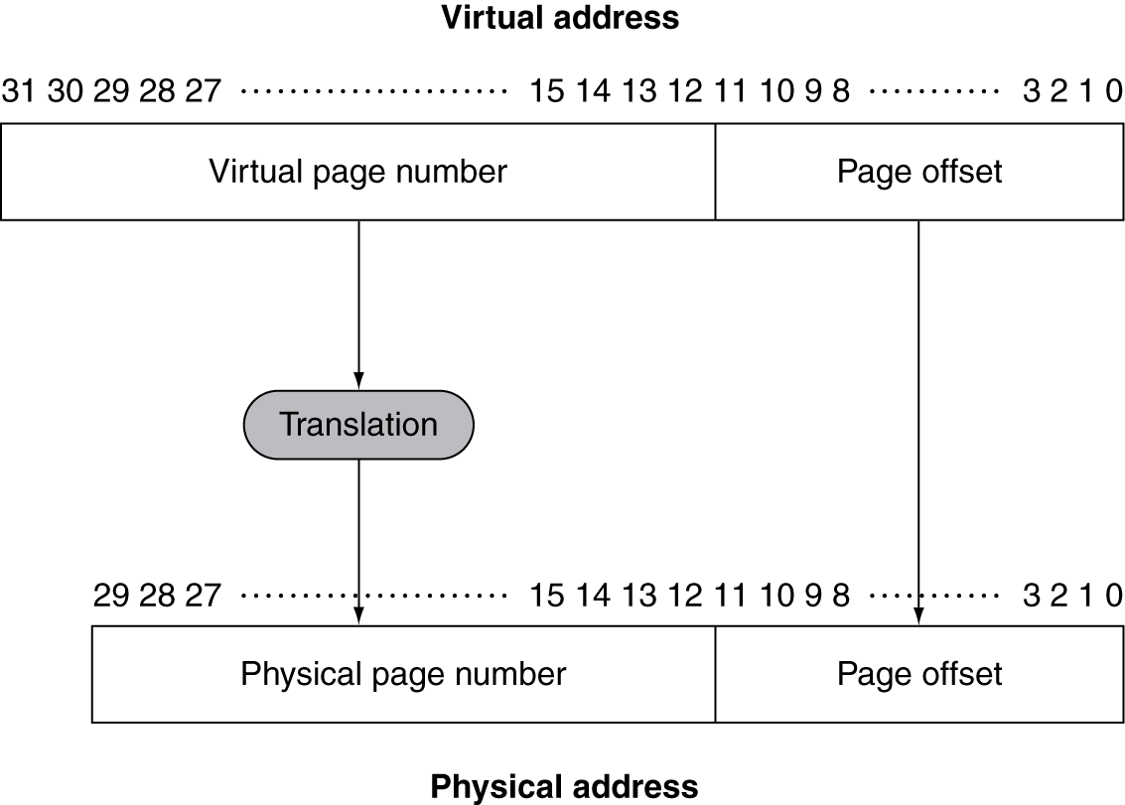
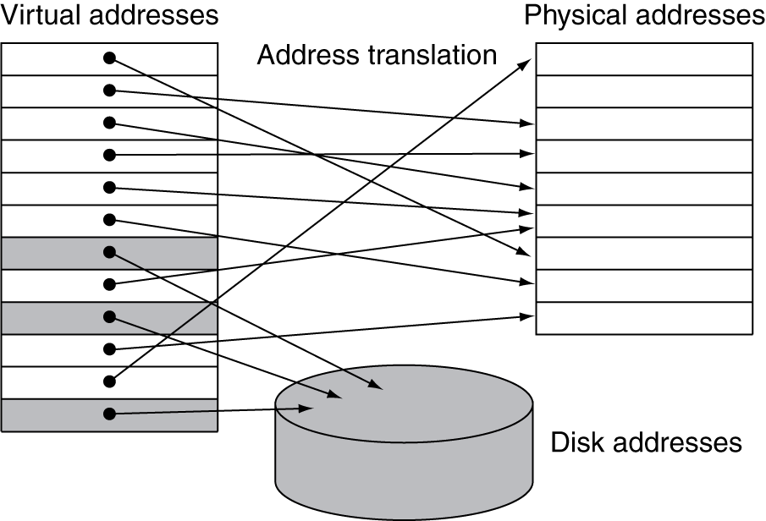
Address Translation
Fixed-size pages (e.g., 4K)

Slide 7
Page Fault Penalty
On page fault, the page must be fetched from disk
Takes millions of clock cycles
Handled by OS code (software is slow)
Try to minimize page fault rate
Fully associative placement
Smart replacement algorithms

Slide 8
Page Tables
Stores placement information
Array of page table entries, indexed by virtual page number
Page table register in CPU points to page table in physical memory
If page is present in memory
PTE stores the physical page number
Plus other status bits (referenced, dirty, …)
If page is not present
PTE can refer to location in swap space on disk

Slide 9
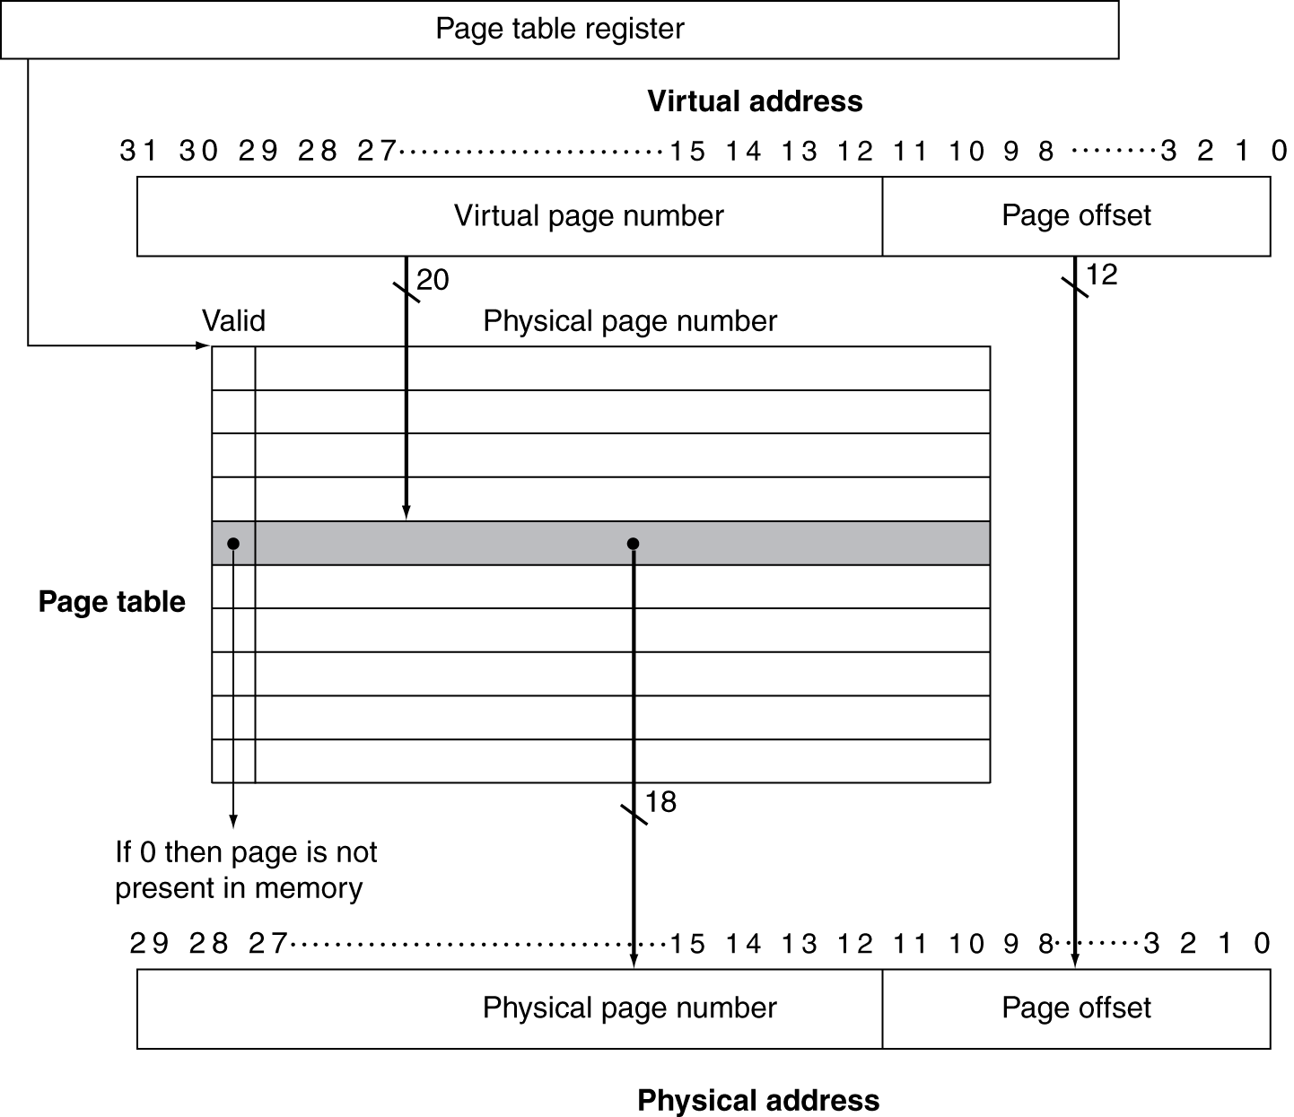
Translation Using a Page Table

Slide 10
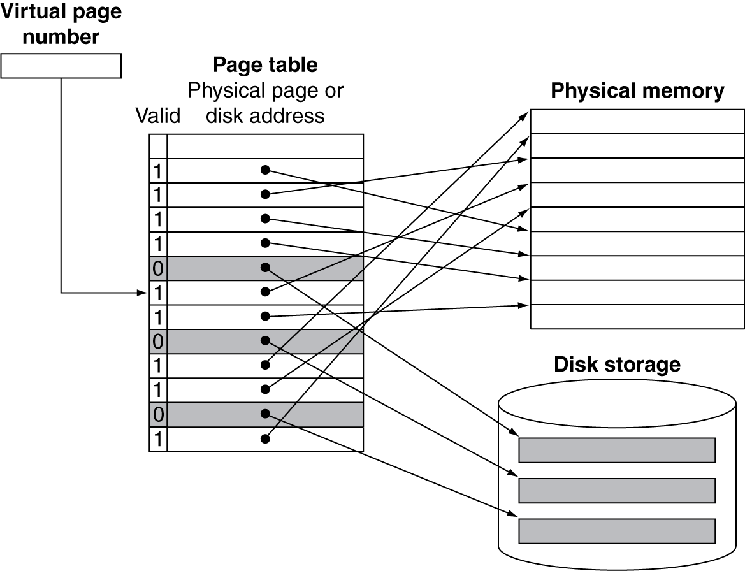
Mapping Pages to Storage

Slide 11
Replacement and Writes
To reduce page fault rate, prefer least-recently used (LRU) replacement
Reference bit (aka use bit) in PTE set to 1 on access to page
Periodically cleared to 0 by OS
A page with reference bit = 0 has not been used recently
Disk writes take millions of cycles
Block at once, not individual locations
Write through is impractical
Use write-back
Dirty bit in PTE set when page is written

Slide 12
Fast Translation Using a TLB
Address translation would appear to require extra memory references
One to access the PTE
Then the actual memory access
But access to page tables has good locality
So use a fast cache of PTEs within the CPU
Called a Translation Look-aside Buffer (TLB)
Typical: 16–512 PTEs, 0.5–1 cycle for hit, 10–100 cycles for miss, 0.01%–1% miss rate
Misses could be handled by hardware or software

Slide 13
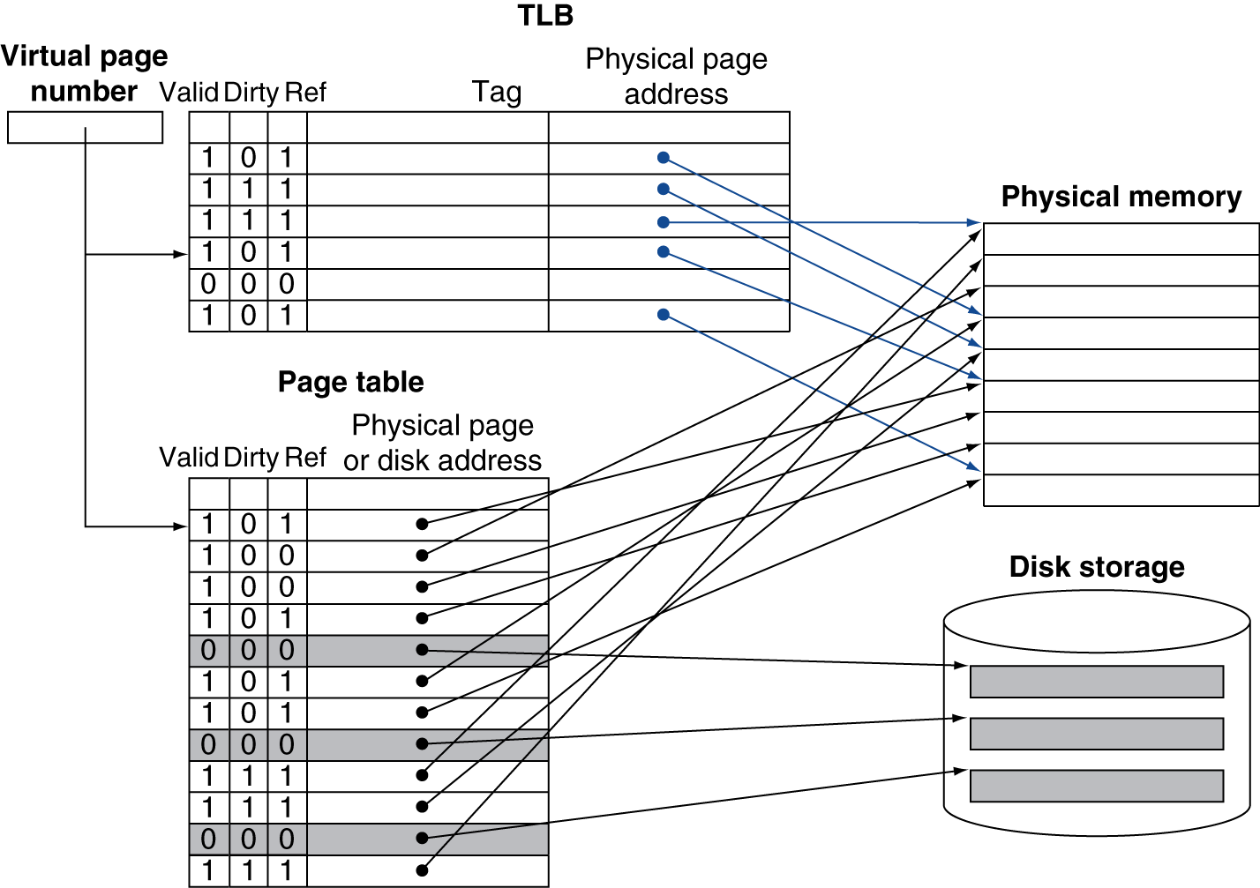
Fast Translation Using a TLB

Slide 14
TLB Misses
If page is in memory
Load the PTE from memory and retry
Could be handled in hardware
Can get complex for more complicated page table structures
Or in software
Raise a special exception, with optimized handler
If page is not in memory (page fault)
OS handles fetching the page and updating the page table
Then restart the faulting instruction

Slide 15
TLB Miss Handler
TLB miss indicates
Page present, but PTE not in TLB
Page not preset
Must recognize TLB miss before destination register overwritten
Raise exception
Handler copies PTE from memory to TLB
Then restarts instruction
If page not present, page fault will occur

Slide 16
Page Fault Handler
Use faulting virtual address to find PTE
Locate page on disk
Choose page to replace
If dirty, write to disk first
Read page into memory and update page table
Make process runnable again
Restart from faulting instruction

Slide 17
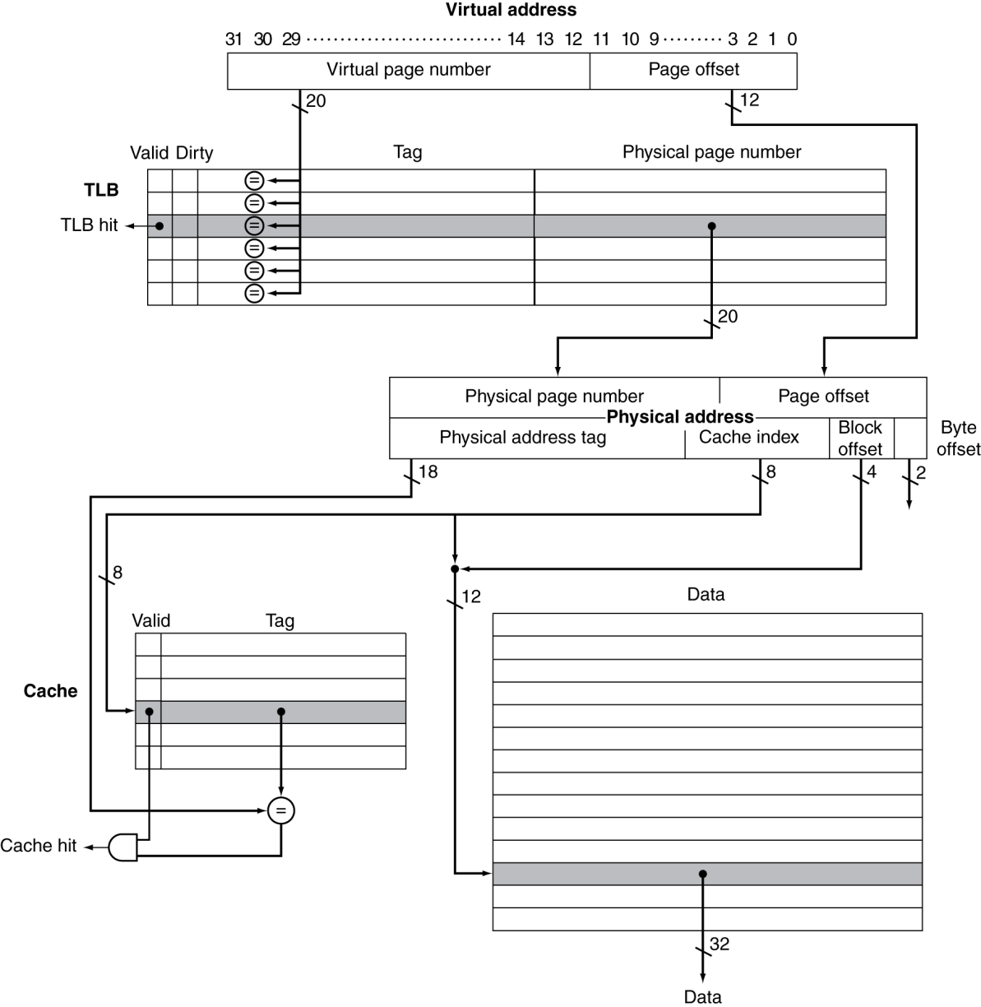
TLB and Cache Interaction
If cache tag uses physical address
Need to translate before cache lookup
Alternative: use virtual address tag
Complications due to aliasing
Different virtual addresses for shared physical address

Slide 18
The Memory Hierarchy
The BIG Picture
Common principles apply at all levels of the memory hierarchy
Based on notions of caching
At each level in the hierarchy
Block placement
Finding a block
Replacement on a miss
Write policy

Slide 19
COSC121: Computer Systems. Cache Coherency (if time)
Jeremy Bolton, PhD
Assistant Teaching Professor
Constructed using materials:
- Patt and Patel Introduction to Computing Systems (2nd)
- Patterson and Hennessy Computer Organization and Design (4th)
**A special thanks to Eric Roberts and Mary Jane Irwin

Slide 20
FSM Cache Controller
Key characteristics for a simple L1 cache
Direct mapped
Write-back using write-allocate
Block size of 4 32-bit words (so 16B); Cache size of 16KB (so 1024 blocks)
18-bit tags, 10-bit index, 2-bit block offset, 2-bit byte offset, dirty bit, valid bit, LRU bits (if set associative)
1-bit Read/Write
Cache
&
Cache
Controller
1-bit Read/Write
1-bit Valid
1-bit Valid
Processor
32-bit address
32-bit address
DDR SDRAM
32-bit data
128-bit data
32-bit data
128-bit data
1-bit Ready
1-bit Ready
Notes:
A blocking cache so the processor must wait until the cache has finished this request
Memory controller will notify the Cache Controller via the Ready signal when the memory read or write is finished

Slide 21
Four State Cache Controller
Cache Hit
Mark Cache Ready
Compare Tag
If Valid && Hit
Set Valid, Set Tag,
If Write set Dirty
Idle
Valid CPU request
Cache Miss
Old block is
Dirty
Memory Ready
Cache Miss
Old block is
clean
Allocate
Read new block
from memory
Write Back
Write old block
to memory
Memory Ready
Memory
Not Ready
Memory
Not Ready
Notes:
Idle – waits for a Read/Write request from the Processor along with a Valid signal, FSM moves to Compare Tag state
Compare Tag – Checks to see if the request is a hit or a miss. On hit and Valid, returns data to the Processor and moves back to Idle state. On miss, if dirty goes to Write Back state or to Allocate state.
Write Back – Writes the 128-bit block to Memory. When memory write is complete move to the Allocate state.
Allocate – Fetch new block from Memory. Wait in this state until the Memory returns a Ready signal. Then write new block into the Cache and return to the Compare Tag state.

Slide 22
Cache Coherence in Multicores
In future multicore processors its likely that the cores will share a common physical address space, causing a cache coherence problem
Core 1
Core 2
L1 I$
L1 D$
L1 I$
L1 D$
Unified (shared) L2
Notes:
For class handout

Slide 23
Cache Coherence in Multicores
In future multicore processors its likely that the cores will share a common physical address space, causing a cache coherence problem
Read X
Read X
Core 1
Core 2
Write 1 to X
L1 I$
L1 D$
L1 I$
L1 D$
X = 0
X = 0
X = 1
X = 1
X = 0
Unified (shared) L2
Notes:
For lecture
Assumes a write through L1 cache

Slide 24
A Coherent Memory System
Any read of a data item should return the most recently written value of the data item
Coherence – defines what values can be returned by a read
Writes to the same location are serialized (two writes to the same location must be seen in the same order by all cores)
Consistency – determines when a written value will be returned by a read
To enforce coherence, caches must provide
Replication of shared data items in multiple cores’ caches
Replication reduces both latency and contention for a read shared data item
Migration of shared data items to a core’s local cache
Migration reduced the latency of the access the data and the bandwidth demand on the shared memory (L2 in our example)
Notes:
Supporting migration and replication is critical to performance in accessing shared data.

Slide 25
Cache Coherence Protocols
Need a hardware protocol to ensure cache coherence the most popular of which is snooping
The cache controllers monitor (snoop) on the broadcast medium (e.g., bus) with duplicate address tag hardware (so they don’t interfere with core’s access to the cache) to determine if their cache has a copy of a block that is requested
Write invalidate protocol – writes require exclusive access and invalidate all other copies
Exclusive access ensure that no other readable or writable copies of an item exists
If two processors attempt to write the same data at the same time, one of them wins the race causing the other core’s copy to be invalidated. For the other core to complete, it must obtain a new copy of the data which must now contain the updated value – thus enforcing write serialization
Notes:
Reading from multiple copies is not a problem!! Only writes cause issues. What happens if two processors try to write to the same shared data word in the same clock cycle? The bus arbiter decides which processor gets the bus first (and this will be the processor with the first exclusive access). Then the second processor will get exclusive access. Thus, bus arbitration forces sequential behavior.
This sequential consistency is the most conservative of the memory consistency models. With it, the result of any execution is the same as if the accesses of each processor were kept in order and the accesses among different processors were interleaved.
Each block needs an additional state bit – owner - which indicates that a block may be shared, but the owning core is responsible for updating any other processors and memory when it changes the block or replaces it.
An alternative to snooping is a directory based cache coherence protocol where the directory keeps the sharing status of blocks of physical memory. They have slightly higher implementation overhead but can reduc traffic between caches and thus scale to larger core counts.

Slide 26
Handling Writes
Ensuring that all other processors sharing data are informed of writes can be handled two ways:
Write-update (write-broadcast) – writing processor broadcasts new data over the bus, all copies are updated
All writes go to the bus → higher bus traffic
Since new values appear in caches sooner, can reduce latency
Write-invalidate – writing processor issues invalidation signal on bus, cache snoops check to see if they have a copy of the data, if so they invalidate their cache block containing the word (this allows multiple readers but only one writer)
Uses the bus only on the first write → lower bus traffic, so better use of bus bandwidth
Notes:
IN HIDE MODE – NEEDED?
All commercial machines use write-invalidate as their standard coherence protocol

Slide 27
Example of Snooping Invalidation
Core 1
Core 2
L1 I$
L1 D$
L1 I$
L1 D$
Unified (shared) L2
Notes:
For class handout

Slide 28
Example of Snooping Invalidation
Read X
Read X
Core 1
Core 2
Write 1 to X
Read X
L1 I$
L1 D$
L1 I$
L1 D$
X = 0
X = 0
X = 1
X = I
X = 1
X = I
X = 1
X = 0
Unified (shared) L2
When the second miss by Core 2 occurs, Core 1 responds with the value canceling the response from the L2 cache (and also updating the L2 copy)
Notes:
For lecture
Snooping bus with write-back L1 cache. Requires an additional state – called owner – which indicates that a block may be shared, but the owning core is responsible for updating any other processors and memory when it changes the block or replaces it

Slide 29
A Write-Invalidate CC Protocol
read (hit or miss)
read (miss)
Invalid
Shared
(clean)
write (miss)
write (hit or miss)
write-back caching protocol in black
Modified
(dirty)
read (hit) or write (hit or miss)
Notes:
For class handout

Slide 30
A Write-Invalidate CC Protocol
read (hit or miss)
read (miss)
Invalid
receives invalidate
(write by another core
to this block)
Shared
(clean)
write-back due to read (miss) by another core to this block
write (miss)
send invalidate
send invalidate
write (hit or miss)
write-back caching protocol in black
Modified
(dirty)
signals from the core in red
signals from the bus in blue
read (hit) or write (hit)
Notes:
For lecture
A read miss causes the cache to acquire the bus and write back the victim block (if it was in the Modified (dirty) state). All the other caches monitor the read miss to see if this block is in their cache. If one has a copy and it is in the Modified state, then the block is written back and its state is changed to Invalid. The read miss is then satisfied by reading from the block memory, and the state of the block is set to Shared.
Read hits do not change the cache state.
A write miss to an Invalid block causes the cache to acquire the bus, read the block, modify the portion of the block being written and changing the block’s state to Modified. A write miss to a Shared block causes the cache to acquire the bus, send an invalidate signal to invalidate any other existing copies in other caches, modify the portion of the block being written and chang the block’s state to Modified.
A write hit to a Modified block causes no action. A write hit to a Shared block causes the cache to acquire the bus, send an invalidate signal to invalidate any other existing copies in other caches, modify the part of the block being written, and change the state to Modified.

Slide 31
Write-Invalidate CC Examples
I = invalid (many), S = shared (many), M = modified (only one)
Core 1
Core 2
Core 1
Core 2
A S
A I
A S
A I
Main Mem
A
Main Mem
A
Core 1
Core 2
Core 1
Core 2
A M
A I
A M
A I
Main Mem
A
Main Mem
A
Notes:
SKIP THIS – FAR TOO MUCH DETAIL, EARLIER EXAMPLE SUFFICES
For class handout

Slide 32
Write-Invalidate CC Examples
I = invalid (many), S = shared (many), M = modified (only one)
3. snoop sees read request for A & lets MM supply A
1. read miss for A
1. write miss for A
Core 1
Core 2
Core 1
Core 2
4. gets A from MM & changes its state to S
2. writes A & changes its state to M
4. change A state to I
A S
A I
A S
A I
2. read request for A
3. C2 sends invalidate for A
Main Mem
A
Main Mem
A
3. snoop sees read request for A, writes-back A to MM
1. read miss for A
1. write miss for A
Core 1
Core 2
Core 1
Core 2
4. gets A from MM & changes its state to M
2. writes A & changes its state to M
5. change A state to I
4. change A state to I
A M
A I
A M
A I
5. C2 sends invalidate for A
2. read request for A
3. C2 sends invalidate for A
Main Mem
A
Main Mem
A
Notes:
SKIP THIS – FAR TOO MUCH DETAIL, EARLIER EXAMPLE SUFFICES
For lecture
1st example – supplying A from Core 1 cache would be faster than getting it from MM
2nd and 4th example – assumes a Write allocate cache policy

Slide 33
Data Miss Rates
Shared data has lower spatial and temporal locality
Share data misses often dominate cache behavior even though they may only be 10% to 40% of the data accesses
64KB 2-way set associative data cache with 32B blocks
Hennessy & Patterson, Computer Architecture: A Quantitative Approach
Notes:
Compulsory misses are all very small and are included in capacity misses. The x axis is core count

Slide 34
Block Size Effects
Writes to one word in a multi-word block mean that the full block is invalidated
Multi-word blocks can also result in false sharing: when two cores are writing to two different variables that happen to fall in the same cache block
With write-invalidate false sharing increases cache miss rates
Core1
Core2
A
B
4 word cache block
Compilers can help reduce false sharing by allocating highly correlated data to the same cache block

Slide 35
Other Coherence Protocols
There are many variations on cache coherence protocols
Another write-invalidate protocol used in the Pentium 4 (and many other processors) is MESI with four states:
Modified – same
Exclusive – only one copy of the shared data is allowed to be cached; memory has an up-to-date copy
Since there is only one copy of the block, write hits don’t need to send invalidate signal
Shared – multiple copies of the shared data may be cached (i.e., data permitted to be cached with more than one processor); memory has an up-to-date copy
Invalid – same
Notes:
For E and S book states that memory has an up-to-date version so is this not a write-back cache ???

Slide 36
MESI Cache Coherency Protocol
Processor
shared read
Invalidate for this block
Invalid
(not valid
block)
Another
processor
has read/write
miss for this
block
Shared
(clean)
Processor
shared read
miss
Processor
shared
read
[Write back block]
Processor
write
miss
[Write back block]
[Send invalidate signal]
Processor
exclusive
read
Processor
exclusive
read miss
Processor
write
Modified
(dirty)
Exclusive
(clean)
[Write back block]
Processor exclusive
read miss
Processor write
or read hit
Processor
exclusive
read
Notes:
In hide mode – too complicated for this undergraduate class.
If going to include need to cleanup and animate it.

Slide 37
Appendix
Jeremy Bolton, PhD
Assistant Teaching Professor
Constructed using materials:
- Patt and Patel Introduction to Computing Systems (2nd)
- Patterson and Hennessy Computer Organization and Design (4th)
**A special thanks to Eric Roberts and Mary Jane Irwin

