Slide 1
COSC121: Computer Systems: LC3 Traps and Subroutines
Jeremy Bolton, PhD
Assistant Teaching Professor
Constructed using materials:
- Patt and Patel Introduction to Computing Systems (2nd)
- Patterson and Hennessy Computer Organization and Design (4th)
**A special thanks to Rich Squier and Walid Najjar

Slide 2
Notes
Read PP.9
HW #4 (upcoming)
Project #1 Posted (in parts) Due Soon!
Supplemental files

Slide 3
Outline
Overview of
Operating System Intro
Trap routines
User Subroutines
Passing and saving data
Standards and protocols
Subroutines calling subroutines … what could go wrong?

Slide 4
This week … our journey takes us …
COSC 121: Computer Systems
Application (Browser)
Operating
System
(Win, Linux)
Compiler
COSC 255: Operating Systems
Software
Assembler
Drivers
Instruction Set
Architecture
Hardware
Processor
Memory
I/O system
Datapath & Control
Digital Design
COSC 120: Computer Hardware
Circuit Design
transistors

Slide 5
PP.9 TRAP Routines and Subroutines

Slide 6
System Calls
Certain operations require specialized knowledge and protection:
specific knowledge of I/O device registers and the sequence of operations needed to use them
I/O resources shared among multiple users/programs; a mistake could affect lots of other users!
Not every programmer knows (or wants to know) this level of detail
Provide service routines or system calls (part of operating system) to safely and conveniently perform low-level, privileged operations

Slide 7
System Call
1. User program invokes system call.
2. Operating system code performs operation.
3. Returns control to user program.
In LC-3, this is done through the TRAP mechanism.

Slide 8
LC-3 TRAP Mechanism
1. A set of service routines.
part of operating system -- routines start at arbitrary addresses up to 256 routines
2. Table of starting addresses.
stored at x0000 through x00FF in memory
called System Control Block in some architectures
3. TRAP instruction.
used by program to transfer control to operating system
8-bit trap vector names one of the 256 service routines
4. A linkage back to the user program.
want execution to resume immediately after the TRAP instruction. Must save the “way back”

Slide 9
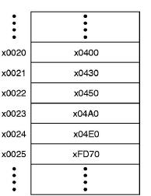
LC-3 TRAP Routines
GETC (TRAP x20)
Read a single character from KBD.
Write ASCII code to R0[7:0], clear R0[15:8].
OUT (TRAP x21)
Write R0[7:0] to the monitor.
PUTS (TRAP x22)
Write a string to monitor (address of first character of string is in R0).
IN (TRAP x23)
Print a prompt to the monitor and read a single character from KBD.
Write ASCII code to R0[7:0], clear R0[15:8], echo character to the monitor.
HALT (TRAP x25)
Print message to monitor & halt execution.
Trap vector table

Slide 10
TRAP Instruction
Trap vector
identifies which system call to invoke
8-bit index into table of service routine addresses
in LC-3, this table is stored in memory at 0x0000 – 0x00FF
8-bit trap vector is zero-extended into 16-bit memory address
Where to go
lookup starting address from table; place in PC
How to get back
save address of next instruction (current PC) in R7

Slide 11
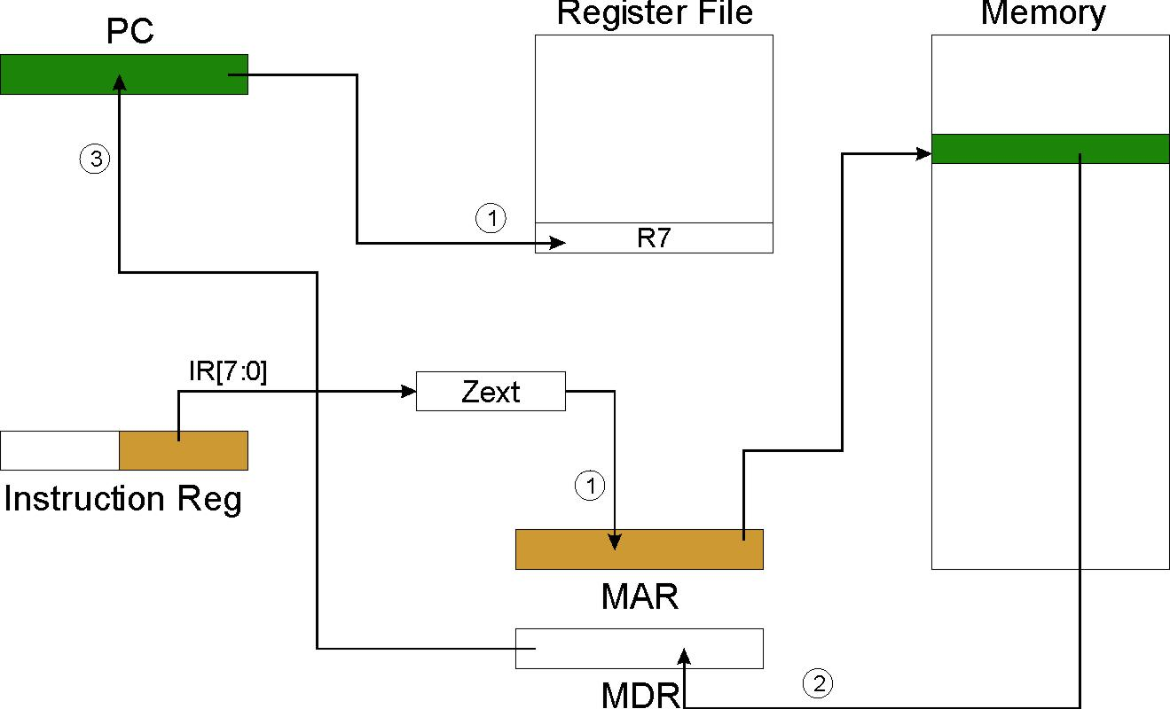
TRAP
NOTE: PC has already been incremented during instruction fetch stage.

Slide 12
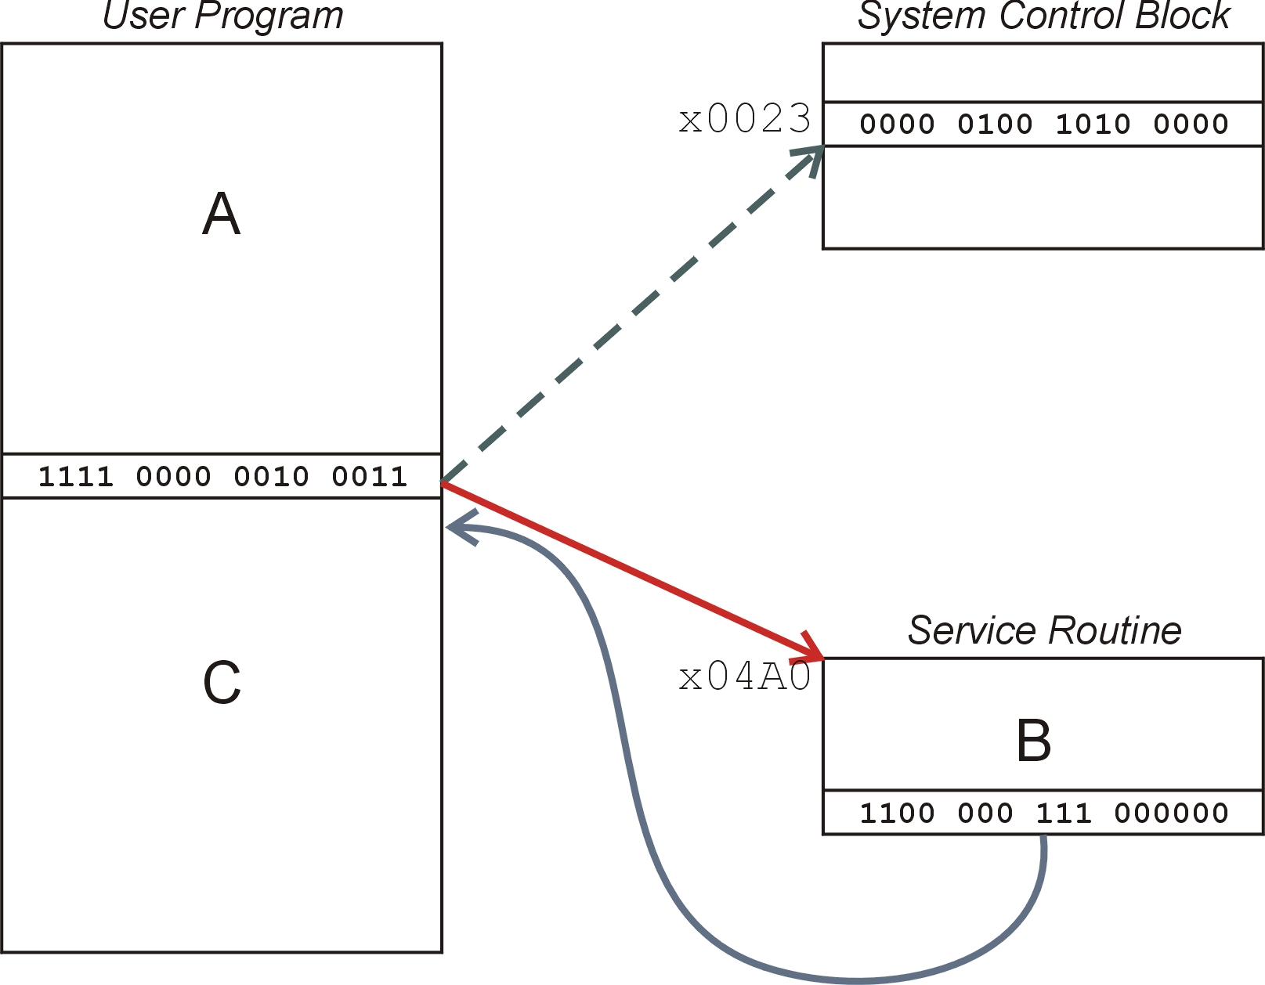
TRAP Mechanism Operation
Lookup starting address.
Transfer to service routine.
Return (JMP R7).

Slide 13
Potential Issues
Control:
How do we return to the correct PC address following the execution of a subroutine?
Must save a way back. Use R7 in LC-3.
Data:
How are input arguments passed to subroutines?
How are return values returned from subroutines?
Use registers or pre-determined memory location. Protocol: preconditions and post conditions of subroutines should be specified.
How can we assure that the subroutine did not “corrupt” the register values?
E.G. Procedure A in the calling scope may have been in the middle of a calculation (using various registers) before calling Subroutine B. When returning from subroutine B; Procedure A continues with its calculations. Can we be sure Subroutine B did not unexpectedly alter register values being used by Procedure A?

Slide 14
RET (JMP R7)
How do we transfer control back to instruction following the TRAP?
We saved old PC in R7.
JMP R7 gets us back to the user program at the right spot.
LC-3 assembly language lets us use RET (return) in place of “JMP R7”.
Must make sure that service routine does not change R7, or we won’t know where to return.

Slide 15
Saving and Restoring Registers
Issue: How can we assure that the subroutine did not “corrupt” the register values?
Must save the value of a register if:
Its value will be destroyed by service routine, and
We will need to use the value after that action.
Who saves?
caller of service routine?
knows what it needs later, but may not know what gets altered by called routine
called service routine?
knows what it alters, but does not know what will be needed later by calling routine

Slide 16
Example: subroutineA
subrA LEA R3, Binary LD R6, ASCII ; char->digit template
LD R7, COUNT ; initialize to 10 AGAIN TRAP x23 ; Get char ADD R0, R0, R6 ; convert to number STR R0, R3, #0 ; store number ADD R3, R3, #1 ; incr pointer ADD R7, R7, -1 ; decr counter BRp AGAIN ; more? BRnzp NEXT ASCII .FILL xFFD0 COUNT .FILL #10 Binary .BLKW #10
What’s wrong with this routine? What happens to R7?
Notes:
Routine: Convert ASCII number to binary representation (str2num). Whats wrong with this subroutine (click)? What happens to R7. Any other concerns? Does TRAP change R3??

Slide 17
Saving and Restoring Registers
Called routine -- “callee-save”
Before start, save any registers that will be altered (unless altered value is desired by calling program!)
When returned, restore those same registers
Calling routine -- “caller-save”
Save registers destroyed by own instructions or by called routines (if known), if values needed later
save R7 before TRAP
save R0 before TRAP x23 (input character)
Or avoid using those registers altogether
Values are saved by storing them in memory.

Slide 18
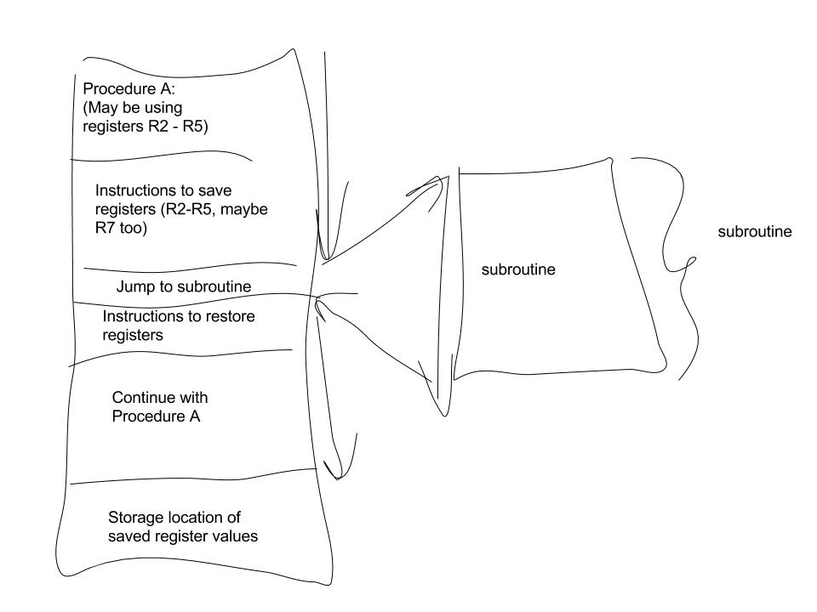
Caller Save
Calling routine -- “caller-save”
Save registers destroyed by own instructions or by called routines (if known), if values needed later
save R7 before TRAP
save R0 before TRAP x23 (input character)
Or avoid using those registers altogether

Slide 19
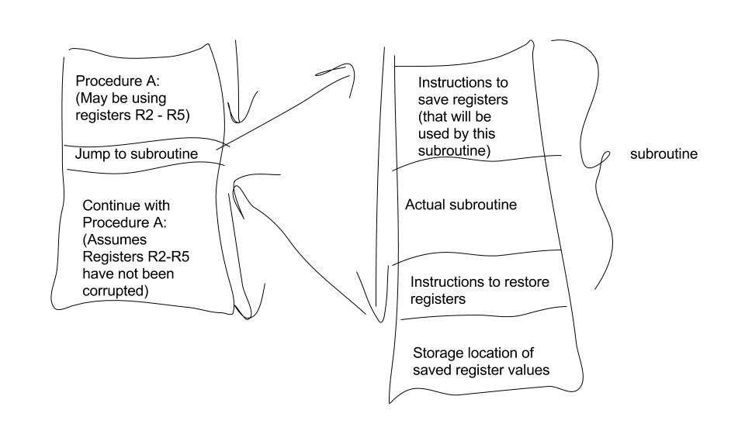
Callee Save
Called routine -- “callee-save”
Before start of subroutine, save any registers that will be altered (unless altered value is desired by calling program!)
When returned, restore those same registers

Slide 20
Example: Using the TRAP Instruction
.ORIG x3000 ; Reads input and sends lowercase to monitor
LD R2, TERM ; Load negative ASCII ‘7’ LD R3, ASCII ; Load ASCII difference AGAIN TRAP x23 ; R0 ← input character ADD R1, R2, R0 ; Test for terminate BRz EXIT ; Exit if done ADD R0, R0, R3 ; Change to lowercase TRAP x21 ; Output to monitor... NEXT SLIDE BRnzp AGAIN ; ... again and again... TERM .FILL xFFC9 ; -‘7’ ASCII .FILL x0020 ; lowercase bit EXIT TRAP x25 ; halt .END

Slide 21
Example: Output Service Routine (callee)
.ORIG x0430 ; syscall address. R0 input char ST R7, SaveR7 ; save R7 & R1 ST R1, SaveR1 ; ----- Write character TryWrite LDI R1, DSR ; get status BRzp TryWrite ; look for bit 15 on WriteIt STI R0, DDR ; write char ; ----- Return from TRAP Return LD R1, SaveR1 ; restore R1 & R7 LD R7, SaveR7 RET ; back to user DSR .FILL xFE04 DDR .FILL xFE06 SaveR1 .FILL 0 SaveR7 .FILL 0 .END
stored in table, location x21
Callee save Example
Instructions to save registers
Instructions to restore registers,
before return
Temp storage for registers

Slide 22
Concerns ….
Can a service routine call another service routine?
Sure, why not!?
If so, is there anything special the calling service routine must do?
Yes – must save data (either callee or caller save protocol)
Must save the “way” back! Must save and restore R7 at each subroutine call.

Slide 23
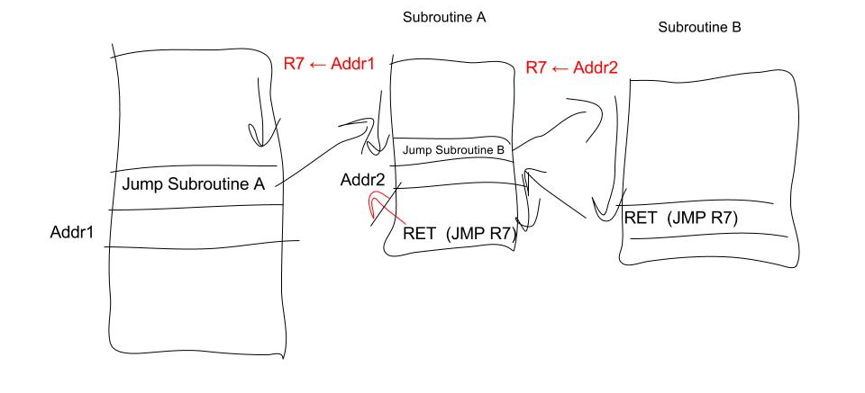
Can a service routine call another service routine?
The way back is “over-written” with more than one subroutine call.
All but the last “way” back is clobbered!
Can we fix this?

Slide 24
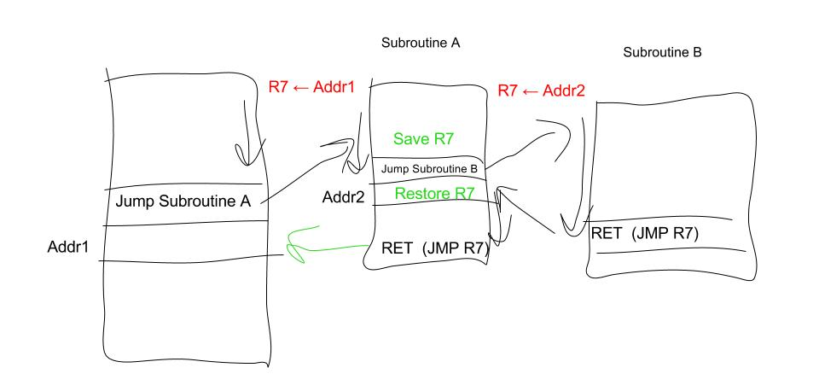
Can a service routine call another service routine?
Solution: Save R7 before jump and restore just after return

Slide 25
What about User Code?
Service routines provide three main functions:
1. Shield programmers from system-specific details.
2. Write frequently-used code just once.
3. Protect system resources from malicious/clumsy programmers.
Subroutines for users to … great idea!

Slide 26
Subroutines
A subroutine is a program fragment that:
lives in user space (as opposed to service routine)
performs a well-defined task
is invoked (called) by another user program
returns control to the calling program when finished
Like a service routine, but not part of the OS
not concerned with protecting hardware resources
no special privilege required
Reasons for subroutines:
reuse useful (and debugged!) code without having to keep typing it in
divide task among multiple programmers
use vendor-supplied library of useful routines

Slide 27
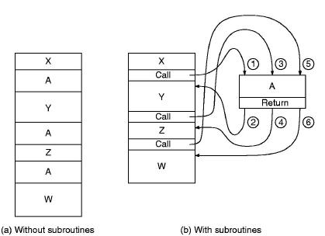
The Call / Return mechanism
The figure illustrates the execution of a program comprising
code fragments A, W, X, Y and Z.
Note that fragment A is repeated several times, and so is
well suited for packaging as a subroutine:

Slide 28
JSR Instruction
Jumps to a location (like a branch but unconditional), and saves current PC (addr of next instruction) in R7.
saving the return address is called “linking”
“the way back”
target address is PC-relative (PC + Sext(IR[10:0]))
bit 11 specifies addressing mode
if =1, PC-relative: target address = PC + Sext(IR[10:0])
if =0, register: target address = contents of register IR[8:6]

Slide 29
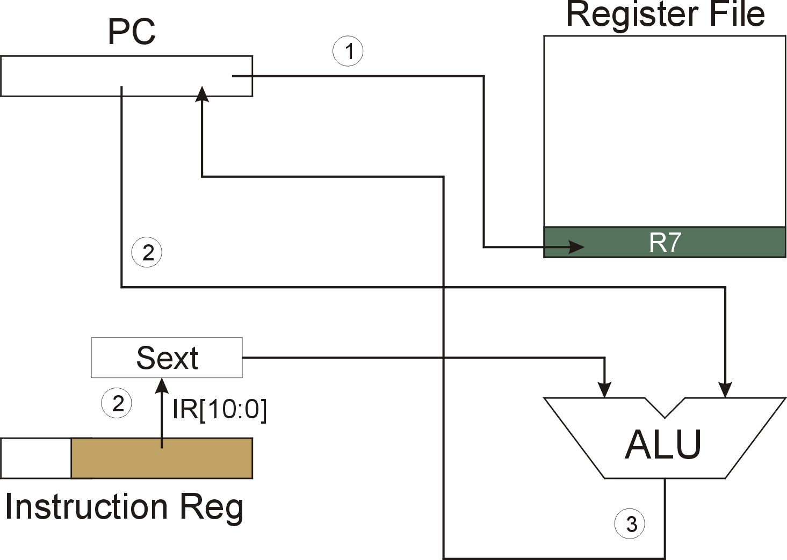
JSR
NOTE: PC has already been incremented during instruction fetch stage.

Slide 30
JSRR Instruction
Just like JSR, except Register addressing mode.
target address is Base Register
bit 11 specifies addressing mode
What important feature does JSRR provide that JSR does not?

Slide 31
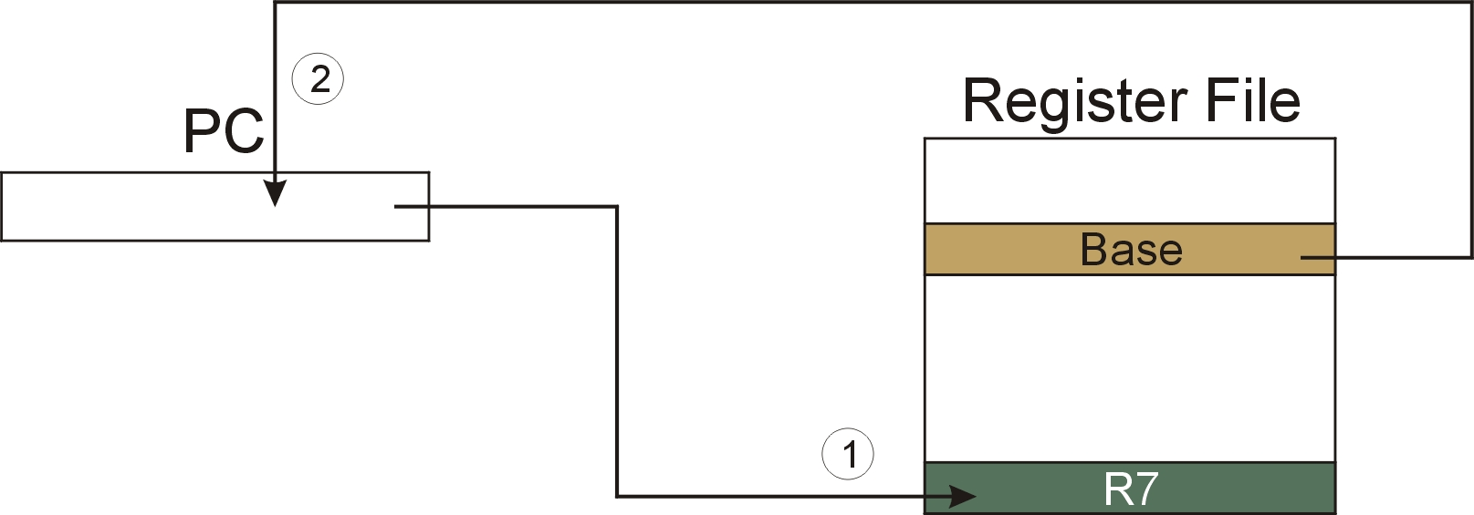
JSRR
NOTE: PC has already been incremented during instruction fetch stage.

Slide 32
Returning from a Subroutine
RET (JMP R7) gets us back to the calling routine.
Assumes way back is stored in R7

Slide 33
Example: Negate the value in R0
2sComp NOT R0, R0 ; flip bits ADD R0, R0, #1 ; add one RET ; return to caller
To call from a program (within 1024 instructions):
; need to compute R4 = R1 - R3 ADD R0, R3, #0 ; copy R3 to R0 JSR 2sComp ; negate ADD R4, R1, R0 ; add to R1 ...
Note: Neither Caller nor Callee save protocol is used here. R0 is assumed arg in and arg out.
Way back is saved in R7 by JSR
Notes:
Example of JSR. Subroutine 2sComp is labeled and is called by program.

Slide 34
Passing Information to/from Subroutines
Arguments
A value passed in to a subroutine is called an argument.
This is a value needed by the subroutine to do its job.
Examples:
In 2sComp routine, R0 is the number to be negated
In OUT service routine, R0 is the character to be printed.
In PUTS routine, R0 is address of string to be printed.
Return Values
A value passed out of a subroutine is called a return value.
This is the value that you called the subroutine to compute.
Examples:
In 2sComp routine, negated value is returned in R0.
In GETC service routine, character read from the keyboard is returned in R0.

Slide 35
Using Subroutines
In order to use a subroutine, a programmer must know:
its address (or at least a label that will be bound to its address)
its function (what does it do?)
NOTE: The programmer does not need to know how the subroutine works, but what changes are visible in the machine’s state after the routine has run.
its arguments (where to pass data in, if any)
its return values (where to get computed data, if any)

Slide 36
Saving and Restore Registers
Since subroutines are just like service routines, we also need to save and restore registers, if needed.
Generally use “callee-save” strategy, except for return values.
returns caller to “state” prior to call (except return values, etc)
Save anything that the subroutine will alter internally that shouldn’t be visible when the subroutine returns.
It’s good practice to restore incoming arguments to their original values (unless overwritten by return value).
Remember: You MUST save R7 if you call any other subroutine or service routine (TRAP).
Otherwise, you won’t be able to return to caller.

Slide 37
Example
Write a subroutine FirstChar to:
find the first occurrence of a particular character (in R0) in a string (pointed to by R1); return pointer to character or to end of string (NULL) in R2.
(2) Use FirstChar to write CountChar, which:
counts the number of occurrences of a particular character (in R0) in a string (pointed to by R1); return count in R2.
Can write the second subroutine first, without knowing the implementation of FirstChar!

Slide 38
CountChar Algorithm (using FirstChar)
save regs
R1 <- R2 + 1
call FirstChar
save R7, since we’re using JSR
R3 <- M(R2)
restore
regs
R3=0
no
return
yes

Slide 39
CountChar Implementation
; CountChar: subroutine to count occurrences of a char CountChar ST R3, CCR3 ; save registers ST R4, CCR4 ST R7, CCR7 ; JSR alters R7 ST R1, CCR1 ; save original string ptr AND R4, R4, #0 ; initialize count to zero
CC1 JSR FirstChar ; find next occurrence (ptr in R2) LDR R3, R2, #0 ; see if char or null BRz CC2 ; if null, no more chars ADD R4, R4, #1 ; increment count ADD R1, R2, #1 ; point to next char in string
BRnzp CC1 CC2 ADD R2, R4, #0 ; move return val (count) to R2 LD R3, CCR3 ; restore regs LD R4, CCR4 LD R1, CCR1 LD R7, CCR7 RET ; and return

Slide 40
FirstChar Algorithm
R3=R0
save regs
yes
R2 <- R1
no
R2 <- R2 + 1
R3 <- M(R2)
restore
regs
R3=0
no
return
yes

Slide 41
FirstChar Implementation
; FirstChar: subroutine to find first occurrence of a char FirstChar ST R3, FCR3 ; save registers ST R4, FCR4 ; save original char NOT R4, R0 ; negate R0 for comparisons ADD R4, R4, #1 ADD R2, R1, #0 ; initialize ptr to beginning of string
FC1 LDR R3, R2, #0 ; read character BRz FC2 ; if null, we’re done ADD R3, R3, R4 ; see if matches input char BRz FC2 ; if yes, we’re done ADD R2, R2, #1 ; increment pointer BRnzp FC1 FC2 LD R3, FCR3 ; restore registers LD R4, FCR4 ; RET ; and return

Slide 42
Library Routines
Vendor may provide object files containing useful subroutines
don’t want to provide source code -- intellectual property
assembler/linker must support EXTERNAL symbols (or starting address of routine must be supplied to user)
... .EXTERNAL SQRT
... LD R2, SQAddr ; load SQRT addr JSRR R2 ... SQAddr .FILL SQRT
Using JSRR, because we don’t know whether SQRT is within 1024 instructions.

